Slide 1
NBA Stats App
Yiannis Karydis | Nicola Cisbani | Joshua Lee

Slide 2
System Description
Our project is a Python-based NBA Database Management System designed to provide interactive access to a large, multi-table SQLite database of NBA information. The system allows users to explore players, teams, statistics, awards, games, and league history using a structured command-line interface. The application integrates multiple datasets (CSV files) and exposes a set of high-level operations for querying and updating basketball data.

Slide 3
Use Cases
Player Search & Player Profiles
Users can look up details about a specific NBA player
Details include
Biographic Data(Height, Weight, birth)
Team history
Career stats(points, rebounds, assists, etc.)
Awards
All-star selections

Slide 4
Use Cases
Team Exploration
Users can explore NBA teams and their players
View full list of teams
Information you can view:
Team info
Team roster and positions
Season record
Schedule and results

Slide 5
Use Cases
League Wide Stats
Users can see top performers in the league
Users can compare performances
Information you can view:
Top scorers, rebounders, and assists
Top performing teams
Player season stats

Slide 6
Use Cases
Draft and All-star
Users can see draft and all-star history
Information you can view:
Draft picks for a certain year
All-star selections
All-star game winners

Slide 7
Use Cases
Updates to the database
Users with admin privilege can update the database
Updates that can be made:
Trade players from one team to another
Player stats can be updated

Slide 8
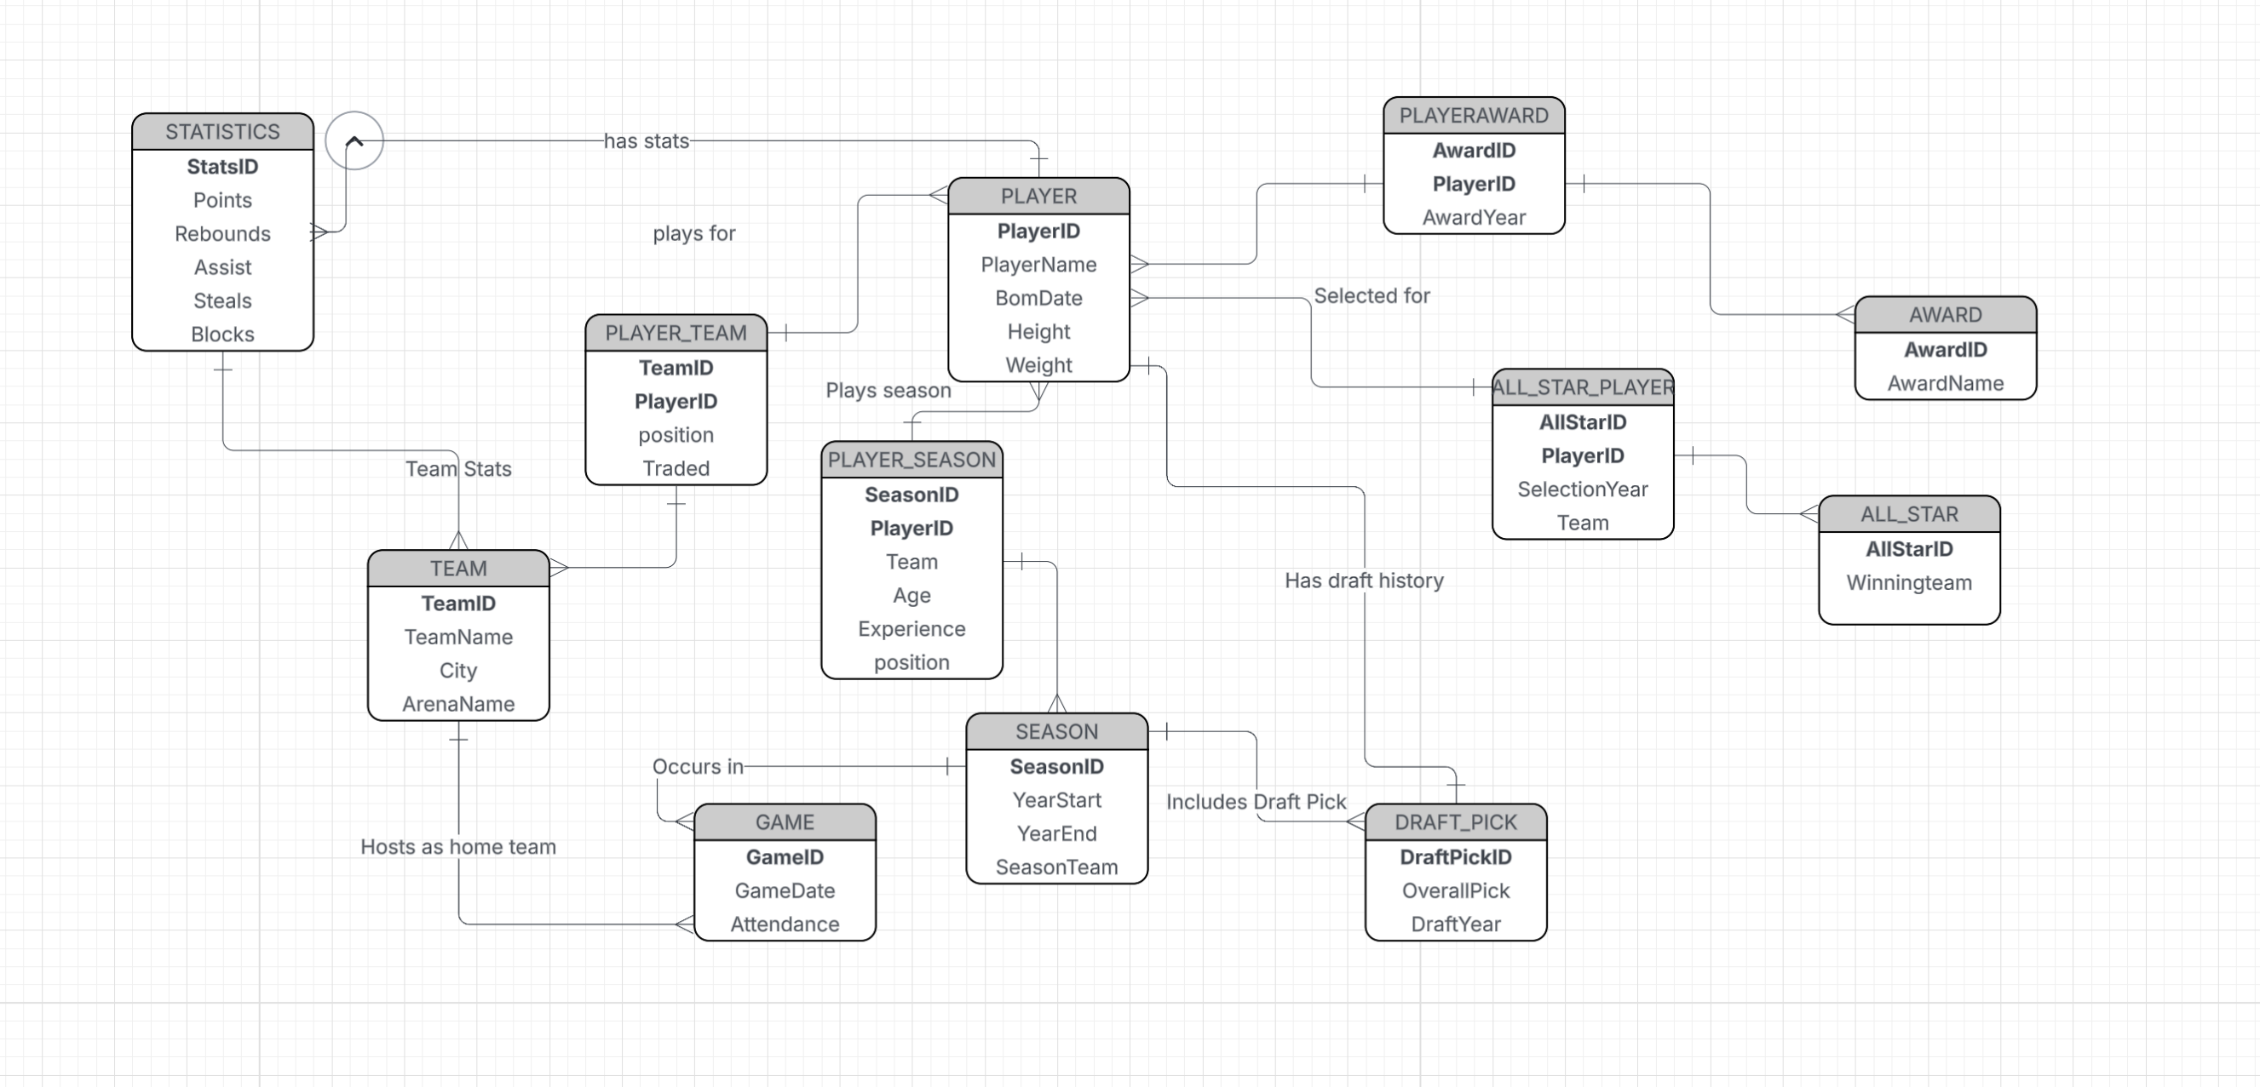
E/R diagram

Slide 9
Relational Schema
PLAYER(PlayerID, PlayerName, BornDate, Height, Weight)
Primary Key: PlayerID Referenced in:
PLAYER_TEAM(PlayerID)
PLAYER_SEASON(PlayerID)
STATISTICS(PlayerID)
PLAYER_AWARD(PlayerID)
ALL_STAR_PLAYER(PlayerID)
DRAFT_PICK(PlayerID)
PLAYER_SEASON(PlayerID, SeasonID, Team)
Primary Key: (PlayerID, SeasonID) Foreign Keys:
PlayerID → PLAYER(PlayerID)
SeasonID → SEASON(SeasonID)
PLAYER_AWARD(PlayerID, AwardID, AwardYear)
Primary Key: (PlayerID, AwardID, AwardYear) Foreign Keys:
PlayerID → PLAYER(PlayerID)
AwardID → AWARD(AwardID)
STATISTICS(StatsID, PlayerID, SeasonID, TeamID, Points, Rebounds, Assist, Steals, Blocks)
Primary Key: StatsID Foreign Keys:
PlayerID → PLAYER(PlayerID)
SeasonID → SEASON(SeasonID)
TeamID → TEAM(TeamID)
ALL_STAR_PLAYER(AllStarID, PlayerID, SelectionYear, Team)
Primary Key: (AllStarID, PlayerID) Foreign Keys:
AllStarID → ALL_STAR(AllStarID)
PlayerID → PLAYER(PlayerID)
TEAM(TeamID, TeamName, City, ArenaName)
Primary Key: TeamID Referenced in:
PLAYER_TEAM(TeamID)
GAME(HomeTeamID), GAME(AwayTeamID), GAME(Winner)
ALL_STAR(WinnerTeam)
GAME(GameID, GameDate, HomeTeamID, AwayTeamID, HomeScore, AwayScore, Winner)
Primary Key: GameID Foreign Keys:
HomeTeamID → TEAM(TeamID)
AwayTeamID → TEAM(TeamID)
Winner → TEAM(TeamID)
SEASON(SeasonID, YearStart, YearEnd)
Primary Key: SeasonID Referenced in:
PLAYER_SEASON(SeasonID)
STATISTICS(SeasonID)
DRAFT_PICK(SeasonID)
ALL_STAR(AllStarID links to Season)
PLAYER_TEAM(PlayerID, TeamID, Position, Traded)
Primary Key: (PlayerID, TeamID) Foreign Keys:
PlayerID → PLAYER(PlayerID)
TeamID → TEAM(TeamID)
ALL_STAR(AllStarID, WinningTeam)
Primary Key: AllStarID Foreign Keys:
WinningTeam → TEAM(TeamID)
AWARD(AwardID, AwardName)
Primary Key: AwardID

Slide 10
Implementation Details
Database Layer:
The application uses SQLite as the database engine, accessed through Python’s built-in sqlite3 module. The main database file is NBA_stats.sqlite, which was populated from multiple CSV datasets of NBA players, teams, games, statistics, awards, drafts, and All-Star data
Each SQL logic method prepares a parameterized SQL query
Features used:
Joins
Aggregations(SUM(), COUNT(), GROUP BY)
Filtering data using WHERE
Queries return either a single row or a list
Connection handling
The NBADatabase class opens a single connection to the SQLite database when the app starts and reuses a shared cursor for queries
A close() method is used to smoothly close the connection

Slide 11
Implementation Details
UI Layer:
The UI is a text-based command-line interface (CLI) implemented in Python.
UI is responsible for
Displaying main menu and headers
Reading user input
Calling appropriate methods
Formatting and outputting
Menu is displayed to show user what options they have
Input is collected using input() function
Print is used to output the results in a neat format
Success and failure messages are displayed for updates to the database
Errors are displayed when invalid selection is made

Slide 12
Use Case
Read Action:
As a user, I want to view information based on a specific action (like a specific player stat, the list of last year awards, ...).
Given the input action, the Application accesses the DB tables and returns the information.

Slide 13
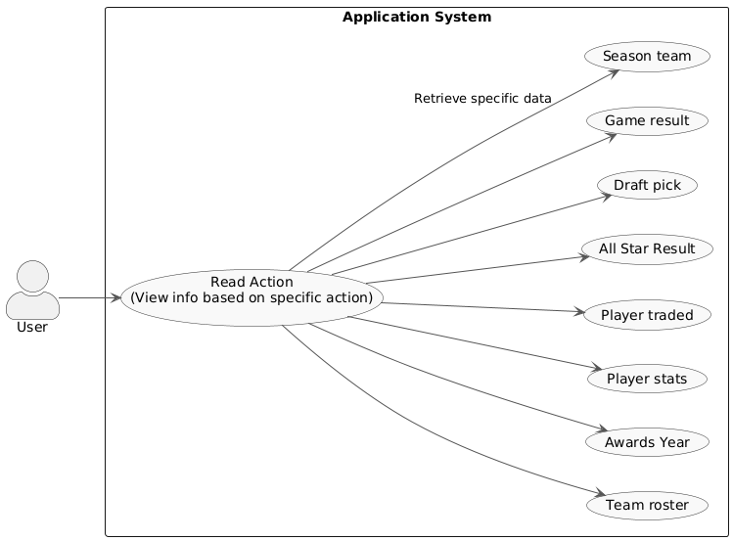
UML Diagram

Slide 14
Use Case
Write Action:
Update Player Roster Mid-Season: As administrator, I want to update a player's team in the database so I can accurately track their tenure and stats following a trade.
Given the Admin initiates a roster change (an INSERT into DB), if the admin is not logged in, the System prompts for a password to grant write privileges.

Slide 15
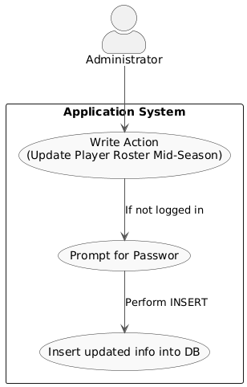
UML Diagram

Slide 16
Entities
Player: This table would contain basic information about players, such as their height, weight, college, and birth date. Data for this table would come from files like Player Career Info.csv.
Team: This table would hold information about each team, including full names, abbreviations, city, and home arena. Information would be derived from files like Team Abbrev.csv or Team Summaries.csv.
Season: This table would list all league seasons with their start and end years. It would serve as a support table to link player and team stats to a specific season with Player Season Info.csv.
Game: This table would include details about each individual game, such as the date, final scores, and the teams that played. Data could be obtained from Game.csv or game summary files.

Slide 17
Entities
Draft Pick: This table would record a player's draft history, including the draft year and their selection number. The data would come from the Draft Pick History.csv file.
All-Star Selection: This table would record every instance a player was selected for the All-Star Game, specifying the year. Information would be derived from the All-Star Selections.csv file.
Award: This table would list the different league awards (e.g., MVP, Rookie of the Year). Data could be extracted from the Player Award Shares.csv file.
Player Stats: This is an associative table that links Players to Seasons. It would contain a player's detailed statistics for a given season, such as points, rebounds, and assists. Information would come from files like Player Per Game.csv or Player Totals.csv.

Slide 18
E/R -> relations
Player(PlayerID, PlayerName, BornDate, Height, Weight)
Team(TeamID, TeamName, City, ArenaName)
Season(SeasonID, YearStart, YearEnd)
Game(GameID, GameDate, Attendance, SeasonID→Season, HomeTeamID→Team)
PlayerTeamSeason(PlayerID→Player, TeamID→Team, SeasonID→Season, StartDate, EndDate) PK = (PlayerID, TeamID, SeasonID)
Draft_Pick(DraftPickID, OverallPick, DraftYear, PlayerID→Player, SeasonID→Season)

Slide 19
E/R -> relations
All_Star(AllStarID, SelectionYear, SelectionType, PlayerID→Player)
Award(AwardID, AwardName)
Player_Award(PlayerID→Player, AwardID→Award, AwardYear) PK = (PlayerID, AwardID, AwardYear)
PlayerGameStats(StatsID, Points, Rebounds, Assists, Steals, Blocks, GameID→Game, PlayerID→Player) UNIQUE(GameID, PlayerID)
TeamGameStats(StatsID, Points, Rebounds, Assists, Steals, Blocks, GameID→Game, TeamID→Team) UNIQUE(GameID, TeamID)

