Slide 1
NBA Stats App
Yiannis Karydis | Nicola Cisbani | Joshua Lee

Slide 2
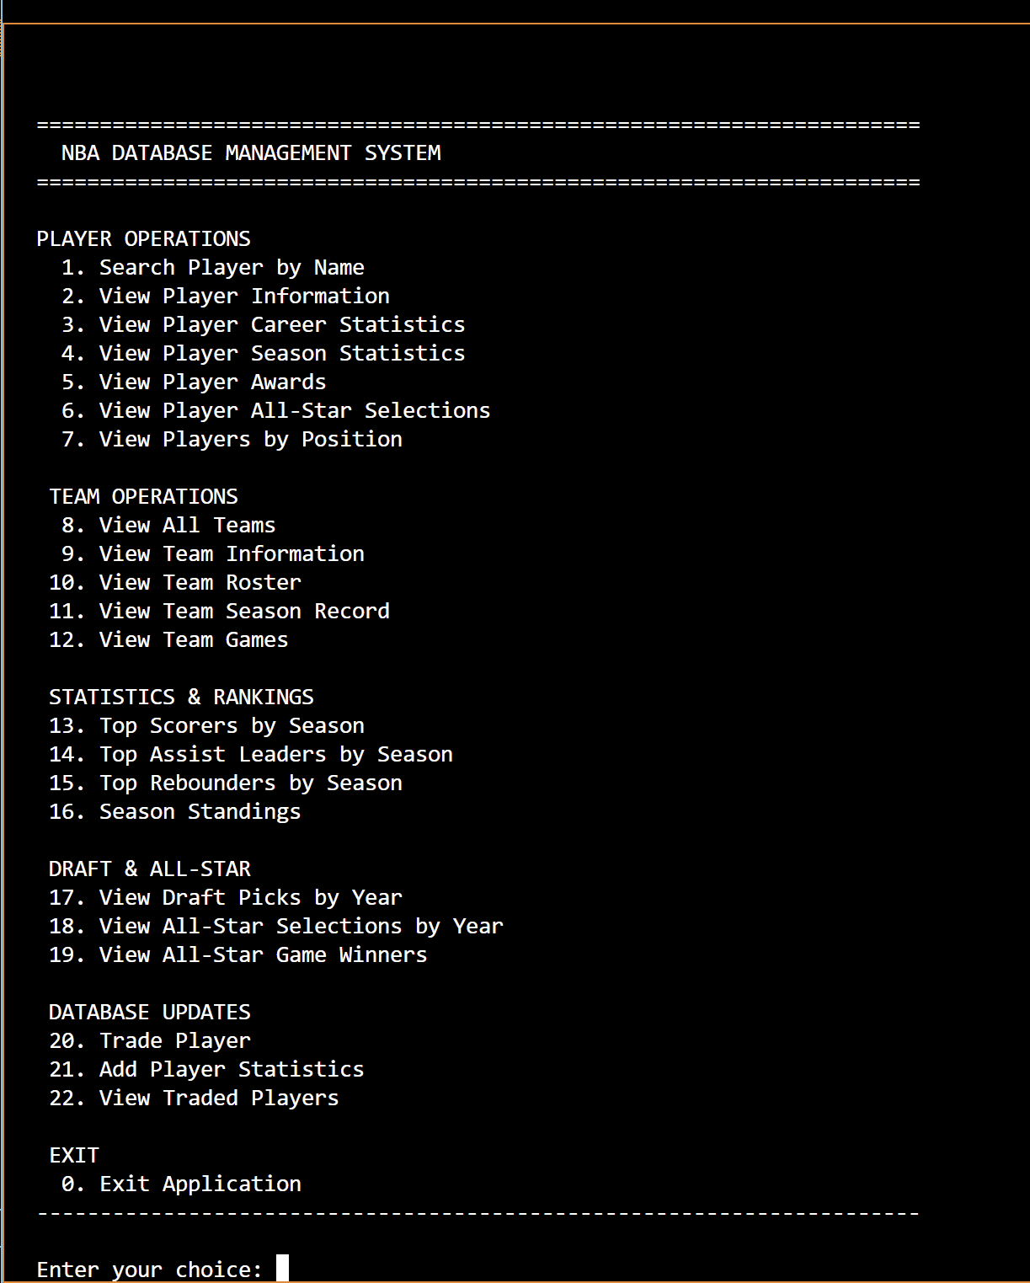
System Description
Platform: Python Application with Command-Line Interface (CLI)
Data: Multi-table SQLite DB populated from CSV files
Goal: Interactive querying and Admin-level data updates(e.g., Trades, stats, etc.)

Slide 3

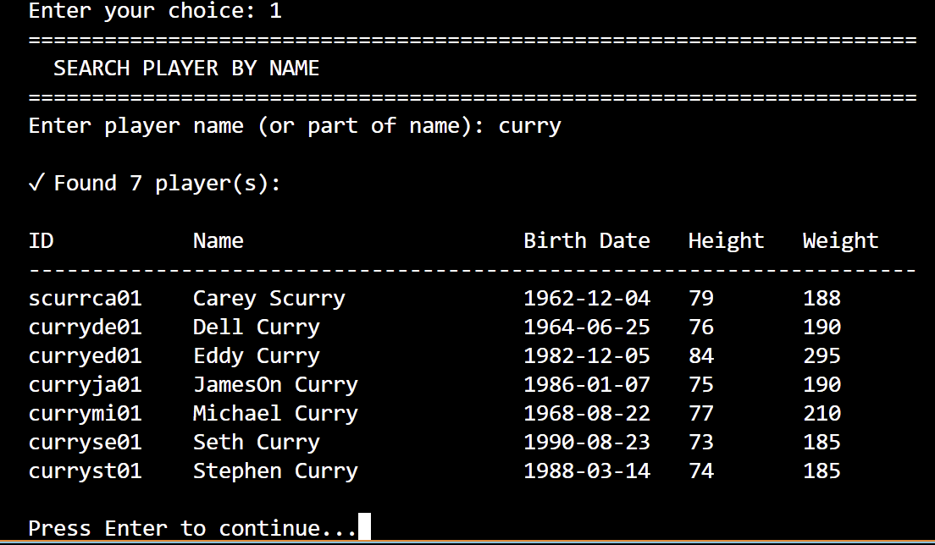
Use Cases
Player Profiles
Team history
Biographic Data
Career stats(points, rebounds, assists, etc.)
Awards
All-star selections

Slide 4
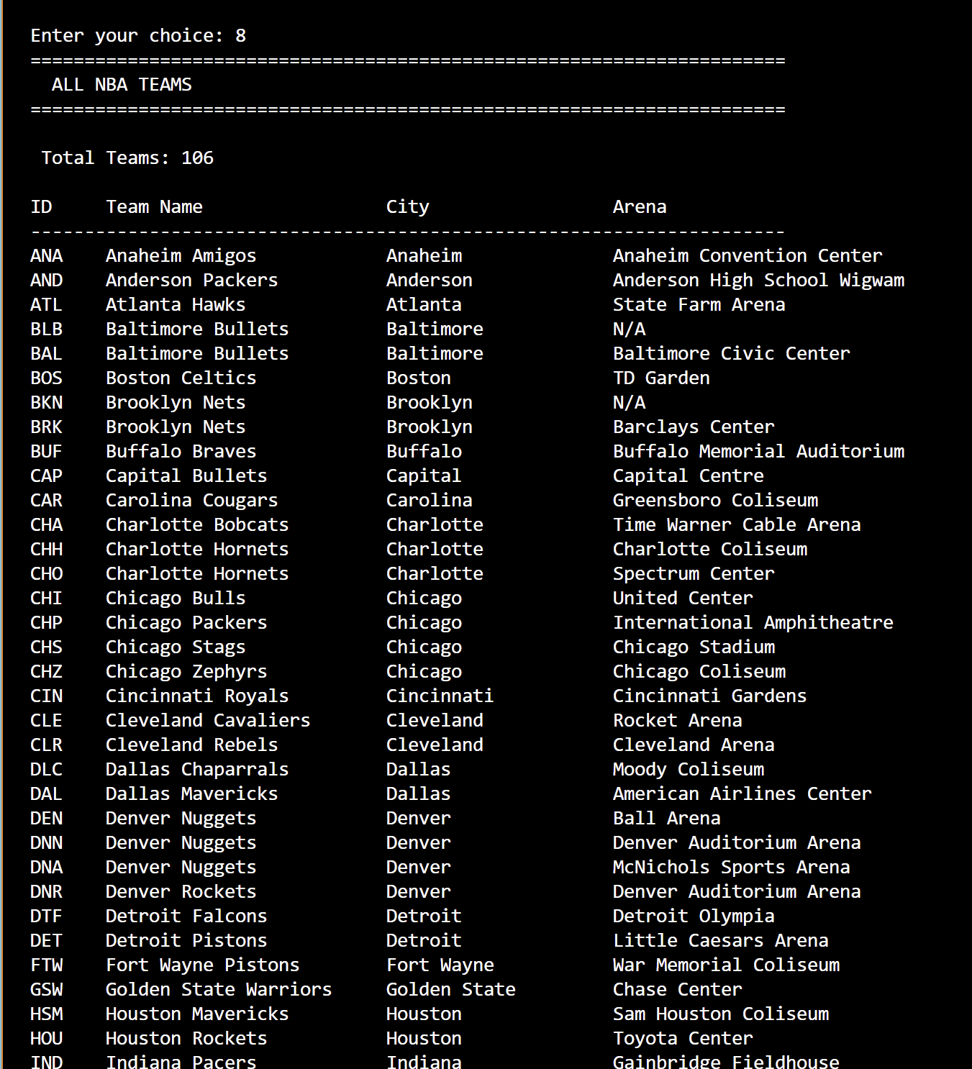
Use Cases
Team Exploration
Team info
Team roster and positions
Season record
Schedule and results

Slide 5
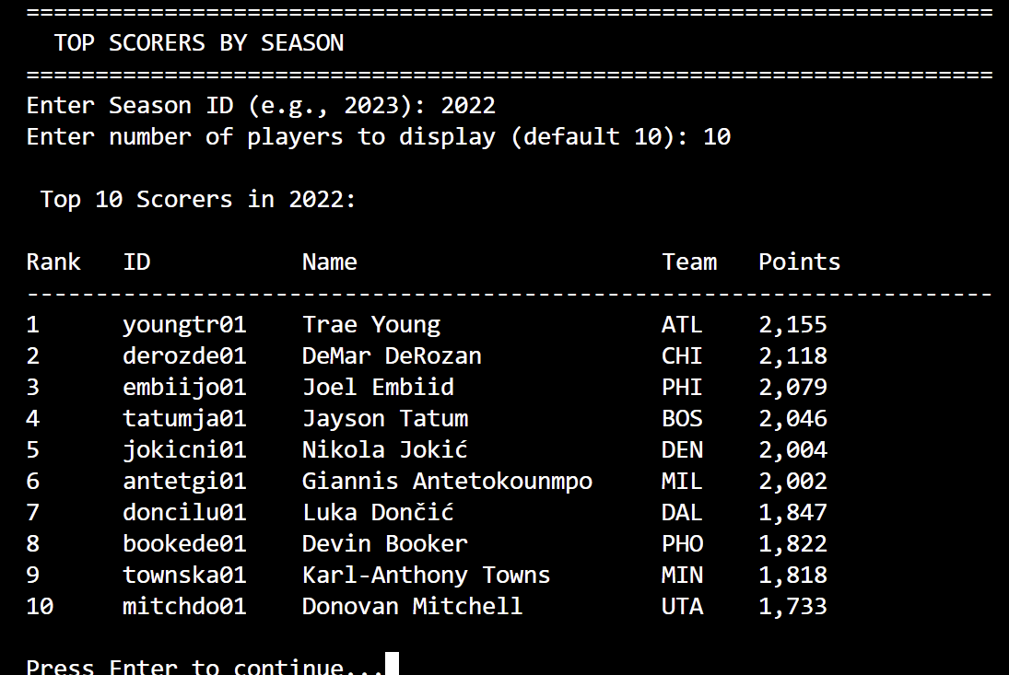
Use Cases
League Wide Stats
Top scorers, rebounders, and assists
Top performing teams
Player season stats

Slide 6
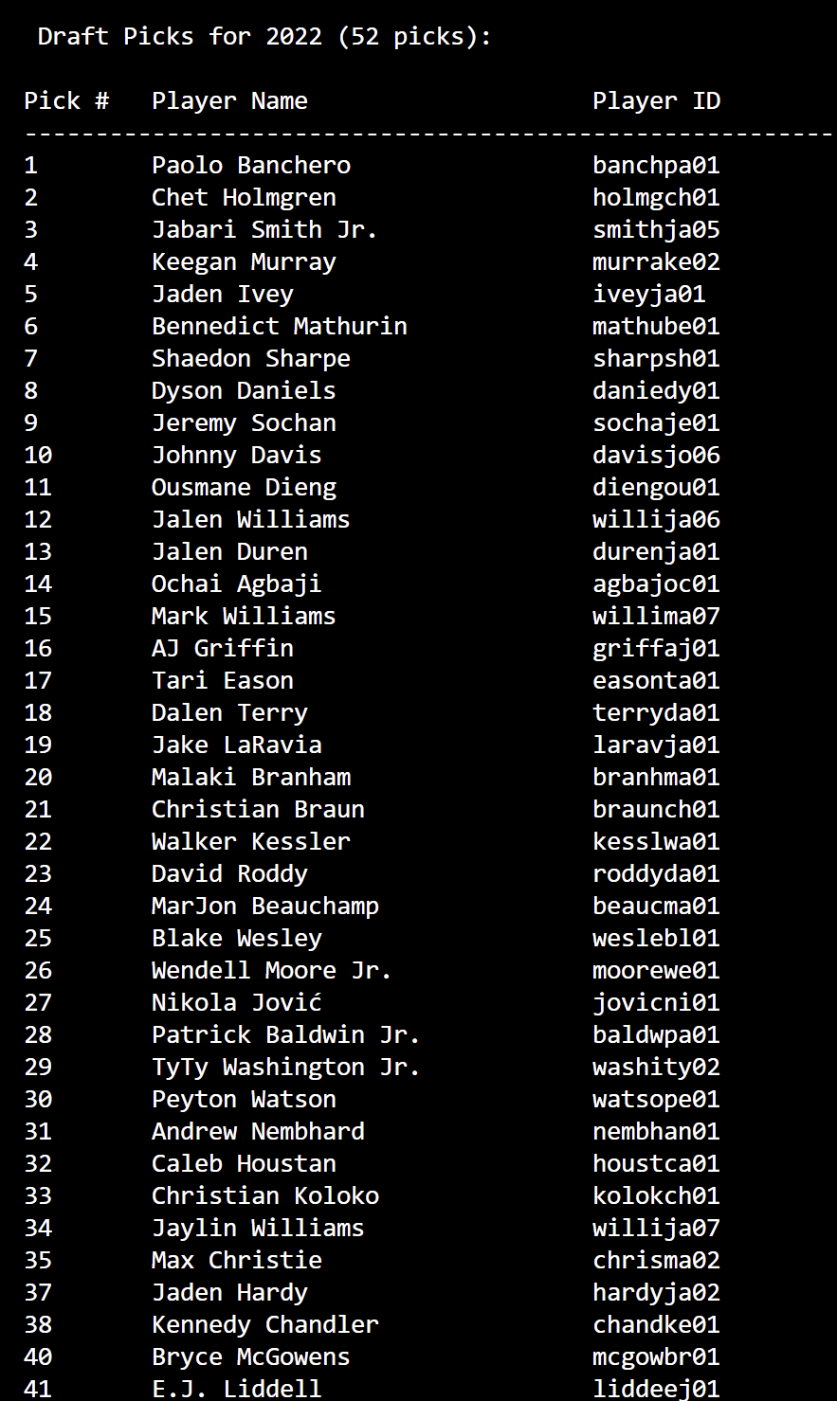
Use Cases
Draft and All-star
Draft picks for a certain year
All-star selections
All-star game winners

Slide 7
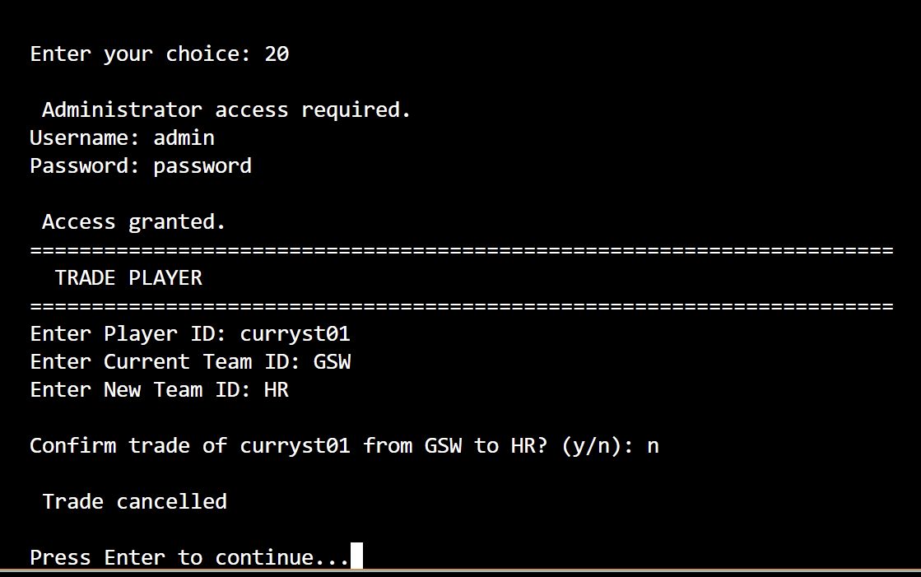
Use Cases
Updates to the database
Trade players from one team to another
Player stats can be updated

Slide 8
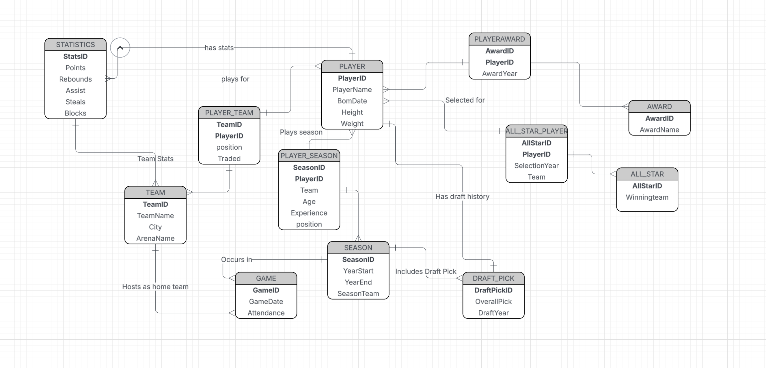
E/R diagram

Slide 9
Relational Schema
PLAYER(PlayerID, PlayerName, BornDate, Height, Weight)
Primary Key: PlayerID Referenced in:
PLAYER_TEAM(PlayerID)
PLAYER_SEASON(PlayerID)
STATISTICS(PlayerID)
PLAYER_AWARD(PlayerID)
ALL_STAR_PLAYER(PlayerID)
DRAFT_PICK(PlayerID)
PLAYER_SEASON(PlayerID, SeasonID, Team)
Primary Key: (PlayerID, SeasonID) Foreign Keys:
PlayerID → PLAYER(PlayerID)
SeasonID → SEASON(SeasonID)
PLAYER_AWARD(PlayerID, AwardID, AwardYear)
Primary Key: (PlayerID, AwardID, AwardYear) Foreign Keys:
PlayerID → PLAYER(PlayerID)
AwardID → AWARD(AwardID)
STATISTICS(StatsID, PlayerID, SeasonID, TeamID, Points, Rebounds, Assist, Steals, Blocks)
Primary Key: StatsID Foreign Keys:
PlayerID → PLAYER(PlayerID)
SeasonID → SEASON(SeasonID)
TeamID → TEAM(TeamID)
ALL_STAR_PLAYER(AllStarID, PlayerID, SelectionYear, Team)
Primary Key: (AllStarID, PlayerID) Foreign Keys:
AllStarID → ALL_STAR(AllStarID)
PlayerID → PLAYER(PlayerID)
TEAM(TeamID, TeamName, City, ArenaName)
Primary Key: TeamID Referenced in:
PLAYER_TEAM(TeamID)
GAME(HomeTeamID), GAME(AwayTeamID), GAME(Winner)
ALL_STAR(WinnerTeam)
GAME(GameID, GameDate, HomeTeamID, AwayTeamID, HomeScore, AwayScore, Winner)
Primary Key: GameID Foreign Keys:
HomeTeamID → TEAM(TeamID)
AwayTeamID → TEAM(TeamID)
Winner → TEAM(TeamID)
SEASON(SeasonID, YearStart, YearEnd)
Primary Key: SeasonID Referenced in:
PLAYER_SEASON(SeasonID)
STATISTICS(SeasonID)
DRAFT_PICK(SeasonID)
ALL_STAR(AllStarID links to Season)
PLAYER_TEAM(PlayerID, TeamID, Position, Traded)
Primary Key: (PlayerID, TeamID) Foreign Keys:
PlayerID → PLAYER(PlayerID)
TeamID → TEAM(TeamID)
ALL_STAR(AllStarID, WinningTeam)
Primary Key: AllStarID Foreign Keys:
WinningTeam → TEAM(TeamID)
AWARD(AwardID, AwardName)
Primary Key: AwardID

Slide 10
Implementation Details
Database Layer
Database:
SQLite database (NBA_stats.sqlite) built from multiple CSV datasets.
Backend Class:
NBADatabase handles all SQL operations (queries + updates).
SQL Features:
Joins, Aggregates, parameter and date filtering
Operations:
Read and write
Connection:
Single, persistent connection

Slide 11
Implementation Details
UI Layer
UI structure:
Text-based Python CLI
Tasks:
Display menu, admin input, display results
Interactions:
Admin login for updates
Messages cleared on error

Slide 12
Use Case
Read Action:
As a user, I want to view information based on a specific action (like a specific player stat, the list of last year awards, ...).
Given the input action, the Application accesses the DB tables and returns the information.

Slide 13
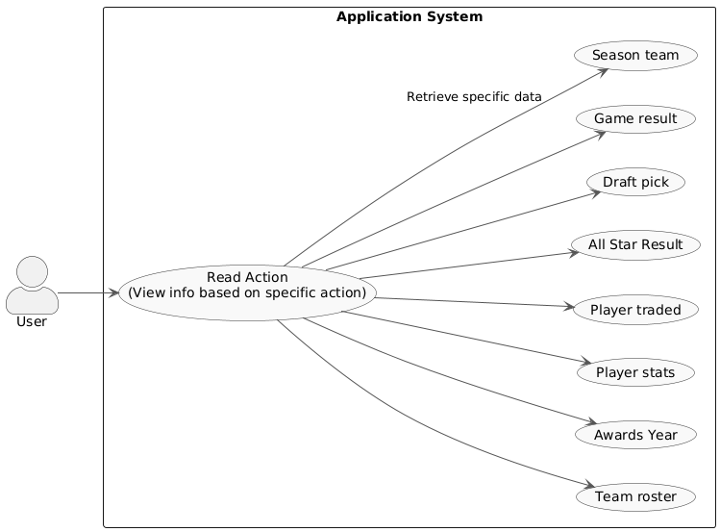
UML Diagram

Slide 14
Use Case
Write Action:
Update Player Roster Mid-Season: As administrator, I want to update a player's team in the database so I can accurately track their tenure and stats following a trade.
Given the Admin initiates a roster change (an INSERT into DB), if the admin is not logged in, the System prompts for a password to grant write privileges.

Slide 15
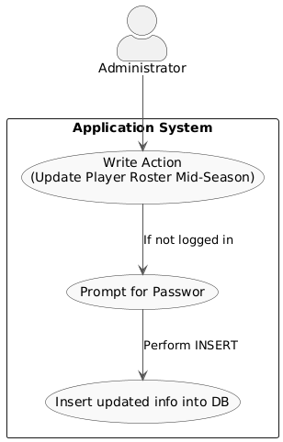
UML Diagram

Slide 16
Entities
Player: This table would contain basic information about players, such as their height, weight, college, and birth date. Data for this table would come from files like Player Career Info.csv.
Team: This table would hold information about each team, including full names, abbreviations, city, and home arena. Information would be derived from files like Team Abbrev.csv or Team Summaries.csv.
Season: This table would list all league seasons with their start and end years. It would serve as a support table to link player and team stats to a specific season with Player Season Info.csv.
Game: This table would include details about each individual game, such as the date, final scores, and the teams that played. Data could be obtained from Game.csv or game summary files.

Slide 17
Entities
Draft Pick: This table would record a player's draft history, including the draft year and their selection number. The data would come from the Draft Pick History.csv file.
All-Star Selection: This table would record every instance a player was selected for the All-Star Game, specifying the year. Information would be derived from the All-Star Selections.csv file.
Award: This table would list the different league awards (e.g., MVP, Rookie of the Year). Data could be extracted from the Player Award Shares.csv file.
Player Stats: This is an associative table that links Players to Seasons. It would contain a player's detailed statistics for a given season, such as points, rebounds, and assists. Information would come from files like Player Per Game.csv or Player Totals.csv.

Slide 18
E/R -> relations
Player(PlayerID, PlayerName, BornDate, Height, Weight)
Team(TeamID, TeamName, City, ArenaName)
Season(SeasonID, YearStart, YearEnd)
Game(GameID, GameDate, Attendance, SeasonID→Season, HomeTeamID→Team)
PlayerTeamSeason(PlayerID→Player, TeamID→Team, SeasonID→Season, StartDate, EndDate) PK = (PlayerID, TeamID, SeasonID)
Draft_Pick(DraftPickID, OverallPick, DraftYear, PlayerID→Player, SeasonID→Season)

Slide 19
E/R -> relations
All_Star(AllStarID, SelectionYear, SelectionType, PlayerID→Player)
Award(AwardID, AwardName)
Player_Award(PlayerID→Player, AwardID→Award, AwardYear) PK = (PlayerID, AwardID, AwardYear)
PlayerGameStats(StatsID, Points, Rebounds, Assists, Steals, Blocks, GameID→Game, PlayerID→Player) UNIQUE(GameID, PlayerID)
TeamGameStats(StatsID, Points, Rebounds, Assists, Steals, Blocks, GameID→Game, TeamID→Team) UNIQUE(GameID, TeamID)

