Slide 1

Achieving Internal Consistency in Databases used by Aqueous Modelling Software
By: Joshua Leiper
Primary supervisor: Dr. Weiss
Secondary supervisor: dr. liu
Notes:
Welcome to my IRP, My name is Joshua Leiper.

Slide 2
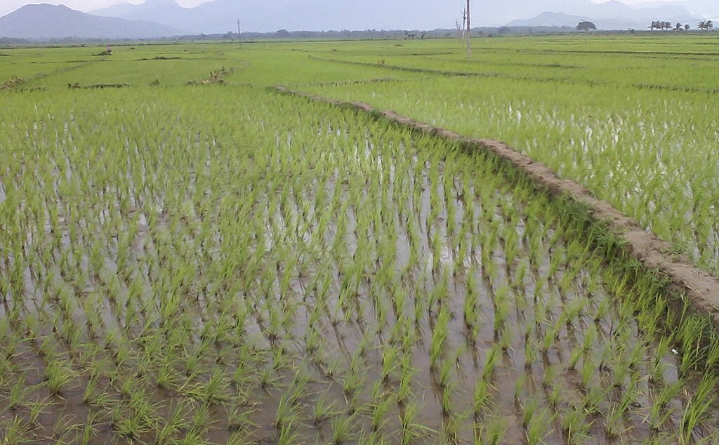
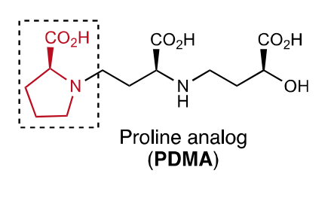
Motivation: Ligand-based fertilizer
PDMA is a molecule currently being researched as a possible fertilizer to increase rice yields. Geochemical software can be used to simulate a variety of environments that the fertilizer might be used in.
Notes:
You are a scientist trying to increase rice yields
W/R/T rice elements are either available (organic) or unavailable (inorganic)
Create a molecule like PDMA to convert elements like Zn and Fe from inorganic to organic
Do a few field studies
If calculate some chemical properties of molecule in lab, then can reuse that information in simulations
See speciation of inorganic forms vs organic forms in many different envrionments

Slide 3
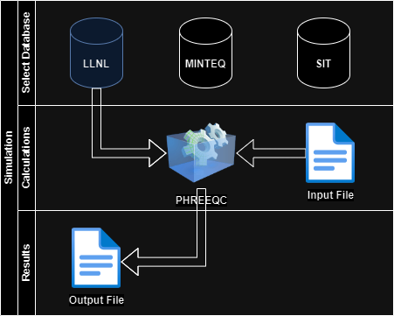
PHREEQC and the usage of geochemical simulation software
Notes:
User chooses a pre-build database and writes an input file. Input file defines the solution for the experiment. Input files can add information to databases. Segue into SMS and SS blocks

Slide 4
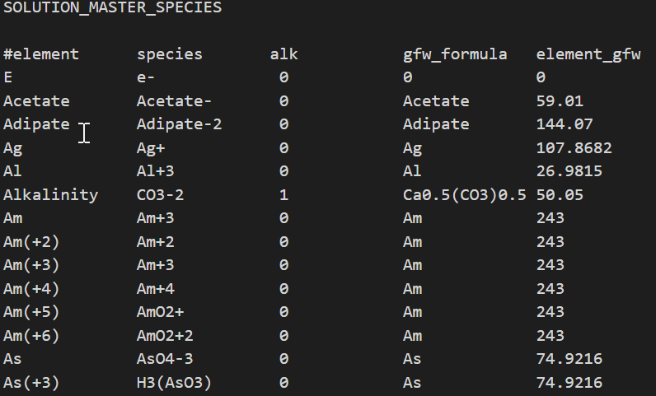
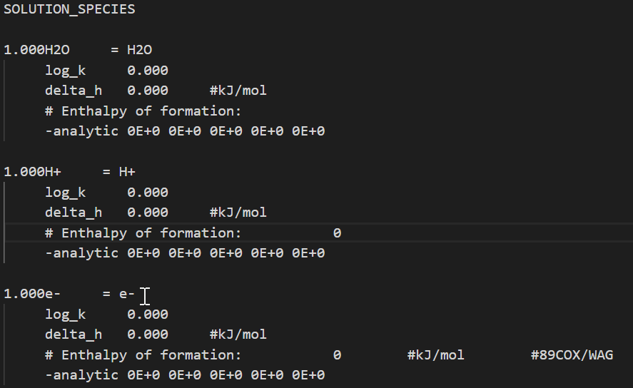
SOLUTION_MASTER_SPECIES & SOLUTION_SPECIES
Notes:
SMS and SS are datablocks in PHREEQC databases that this project focuses on. Elements are unique. Species are abstractions of elements. Alk is alkalinity, gfw and Gram Formula weight or mass.
SS uses species from SMS block for calculations.

Slide 5

Objectives
Use Python to scrape PHREEQC database files
1
Compile SMS and SS into Pandas Dataframes
2
Inspect databases for conflicting values
3
Use analysis to chose baseline database and append unique information from other databases
4
Write database back into PHREEEQC database format
5

Slide 6
The problem - databases
Elements can be defined with different species
Each database has its own syntax and definition paradigm
Databases are independently developed
Similar information have different values
Element | Species | Source
As | H2AsO₄⁻ | LLNL
As | H₃AsO₄ | MINTEQ
As | AsO₄⁻³ | SIT
Notes:
As = arsenic
Independed development allows flexabilty, also inhibits unification
Define what a conflicting value is
Briefly mention codeing challenges with REGEX

Slide 7
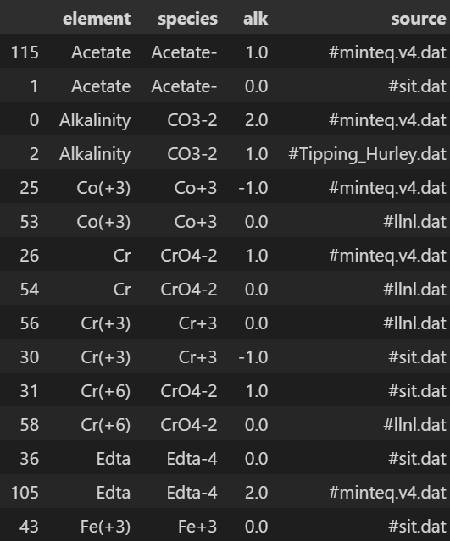
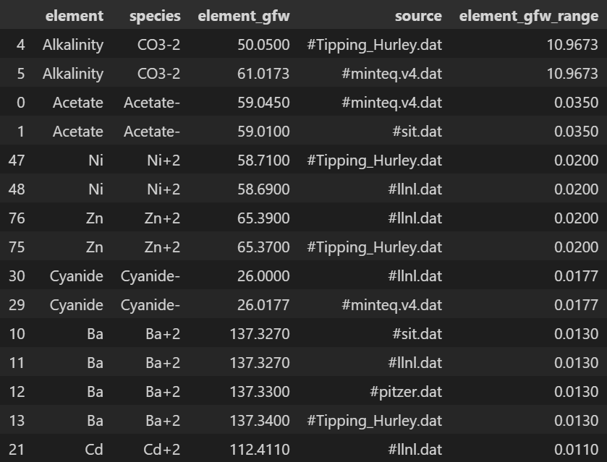
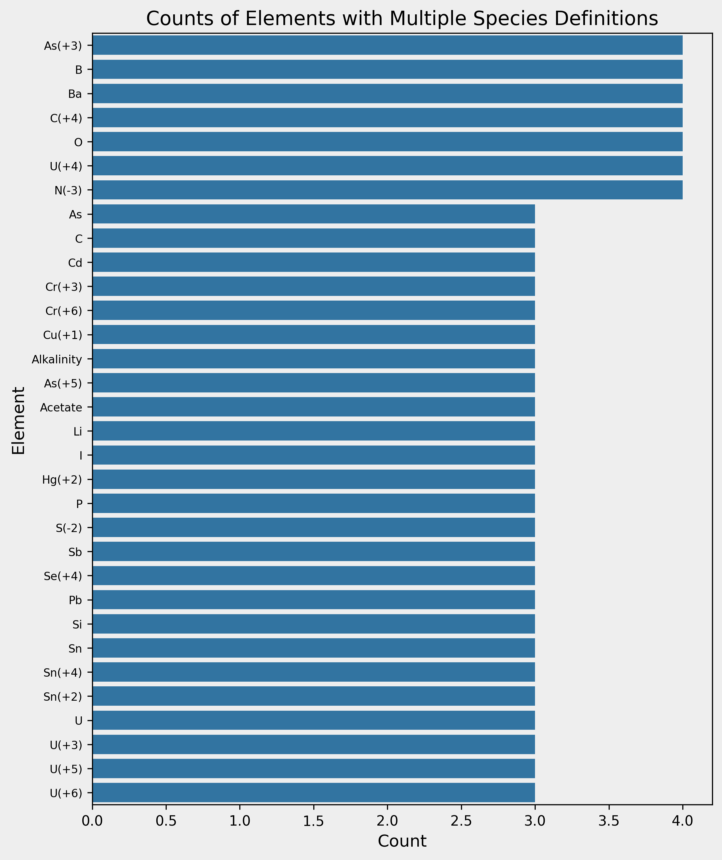
SOLUTION_MASTER_SPECIES Conflicts
Alkalinity
Gram Formula Weight
Element-Species Definitions
Notes:
Be quick here

Slide 8
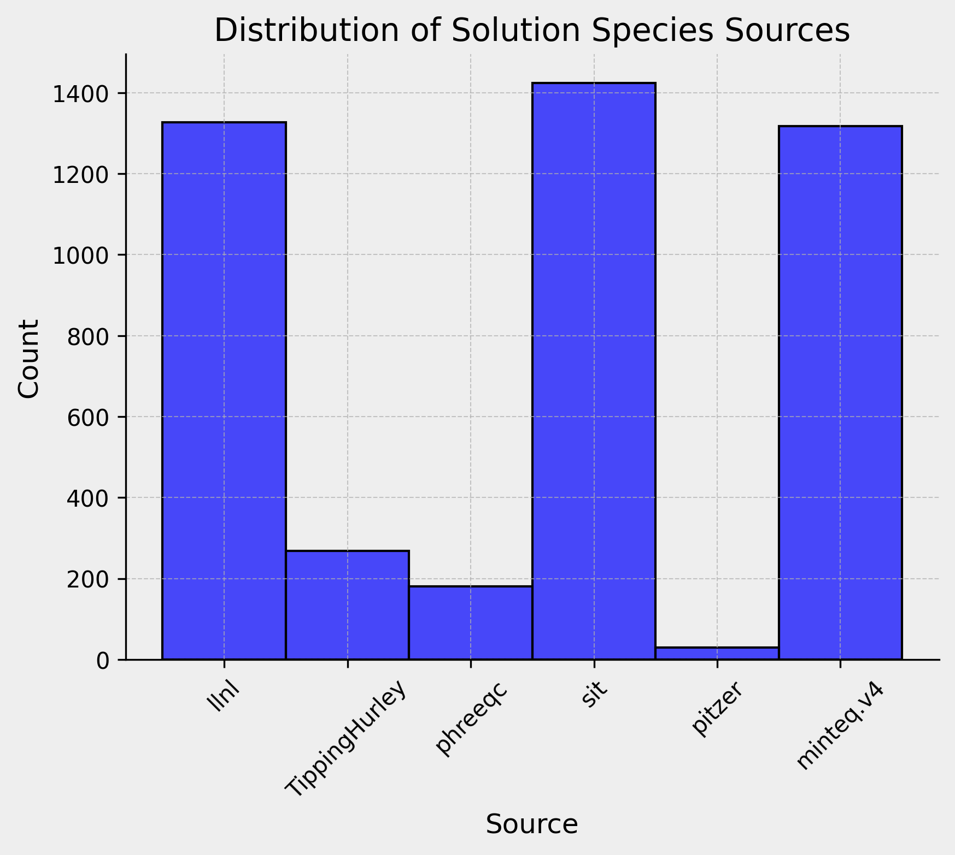
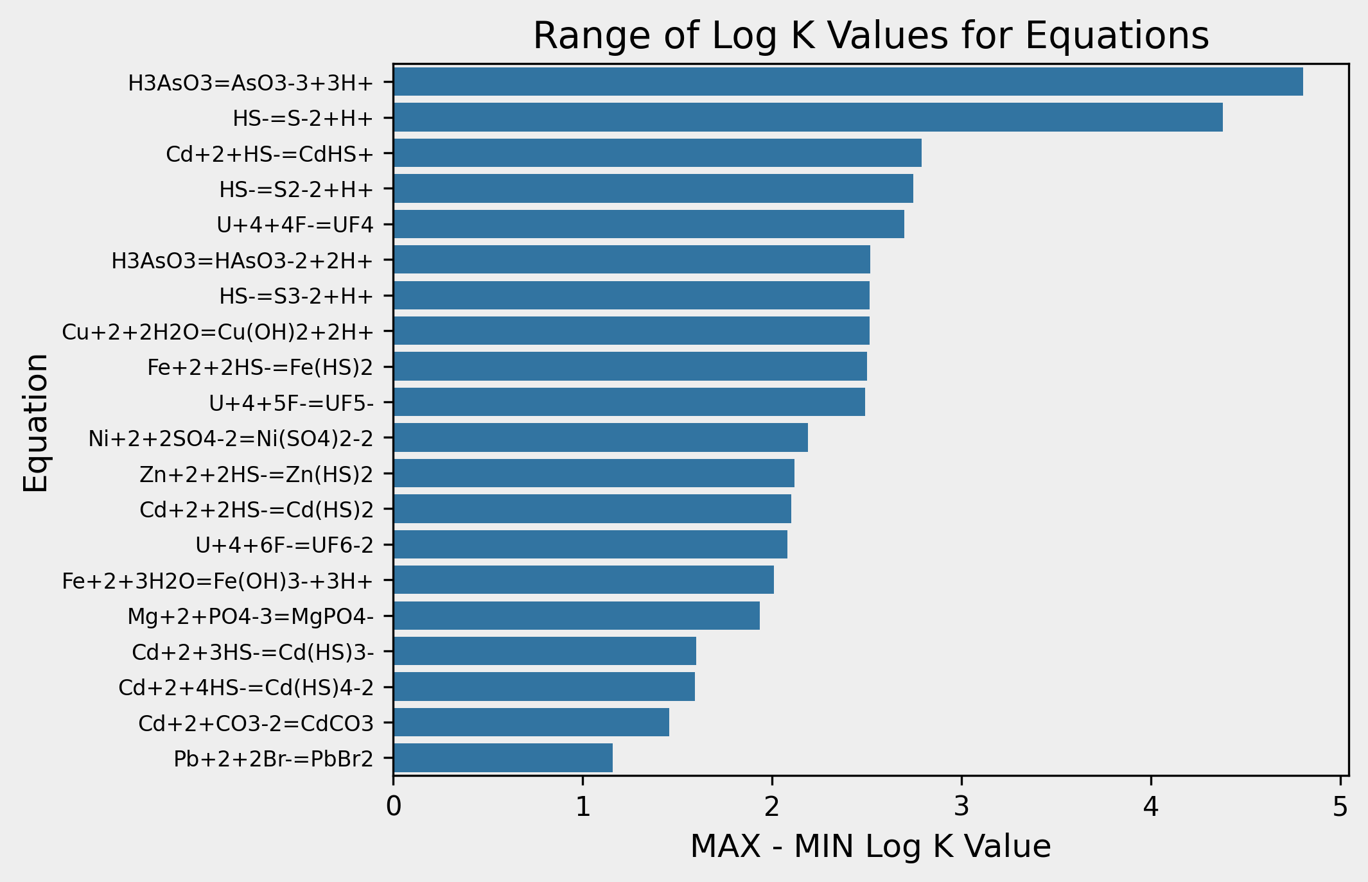
SOLUTION_SPECIES Conflicts
Notes:
Be quick here, don’t bog down in details

Slide 9
Unified Database composition
Contributing Databases
LLNL
PHREEQC
Minteq.v4
SIT
Databases with no unique entries
Pitzer
Tipping Hurley
Notes:
LLNL is a baseline database, additional information from other databases is appended to LLNL

Slide 10
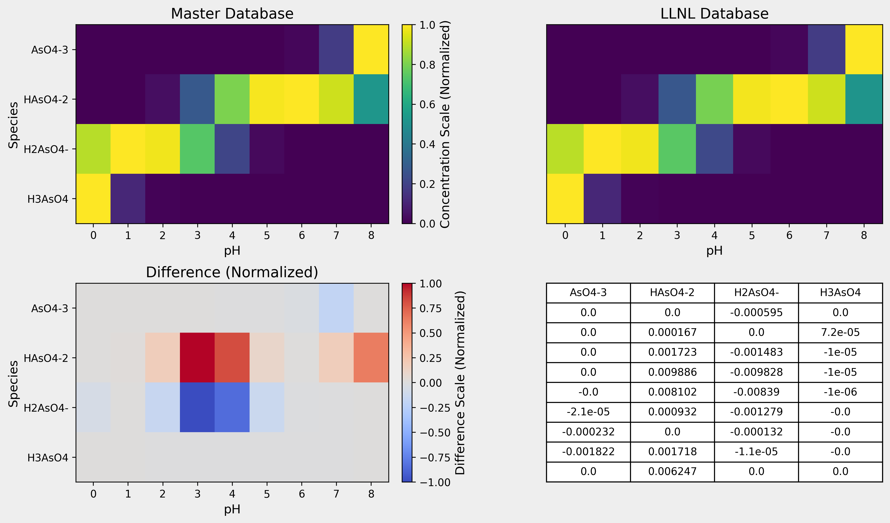
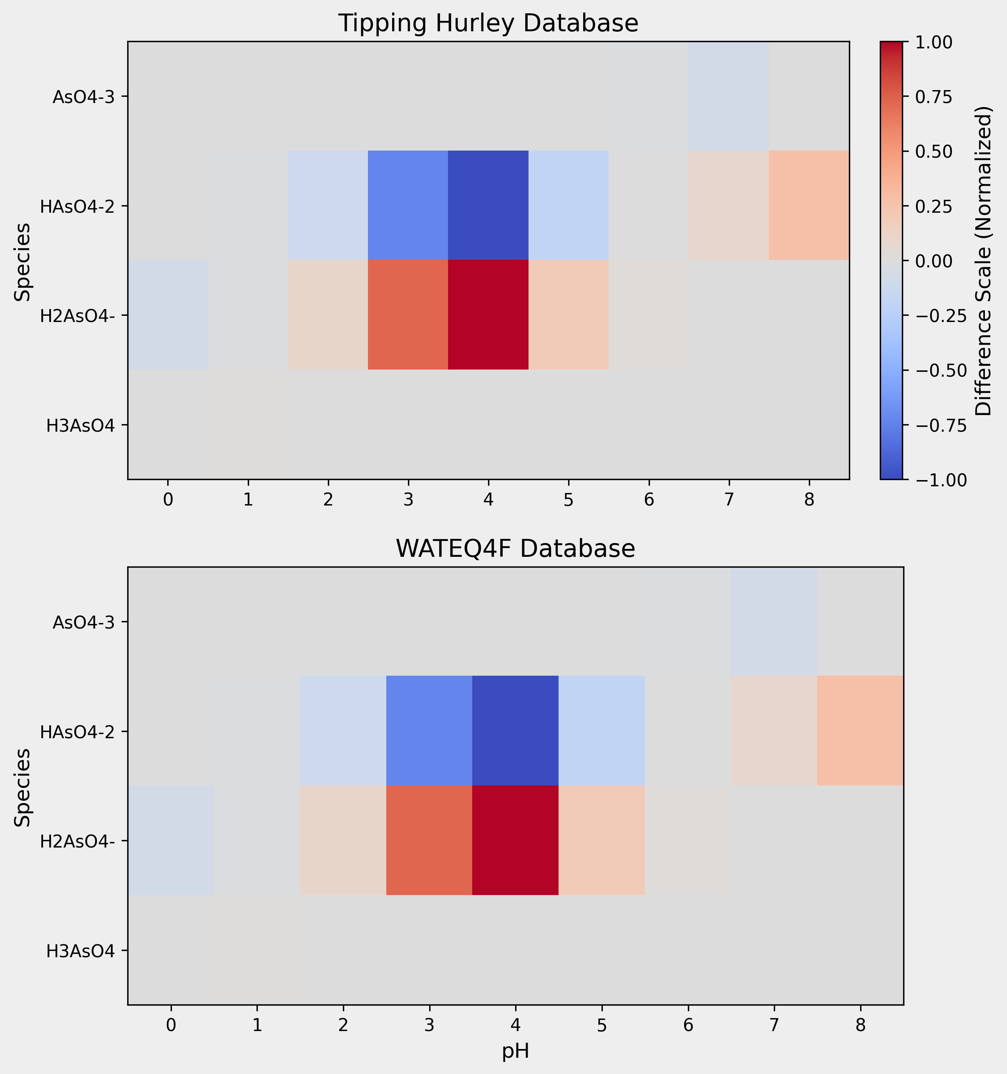
Database validation
Basic Simulation Using Master and LLNL databases
Same simulation with Tipping and WaterQ4F

Slide 11

Conclusion
A comparative analysis of PHREEQC databases was conducted and areas of further investigation were identified
A general-use database containing information from several PHREEQC databases was developed.
Future Work
More validation trials of novel database
Include other data blocks present in PHREEQC databases
Develop more robust scraping methods for databases
Notes:
Simple, did I achieve my objectives , tools I made

Slide 12
Citations
Suzuki, Motofumi, et al. “Development of a Mugineic Acid Family Phytosiderophore Analog as an Iron Fertilizer.” Nature Communications, vol. 12, no. 1, 10 Mar. 2021, p. 1558, www.nature.com/articles/s41467-021-21837-6, https://doi.org/10.1038/s41467-021-21837-6. Accessed 25 Apr. 2022.

