Slide 1
Simple Linear Regression
Chapter 2 (section 2.4-2.6, 2.9-2.11)
Lecture 6
Thursday, September 14, 2017

Slide 2
Review
Normal, T, Chi-square, and F Distributions
Inference related to mean µ and variance σ²: confidence interval and hypothesis testing
The estimates of β₀ and β₁ and related distributions

Slide 3
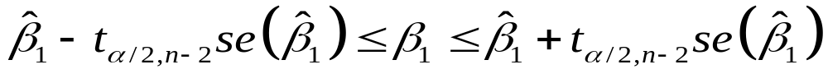
2.4 Interval Estimation in Simple
Linear Regression
100(1-α)% Confidence interval for Slope
100(1-α)% Confidence interval for the Intercept

Slide 4
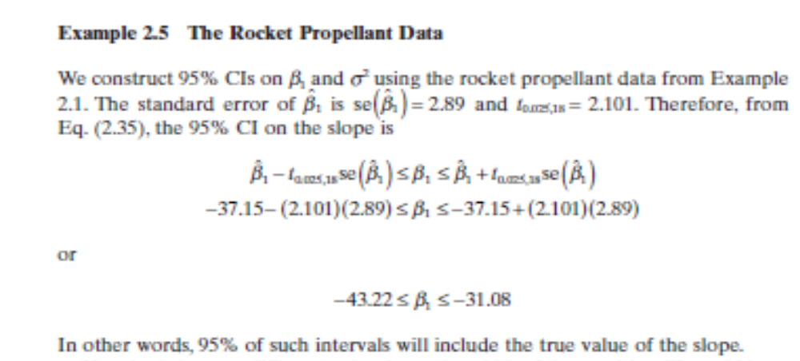
Also see page 30, text

Slide 5
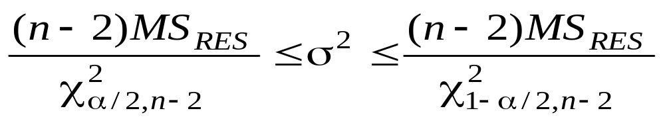
2.4 Interval Estimation in Simple
Linear Regression
100(1-α)% Confidence interval for σ²

Slide 6
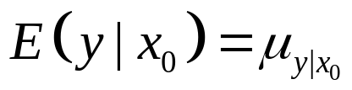
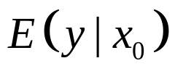
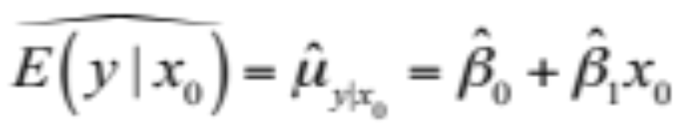
2.4.2 Interval Estimation of the Mean Response
Let x₀ be the level of the regressor variable at which we want to estimate the mean response, i.e.
  Point estimator of (parameter) once the model is fit:
  In order to construct a confidence interval on the mean response (parameter) , we need the variance of the point estimator.

Slide 7
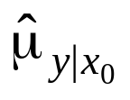
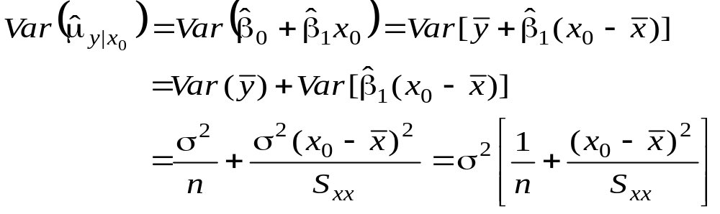
2.4.2 Interval Estimation of the Mean
Response
The variance of is
Extrapolation penalty

Slide 8
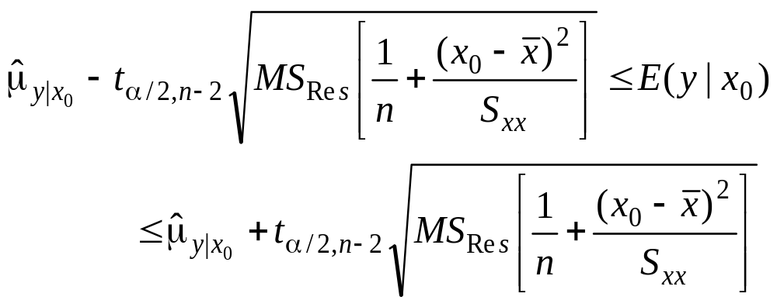
2.4.2 Interval Estimation of the Mean Response
100(1-α)% confidence interval for E(y|x₀)
Notice that the length of the CI depends on the location of the point of interest
(that is, extrapolation penalty)

Slide 9
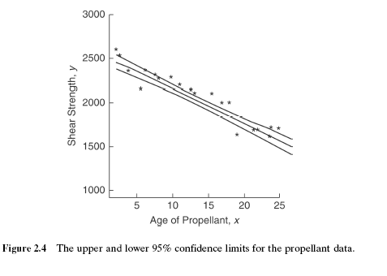
See pages 34-35, text

Slide 10
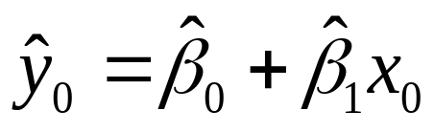
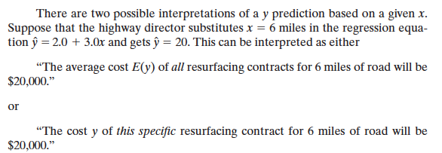
2.5 Prediction of New Observations
Suppose we wish to construct a prediction interval on a future observation, y₀ corresponding to a particular level of x, say x₀.
The point estimate would be:
The confidence interval on the mean response (a parameter) at this point is not appropriate for this situation (a specific observation). Why? (see text page 33-34)

Slide 11
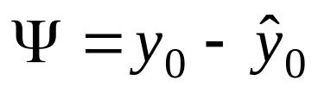
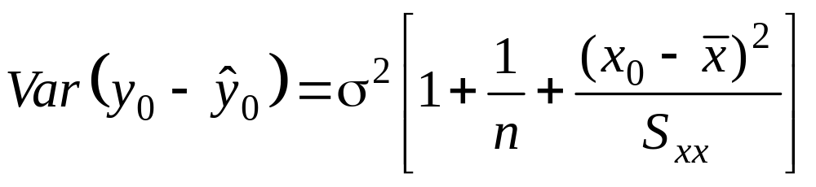

2.5 Prediction of New Observations
Let the random variable, Ψ be
Ψ is normally distributed with
  E(Ψ) = 0
  Var(Ψ) =
  If we use to predict y₀, then the standard error of ψ is the appropriate statistic on which to base a prediction interval.
  Note: y₀ is independent of

Slide 12
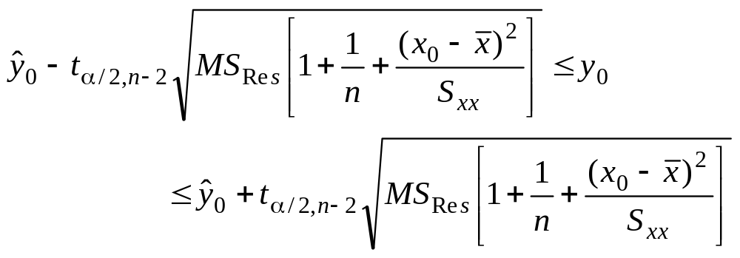
2.5 Prediction of New Observations
100(1 - α)% prediction interval on a future observation, y₀, at x₀

Slide 13
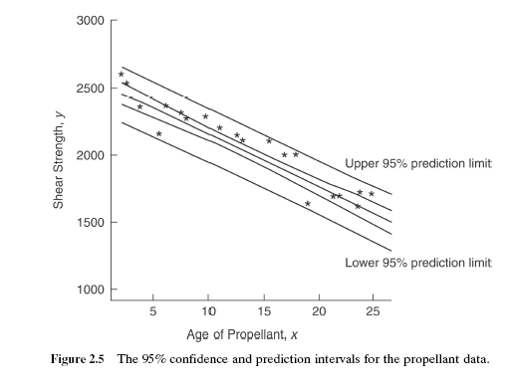

Slide 14
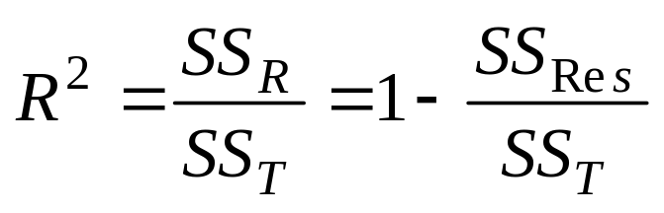

2.6 Coefficient of Determination
R² - coefficient of determination
Proportion of variation explained by the regressor, x
For the rocket propellant data

Slide 15
2.6 Coefficient of Determination
R² can be misleading!
  Simply adding more terms to the model will increase R²
  As the range of the regressor variable increases (decreases), R² generally increases (decreases).
  R² does not indicate the appropriateness of a linear model

Slide 16
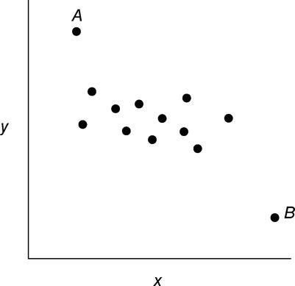
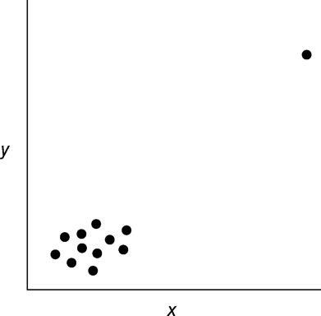
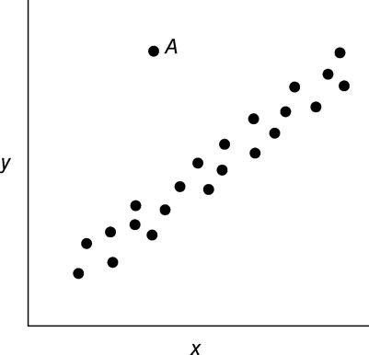
2.9 Considerations in the Use of Regression
Extrapolating
Extreme points will often influence the slope (see Fig 2.8 and 2.9)
Outliers can disturb the least-squares fit (see Fig 2.10)
Linear relationship does not imply cause-effect relationship (interesting mental defective example in the book pg 40)
Sometimes, the value of the regressor variable is unknown and itself be estimated or predicted (see example on page 45 of the text) .
Fig 2.8 Two influential observations Fig 2.9 Fig 2.10: Outlier

Slide 17
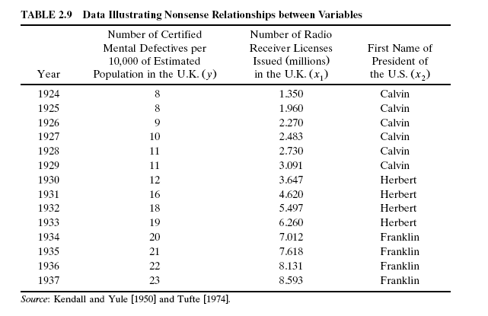
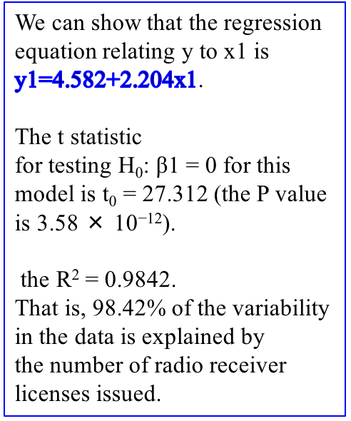
Explanation: Clearly this is a nonsense relationship, as it is highly unlikely that the number of mental
defectives in the population is functionally related to the number of radio receiver licenses issued.
The reason for this strong statistical relationship is that y and x1 are monotonically related
(two sequences of numbers are monotonically related if as one sequence increases, the other always either increases or decreases). In this example y is increasing because diagnostic procedures for mental disorders are becoming more refined over the years represented in the study and x1 is increasing because of the emergence and low-cost availability of radio technology over the years. Any two sequences of numbers that are monotonically related will exhibit similar properties.

Slide 18
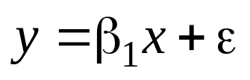
2.10 Regression Through the Origin
The no-intercept model is
This model would be appropriate for situations where the origin (0, 0) has some meaning.
A scatter diagram can aid in determining where an intercept- or no-intercept model should be used.
In addition, the practitioner could test both models. Examine t-tests, residual mean square.

Slide 19
http://www2.kenyon.edu/Depts/Math/hartlaub/Math305%20Fall2011/R.htm
Linear Regression Models
regmodel=lm(y ~ my.X) #fit a regression model
summary(regmodel) #get results from fitting the regression model
anova(regmodel) #get the ANOVA table fro the regression fit
plot(regmodel) #get four plots, including normal probability plot, of residuals
fits=regmodel$fitted #store the fitted values in variable named "fits"
resids=regmodel$residuals #store the residual values in a varaible named "resids"
beta1hat=regmodel$coeff[2] #assign the slope coefficient to the name "beta1hat"
confint(regmodel) #CIs for all parameters
predict.lm(regmodel, interval="confidence")
#make prediction and give confidence interval for the mean response
predict.lm(regmodel, interval="prediction")
#make prediction and give prediction interval for the mean response
newx=data.frame(my.X=4) #create a new data frame with one new x* value of 4
predict.lm(regmodel, newx, interval="confidence") #get a CI for the mean at the value x*
Note, in the R code “ newx=data.frame(my.X=4) “, the “x” variable name “my.X” should be consistent with the original variable “x” variable name “my.X”, otherwise, you will get warning messages if you use a different name “X” instead of “my.X” (e.g., “ newx=data.frame(X=4) “).

Slide 20
About drawing confidence intervals: https://www.researchgate.net/post/How_can_I_put_confidence_intervals_in_R_plot
# example data from the built-in data set "mtcars"
x = mtcars$wt
y = mtcars$drat
# prepare plot, fit model, get predictions,
# add lines for confidence limits and regression line, add points
plot(y~x,type="n")
m = lm(y~x)
wx = par("usr")[1:2] # This is just to get two numbers to generate new “X’ observations.
new.x = seq(wx[1], wx[2], len=100)
pred = predict(m, new=data.frame(x=new.x), interval="conf")
# This “pred” is a matrix with three columns: “fit”, “lwr”, “upr”.
lines(new.x,pred[,"fit"], lwd=2)
lines(new.x,pred[,"lwr"], lty=3)
lines(new.x,pred[,"upr"], lty=3)
points(x,y,pch=16,col="steelblue")
### alternative: plot confidence band:
plot(y~x,type="n")
polygon(c(new.x,rev(new.x)),c(pred[,"lwr"],rev(pred[,"upr"])),border=NA,col=blues9[3])
lines(new.x,pred[,"fit"],lwd=2,col=blues9[8])
points(x,y,pch=16)
box()

Slide 21
R practice
Data.Ch2.Propellant.txt
Posted on TRACS in the
Data/Lecture Data folder.
> setwd("/Users/ssun/Desktop")
> prop<-read.table("Data.Ch2.Propellant.txt", header=T)
> prop
Observation ShearStrength.y Propellant.Age.x
1 1 2158.70 15.50
2 2 1678.15 23.75
3 3 2316.00 8.00
4 4 2061.30 17.00
5 5 2207.50 5.50
6 6 1708.30 19.00
7 7 1784.70 24.00
8 8 2575.00 2.50
9 9 2357.90 7.50
10 10 2256.70 11.00
11 11 2165.20 13.00
12 12 2399.55 3.75
13 13 1779.80 25.00
14 14 2336.75 9.75
15 15 1765.30 22.00
16 16 2053.50 18.00
17 17 2414.40 6.00
18 18 2200.50 12.50
19 19 2654.20 2.00
20 20 1753.70 21.50
Plot the data
Fit a linear model
Get ANOVA
Inference for β₁

Slide 22
