Slide 1
Chapter 10
Variable Selection and
Model Building
Lecture 16
Oct 26, 2017, Week 9 Thursday
Note, for the property and theory listed in these slides,
we will just accept them and do not show detailed proof.
Example R code will be posted later.

Slide 2
How to decide which variables to be included in the regression or final model?
> dim(se) # [1] 1755 39
> reg.model=lm(new_Stock_Price~Cash_Ratio+
+ Cash_and_Cash_Equivalents+
+ Common_Stocks+
+ Cost_of_Revenue+
+ Current_Ratio+
+ Earnings_Before_Interest_and_Tax+
+ Earnings_Before_Tax+
+ Fixed_Assets+
+ Gross_Profit+
+ Income_Tax+
+ Inventory+
+ Long.Term_Debt+
+ Net_Cash_Flow+
+ Net_Cash_Flow.Operating+
+ Net_Cash_Flows.Financing+
+ Net_Cash_Flows.Investing+
+ Net_Income+
+ Net_Income_Adjustments+
+ Net_Receivables+
+ Operating_Income+
+ Operating_Margin+
+ Pre.Tax_Margin+
+ Pre.Tax_ROE+
+ Profit_Margin+
+ Quick_Ratio+
+ Retained_Earnings+
+ Total_Assets+
+ Total_Current_Assets+
+ Total_Current_Liabilities+
+ Total_Equity+
+ Total_Liabilities+
+ Total_Liabilities_._Equity+
+ Total_Revenue+
+ Treasury_Stock+
+ Earnings_Per_Share+
+ Estimated_Shares_Outstanding,
+ data=se)
Summary of a regression model: Coefficients:
Estimate Std. Error t value Pr(>|t|)
(Intercept) 3.663e+00 4.586e-02 79.890 < 2e-16 ***
Cash_Ratio -4.858e-04 4.660e-04 -1.043 0.297335
Cash_and_Cash_Equivalents -1.386e-11 9.766e-12 -1.419 0.156070
Common_Stocks 6.930e-12 4.276e-12 1.621 0.105339
Cost_of_Revenue -2.652e-11 2.021e-10 -0.131 0.895640
Current_Ratio 2.608e-04 3.628e-04 0.719 0.472355
Earnings_Before_Interest_and_Tax -2.248e-10 8.492e-11 -2.647 0.008214 **
Earnings_Before_Tax 1.361e-10 9.066e-11 1.502 0.133441
Fixed_Assets -9.800e-12 2.419e-12 -4.052 5.39e-05 ***
Gross_Profit -1.061e-11 2.020e-10 -0.053 0.958116
Income_Tax 1.373e-10 3.817e-11 3.597 0.000334 ***
Inventory 1.446e-11 8.480e-12 1.705 0.088393 .
Long.Term_Debt 5.306e-12 5.928e-12 0.895 0.370893
Net_Cash_Flow -2.275e-11 5.502e-11 -0.413 0.679322
Net_Cash_Flow.Operating 7.823e-11 5.606e-11 1.395 0.163112
Net_Cash_Flows.Financing 3.066e-11 5.520e-11 0.555 0.578740
Net_Cash_Flows.Investing 1.302e-11 5.593e-11 0.233 0.815893
Net_Income -2.764e-11 3.075e-11 -0.899 0.368909
Net_Income_Adjustments -4.812e-11 1.648e-11 -2.920 0.003557 **
Net_Receivables -1.827e-11 7.169e-12 -2.549 0.010927 *
Operating_Income 7.389e-12 2.517e-11 0.294 0.769156
Operating_Margin 1.282e-02 2.332e-03 5.496 4.69e-08 ***
Pre.Tax_Margin 3.583e-03 3.223e-03 1.112 0.266458
Pre.Tax_ROE 8.550e-06 3.976e-05 0.215 0.829764
Profit_Margin -1.137e-02 3.728e-03 -3.051 0.002331 **
Quick_Ratio 3.026e-04 5.511e-04 0.549 0.583045
Retained_Earnings 5.863e-12 3.039e-12 1.929 0.053942 .
Total_Assets -8.174e-11 5.843e-11 -1.399 0.162074
Total_Current_Assets 4.634e-12 4.964e-12 0.933 0.350765
Total_Current_Liabilities -2.786e-12 6.918e-12 -0.403 0.687221
Total_Equity -1.183e-10 2.202e-10 -0.537 0.591048
Total_Liabilities -1.129e-10 2.204e-10 -0.512 0.608580
Total_Liabilities_._Equity 1.976e-10 2.270e-10 0.870 0.384234
Total_Revenue 2.569e-11 2.020e-10 0.127 0.898813
Treasury_Stock 1.311e-12 3.525e-12 0.372 0.710102
Earnings_Per_Share 9.060e-02 3.802e-03 23.831 < 2e-16 ***
Estimated_Shares_Outstanding -2.384e-10 3.432e-11 -6.946 6.02e-12 ***
------
Signif. codes: 0 ‘***’ 0.001 ‘**’ 0.01 ‘*’ 0.05 ‘.’ 0.1 ‘ ’ 1
Residual standard error: 0.5185 on 1258 degrees of freedom
(460 observations deleted due to missingness)
Multiple R-squared: 0.469, Adjusted R-squared: 0.4538
F-statistic: 30.87 on 36 and 1258 DF, p-value: < 2.2e-16

Slide 3

10.1 Introduction
10.1.1 Model-Building Problem
Two “conflicting” goals in regression model building:
Want as many regressors as possible so that the “information content” in the variables will influence
Want as few regressors as necessary because the variance of will increase as the number of regressors increases. (Also, more regressors can cost more money in data collection/model maintenance)
A compromise between the two hopefully leads to the best regression equation.

Slide 4
10.1 Introduction
In this chapter, we will cover some variable selection techniques. Keep in mind the following:
None of the variable selection techniques can guarantee the best regression equation for the dataset of interest.
The techniques may very well give different results.
Complete reliance on the algorithm for results is to be avoided. Other valuable information such as experience with and knowledge of the data and problem.

Slide 5

10.1 Introduction
10.1.2 Consequences of Model Misspecification
Say there are K regressor variables under investigation in a problem. Then
where X can be partitioned into two submatrices:
1) a matrix containing the intercept and the p – 1 regressors that are significant (to be retained in the model) – denoted X_{p} ; and,
2) a matrix containing the remaining r regressors that are not significant and should be deleted from the model – denoted X_{r}.

Slide 6
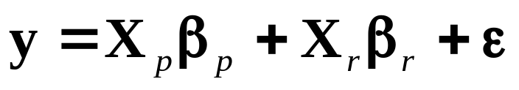


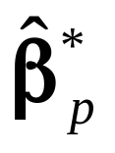

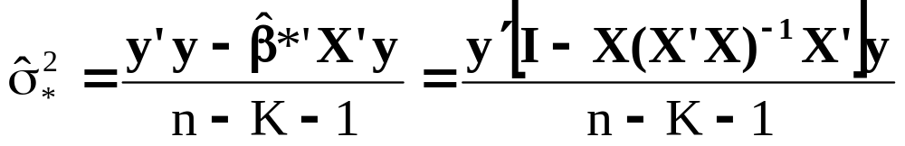
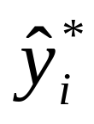
10.1 Introduction
Note that K +1 = p + r. Our model is rewritten as
For the full model:
1) , consists of two parts and
2)
3) Fitted values are

Slide 7
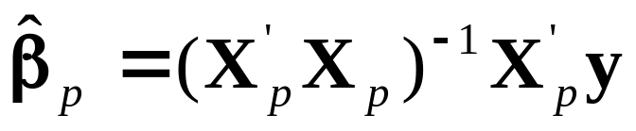
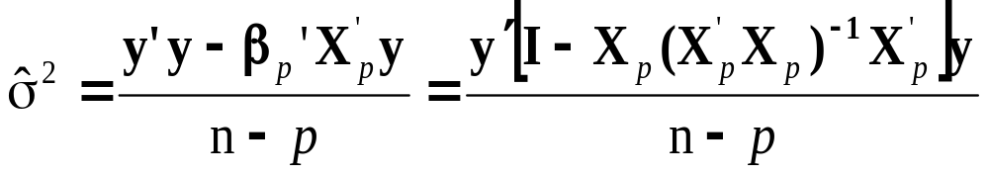


10.1 Introduction
For the subset model:
1)
2)
3) Fitted values are
(What is the difference between and _{p}?)

Slide 8
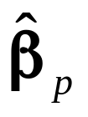

10.1 Introduction
Some properties of the estimates and are:
E( ) = β_{p}+Aβ_{r} . is a biased estimate of β_{p} unless the regression coefficients of the insignificant (or deleted) variables are zero or are orthogonal to the retained variables. (X_{p}’X_{r} = 0).
2. Var( ) = σ²(X_{p}’X_{p})⁻¹, Var( *) = σ²(X’X)⁻¹. Var( ) - Var( _{p}) is a matrix such that all variances of regression coefficients in the full model are greater than or equal to variances of corresponding coefficients in the reduced model. In other words, deleting unnecessary variables will not increase the variance on remaining coefficients.

Slide 9
10.1 Introduction
10.1.2 Consequences of Model Misspecification
Some properties of the estimates and are:
3. MSE( ) < MSE( ) when each coefficient in < the standard error of . In a nutshell, the MSE for the subset model is better (smaller) than the MSE for the same coefficients when the full model is employed – if the deleted variables are really insignificant.

Slide 10
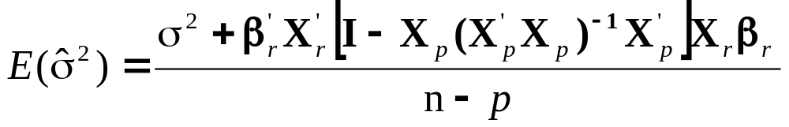

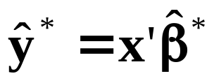
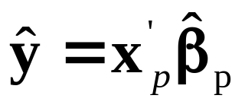


10.1 Introduction
10.1.2 Consequences of Model Misspecification
Some properties of the estimates and are:
4. For the subset model,
that is for this model, is a biased upward estimate of σ².
5. Prediction: From full model: , from the subset model: , then
Var( ) ≥ MSE( )

Slide 11
10.1 Introduction
10.1.2 Consequences of Model Misspecification
The summary of the five statements is
Deleting variables improves the precision of the parameter estimates of retained variables.
Deleting variables improves the precision of the variance of the predicted response.
Deleting variables can induce bias into the estimates of coefficients and variance of predicted response. (But, if the deleted variables are “insignificant” the MSE of the biased estimates will be less than the variance of the unbiased estimates).
Retaining insignificant variables can increase the variance of the parameter estimates and variance of the predicted response.

Slide 12
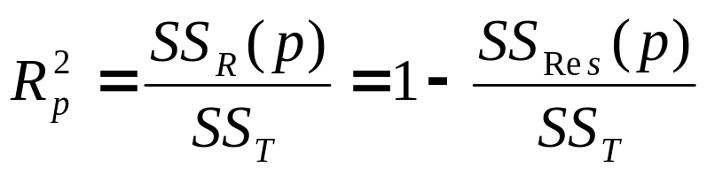
10.1 Introduction
10.1.3 Criteria for Evaluating Subset Regression Models
Coefficient of Multiple Determination
Say we are investigating a model with p terms,
Models with large values of R_{p}² are preferred, but adding terms will increase this value.

Slide 13
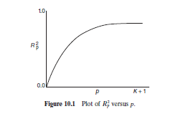
10.1 Introduction

Slide 14
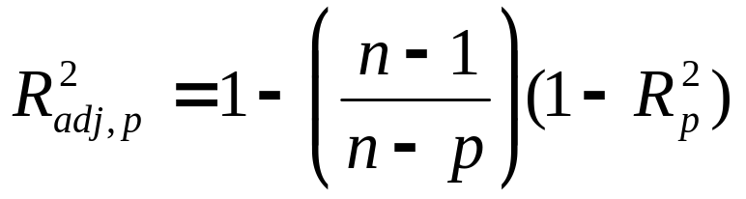
10.1 Introduction
10.1.3 Criteria for Evaluating Subset Regression Models
Adjusted R²
Say we are investigating a model with p terms,
This value will not necessarily increase as additional terms are introduced into the model. We want a model with the maximum adjusted R².

Slide 15
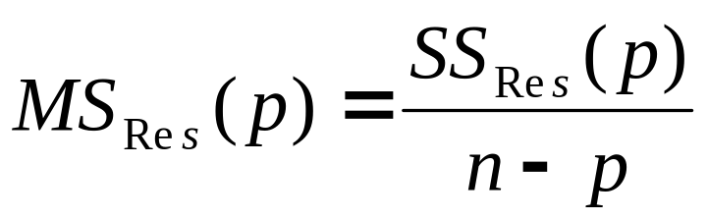
10.1 Introduction
10.1.3 Criteria for Evaluating Subset Regression Models
Residual Mean Square
The MS_{res} for a subset regression model is
MS_{Res}(p) increases as p increases, in general. The increase in MS_{Res}(p) occurs when the reduction in SS_{Res}(p) from adding a regressor to the model is not sufficient to compensate for the loss of one degree of freedom. We want a model with a minimum MS_{Res}(p).

Slide 16
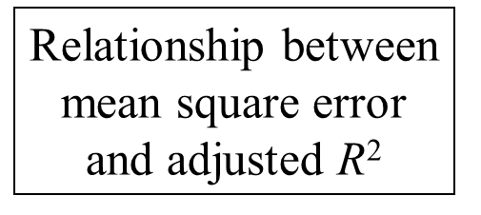
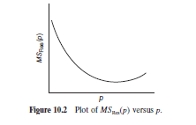
10.1 Introduction

Slide 17
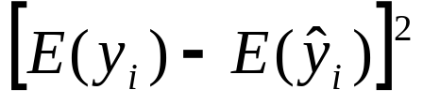
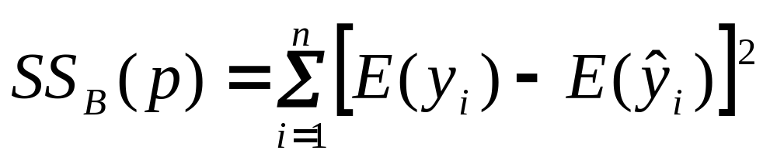
10.1 Introduction
10.1.3 Criteria for Evaluating Subset Regression Models
Mallow’s C_{p} Statistic
This criterion is related to the MSE of the fitted value, that is
where is the squared bias. The total squared bias for a p-term model is

Slide 18
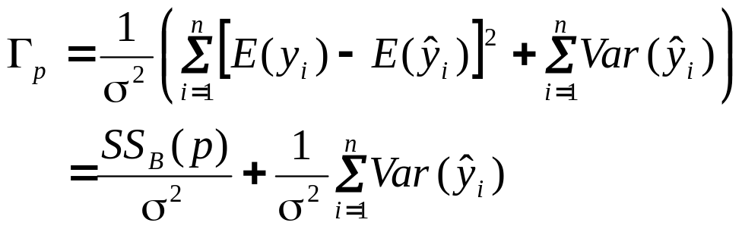
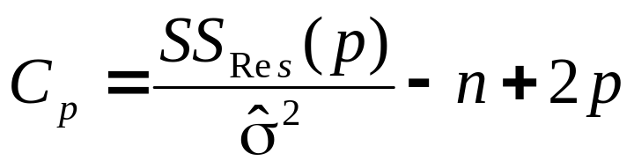
10.1 Introduction
10.1.3 Criteria for Evaluating Subset Regression Models
Mallow’s C_{p} Statistic
The standardized total squared error is
Making some appropriate substitutions, we can find the estimate of Γ_{p}, denoted C_{p}:

Slide 19
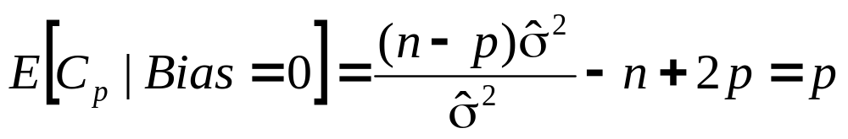
10.1 Introduction
10.1.3 Criteria for Evaluating Subset Regression Models
Mallow’s C_{p} Statistic
It can be shown that if Bias = 0, the expected value of C_{p} is

Slide 20
10.1 Introduction
10.1.3 Criteria for Evaluating Subset Regression Models
Mallow’s C_{p} Statistic
Notes:
C_{p} is a measure of variance in the fitted values and (bias)². (Large bias can be a result of important variables being left out of the model).
C_{p} >> p, then significant bias.
Small C_{p} values are desirable.
Beware of negative values of C_{p}. These could result because the MSE for the full model overestimates the true σ².

Slide 21
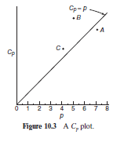
10.1 Introduction

Slide 22
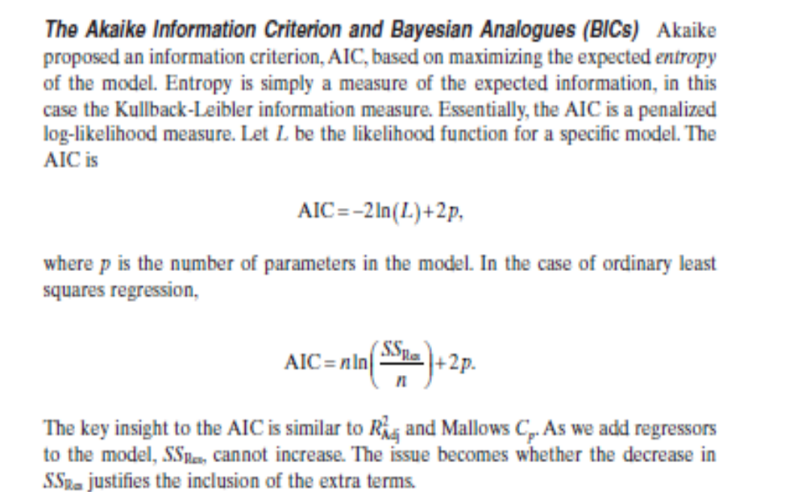

Slide 23
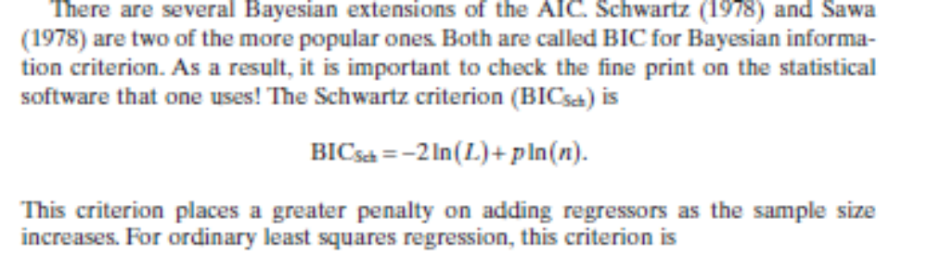
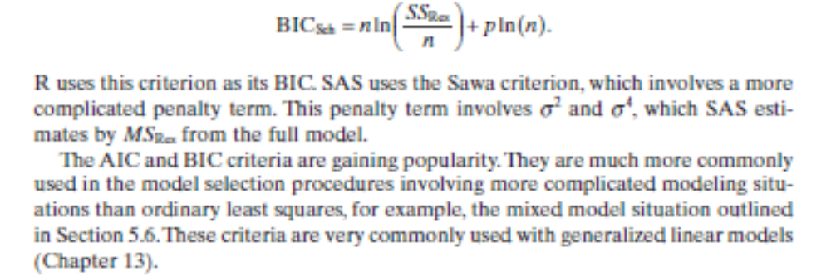

Slide 24
10.2 Computational Techniques for
Variable Selection
10.2.1 All Possible Regressions
Assume the intercept term is in all equations considered. Then, if there are K regressors, we would investigate 2^{K} possible regression equations. Use the criteria above to determine some candidate models and complete regression analysis on them.

Slide 25
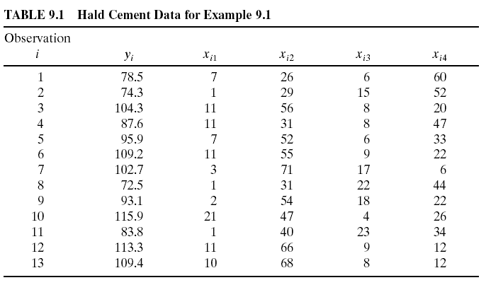
Example 10.1 Hald Cement Data (Appendix Table B21)

Slide 26
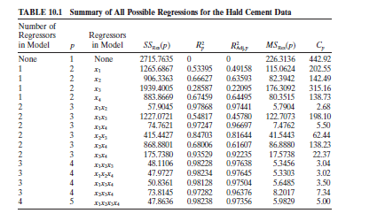
Example 10.1 Hald Cement Data

Slide 27
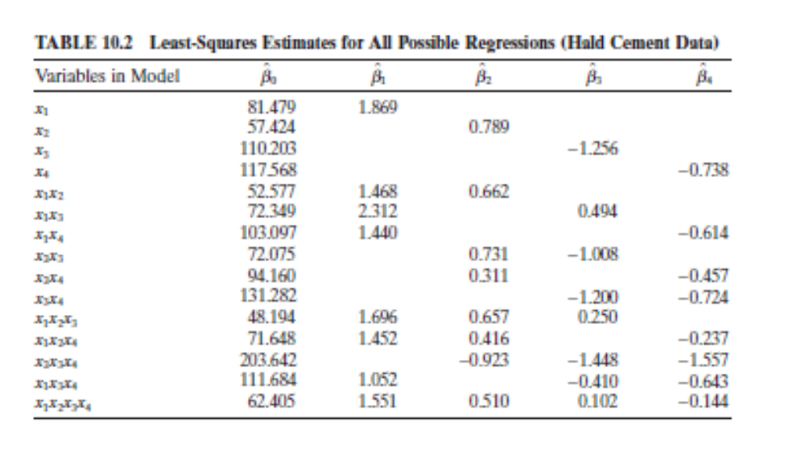
Example 10.1 Hald Cement Data

Slide 28
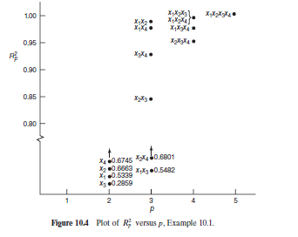
Example 10.1 Hald Cement Data

Slide 29
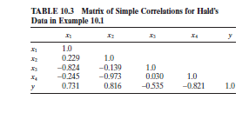
Example 10.1 Hald Cement Data

Slide 30
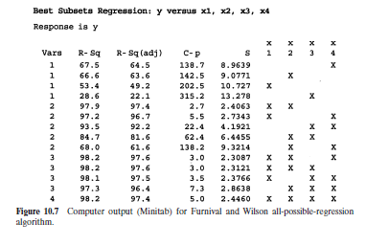
Example 10.1 Hald Cement Data

Slide 31
10.2 Computational Techniques for
Variable Selection
10.2.1 All Possible Regressions
Notes:
Once some candidate models have been identified, run regression analysis on each one individually and make comparisons .
A caution about the regression coefficients. If the estimates of a particular coefficient tends to “jump around”, this could be an indication of multicollinearity. Jumping around is a technical term – example: if some estimates are positive and then negative.

Slide 32
10.2 Computational Techniques for
Variable Selection
10.2.2 Stepwise Regression Methods
Three types of stepwise regression methods
forward selection
backward elimination
3. stepwise regression (combination of forward and backward)

Slide 33
10.2 Computational Techniques for
Variable Selection
10.2.2 Stepwise Regression Methods
Forward Selection
Procedure is based on the idea that no variables are in the model originally, but are added one at a time. The selection procedure is:
1. The first regressor selected to be entered into the model is the one with the highest correlation with the response. If the F statistic corresponding to the model containing this variable is significant (larger than some predetermined value, F_{in}), then that regressor is left in the model.
2. The second regressor examined is the one with the largest partial correlation with the response. If the F-statistic corresponding to the addition of this variable is significant, the regressor is retained.
3. This process continues until all regressors are examined.

Slide 34
10.2 Computational Techniques for
Variable Selection
10.2.2 Stepwise Regression Methods
Backward Elimination
Procedure is based on the idea that all variables are in the model originally, examined one at a time and removed if not significant.
The partial F statistic is calculated for each variable as if it were the last one added to the model. The regressor with the smallest F statistic is examined first and will be removed if this value is less than some predetermined value F_{out}.
If this regressor is removed, then the model is refit with the remaining regressor variables and the partial F statistics calculated again. The regressor with the smallest partial F statistic will be removed if that value is less than F_{out}.
The process continues until all regressors are examined.

Slide 35
10.2 Computational Techniques for
Variable Selection
10.2.2 Stepwise Regression Methods
Stepwise Regression
This procedure is a modification of forward selection.
The contribution of each regressor variable that is put into the model is reassessed by way of its partial F statistic.
A regressor that makes it into the model, may also be removed it if is found to be insignificant with the addition of other variables to the model. If the partial F-statistic is less than F_{out}, the variable will be removed.
Stepwise requires both an F_{in} value and F_{out} value.

Slide 36
10.2 Computational Techniques for
Variable Selection
10.2.2 Stepwise Regression Methods
Cautions
No one model may be the “best”
The three stepwise techniques could result in different models
Inexperienced analysts may use the final model simply because the procedure spit it out.
Please look over the discussion on “Stopping Rules for Stepwise Procedures” on page 283.

Slide 37
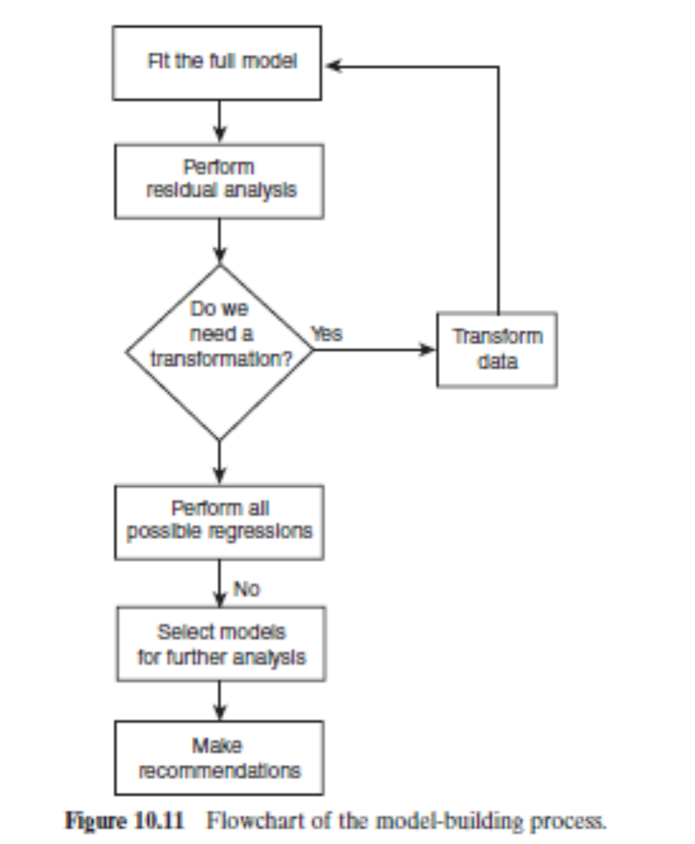
Strategy for Regression Model Building

