Slide 1

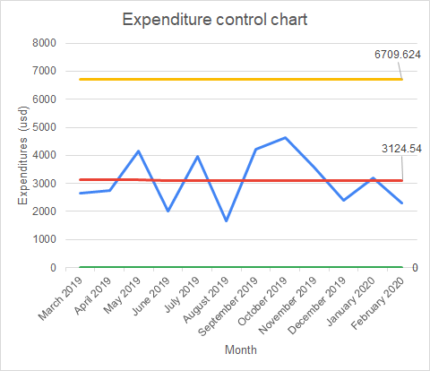
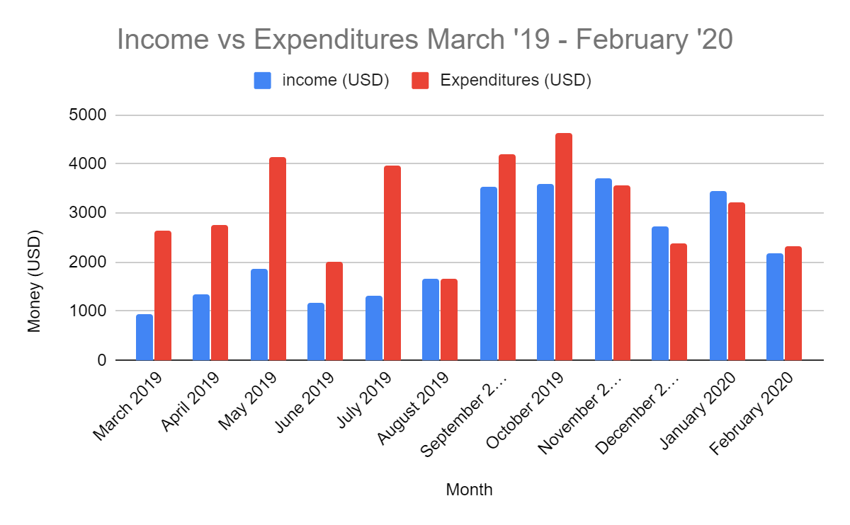
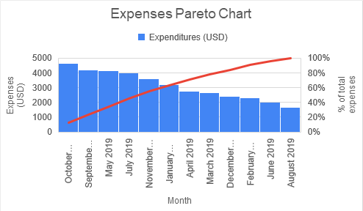
Personal Expense Reduction
Joshua McCleary
Key Dates --->
Team launch
Define:1/16/2020
Measure:1/25/2020
Analyze: 3/6/2020
Improve:3/14/2020
Control:ongoing
DEFINE
MEASURE
ANALYZE
IMPROVE
-My expenses are in control but because they still exceed my income so there still need to be a reduction.
-smoothing predictions confirm that there would not be a large increase in spending in March.
Problem- consistent overspending
Solution: a stringent budget with exceptions in the summer.
Munting student debt necessitates a certain level of financial commitment to ensure it is all paid off
Average expenditures average to about $3800 a month which is $2400 above the desired amount
Reducing expenditures to $1200 a month would ensure that i can pay off my student debt in 50% time and save upwards of $20,000
Defects are occurring in most months. SQL:1.1
- My expenses were highest when the weather was warm
New procedure : create a budget cap of $1854
Exponential Smoothing
w=0.2 : $3097.13 w=0.5 : $3145.77
w=0.8 : $3198.08
- Oct, Sept, May, July accounted for 45% of my yearly expenses
CONTROL
Hypothesis Testing
Ho: 𝝻 = 𝝻 0, Ha:𝝻 < 𝝻 0
Sample size(n)= 13 ,Df = 12
t=(3125.5-1854)/(970.2/√13)= -4.73
-Monitoring my weekly expenses
-restricting leisure spending
- spending should reduce to between 75 and 80% of my income in six months

Slide 2
Define
Goal
My goal is to reduce my monthly expenses to 75% of my income ($2472). Once this has been achieved for 6 consecutive months i will have succeeded in implementing this budget long term
Operation Definitions
Total monthly expenses (output -y) - all expenses incurred from all accounts during a calendar month
Current process
My current process does not depend on strict budget but whether or not my utilities and rent are paid. This allows for a lot of unexpected expenses, mainly from eating out and entertainment, that stifles my ability to save, invest, and pay off debt more efficiently.

Slide 3
Define
Current process: My current process does not depend on strict budget but whether or not my utilities and rent are paid. This allows for a lot of unexpected expenses, mainly from eating out and entertainment, that stifles my ability to save, invest, and pay off debt more efficiently.

Slide 4
Data Measurement Plan
Performance Measure
Data Source and Location
How Will Data Be Collected
Who Will Collect
Data
When Will Data Be Collected
Target
Sample
Size
Adding the expenses and divide it by the total expenditures
myself
1/25/20
% of expenses going to groceries
Chase and Discover
12 mo
% of expenses going to rent
Adding the expenses and divide it by the total expenditures
myself
1/25/20
Chase Bank and Venmo
12 mo
% of expenses going to eating out and drinks
Chase Bank and Discover
Adding the expenses and divide it by the total expenditures
myself
1/25/20
12 mo
Chase Bank
Adding the expenses and divide it by the total expenditures
myself
1/25/20
% of expenses going utilities
12 mo
Adding the expenses and divide it by the total expenditures
myself
1/25/20
Total month’s expenses
Chase Bank and Discover
12 mo
% of expenses going to transportation
Chase Bank and Discover
Adding the expenses and divide it by the total expenditures
myself
1/25/20
12mo
% of expenses going to travel
Adding the expenses and divide it by the total expenditures
myself
1/25/20
12 mo
Chase Bank and Discover
% of expenses for entertainment
Chase Bank and Discover
Adding the expenses and divide it by the total expenditures
myself
1/25/20
12 mo
% of expenses going to miscellaneous items
Chase Bank and Discover
Adding the expenses and divide it by the total expenditures
myself
1/25/20
12 mo

Slide 5
Measure
Data type: expenses $, Continuous
Data was procured from records stored by Chase and Discover Bank, with whom I have spending accounts
I reviewed all the accounts to make sure all of my expenses matched up
At the time of measurement the credit card balances were all paid off
Sample size needed: [(z* sample std dev/E)^2] 95% confidence * =1.96 std dev= 970.2 E = $618 one week’s pay
N= (1.96*970.2/618)^2=9 i collected 12 samples as that was the maximum number months that the banks keep record of
12 = (1.96*970.2/E)^2 E= $548 * in order to minimize my margin of error i’ll need to keep track of my monthly spending to collect a larger sample size
SQL
My average monthly income from 2019 was $2290. My average monthly expenditures were $3125. Any month i exceed my income in spending is a defect. .
D = 1
U = 12
D x U = 12
A = 8
AU = DPO = .667
DPO x 1,000,000 = 667,000
SQL = 1.1

Slide 6
This graph shows the relationship between my income and expenses from March 2019 and February 2020
Late August I started a new job that doubled my salary
This shows the expenses from all lines of credit and the debit account
May and July 2019 had the highest disparity between income and expenses

Slide 7
My highest spending month was October( 12.3% of total expenses)
45% of my spending came from four months (October, September, May, July)
Based on the data i spend the most during the summer months since i can travel more. Spring and winter are lower due to the weather and school.

Slide 8
Analyze- control chart
Lower control level was calculated at -$458.54 but was shifted to 0 because the lowest i could theoretically spend is $0
Based on this control chart my expenditures are under control despite being higher that than my base income 8 of the 12 months

Slide 9
Analyze - Hypothesis testing
One sample one-tail test with ( 𝝻= current average monthly expenses $3125, 𝝻0= to goal average budget $1854, alpha =.05) i’m testing to see if my goal budget is statistically lower than my current expenses .
Ho: 𝝻 = 𝝻 0
Ha:𝝻 < 𝝻 0
Sample size(n)= 13
Df = 12
t=(1854-3125.5)/(970.2/√13)= 4.73
The resulting p-value is less than 0.005 so H0 must go and we know that there is a statistical difference

Slide 10
Analyze- exponential Smoothing
I used smoothing constants of 0.2, 0.5 , and 0.8 to predict my March expenses if i don’t implement a budget. Based on the these predictions March would exceed my income by almost $700 or a full week’s paid.
w=0.2 : $3097.13
w=0.5 : $3145.77
w=0.8 : $3198.08

Slide 11
Analyze
New SQL- Any month where expenses exceed income is a defect. This SQL is based off the assumption that I stick to this budget for the next 12 months
D = 1
U = 12
D x U = 12
A = 0
A/U = DPO = 0
DPO x 1,000,000 = 0
SQL = 6

Slide 12
Improve
Implementing a budget of 1854 or 75% of my monthly income will keep my expense in control and allow a little
Limiting eating and going out to once a week and planning trips in advance ( things i do when the weather is nice)should allow me to reduce my spending
Setting alerts on my spending accounts will also remind me when i approach my desired limit.

Slide 13
Control
Every 6 months i will run an analysis to see if my budget has been steady
Monthly reviews of my expenditures will help me continue to pinpoint excess spending

