Slide 1

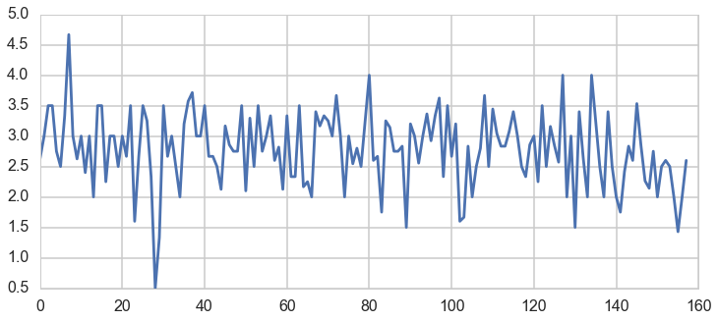
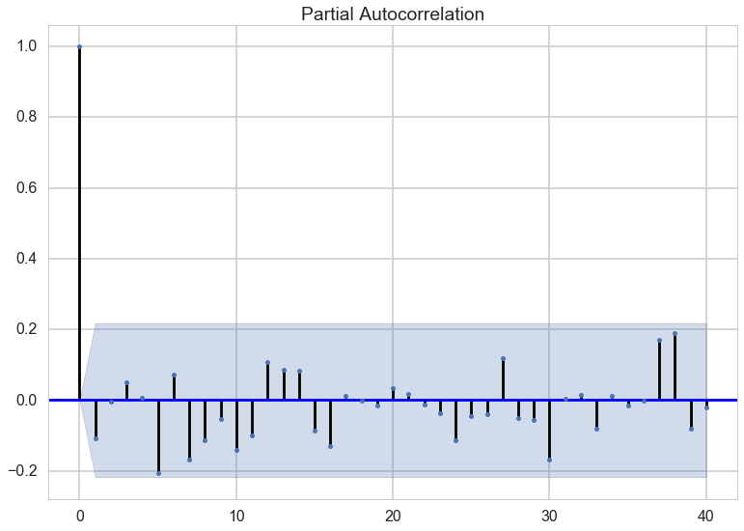
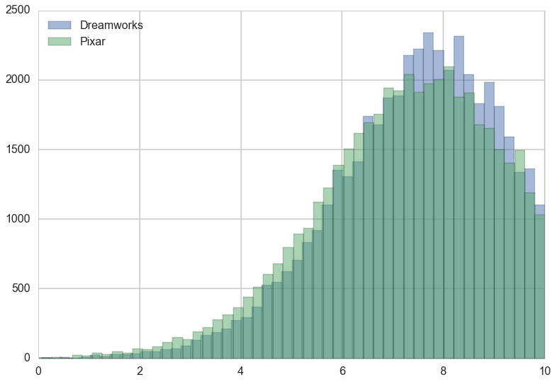


Bayesian Movie Analysis
Thomas Seah, Joshua Mei, Yipei Guo
zhiqianseah@g.harvard.edu, joshuamei@g.harvard.edu, yipeiguo@g.harvard.edu
AM 207
Spring 2016
Introduction
I am an abstract. I am succinct and carefully written.
Our project seeks to analyze movies in different ways using the tools that we learnt in this class.
The first analysis tries to answer the simple question: Is Dreamworks or Pixar better? Both are famous animation studios with classic hits. Yet, they have also produced flops over the years. By measuring user ratings of the 10 most recent movies from each studio, we hope to settle this debate.
The second analysis tackle the problem of critic reviews. Movie critics shape our perception of movies before we watch them. Yet, critics are also human, and they may be wrong. By analyzing the reviews of 5 top critics and the subsequent reception of the movie, we hope to find out how often are they correct/wrong.
The third analysis attempts to classify a user’s preference for genres of movies. This is useful for movie recommendation systems. By ……. (I also not sure what you doing haha)
Lastly, we also did some time series analysis on movie sales data.
blah blah blah
Data
Movie sales
Our data is scraped from movie review websites such as Rotten Tomatoes, and IMDB. We collate the user and critic reviews for selected movies and genres. We also collected data from boxofficemojo.com for movie sales.
Conclusions
Dreamworks is marginally “better” than Pixar in terms of reception to their most recent movies.
Critics are usually correct about good movies, and they are more often to be wrong or have differing opinions of bad movies.
Movie sales can be represented as a time series, but after removing periodicity and exponential decrease over time, the sales of movie is largely independent.
Approach
Results
blah blah blah
For Dreamworks vs Pixar, we use hierarchical Bayes. To determine the popularity of each studio, we use the popularity of the 10 most recent movies. To determine the popularity of a movie, we use the user reviews from 4 different movie review websites.
blah blah blah
here is some of my code.
Citations and Links
Figure 2. And all about Figure 2.
Protopapas, P. P., and friends. 2013. How we taught AM207 and lived to tell the tale. IACS Journal 1:1–3.
The students of AM207. 2013. Everything we know, we learned in AM207. IACS Journal 1:3–5.
Figure 1. And all about Figure 1.
School of Engineering and Applied Sciences • Institute for Applied Computational Science

