Slide 1

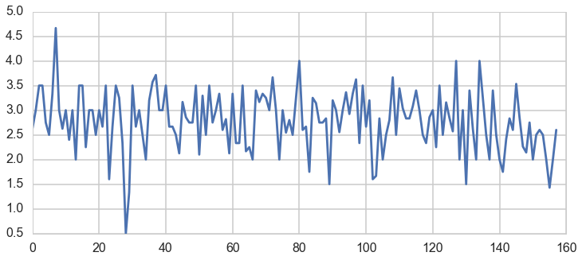
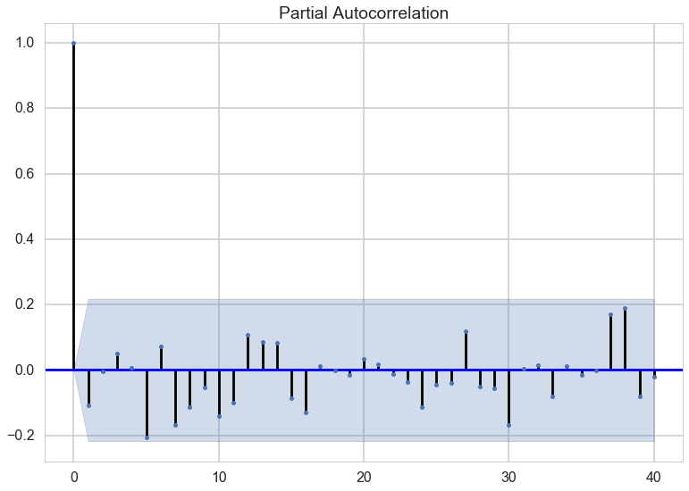
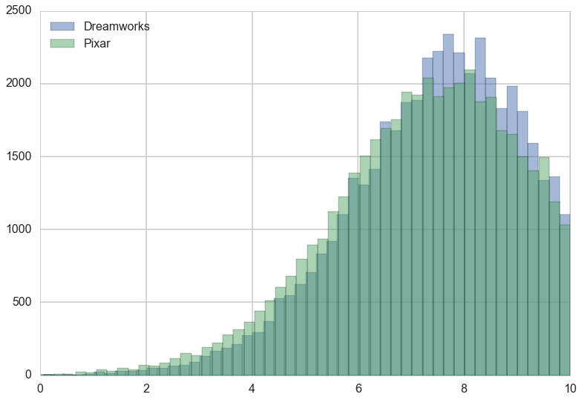
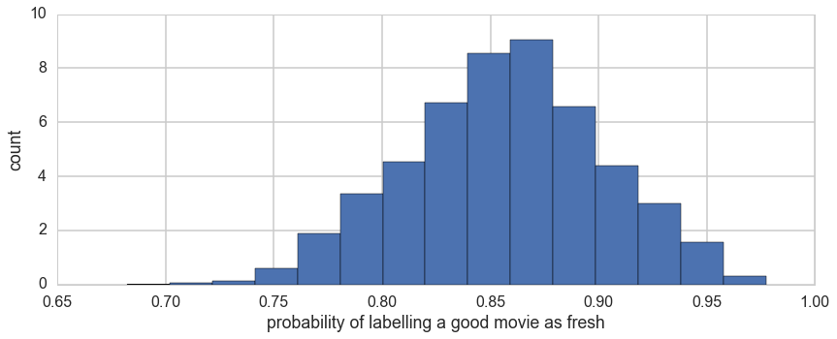
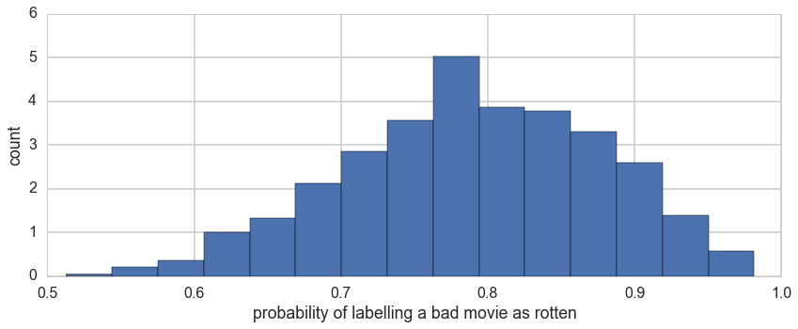
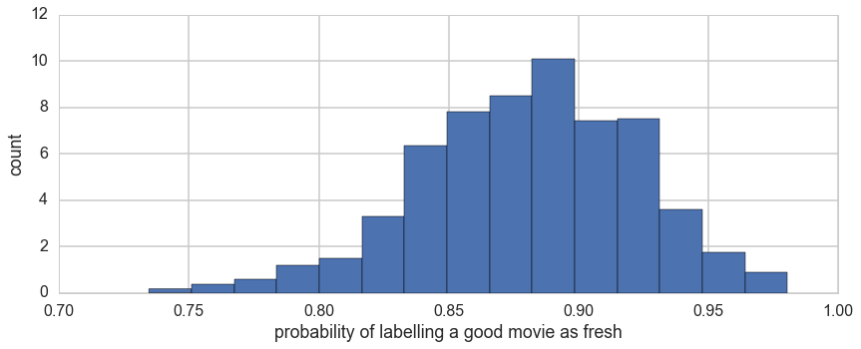
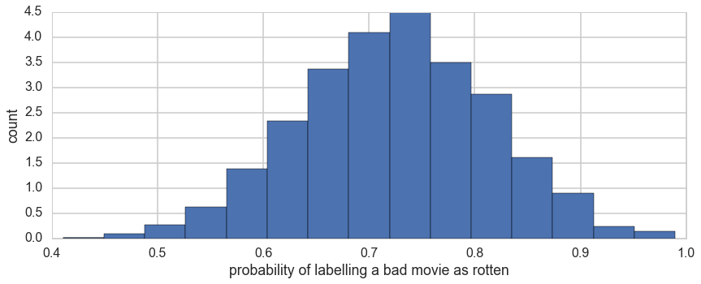
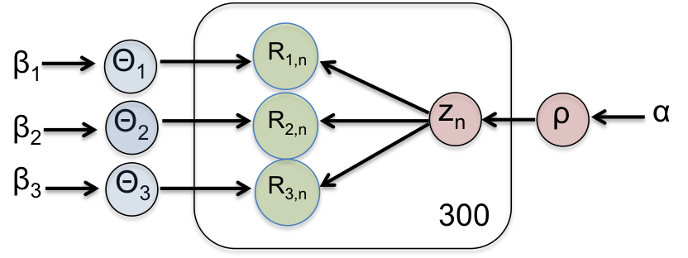

Bayesian Movie Analysis
Thomas Seah, Joshua Mei, Yipei Guo
zhiqianseah@g.harvard.edu, joshuamei@g.harvard.edu, yipeiguo@g.harvard.edu
AM 207 Stochastic Methods for Data Analysis, Inference and Optimization
Spring 2016
Introduction
Our project seeks to analyze movies in different ways using the tools from AM 207.
The first analysis tries to answer the simple question: Is Dreamworks or Pixar better? Both are famous animation studios with classic hits. Yet, they have also produced flops over the years. By using Bayesian hierarchal modeling and user ratings of the 10 most recent movies from each studio, we hope to settle this debate.
The second analysis tackles the problem of critic reviews. Critics shape our perception of movies before we watch them. Yet, critics are also human and may be wrong. By using a Bayesian model to analyze the reviews of 3 top critics, we hope to infer how good they are at identifying the quality of a movie.
The third analysis attempts to classify a user’s preference for genres of movies. This is useful for movie recommendation systems. By ……. (I also not sure what you doing haha)
Lastly, we also did some time series analysis on movie sales data.
blah blah blah
I am an abstract. I do not exist. I am succinct and carefully written.
Data
Movie sales
Our data is scraped from movie review websites such as Rotten Tomatoes and IMDB. We collate the user and critic reviews for selected movies and genres. We also collected movie sales data from boxofficemojo.com.
Results
Conclusions
Dreamworks is marginally “better” than Pixar in terms of reception to their most recent movies.
Critics are usually correct about good movies, and they are more often to be wrong or have differing opinions of bad movies.
Movie sales can be represented as a time series, but after removing periodicity and exponential decrease over time, the sales of movie is largely independent.
Approach
blah blah blah
For Dreamworks vs Pixar, we use hierarchical Bayes. To determine the popularity of each studio, we use the popularity of the 10 most recent movies. To determine the popularity of a movie, we use the user reviews from 4 different movie review websites.
To determine how well critics rate good movies as fresh and bad movies as rotten, we computed confusion matrices for 3 critics as a measure of how accurate their ratings are.
Figure 2. And all about Figure 2.
Citations and Links
Figure 1. Dependency graph for Bayesian model. Θ are the confusion matrices, R are the critic ratings, z is the quality of the movie (fresh/rotten).
Protopapas, P. P., and friends. 2013. How we taught AM207 and lived to tell the tale. IACS Journal 1:1–3.
The students of AM207. 2013. Everything we know, we learned in AM207. IACS Journal 1:3–5.
School of Engineering and Applied Sciences • Institute for Applied Computational Science

