Slide 1

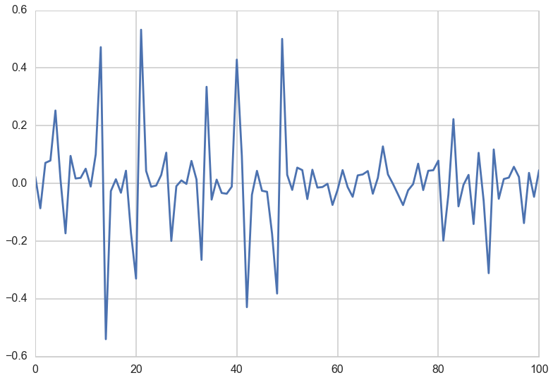
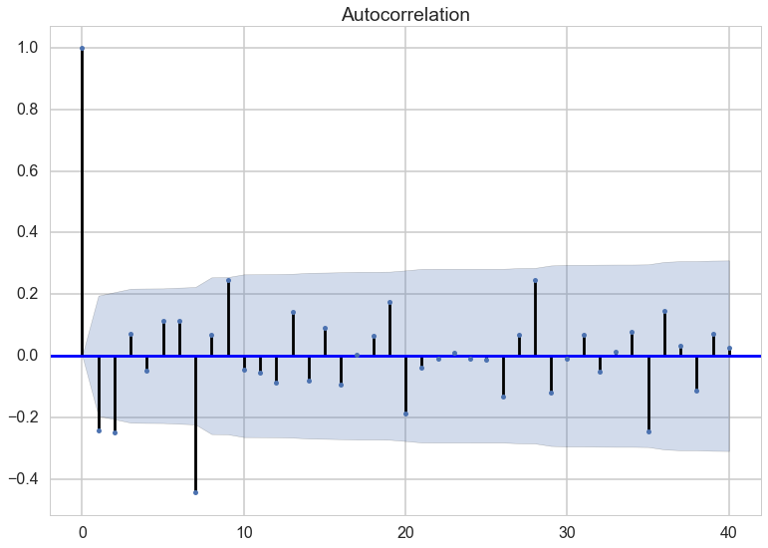
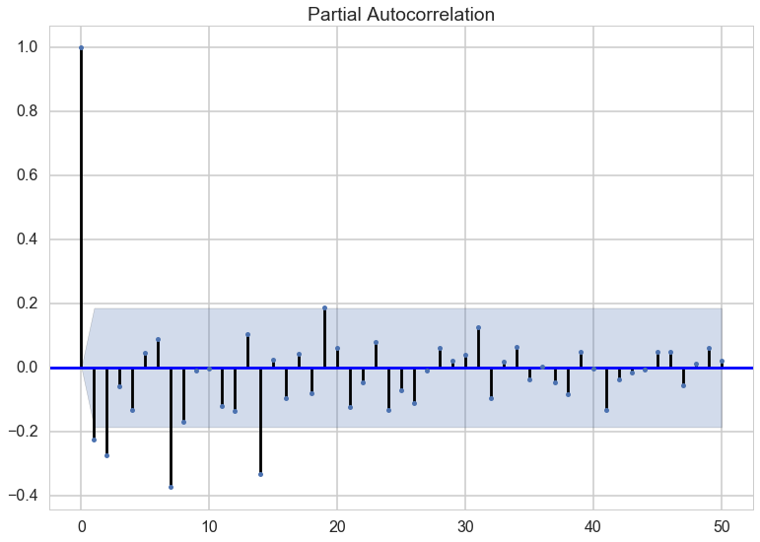
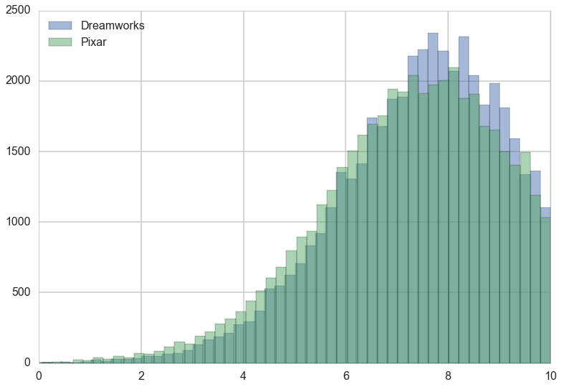
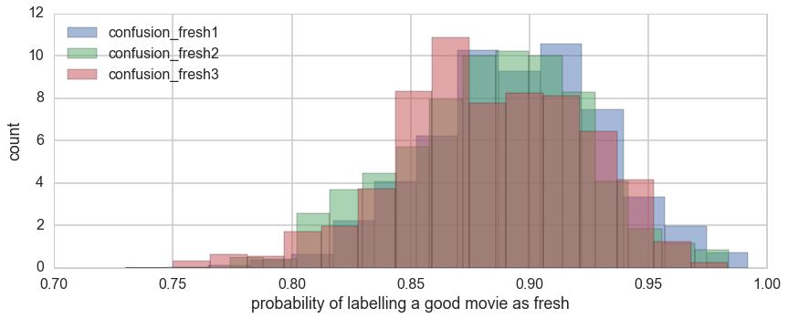
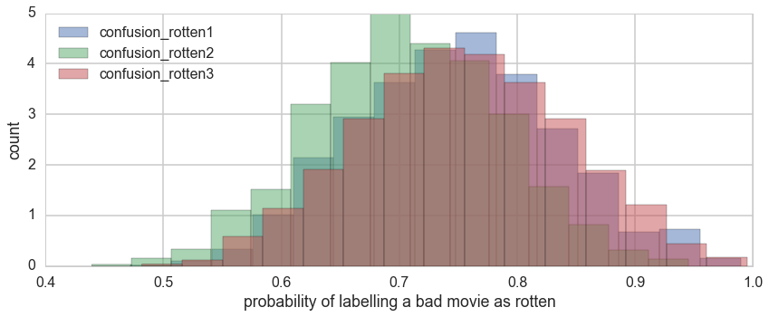
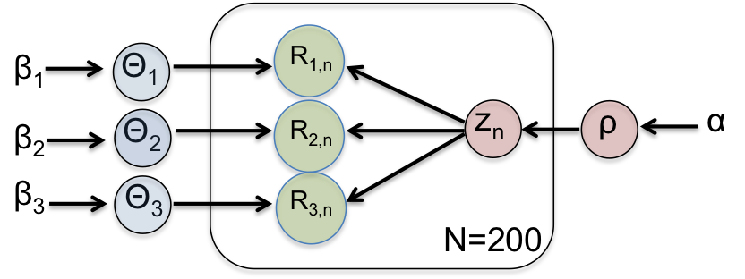
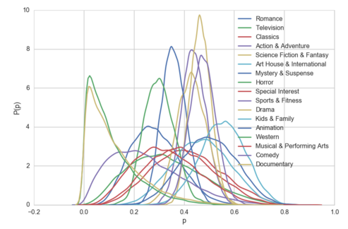
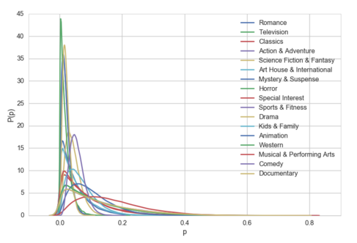
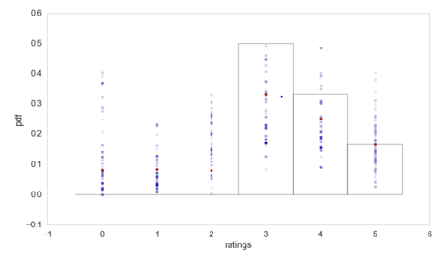
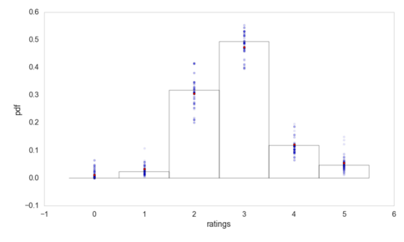

Bayesian Movie Analysis
Thomas Seah, Joshua Mei, Yipei Guo
zhiqianseah@g.harvard.edu, joshuamei@g.harvard.edu, yipeiguo@g.harvard.edu
AM 207 Stochastic Methods for Data Analysis, Inference and Optimization
Spring 2016
Introduction
Abstract: In this project, we answer interesting questions such as whether Dreamworks or Pixar is more well-liked by reviewers, how accurate critic ratings are, whether time series sales can be modeled by an autoregressive model, and explored how a movie recommendation system for individual users can be implemented. Using a Bayesian framework and sampling methods taught in the course, we discovered that Dreamworks is slightly more popular than Pixar, that we can trust critics when they say that a movie is good but they are not so reliable when they rate a movie as rotten, and that movie sales on one day seems to be independent from that on previous days.
Our project seeks to analyze movies in different ways using the tools from AM 207.
The first analysis tries to answer the question: Is Dreamworks or Pixar better? Both are famous animation studios with classic hits. Yet, they have also produced flops over the years. By using Bayesian hierarchical modeling and user ratings of the 10 most recent movies from each studio, we hope to settle this debate.
The second analysis tackles the problem of critic reviews. Critics shape our perception of movies before we watch them. Yet, critics are also human and may be wrong. By using a Bayesian model to analyze the reviews of 3 top critics, we hope to infer how good they are at identifying the quality of a movie.
The third analysis attempts to rank a user’s preference for genres of movies, which is often useful for movie recommendation systems. We aim to make this prediction using a single user’s rating distributions for 17 different genres.
Lastly, we also did some time series analysis on movie sales data.
blah blah blah
Data
Our data is scraped from movie review websites such as Rotten Tomatoes and IMDB. We collate the user and critic reviews for selected movies and genres. We also collected movie sales data from boxofficemojo.com.
Fig 6. Time series of movie sales after correcting for exponential decrease, and seasonality due to different days of a week [1]
Results
Fig 7. Autocorrelation (left) and partial autocorrelation (right) of the corresponding time series
Conclusions
Approach
Dreamworks is marginally “better” than Pixar in terms of reception to their most recent movies.
Critics would correctly rate good movies as fresh with probability of 0.9 and they would rate a bad movie as rotten with a probability of 0.75. Furthermore, the standard deviation of the latter is larger. Hence, critics are more often wrong or have differing opinions of bad movies.
Using a Bayesian approach, we can predict one’s movie preferences based on the individual’s past ratings of movies from different genres. This probabilistic method has the advantage of taking into account different number of movies voted in different categories.
Movie sales can be represented as a time series, but the daily sales of movie seems to be independent from that of previous days.
blah blah blah
Fig 2. Distribution of ratings for Dreamworks and Pixar
For Dreamworks vs Pixar, we used partial pooling. Each of the 10 most recent movies is an observation of how good the animation studio is. Similarly, each of the 4 movie review websites is an observation of how good a movie is.
To determine how well critics rate good movies as fresh and bad movies as rotten, we computed confusion matrices for 3 critics as a measure of how accurate their ratings are.
Fig 3. Distribution of diagonal entries in confusion matrices
Fig 1. Dependency graph for Bayesian model. Θ are the confusion matrices, R are the critic ratings, z is the quality of the movie (fresh/rotten).
Citations and Links
To rank a user’s preference for different movie genres, we modeled the distribution of discrete ratings using a Multinomial likelihood function, which together with the conjugate Dirichlet prior, allow us to obtain the posterior distributions for the probabilities of giving each rating (p₀ to p₅). The samples from the posterior are then used to construct the posterior predictive which we used to calculate the average rating for each genre.
Fig 4. Posterior distribution for p₃ (left), the probability of rating a movie 3, and p₅ (right), the probability of rating a movie 5, for different genres
[1] Mining Online Reviews for Predicting Sales Performance: A Case Study in the Movie Domain,
Xiaohui Yu et al.
Fig 5. Posterior predictive for musical and performing arts (left) and comedy (right) genres with 6 and 85 total votes respectively.
School of Engineering and Applied Sciences • Institute for Applied Computational Science

