Slide 1
SSL certificates
TIBCO BusinessWorks

Slide 2
Generating the key

Slide 3
Keytool
You will have to create a certificate as you own the server.
The ‘Keytool’ is a utility provided in the Java 2 SDK which is used to create a certificate.
It should be run as a command line utility.
Available in the bin folder of J2SDK.

Slide 4
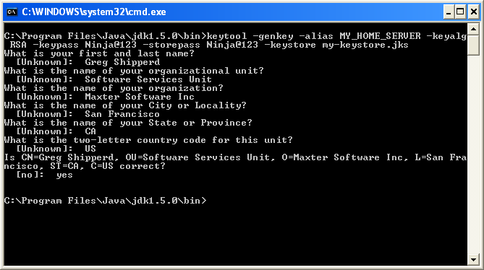
Keytool -genkey
The my-keystore.jks file will be created at the current location

Slide 5
Keytool
-alias is used to give a name to your key. It should be unique for its purpose. Here it is MY_HOME_SERVER.
-keyalg is encryption algorithm type. Here it is RSA.
-keypass is the password affiliated to key. Here it is Ninja@123
-storepass is the password affiliated to the repository. Here it is Ninja@123
my-keystore.jks is name of the file which acts as repository keys.

Slide 6
Keytool
When we fill all the CN, OU, O, L, ST & C details, the key called MY_HOME_SERVER will be stored in the repository my-keystore.jks
This entry in the my-keystore.jks would have the public key as well as the private key.
You would now require to publish the public key to the world.

Slide 7
Keytool
To publish the public key to the external world, we need to extract it from the entry we created in the my-keystore.jks repository
We can use the export option in the keytool command to achieve the desired result.

Slide 8
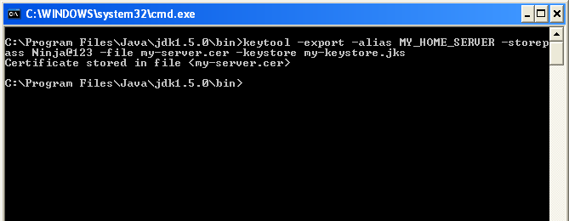
Keytool -export
The public key also known as the certificate will be stored in the file named my-server.cer
You can give this certificate to anyone who wants to connect to your server

Slide 9
Installing Key
Server Side

Slide 10
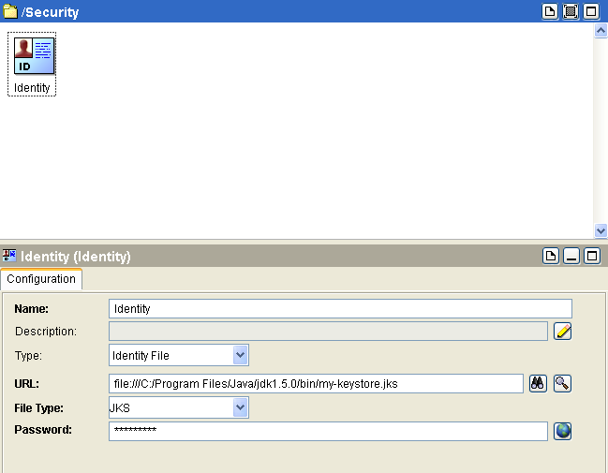
Server Identity
Create identity from the ‘GENERAL’ pallete
Make sure the URL consists of 3 forward slashes, otherwise it will not work as desired
Identity file
Keystore Location
JKS

Slide 11
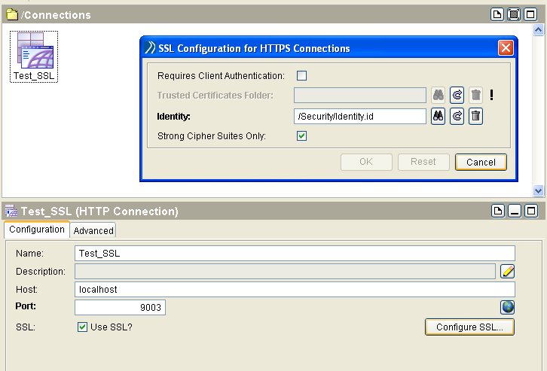
HTTPS

Slide 12
Import & Install Certificate
Client Side

Slide 13
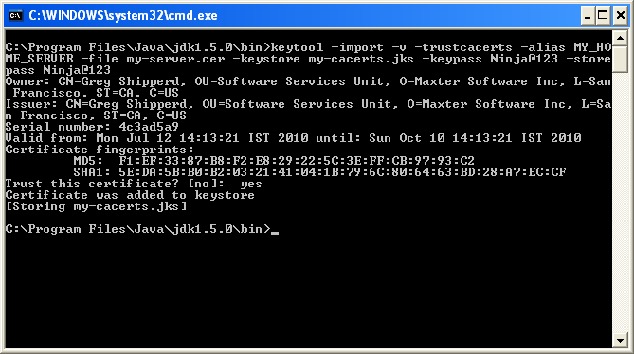
Keytool -import
Get the my-server.cer from the server authority which is publicly available and paste it into the desired folder

Slide 14
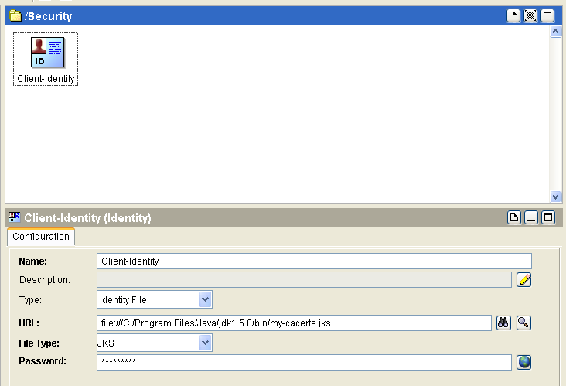
Client Identity

Slide 15
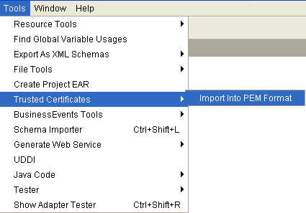
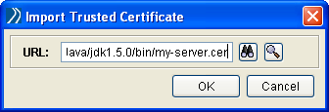
Import Certificate in BW

Slide 16
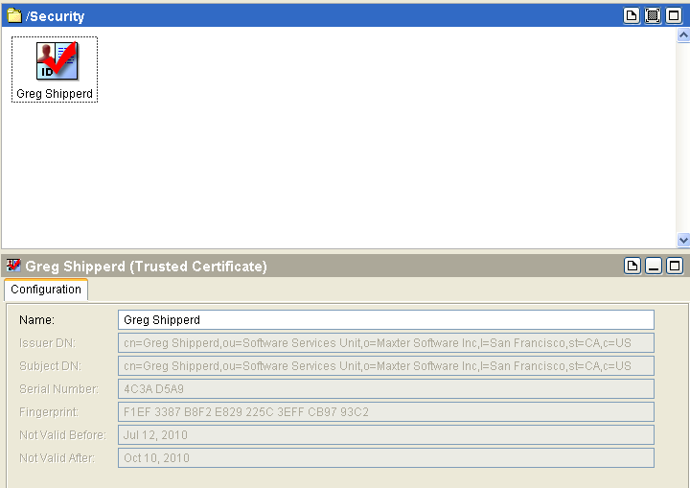
Imported Certificate

Slide 17
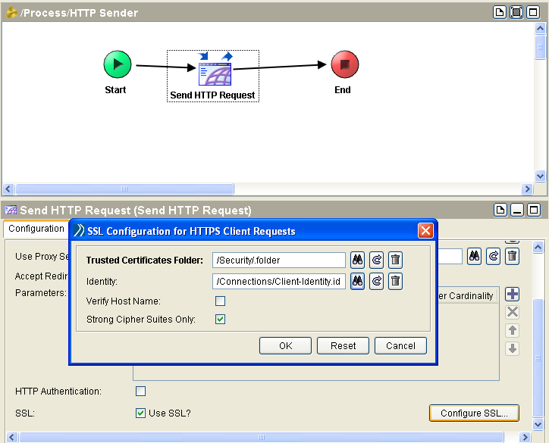
Configuring HTTP request

Slide 18

Q & A

