Slide 1

Problem Solving and Computing
Lesson 6
Processing
Notes:
Lesson Plan: https://studio.code.org/s/csd1-2022/lessons/6

Slide 2


Slide 3

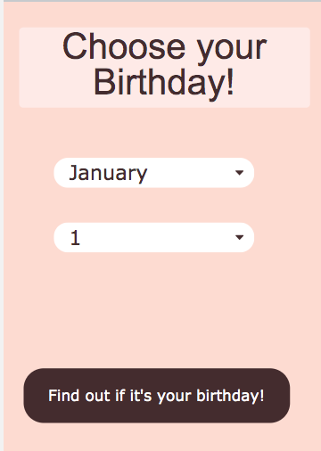
Problem Solving and Computing Lesson 6 - Warm Up
Prompt:
Go on Code Studio to try out the birthday app.
It has three possible outputs. Try to find each one.
What is the input to the app?
What is the output?
How do you think the app decides which output to give to the user?

Slide 4
Problem Solving and Computing Lesson 6 - Warm Up
Key Vocabulary:
Processing - the thinking work computers do to turn input into output

Slide 5
Problem Solving and Computing Lesson 6 - Warm Up
Question of the Day
What are the different ways computers can process information?

Slide 6


Slide 7

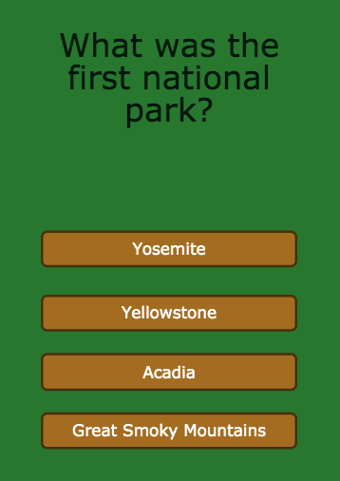
Problem Solving and Computing Lesson 6 - Activity
National Park Quiz
Try out this quiz about America's national parks.
How does this app use comparing and if/then to turn the input into output?

Slide 8
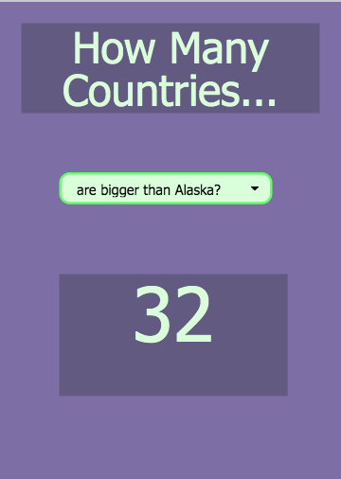
Problem Solving and Computing Lesson 6 - Activity
How Many Countries...
This app tells you some fun facts different countries.
What new kinds of processing
might it use to turn input to output?

Slide 9
Problem Solving and Computing Lesson 6 - Activity
Four Kinds of Processing
If/Then - If something is true, do something else.
Comparing - Check whether things are the same, or one is bigger than the other.
Finding a Match - Search a list or group of things for a match.
Counting - Keep track of how many of something there are.

Slide 10
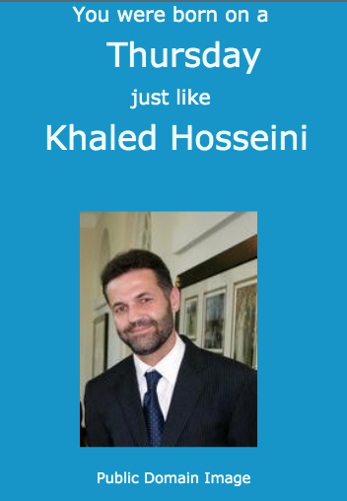
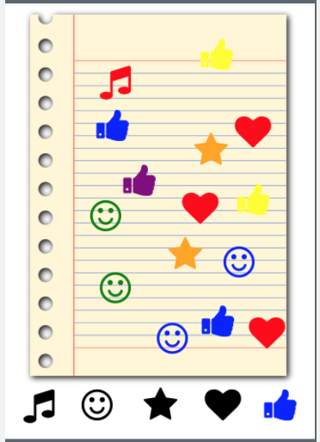
Problem Solving and Computing Lesson 6 - Activity
App and Processing
For each app, choose one type of processing it uses and explain how it is used.

Slide 11
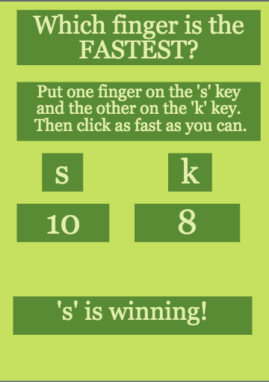
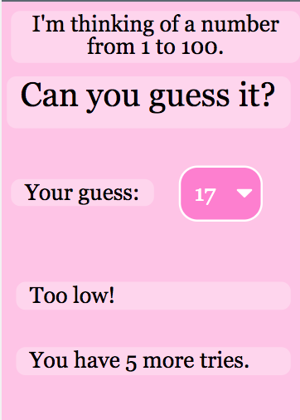
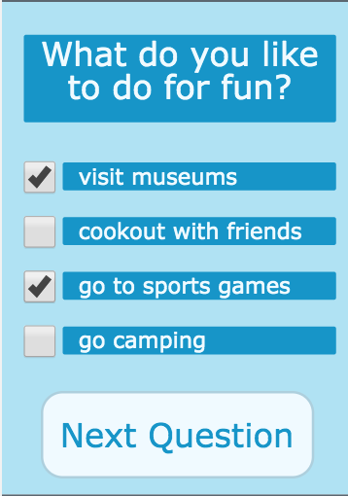
Problem Solving and Computing Lesson 6 - Activity
More Processing
For each app, choose two types of processing it uses and explain how they are used.

Slide 12
Problem Solving and Computing Lesson 6 - Activity
Your App Idea
With your partner, think of a new app idea.
What inputs does it need?
What outputs?
What types of processing does it use to change the input to output?
?

Slide 13


Slide 14

Problem Solving and Computing Lesson 6 - Wrap Up
Prompt:
We saw four different types of processing today, but there are many more
What’s another type of processing that you think would be useful?
What kind of app might use it?

Slide 15
Problem Solving and Computing Lesson 6 - Wrap Up
Key Vocabulary:
Processing - the thinking work computers do to turn input into output

Slide 16
Problem Solving and Computing Lesson 6 - Wrap Up
Question of the Day
What are the different ways computers can process information?

