Slide 1

Problem Solving and Computing
Lesson 2
The Problem Solving Process
Notes:
Lesson Plan: https://studio.code.org/s/csd1-2023/lessons/2

Slide 2
Teacher Resources
For Teachers!
Lesson Overview
This lesson introduces the formal problem-solving process that students will use over the course of the year, Define - Prepare - Try - Reflect. The lesson begins by anchoring the formal problem-solving process in some real-life experiences they already have solving problems by asking students to brainstorm all the different types of problems that they encounter in everyday life. Students are then shown the four steps of the problem-solving process and work together to relate these abstract steps to their actual experiences solving problems. First students relate these steps to the problem activities from the previous lesson, then a problem they are good at solving, then a problem they want to improve at solving. At the end of the lesson, the class collects a list of generally useful strategies for each step of the process to put on posters that will be used throughout the unit and year.
More guidance and resources for this lesson are available in the Lesson Plan:
https://studio.code.org/s/csd1-2023/lessons/2

Slide 3


Slide 4

Problem Solving and Computing Lesson 2 - Warm Up
Journal Prompt:
We use the term "problem" to refer to lots of different situations.
Brainstorm as many different kinds of problems as you can and be ready to share with the class.

Slide 5
Problem Solving and Computing Lesson 2 - Warm Up
Question of the Day
What are some common steps we can use to solve many different types of problems?

Slide 6
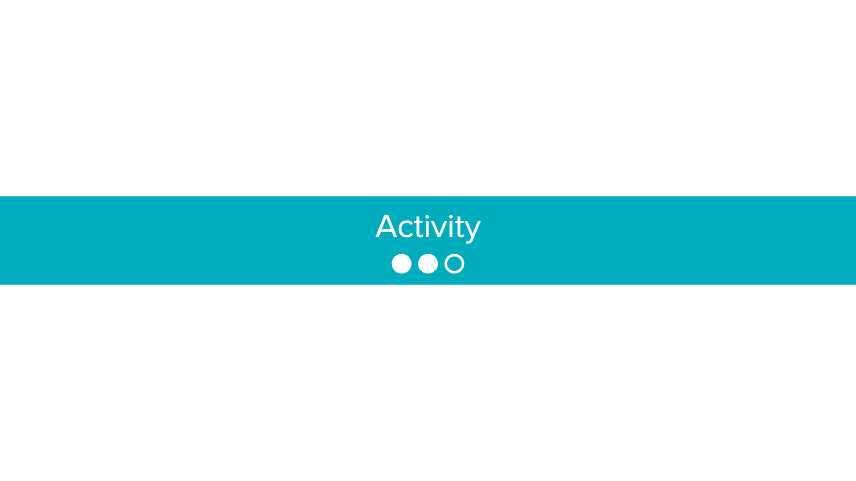

Slide 7


Problem Solving and Computing Lesson 2 - Activity
How did you follow the problem solving process in the last lesson?
How could you use this process on a problem in your everyday life?

Slide 8
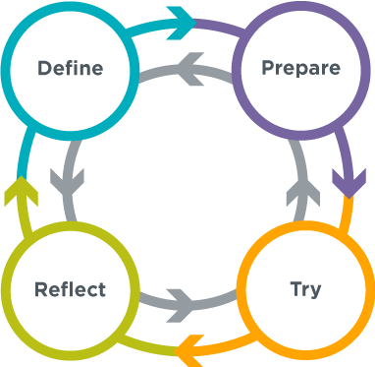
Problem Solving Process
Problem Solving and Computing Lesson 2 - Activity
Define
What problem are you trying to solve?
What are your constraints?
What does success look like?
Prepare
Brainstorm / research possible solutions
Compare pros and cons
Make a plan
Try
Put your plan into action
Reflect
How do your results compare to the goals you set while defining the problem?
What can you learn from this or do better next time?
What new problems have you discovered?

Slide 9
Building Challenge
Problem Solving and Computing Lesson 2 - Activity
Think about the building challenge you did last class
Which parts of that activity were part of the following steps?
Define
Prepare
Try
Reflect
What strategies did you use in solving this problem that could help you solve other problems?
Share with your neighbor once you're done

Slide 10
What are you good at?
Problem Solving and Computing Lesson 2 - Activity
Think about a type of problem you are good at solving
Write down which parts of your process fit into these steps
Define
Prepare
Try
Reflect
What strategies did you use in solving this problem that could help you solve other problems?
Share with your neighbor once you're done

Slide 11
What do you and your partner want to get better at?
Problem Solving and Computing Lesson 2 - Activity
Get in pairs with your neighbor
Think about a type of problem both you and your partner want to get better at solving
Write down strategies or steps you would take to solve this problem using the problem solving process
Define
Prepare
Try
Reflect
Share with your neighbor once you're done

Slide 12


Slide 13

Problem Solving and Computing Lesson 2 - Wrap Up
Journal Prompt:
You saw a lot of different types of problems today, but they all used our Problem Solving Process.
For each step of the process, think of one general tip that could be useful no matter what problem someone is trying to solve.

Slide 14
Problem Solving and Computing Lesson 2 - Wrap Up
Question of the Day
What are some common steps we can use to solve many different types of problems?

