Slide 1

Problem Solving and Computing
Lesson 3
Exploring Problem Solving
Notes:
Lesson Plan: https://studio.code.org/s/csd1-2023/lessons/3

Slide 2
Teacher Resources
For Teachers!
Lesson Overview
In this lesson, students apply the problem-solving process to three different problems in order to better understand the value of each step. They will solve a word search, arrange seating for a birthday party, and redesign a classroom. The problems grow increasingly complex and poorly defined to highlight how the problem-solving process is particularly helpful when tackling these types of problems. The lesson concludes with students reflecting on their experience with the problem-solving process. They will justify the inclusion of each step and will brainstorm questions or strategies that can help them better define open-ended problems, as this is often the most critical step.
This lesson will likely take two class periods or more to complete. The first two problems may fit into a single class period but the third will need to be moved to a second day.
More guidance and resources for this lesson are available in the Lesson Plan:
https://studio.code.org/s/csd1-2023/lessons/3

Slide 3


Slide 4

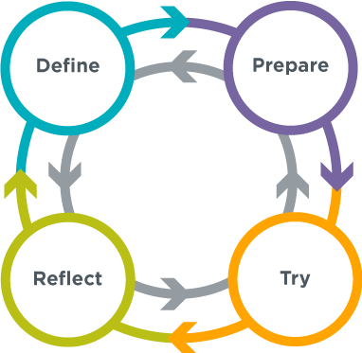
Problem Solving and Computing Lesson 3 - Warm Up
Journal Prompt:
Think of the silliest problem the problem solving process could help with.
Be prepared to say how each step of the process could apply.

Slide 5
Problem Solving and Computing Lesson 3 - Warm Up
Question of the Day
How can we apply the problem solving process to many different kinds of problems?

Slide 6
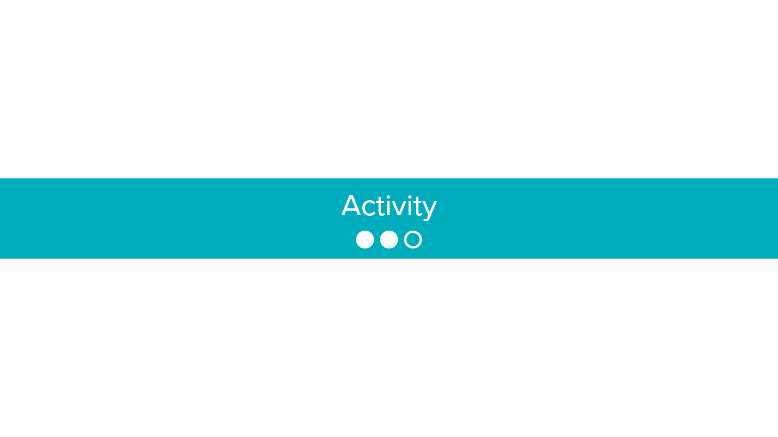

Slide 7

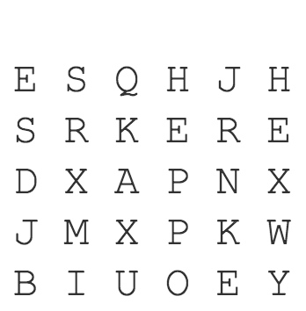
Word Search
Problem Solving and Computing Lesson 3 - Activity
Get into groups of 2-4 to do the word search
Try to use the steps of the problem solving process:
Define
Prepare
Try
Reflect

Slide 8
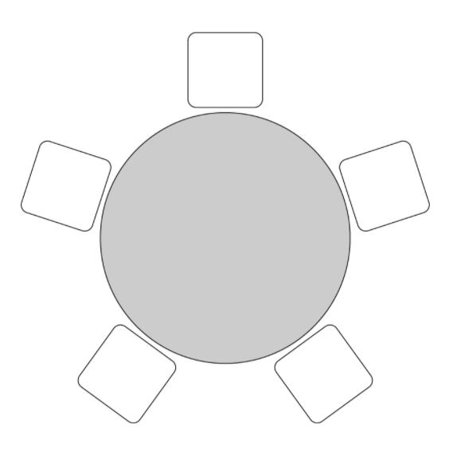
Birthday Guests
Problem Solving and Computing Lesson 3 - Activity
In your groups, read the Birthday Guests problem
Before starting the problem, try thinking about how to use the steps of the problem solving process
Define
Prepare
Try
Reflect

Slide 9
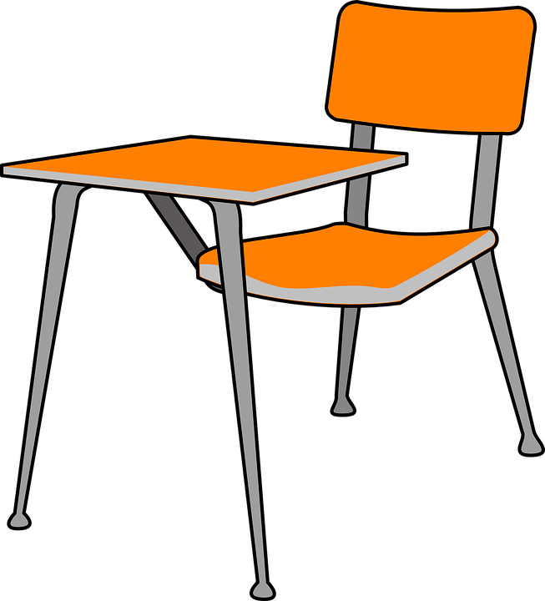
Redesign Your Classroom
Problem Solving and Computing Lesson 3 - Activity
In groups, start by choosing goals
What will your classroom plan do well?
Write down your goals.
Think about how to use the problem solving process while designing your classroom
Define
Prepare
Try
Reflect
Once you have an initial plan, share with another group
Adjust your design based on the feedback you receive

Slide 10
Reflect
Problem Solving and Computing Lesson 3 - Activity
Reflect on how you used the steps of the problem solving process for each problem
Problem Solving Process
Define
Prepare
Try
Reflect

Slide 11
Problem Solving and Computing Lesson 3 - Activity
Understanding the Problem Solving Process
For each step in the problem solving process...
What is its purpose?
Why is it included?
Are there any kinds of problems that the problem solving process is particularly helpful at solving?

Slide 12


Slide 13

Problem Solving and Computing Lesson 3 - Wrap Up
Prompt:
We saw today that without a well-defined problem the rest of the problem solving process is difficult to follow.
What are some questions or strategies we can use to help us better understand and define problems before we try to solve them?

Slide 14
Problem Solving and Computing Lesson 3 - Wrap Up
Question of the Day
How can we apply the problem solving process to many different kinds of problems?

