Slide 1

Problem Solving and Computing
Lesson 4
What is a Computer?
Notes:
Lesson Plan: https://studio.code.org/s/csd1-2023/lessons/4

Slide 2
Teacher Resources
For Teachers!
Lesson Overview
This lesson builds on the problem-solving theme of the earlier lessons and focuses on the specifics of how computing is used in problem-solving, starting with developing a preliminary definition of a computer. To begin the lesson, the class will brainstorm possible definitions for a computer and place the results of this brainstorm on the board. Next, students will work in groups to sort pictures into “is a computer” or “is not a computer” on poster paper. Groups will place their posters around the room and briefly explain their motivations for choosing some of their most difficult categorizations. The teacher will then introduce a definition of the computer and allow students to revise their posters according to the new definition.
More guidance and resources for this lesson are available in the Lesson Plan:
https://studio.code.org/s/csd1-2023/lessons/4

Slide 3


Slide 4

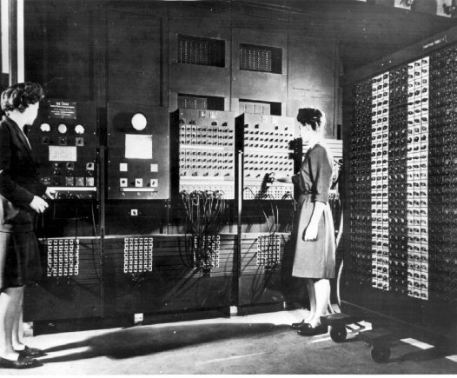
Problem Solving and Computing Lesson 4 - Warm Up
Journal 3-2-1:
This picture shows one of the world's first computers, and two of the world's first computer programmers.
What are 3 ways this computer is different from computers that we use today?
What are 2 ways that it is the same?
What is 1 thing you think is true of ALL computers?

Slide 5
Problem Solving and Computing Lesson 4 - Warm Up
Question of the Day
What is a computer?

Slide 6


Slide 7

Problem Solving and Computing Lesson 4 - Activity
What is a Computer?
Draw a line down the middle of your poster, label one side "Computer" and the other "Not a Computer".
Discuss as a group which of the objects in your set (from the activity guide) belong in each category.
Once your group is in agreement. tape your objects to the appropriate side.
Develop a list of characteristics your groups used to determine whether an object is a computer.

Slide 8
Problem Solving and Computing Lesson 4 - Activity
What is a Computer?
What rules or definition did you use to categorize your objects?
Which item was most difficult for you to categorize? How did you eventually make the decision of where to place it?

Slide 9
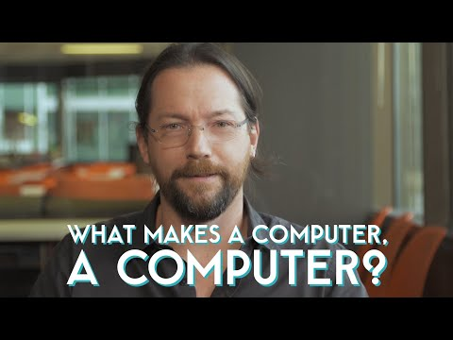
Problem Solving and Computing Lesson 4 - Activity
What made computers different from machines that came before them?

Slide 10
Problem Solving and Computing Lesson 4 - Activity
Key Vocabulary
Computer - A machine that works with information

Slide 11
Problem Solving and Computing Lesson 4 - Activity
What is a Computer? Rethink!
Revise your posters using your new knowledge.
Think about...
What types of problems is this device used to solve?
Does the device use information to solve problems?
Where does it get the information?
How does it use the information to solve problems?

Slide 12
Problem Solving and Computing Lesson 4 - Activity
What is a Computer?
Did your group change your mind about whether something was a computer?
What about the definition convinced you?

Slide 13


Slide 14

Problem Solving and Computing Lesson 4 - Wrap Up
Prompt:
Think of a problem that a computer can help you to solve.
What is the information problem?
What information does the computer need to solve that problem?
What type of thinking work does the computer need to do to solve the problem?

Slide 15
Problem Solving and Computing Lesson 4 - Wrap Up
Key Vocabulary
Computer - a machine that works with information

Slide 16
Problem Solving and Computing Lesson 4 - Wrap Up
Question of the Day
What is a computer?

