Slide 1

Problem Solving and Computing
Lesson 6
Processing
Notes:
Lesson Plan: https://studio.code.org/s/csd1-2023/lessons/6

Slide 2
Teacher Resources
For Teachers!
Lesson Overview
This lesson introduces the concept of processing within computational problem-solving. While this lesson focuses on four common types of processing - if/then (conditionals), finding a match (searching), counting, and comparing - students should understand that processing is whatever a computer does to turn inputs into outputs. Students are first introduced to the types of processing through several sample apps. They then investigate more apps to determine what sorts of processing each uses. They then think of their own app and decide what types of processing it would need to work. Finally, they brainstorm other types of processing that may be useful but were not included in the main lesson.
More guidance and resources for this lesson are available in the Lesson Plan:
https://studio.code.org/s/csd1-2023/lessons/6

Slide 3


Slide 4

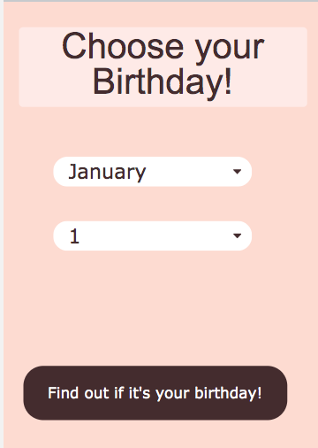
Problem Solving and Computing Lesson 6 - Warm Up
Prompt:
Go on Code Studio to try out the birthday app.
It has three possible outputs. Try to find each one.
What is the input to the app?
What is the output?
How do you think the app decides which output to give to the user?

Slide 5
Problem Solving and Computing Lesson 6 - Warm Up
Key Vocabulary:
Processing - the thinking work computers do to turn input into output

Slide 6
Problem Solving and Computing Lesson 6 - Warm Up
Question of the Day
What are the different ways computers can process information?

Slide 7


Slide 8

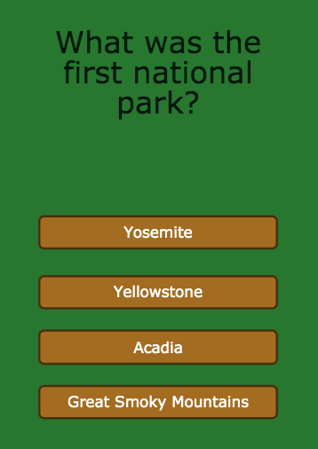
Problem Solving and Computing Lesson 6 - Activity
National Park Quiz
Try out this quiz about America's national parks.
How does this app use comparing and if/then to turn the input into output?

Slide 9
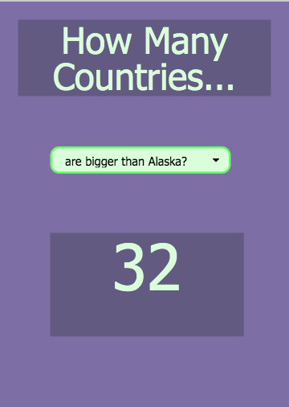
Problem Solving and Computing Lesson 6 - Activity
How Many Countries...
This app tells you some fun facts different countries.
What new kinds of processing
might it use to turn input to output?

Slide 10
Problem Solving and Computing Lesson 6 - Activity
Four Kinds of Processing
If/Then - If something is true, do something else.
Comparing - Check whether things are the same, or one is bigger than the other.
Finding a Match - Search a list or group of things for a match.
Counting - Keep track of how many of something there are.

Slide 11
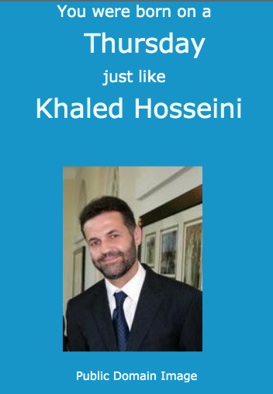
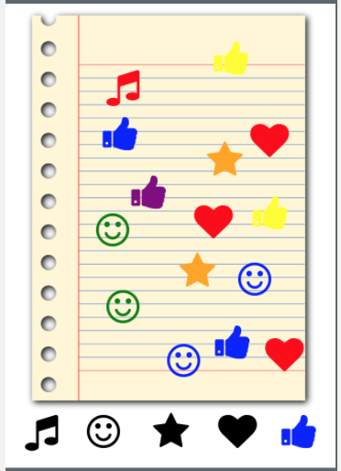
Problem Solving and Computing Lesson 6 - Activity
App and Processing
For each app, choose one type of processing it uses and explain how it is used.

Slide 12
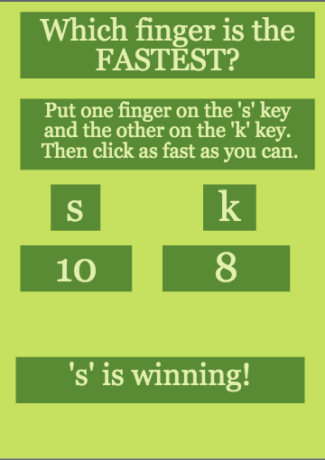
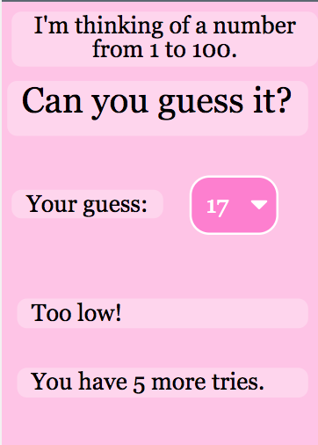
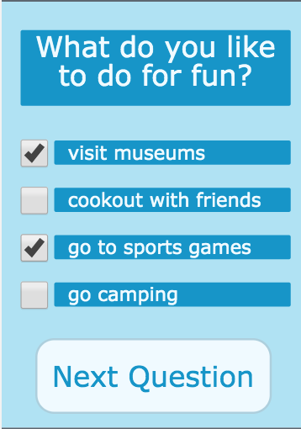
Problem Solving and Computing Lesson 6 - Activity
More Processing
For each app, choose two types of processing it uses and explain how they are used.

Slide 13
Problem Solving and Computing Lesson 6 - Activity
Your App Idea
With your partner, think of a new app idea.
What inputs does it need?
What outputs?
What types of processing does it use to change the input to output?
?

Slide 14


Slide 15

Problem Solving and Computing Lesson 6 - Wrap Up
Prompt:
We saw four different types of processing today, but there are many more
What’s another type of processing that you think would be useful?
What kind of app might use it?

Slide 16
Problem Solving and Computing Lesson 6 - Wrap Up
Key Vocabulary:
Processing - the thinking work computers do to turn input into output

Slide 17
Problem Solving and Computing Lesson 6 - Wrap Up
Question of the Day
What are the different ways computers can process information?

