Slide 1

Problem Solving and Computing
Lesson 1
Intro to Problem Solving
(Aluminum Boats)
Notes:
Lesson Plan: https://studio.code.org/s/csd1-2023/lessons/1

Slide 2
Teacher Resources
For Teachers!
Lesson Overview
This lesson is a fun introduction to the open-ended, collaborative, and creative problem-solving students will be using over the rest of this unit and course. Students work in groups to design aluminum foil boats that will support as many pennies as possible. Groups have two rounds to work on their boats, with the goal of trying to hold more pennies than they did in round 1. The structure of the activity foreshadows different steps of the problem-solving process that students will be introduced to in more detail in the following lesson. At the end of the lesson, students reflect on their experiences with the activity and make connections to the types of problem-solving they will be doing for the rest of the course
More guidance and resources for this lesson are available in the Lesson Plan:
https://studio.code.org/s/csd1-2023/lessons/1

Slide 3


Slide 4

Problem Solving and Computing Lesson 1 - Warm Up
Journal Prompt:
What makes someone a good problem solver? Be ready to share three ideas with your group.

Slide 5
Problem Solving and Computing Lesson 1 - Warm Up
Question of the Day
What can help us to work together and solve problems as a team?

Slide 6
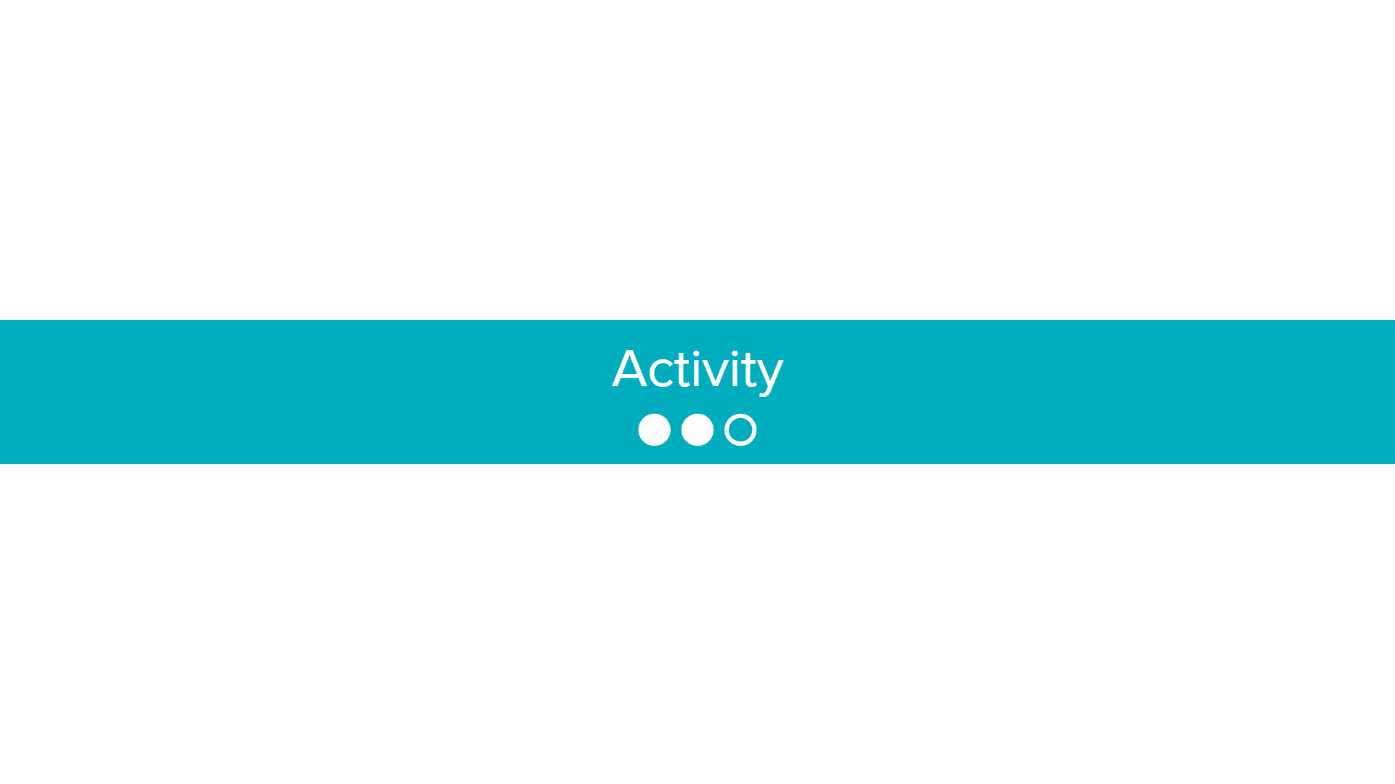

Slide 7


Aluminum Boats
Problem Solving and Computing Lesson 1 - Activity
Goal
Build a boat that holds the most possible pennies, using a piece of aluminum foil.
You will build two boats and will try to improve your design between the first and the second.
Rules
You may only use a single piece of foil to build your boat
You may not touch or adjust your boat once it is in the water
You must add pennies one at a time

Slide 8
Develop a Plan
Problem Solving and Computing Lesson 1 - Activity
Answer these questions on your activity guide
What kind of boat does your group plan to make?
What are the strengths of this design?
What possible weaknesses might this design have?
Once your group is ready, come get your aluminum foil

Slide 9
Test Your Boat
Problem Solving and Computing Lesson 1 - Activity
Work together in your group to build your boat
Once you're ready, test your boat in the water.
You may not touch or adjust your boat once it is in the water
You must add pennies one at a time
Answer the following questions on your activity guide
How many pennies did your boat hold?
Why did your boat eventually sink?
What needs to be improved?

Slide 10
Evaluate and Improve
Problem Solving and Computing Lesson 1 - Activity
Share with other groups the results of your first boat.
What are the most common kinds of problems you see among the boats tested?
What ideas seem to be working well?

Slide 11
Develop a New Plan
Problem Solving and Computing Lesson 1 - Activity
Answer these questions on your activity guide
What kind of boat does your group plan to make?
What are the strengths of this design?
What possible weaknesses might this design have?
Once your group is ready, come get your aluminum foil

Slide 12
Test Your Boat
Problem Solving and Computing Lesson 1 - Activity
Work together in your group to build your boat
Once you're ready, test your boat in the water.
You may not touch or adjust your boat once it is in the water
You must add pennies one at a time
Answer the following questions on your activity guide
How many pennies did your new boat hold?
Why did your boat eventually sink?
What needs to be improved?

Slide 13


Slide 14

Problem Solving and Computing Lesson 1 - Wrap Up
Journal Prompt:
You worked in teams for this activity.
How did working in a team make this activity easier?
How did it make the activity more challenging?
What helped your group overcome these challenges?

Slide 15
Problem Solving and Computing Lesson 1 - Wrap Up
Question of the Day
What can help us to work together and solve problems as a team?

