Slide 1

Problem Solving and Computing
Lesson 7
Storage
Notes:
Lesson Plan: https://studio.code.org/s/csd1-2023/lessons/7

Slide 2
Teacher Resources
For Teachers!
Lesson Overview
This lesson introduces the final component of the unit's model of computing: storage. After trying out an "outfit picker" app, students discuss what information should be stored in the app versus input every time the app is run. They then look at a series of apps and use their decisions about what should be stored to create guidelines for deciding what information to store. They then review the four components of this chapter's model of computing: input, output, storage, and processing. Afterward, they have one last opportunity to revise their decisions about which items should be classified as a "computer" from earlier in the chapter. The lesson ends with a reflection on their own app ideas and how storage could be used.
More guidance and resources for this lesson are available in the Lesson Plan:
https://studio.code.org/s/csd1-2023/lessons/7

Slide 3


Slide 4

Problem Solving and Computing Lesson 7 - Warm Up
Journal Prompt:
Go on Code Studio to look at the outfit picker app.
What is one input, one output, and one kind of processing it might use?
If you used this app every day, what information would you want it to remember?

Slide 5
Problem Solving and Computing Lesson 7 - Warm Up
Key Vocabulary
Storage - saving information to use in the future

Slide 6
Problem Solving and Computing Lesson 7 - Warm Up
Question of the Day
Why is storage an important part of the computing process?

Slide 7
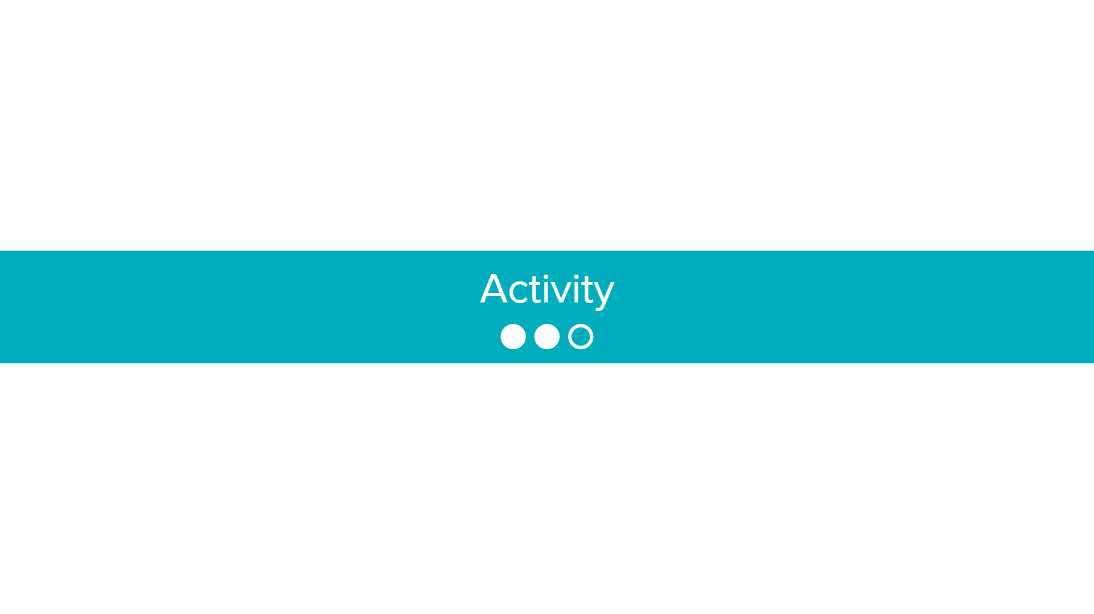

Slide 8

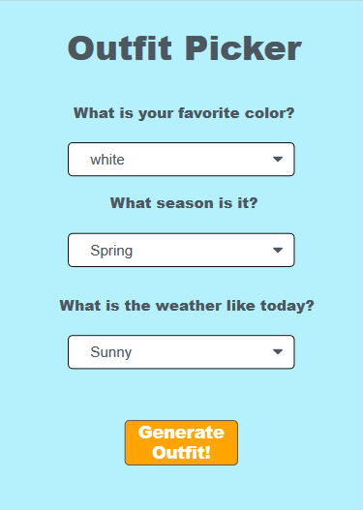
Storage: Outfit Picker
Problem Solving and Computing Lesson 7 - Activity
Get into groups of 2-3 and go to Code studio.
Based on the outfit picker app in Code studio, answer the following questions:
Should the following information be stored?
Why or why not?
Favorite color
Season
Weather

Slide 9
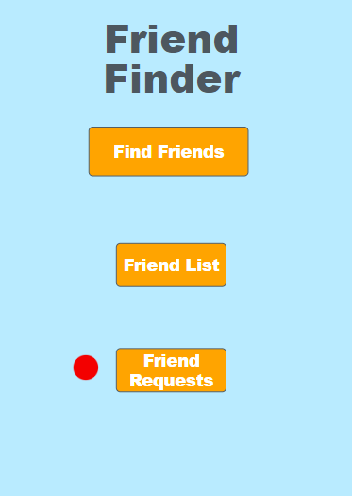
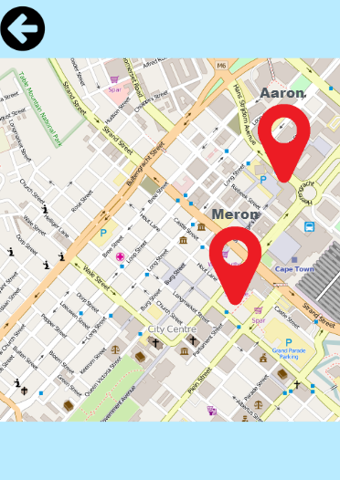
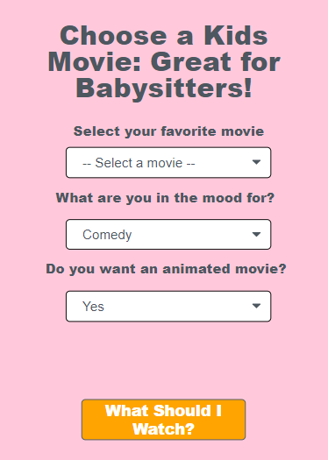
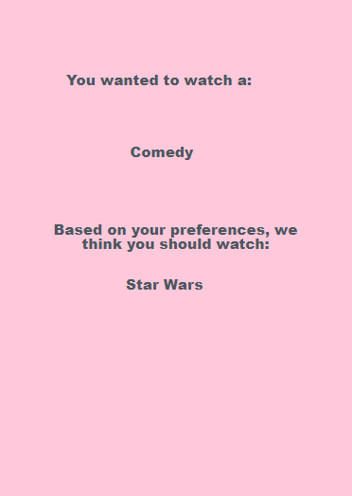
Friend Finder and Movie Picker
Problem Solving and Computing Lesson 7 - Activity
In your groups, try out these two apps.
On your activity guide, explain which information should and should not be stored and why.

Slide 10
Guidelines for Storage
Problem Solving and Computing Lesson 7 - Activity
In your groups, brainstorm at least two guidelines about what types of information should and should not be stored.
“If the information ______________, then that information (should / should not) be stored because _____________. For example, ____________ (should / should not) be stored.”

Slide 11
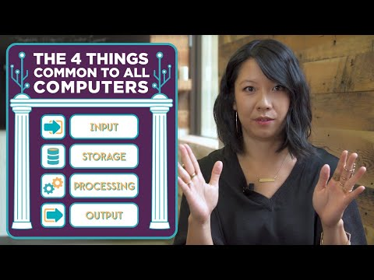
Problem Solving and Computing Lesson 7 - Activity
Think of something you do on the computer. What sort of input, output, storage, and processing are happening?

Slide 12
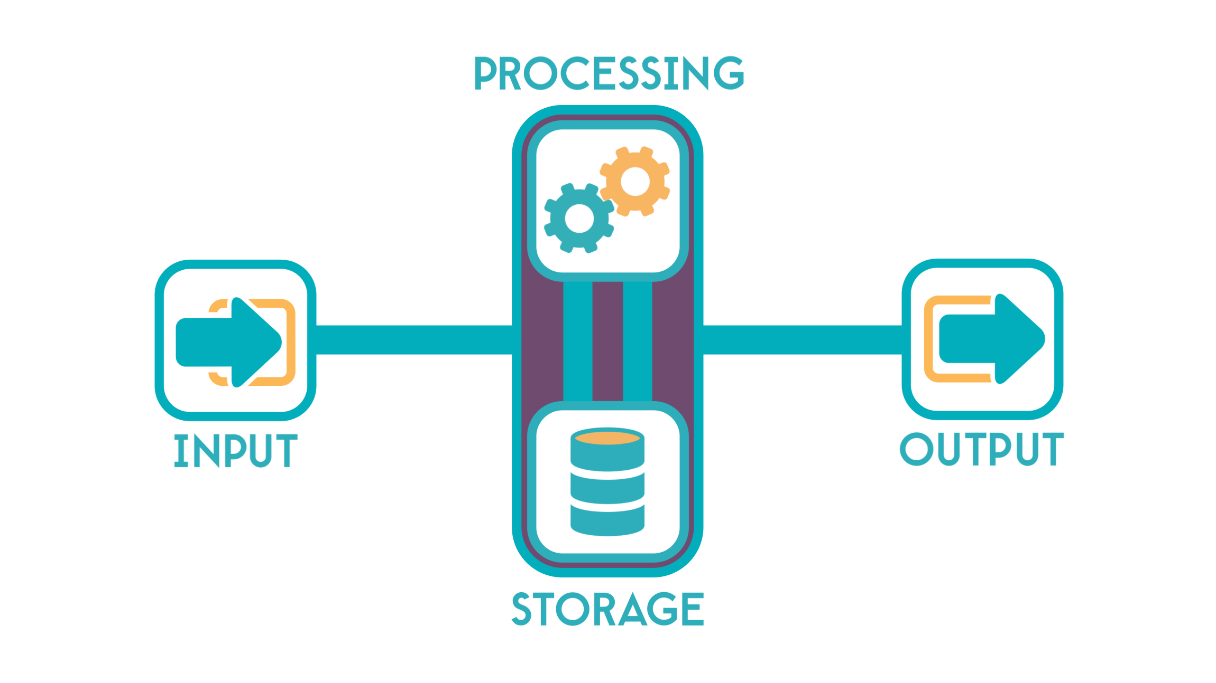
Problem Solving and Computing Lesson 7 - Activity
Input-Output-Storage-Processing Model
What kinds of input, output, storage, and processing are used in a modern smartphone?

Slide 13


Slide 14

Problem Solving and Computing Lesson 7 - Wrap Up
Prompt:
Think of an app you would like to make.
What information would it store?

Slide 15
Problem Solving and Computing Lesson 7 - Wrap Up
Key Vocabulary
Storage - saving information to use in the future

Slide 16
Problem Solving and Computing Lesson 7 - Wrap Up
Question of the Day
Why is storage an important part of the computing process?

