Slide 1

Problem Solving and Computing
Lesson 8
Project: Propose an App
Notes:
Lesson Plan: https://studio.code.org/s/csd1-2023/lessons/8

Slide 2
Teacher Resources
For Teachers!
Lesson Overview
To conclude this unit, this project combines the two major themes of Unit 1, the problem-solving process and the input/output/store/process model of a computer, to have students identify real-world problems and find ways to use technology to help solve them. This project will be completed across multiple days and will result in students creating a poster of a proposed app they design to solve a real-world problem, highlighting the features of their app that they will present to their classmates. A project guide provides step-by-step instructions for students and helps them organize their thoughts. The project is designed to be completed in pairs though it can be completed individually.
More guidance and resources for this lesson are available in the Lesson Plan:
https://studio.code.org/s/csd1-2023/lessons/8

Slide 3


Slide 4

Problem Solving and Computing Lesson 8 - Warm Up
Prompt:
Of the apps we've seen in this unit, what was your favorite? What problem did it solve?

Slide 5
Problem Solving and Computing Lesson 8 - Warm Up
Question of the Day
How can the IOSP model help us to design an app that solves a problem?

Slide 6


Slide 7

Problem Solving and Computing Lesson 8 - Activity
Project Overview
You will…
Work with a partner
Define a real world problem
Brainstorm ways an app could help solve that problem
Identify the inputs/outputs/storage/processing your app uses
Share your ideas with another group for peer feedback
Incorporate feedback to create a final version of the app
Create a poster of your app to share with the class

Slide 8
Problem Solving and Computing Lesson 8 - Activity
Brainstorm Problems
You might think about...
Things you’d like to improve in your school, neighborhood, or community
A task in your everyday life that you wish could be completed more easily
A cause that you feel strongly about
Something that is currently inconvenient or annoying to do

Slide 9
Problem Solving and Computing Lesson 8 - Activity
Choose Your Problem
Your problem should be...
Interesting: Both group members are interested in the problem
Well-Defined: You can explain who specifically the problem affects, what needs to change, and how you’ll be able to tell that the problem had been solved
Computing is Relevant: The problem is an “information problem” that can be solved with “thinking work.”

Slide 10
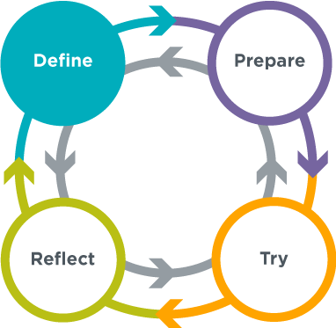
Problem Solving and Computing Lesson 8 - Activity
Define
What is the problem?
Who does the problem affect?
How will you be able to know that a solution has worked?

Slide 11
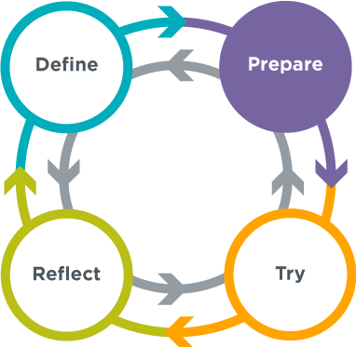
Problem Solving and Computing Lesson 8 - Activity
Prepare
What will your app do?
What will it look like?
What inputs and outputs will it use?
What processing will it use?
What types of information will it store?

Slide 12
Problem Solving and Computing Lesson 8 - Activity
Peer Review
Fill out the top part of the peer review guide, then swap project and peer review guides with another group.
Read over the other group’s ideas and give them feedback in the peer review guide.
Trade back and look at the feedback you got on your app.
Reflect on the feedback and decide what changes you will make based on the other group’s ideas.

Slide 13
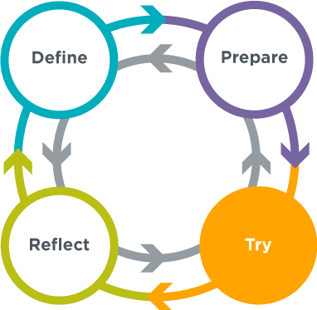
Problem Solving and Computing Lesson 8 - Activity
Try
Finalize your app .
Create a poster based on your app.
Get ready to present your ideas to the class.

Slide 14


Slide 15

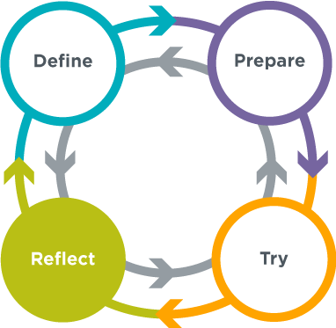
Problem Solving and Computing Lesson 8 - Wrap Up
Prompt:
What are you most proud of in your project?

Slide 16
Problem Solving and Computing Lesson 8 - Wrap Up
Question of the Day
How can the IOSP model help us to design an app that solves a problem?

