Slide 1

Problem Solving and Computing
Lesson 5
Input and Output
Notes:
Lesson Plan: https://studio.code.org/s/csd1-2023/lessons/5

Slide 2
Teacher Resources
For Teachers!
Lesson Overview
This lesson introduces focuses on two of the features identified in the previous lesson, input and output, that can help classify devices as a computer and has students identify different methods of input or output in common apps. In this lesson, students consider how computers get and give information to the user through inputs and outputs. Students first consider what information they would need to solve a "thinking problem", then use that information to produce a recommendation. They then identify the inputs and outputs of that process. Afterward, students consider an app that engages in the same process and determine how that app inputs and outputs information. Last, they consider other types of inputs and outputs that computers can use to help solve problems.
More guidance and resources for this lesson are available in the Lesson Plan:
https://studio.code.org/s/csd1-2023/lessons/5

Slide 3


Slide 4

Problem Solving and Computing Lesson 5 - Warm Up
Prompt:
Imagine that you are going to recommend a pet to someone
What are three questions you would ask them to help make that recommendation?

Slide 5
Problem Solving and Computing Lesson 5 - Warm Up
Prompt:
Take turns asking your questions and making a recommendation to your partner

Slide 6
Problem Solving and Computing Lesson 5 - Warm Up
Key Vocabulary:
Input - the information computers get from users, devices, or other computers
Output - the information computers give to users, devices, or other computers

Slide 7
Problem Solving and Computing Lesson 5 - Warm Up
Question of the Day
How do computers use input and output to get and give the information that they need to solve problems?

Slide 8


Slide 9

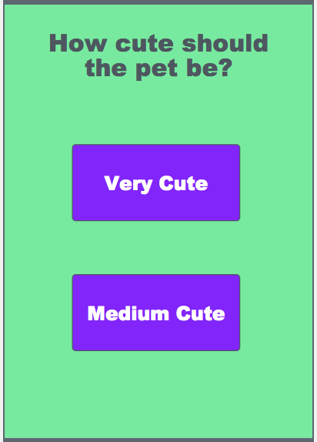
Problem Solving and Computing Lesson 5 - Activity
Pet Chooser App
Try playing this pet chooser app a few times.
What are the inputs?
What are the outputs?

Slide 10
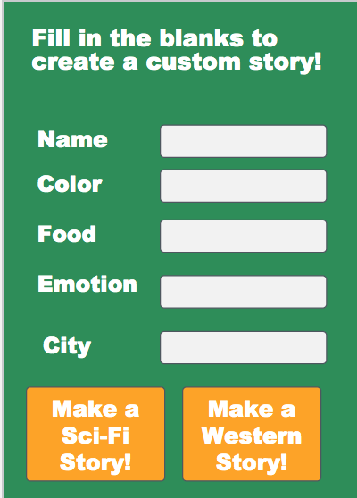
Problem Solving and Computing Lesson 5 - Activity
Story Creator App
Try out this app that writes a custom story for you.
What are its inputs?
What are its outputs?

Slide 11
Problem Solving and Computing Lesson 5 - Activity
Your App Idea
With your partner, think of a new app idea.
What does the app do?
What inputs and outputs does it need?
?

Slide 12
Problem Solving and Computing Lesson 5 - Activity
Other Sources of Input
So far, all of the input that we have seen comes directly from the user.
Is there any other way that apps can get the information that they need?

Slide 13
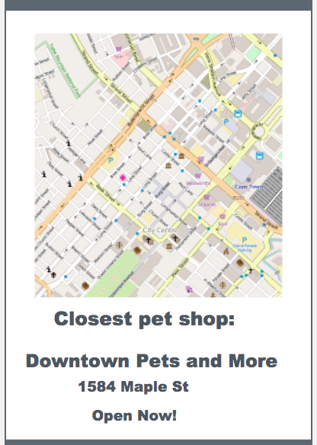
Problem Solving and Computing Lesson 5 - Activity
Improved Pet Chooser App
This new version of the pet chooser app also tells you where you can find a pet.
What are the new inputs?
What are the sources of the new inputs?

Slide 14


Slide 15

Problem Solving and Computing Lesson 5 - Wrap Up
Prompt:
Brainstorm an everyday activity you or people you know do with an app or computer
What is the input used for that activity?
What is the output?

Slide 16
Problem Solving and Computing Lesson 5 - Wrap Up
Key Vocabulary:
Input - the information computers get from users, devices, or other computers
Output - the information computers give to users, devices, or other computers

Slide 17
Problem Solving and Computing Lesson 5 - Wrap Up
Question of the Day
How do computers use input and output to get and give the information that they need to solve problems?

