Slide 1


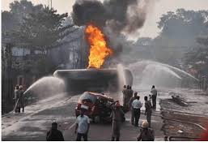
IOT-BASED AIR QUALITY MONITORING SYSTEM
PROPOSAL PRESETATION
Joshua Wambua
EG209/109705/22
BTech. Electrical and Electronic Engineering

Slide 2
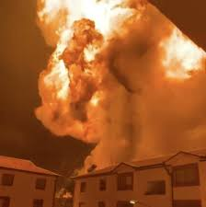

Background of the study
Air pollution is a growing public health and environmental concern
worldwide.
Urbanization and industrial activities increase emission of harmful
gases and particulate matter.
Pollutants such as CO, LPG, PM2.5 and PM10 cause serious
health problems.
Gas leaks in domestic environments pose risks of fire, explosions, and
poisoning.
Existing air quality monitoring systems are centralized and expensive.
Households lack access to real-time, localized air quality information.
Advances in IoT enable low-cost, real-time monitoring solutions.
This project proposes an IoT-based system for continuous
monitoring and early warning.

Slide 3

Problem Statement
Air pollution and gas leaks often go undetected
in homes and small premises.
Existing air quality monitoring systems are
expensive and inaccessible to individuals.
Lack of real-time, localized monitoring increases
health and safety risks.

Slide 4
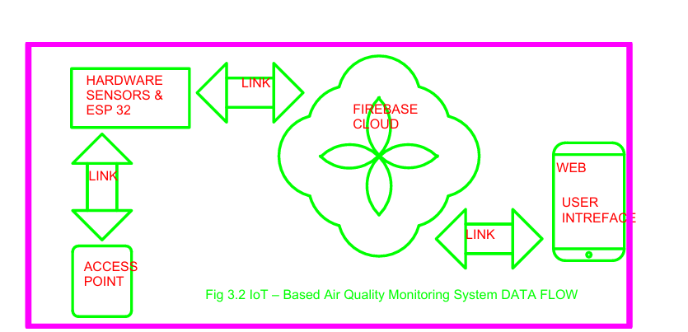
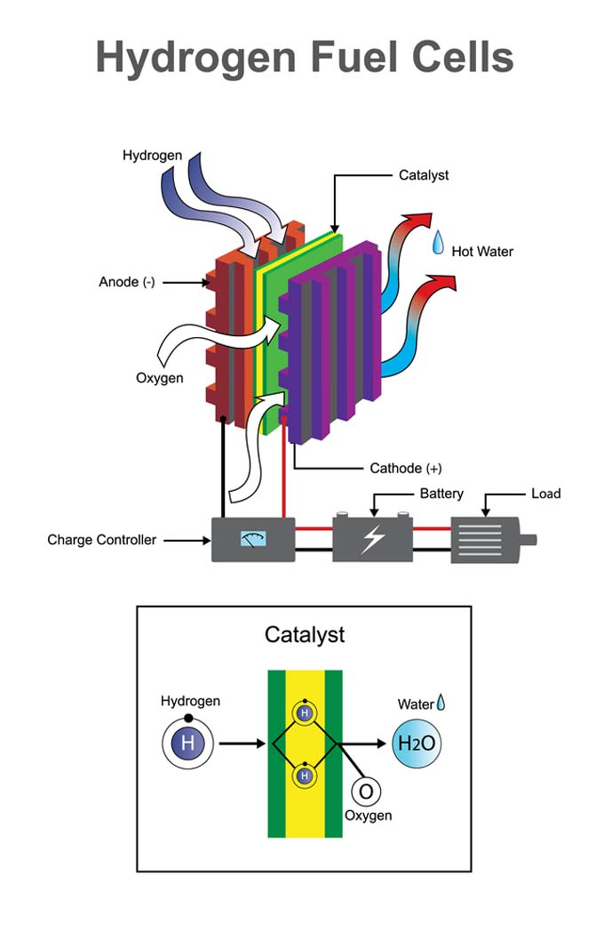
Objectives
Main Objective
To design a scalable IoT-Based Air Quality Monitoring System with real-time detection, prediction, alerts, and actuation.
Specific Objectives
Monitor particulate matter and hazardous gases in real time.
Measure temperature and humidity.
Enable remote monitoring via a cloud-based web application.
Provide instant alerts when unsafe levels are detected.
Implement a safety response system.

Slide 5
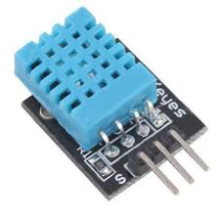
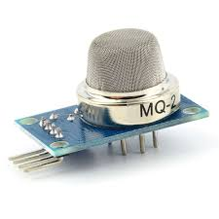
Literature review
Author & Year | Focus Area | Key Findings | Identified Gap
Bagkis et al. (2025) | Low-cost sensor networks | Scalable but accuracy issues | Limited household deployment
Concas et al. (2021) | Sensor calibration | Accuracy affected by drift | Need ML calibration
Garcia et al. (2025) | IoT & AI monitoring | Real-time analytics possible | Limited safety response
Gatari et al. (2018) | Kenyan PM monitoring | Reliable low-cost sensors | Sparse local coverage
Ramesh et al. (2024) | IoT monitoring | Real-time data & alerts | Limited prediction capability

Slide 6
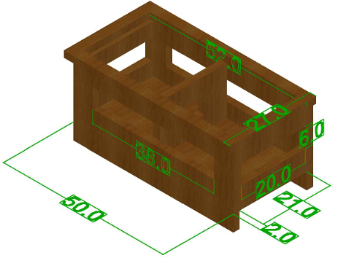
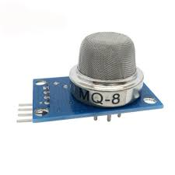
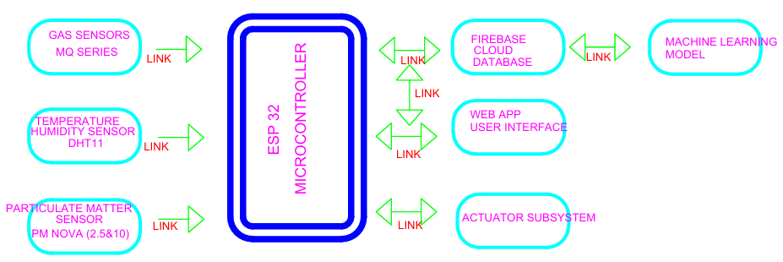
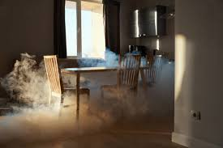
Methodology

Slide 7
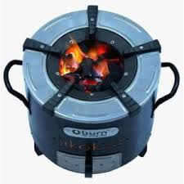

Methodology-System Operation
Sensors continuously measure air pollutants and environmental parameters.
ESP32 processes and evaluates sensor data locally.
Unsafe conditions trigger immediate alerts and safety actions.
Data is transmitted to Firebase via Wi-Fi.
Web application displays real-time and historical data.
Machine learning models predict trends and detect anomalies.

Slide 8
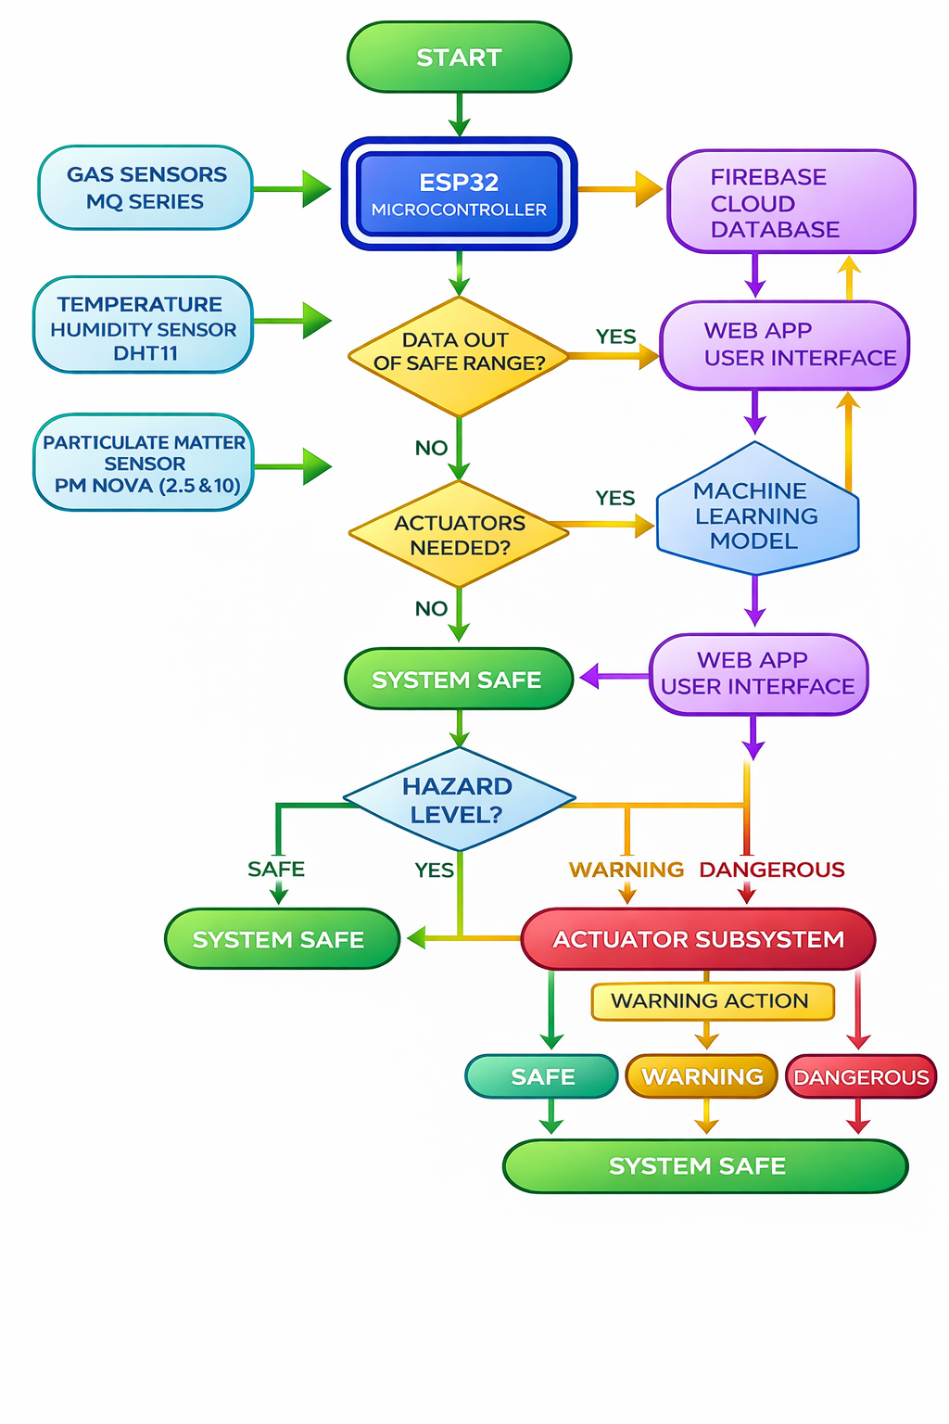

METHODOLOGY-LOGICAL FLOW CHART

Slide 9
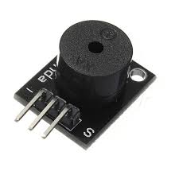


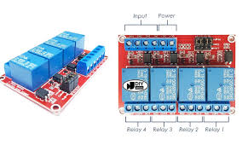
Expected Results
Real-time monitoring of air pollutants and hazardous
gases.
Early detection of gas leaks and fire risks.
Automated alerts and notifications.
Accessible web-based visualization.
Improved environmental awareness and safety.

Slide 10

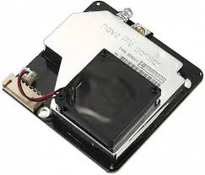
Work plan
Activity | Start Date | End Date | Days
Project Incubation & Topic Refinement | 01-Sep-2025 | 14-Sep-2025 | 13
Introduction and Background Study | 15-Sep-2025 | 05-Oct-2025 | 20
Literature Review | 06-Oct-2025 | 09-Nov-2025 | 34
Problem Definition | 10-Nov-2025 | 16-Nov-2025 | 7
Objectives Finalization | 17-Nov-2025 | 23-Nov-2025 | 7
Methodology Development | 24-Nov-2025 | 30-Nov-2025 | 7
Proposal Writing and Submission | 01-Dec-2025 | 14-Dec-2025 | 14
Proposal Presentation | 15-Dec-2025 | 21-Dec-2025 | 6
System Architecture & Design | 05-Jan-2026 | 25-Jan-2026 | 20
Hardware Design & Integration | 26-Jan-2026 | 16-Feb-2026 | 21
Firmware Development | 10-Feb-2026 | 10-Mar-2026 | 28
Cloud and Database Integration | 01-Mar-2026 | 22-Mar-2026 | 21
Web Application Development | 10-Mar-2026 | 05-Apr-2026 | 26
Machine Learning Integration | 23-Mar-2026 | 05-Apr-2026 | 14
Testing & Documentation | 06-Apr-2026 | 25-Apr-2026 | 19
Presentation & Submission | 26-Apr-2026 | 30-Apr-2026 | 4

Slide 11
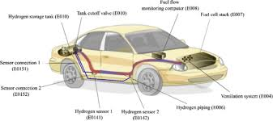
Gantt Chart

Slide 12

Budget
COMPONENTS | COST
SENSORS | 4400
MICROCONTOLLER | 1500
POWER SUPPLY UNIT | 5900
Miscellaneous | 560
CONNECTIVITY | 4500
ENCLOSURE | 1000
TOTAL | 17860

Slide 13

Serial No | Component | DESCRIPTION | Unit cost | Quantity | Total
1 | ESP 32 | DOIT ESP32 DEVKIT V1 | 1500 | 1 | 1500
2 | MQ-SERIES | MQ‑135 / MQ‑7 gas sensors (analog modules) | 400 | 4 | 1600
3 | NOVA PM | SDS011 PM2.5/PM10 particulate sensor (UART) | 2300 | 1 | 2300
4 | BATTERY | 12 V Li‑ion / lead‑acid battery, 2–5 Ah typical | 1800 | 1 | 1800
5 | BATTERY CHARGER | TP4056 Li‑ion charger module | 1200 | 1 | 1200
6 | PSU | AMS1117‑3.3 voltage regulator (3.3 V output). | 400 | 1 | 400
7 | JUMPERS | 20 cm male‑to‑male jumper wires. (common prototyping set) | 250 | 2 | 500
8 | STRIP BOARD | Standard perfboard, proto assembly | 100 | 2 | 200
9 | BREAD BOARD | Standard 830‑tie point breadboard. | 200 | 1 | 200
10 | ENCLOSURE | wooden box | 1000 | 1 | 1000
11 | INTERNET | Wi‑Fi data connection plan (monthly) | 1000 | 2 | 2000
12 | DHT11 | Temp/humidity sensor module (5 V) | 500 | 1 | 500
13 | ACCESS POINT | Wi‑Fi router | 2500 | 1 | 2500
14 | POWERBANK | 10 000 mAh USB power bank | 1200 | 1 | 1200
15 | Miscellaneous | Screws, headers, mounts. | 400 | 1 | 400
16 | LEDS | 5 mm LEDs (e.g., red, green, blue). | 10 | 10 | 100
17 | BUZZER | 5 V active piezo buzzer. | 2 | 20 | 40
18 | PUSH BUTTON | Standard tactile push button/switch | 1 | 20 | 20
19 | RESISTORS | Assorted: 10 kΩ, 4.7 kΩ, 1 kΩ, 220 Ω | 10 | 20 | 200
20 | CAPACITORS | Decoupling and bulk: 100 µF, 10 µF, 0.1 µF | 20 | 10 | 200
 |  |  |  | TOTAL | 17860

Slide 14

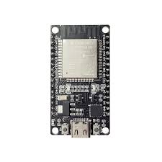
Key References
Bagkis et al., npj Climate and Atmospheric Science, 2025.
Concas et al., ACM TOSN, 2021.
Garcia et al., Artificial Intelligence Review, 2025.
Gatari et al., Atmospheric Chemistry and Physics, 2018.
Ramesh et al., ICCES, 2024.
Tastan, Sensors, 2025.

Slide 15



