Slide 1
Superstore Sales Dashboard Analysis
Week 4 – Data Visualization & Dashboarding
Prepared by: Isah Joshua Ochuko
AnalystLab Africa Data Analytics Internship
Tool: Microsoft Power BI

Slide 2
Project Overview
Objective: Build an interactive sales dashboard.
Dataset: Superstore Sales Dataset (Kaggle).
Goals: Monitor Sales, Profit, Customers, Products and Regions.

Slide 3
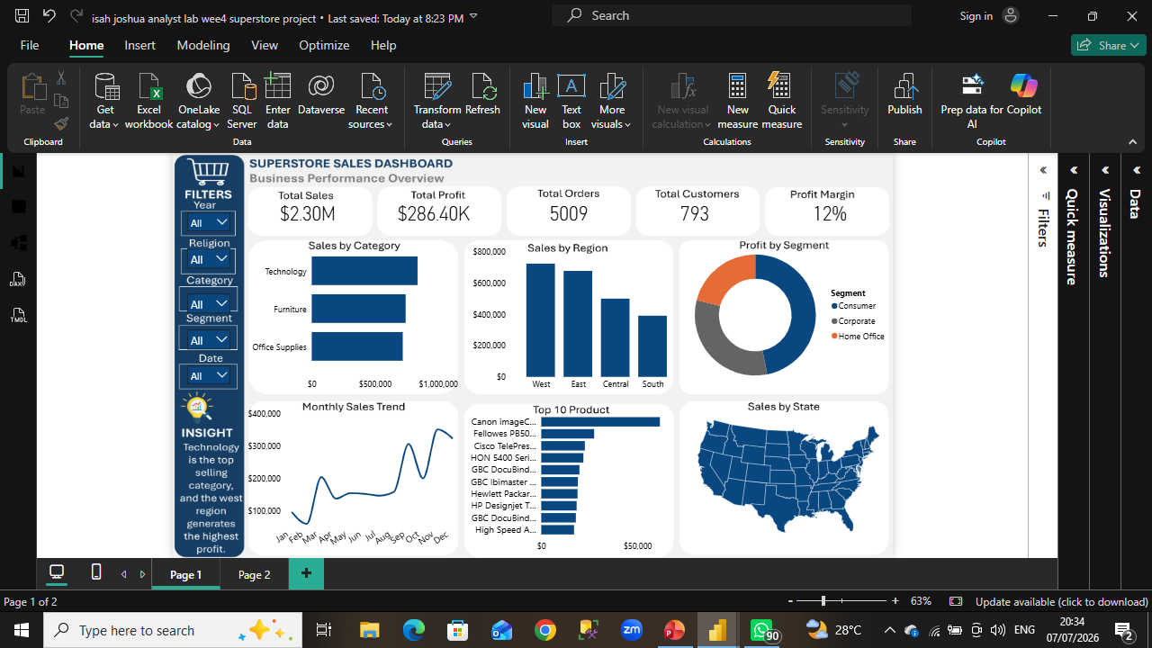
Dataset Overview
Dataset: Superstore Sales
Fields: Orders, Customers, Products, Sales, Profit, Discount, Region, Category, Dates.

Slide 4
Key Performance Indicators
Total Sales
Total Profit
Total Orders
Total Customers
Profit Margin

Slide 5
Dashboard Overview
Insert your full dashboard screenshot on this slide.
Highlight KPI cards, charts, map and slicers.
Insert Screenshot Here

Slide 6
Key Insights
Technology generated the highest sales.
West region showed strong performance.
Consumer segment contributed significantly.
Update these with your final findings.

Slide 7
Business Recommendations
Invest in top-performing categories.
Focus on high-performing regions.
Improve low-performing products.
Use trends for forecasting.

Slide 8
Challenges & Conclusion
Challenges: Data cleaning, DAX, dashboard design.
Skills: Power Query, DAX, Visualization, Storytelling.
Conclusion: Interactive dashboards support informed decisions.

