Slide 1
Automobile Accident Severity
Joshua Osko
Coursera Capstone Project

Slide 2
The Problem
Automobile accidents are a responsible for over $800 billion [1] and over 30,000 casualties [2] in the United States each year. Identifying factors which most contribute to fatal accidents could help political officials better formulate policies which could reduce loss of life and save billions of dollars. In this paper, we will build a predictive supervised machine learning model to predict the potential severity of an automobile accident based on existing traffic conditions.

Slide 3
Tools
Pandas (Data Analysis Library)
Scikit-Learn (Machine Learning Library)
Seaborn (Data Visualization)

Slide 4
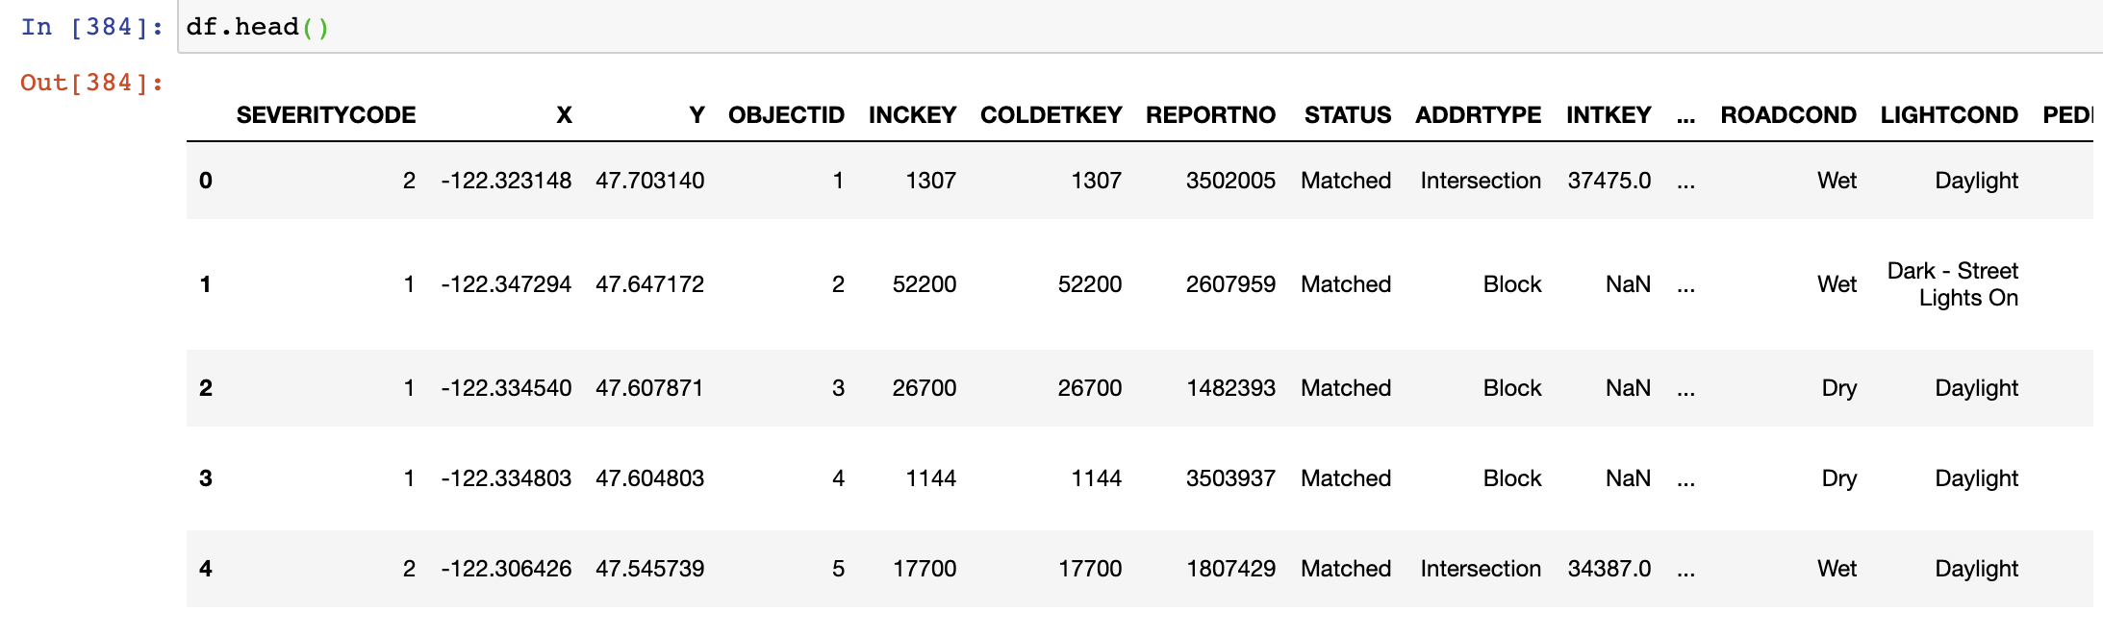
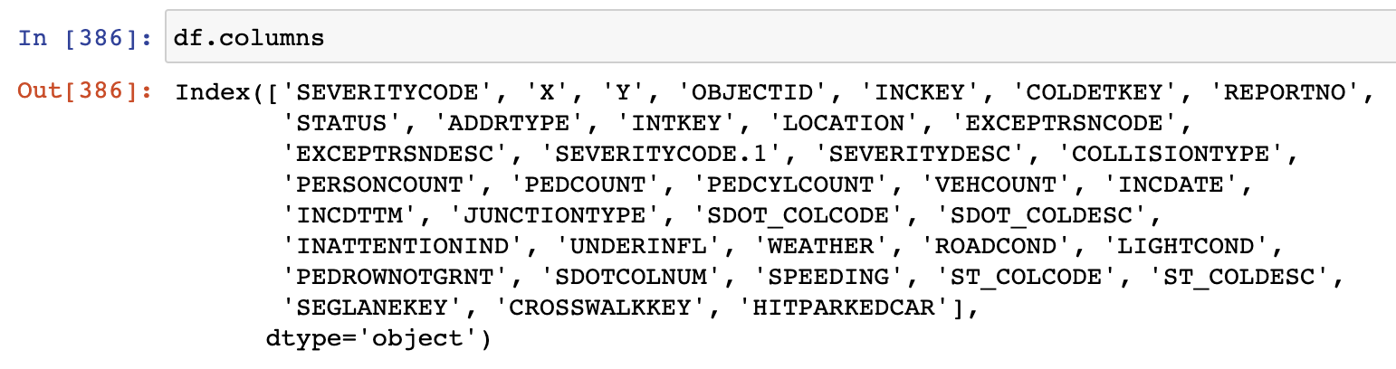
The Data

Slide 5
Methodology
1. Understand the problem
2. Collect data
3. Understand the data
4. Clean the data for data modeling
5. Build models
6. Evaluate model accuracies
7. Deploy optimal model

Slide 6
Data Cleaning
Feature | Action
JUNCTIONTYPE | Convert all values to a 0 if not intersection related or a 1 if intersection related
INATTENTIONIND | Convert all values to a 0 for cause of accident not due to inattention or a 1 if it was due to inattention
UNDERINFL | Convert all values into a 0 for not under the influence or a 1 for under the influence
WEATHER | Convert all values into a 0 for bad weather or a 1 for good weather
ROADCOND | Convert all values into a 0 for bad road conditions or 1 for good road conditions
LIGHTCOND | Convert all values into a 0 for poor visibility, 1 for moderate visibility, or 2 for good visibility
SPEEDING | Convert all values into a binary 1 for speeding or 0 for not speeding

Slide 7
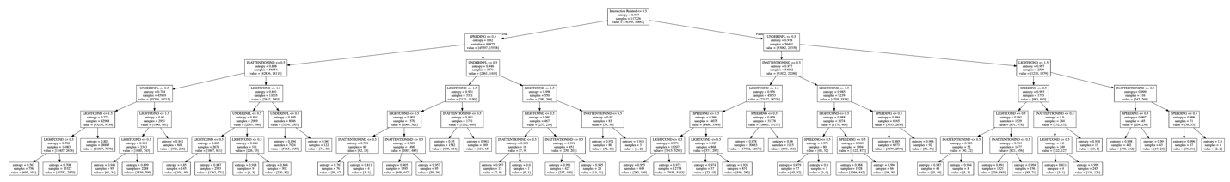
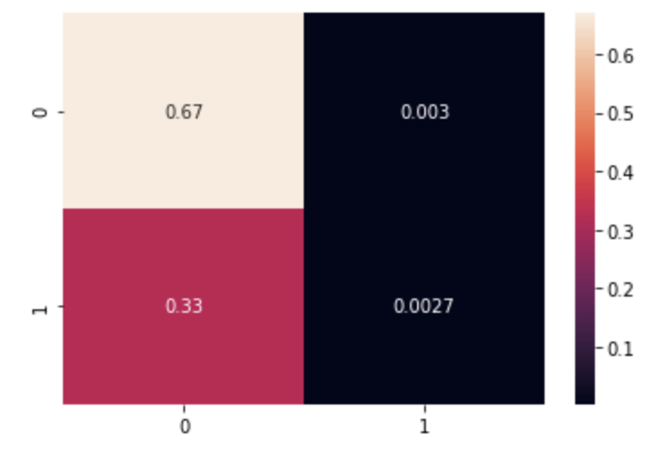
Results
Decision Tree Classifier
Decision Tree Classifier Confusion Matrix

Slide 8
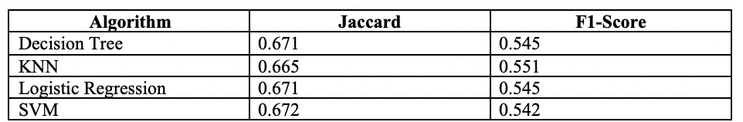
Model Evaluation
Optimal Decision Tree Classifier Depth: 5
Optimal K-Nearest Neighbors N: 2
Optimal Support Vector Machine Kernel: Polynomial

Slide 9
Conclusion
Cities can benefit greatly from leveraging machine learning to drive business decisions with regards to infrastructure plans that would reduce the number of traffic accidents and fatalities
More variables need to be weighed in than were obtained from this dataset to build a more accurate prediction model.
Intersections are a large cause of fatal traffic accidents.
Perhaps improving transportation infrastructure by eliminating intersections and replacing them with roundabouts could help ease traffic congestion and limit the number of high fatalities that result as a consequence of automobile accidents.

Slide 10
References
[1] https://crashstats.nhtsa.dot.gov/Api/Public/ViewPublication/812013
[2] https://www-fars.nhtsa.dot.gov/Main/index.aspx

