Slide 1

Ascueta, vergel g.
Basobas, andrea t.
Castano, tome teofilo
Quilala, joshua c.
Sabinosa, reccalyn a.

Slide 2
INTRODUCTION:
OPHIR:
THE ANCIENT NAME OF THE PHILIPPINES
IS A REGION OF ISLANDS MENTIONED IN THE BIBLE, MOST FAMOUS FOR IT’S WEALTH

Slide 3
OVERVIEW
First person shooting game
Collecting
Hunting
Looting
Tournaments
Team play
Solo play
Upgrades

Slide 4

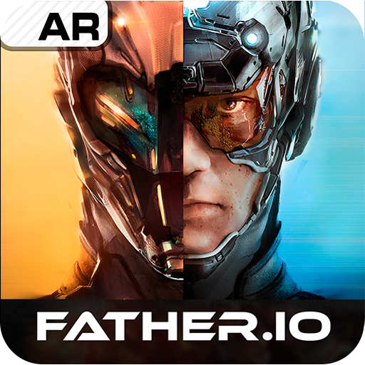
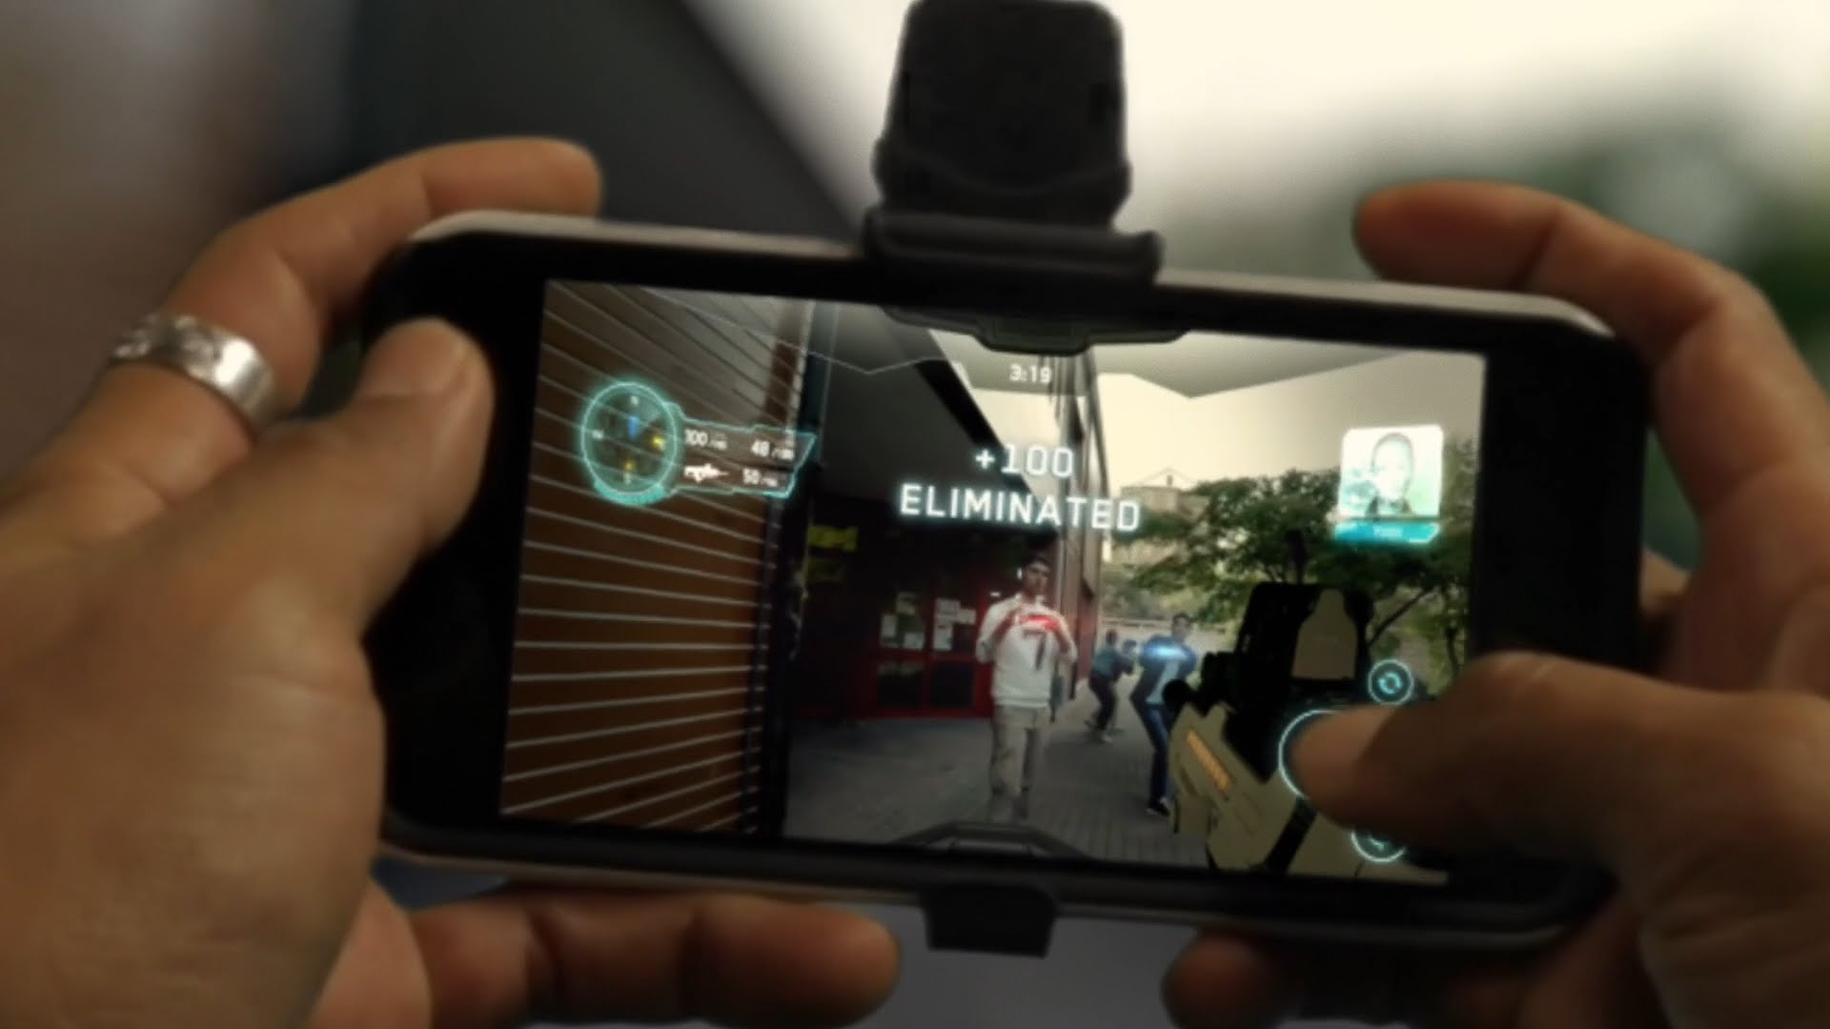

USERS:
PEOPLE WHO LOVES:
-HORROR
-ZOMBIES
-HUNTING
MILLENIALS
PHYSICALLY ACTIVE GAMERS
FIRST PERSON SHOOTING GAME
ANYONE WHO OWN
SMARTPHONE WITH CAMERA

Slide 5
LIMITAIONS
IT IS AN ONLINE GAME (NEED INTERNET TO PLAY)
LIMITED AMMO FOR THE WEAPONS
MORTAL LIFE
PERSON WITH DISABILITY

Slide 6
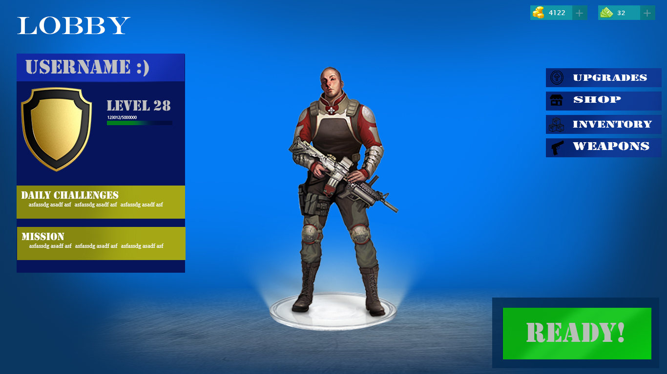
PROPOSAL

Slide 7
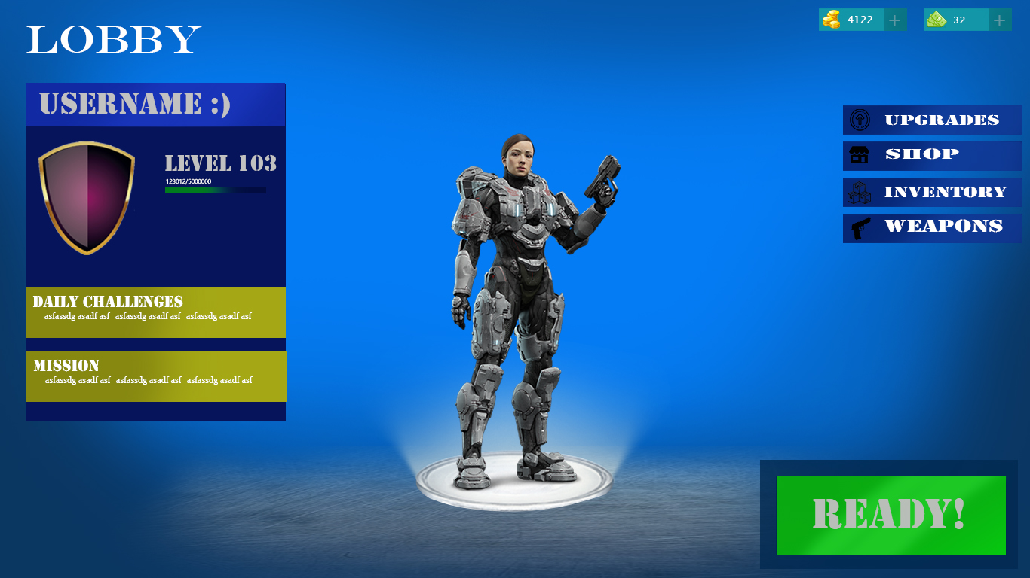
PROPOSAL

Slide 8
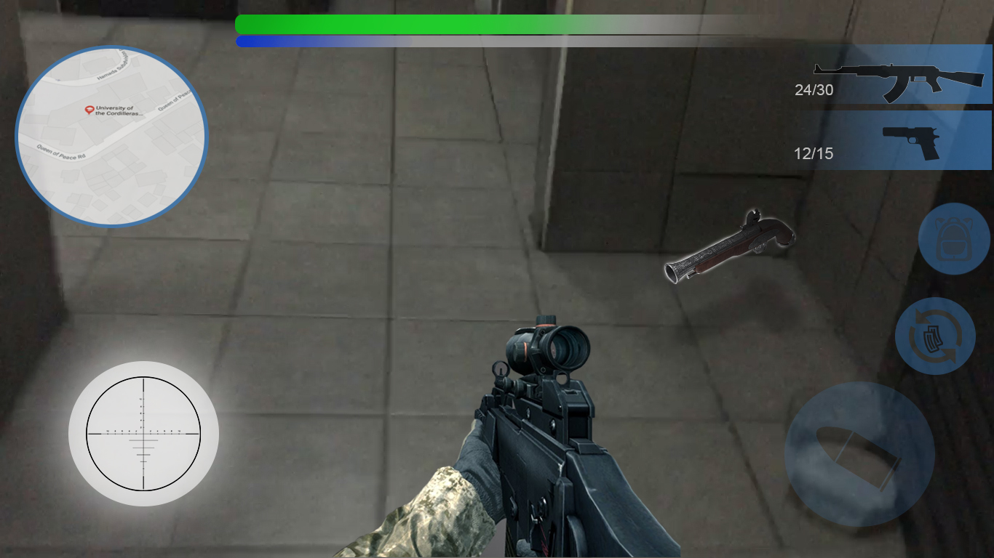
PROPOSAL:

Slide 9
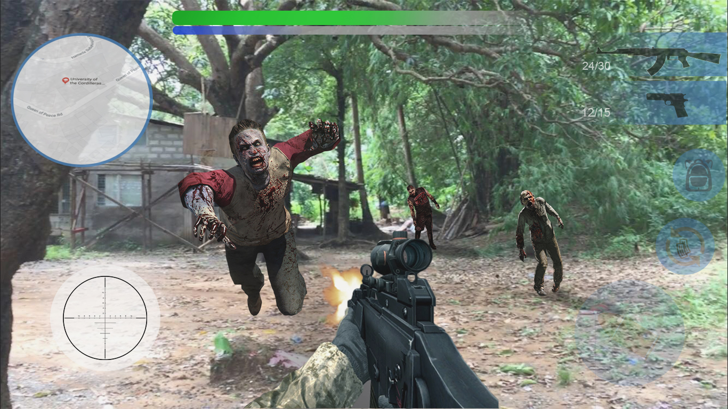
PROPOSAL
Ophir\test 2.mp4
Ophir\test 1.mp4

Slide 10


USABILITY KIT:
PHOTOSHOP
BLENDER
UNITY

