Slide 1
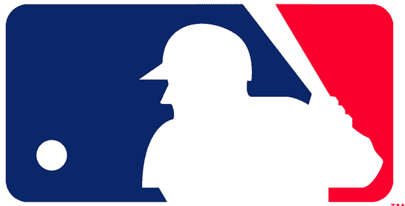
Most Valuable Player
Josh Sellers

Slide 2
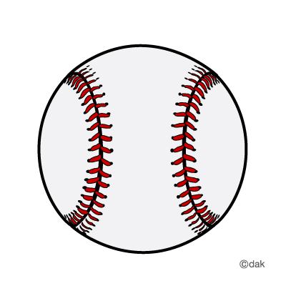
Background
Major League Baseball (MLB) has become an analytical sport
Player analysis is more technical
Traditional methods have less relevance
Moneyball

Slide 3
Problem
GOAL: A way to model player value
Fans want to understand these changes
However, they lack a technical background
Fans need a simple way of following team’s moves
Enlightened fans will gain a sense of connection
Teams want invested fans

Slide 4
Approach
WAR – Wins Above Replacement
How many wins does a player contribute above the average amount
WAR compared to salary approximates player value
Modeling player WAR and salary over time
Allows fans to predict a player’s value
Gives value to rookies, free agents and rostered players

Slide 5
Assumptions
Same starting year for compared players
Constant pay over time
No unexpectedly huge or small contracts
Consistent performance by players
No exceeding or falling below expectations
All non-pitchers have similar rates of injury and decline
No minor league busts

Slide 6
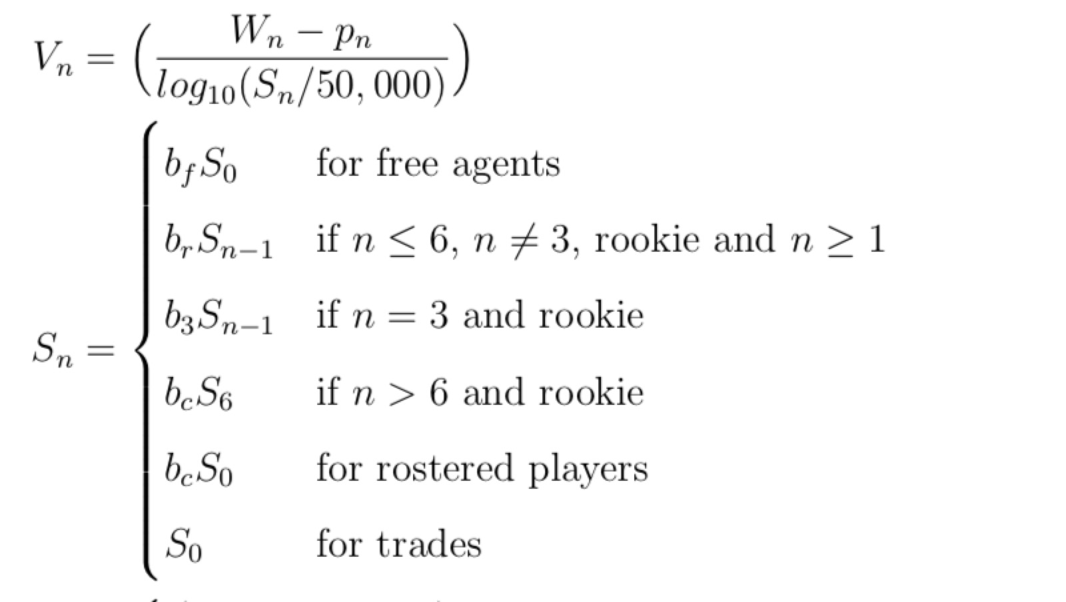
Equations

Slide 7
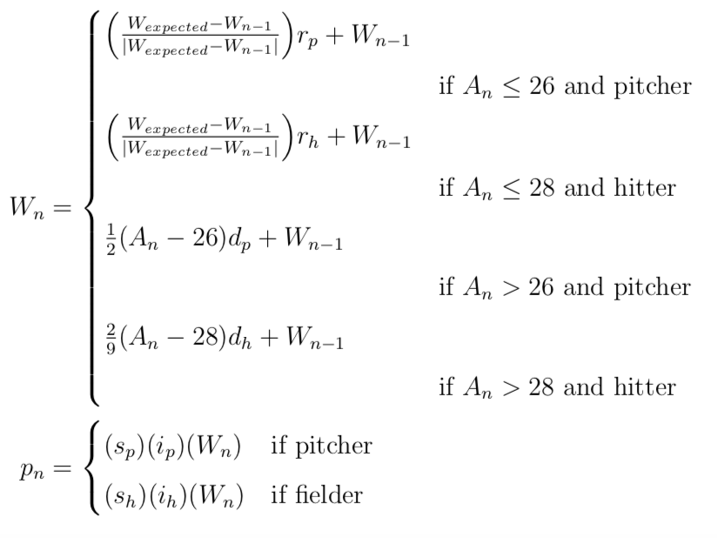
Equations

Slide 8
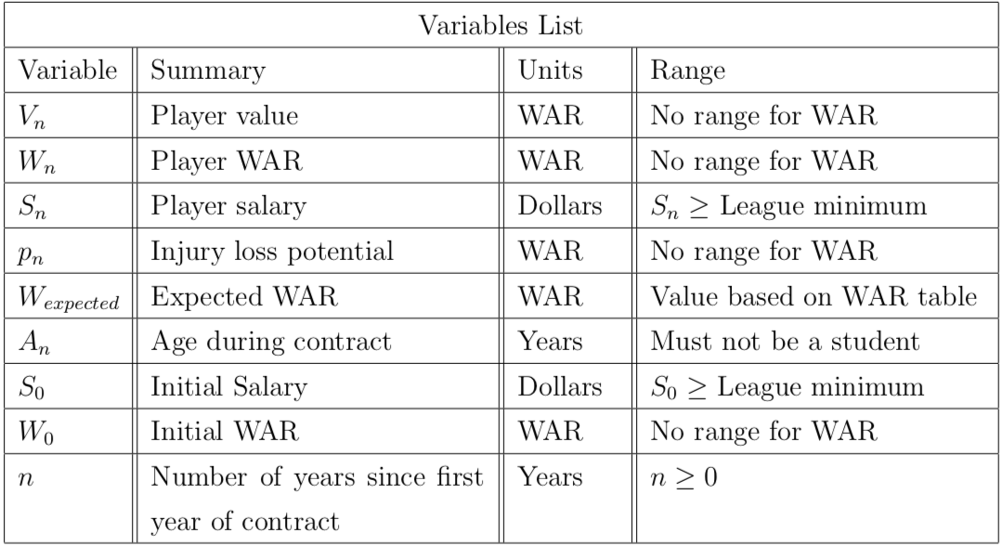
Variables

Slide 9
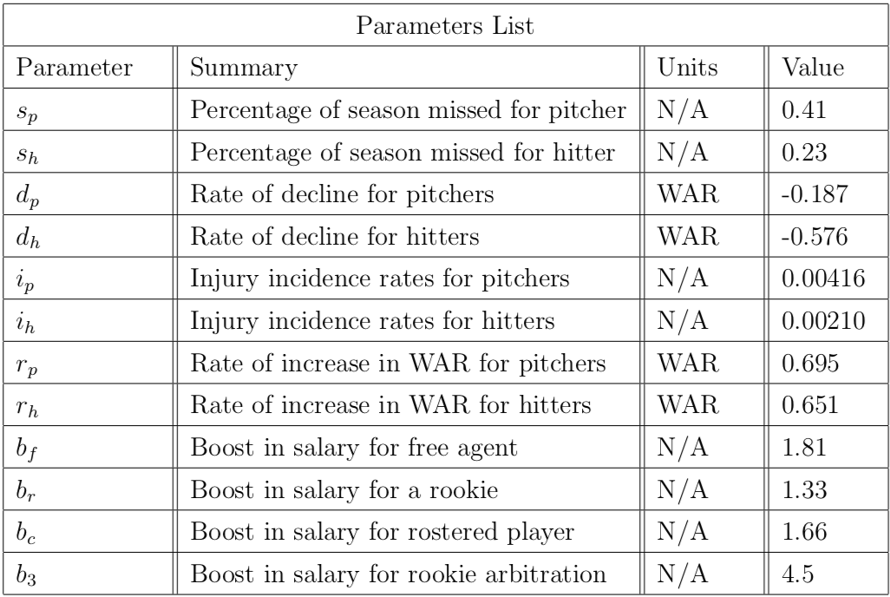
Parameters

Slide 10
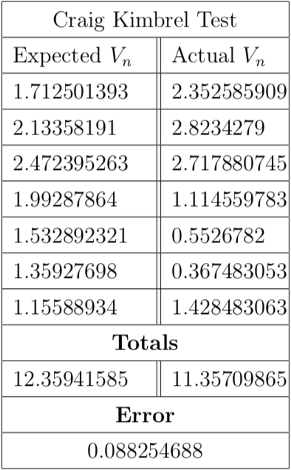
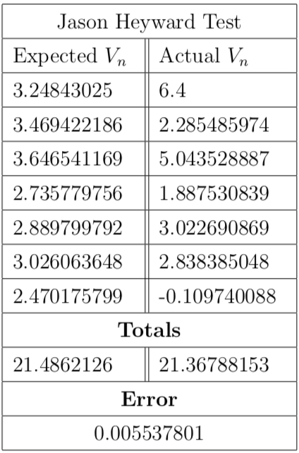
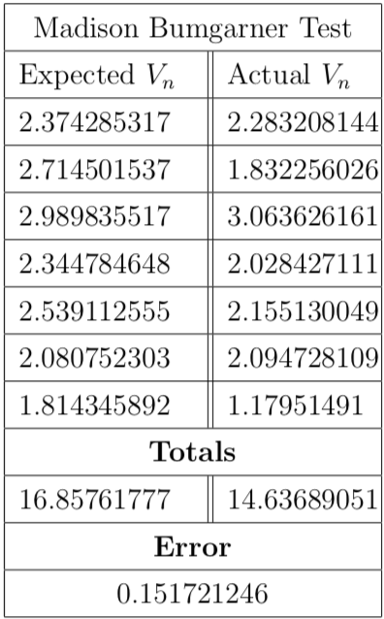
Results (rookies)

Slide 11
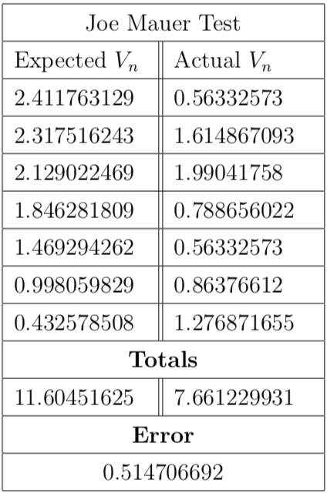
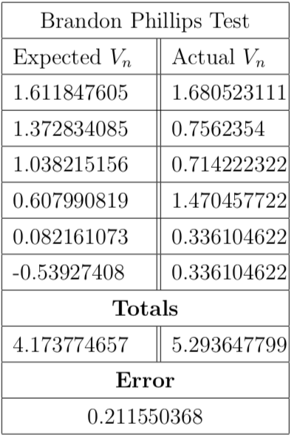
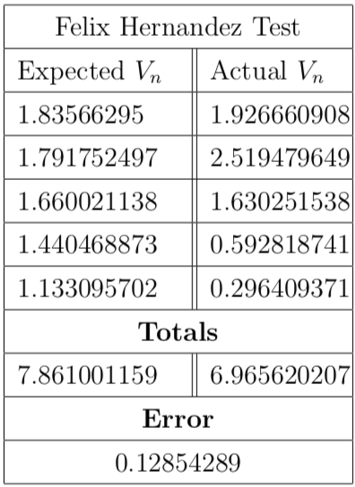
Results (rostered)

Slide 12
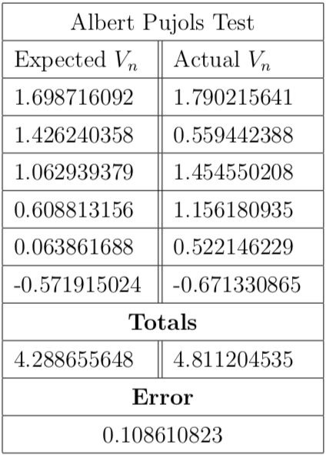
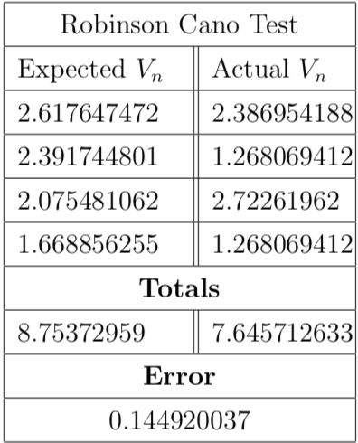
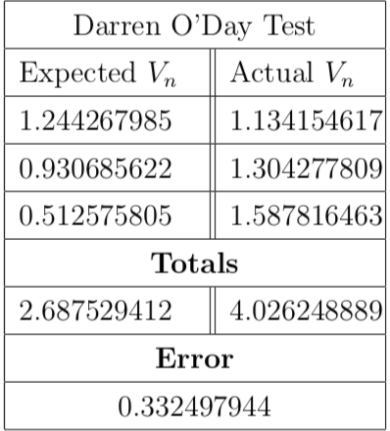
Results (free agents)

Slide 13
Evaluation
Model does a good job for rookies
Free agents and rostered players are less accurate
Due to variability in decline
These types of players earn shorter contracts anyway

Slide 14
Assessment
Model meets needs of casual fan
Gives decent estimate of player value
While not completely accurate, it provides enough insights
Further analysis into player decline and injury could improve accuracy
Allow for longer veteran contracts
Factor in lower value for injuries

Slide 15
Conclusion
Younger players tend to have more value
Long contracts are a gamble
A lot of variability exists in Baseball

