Slide 1


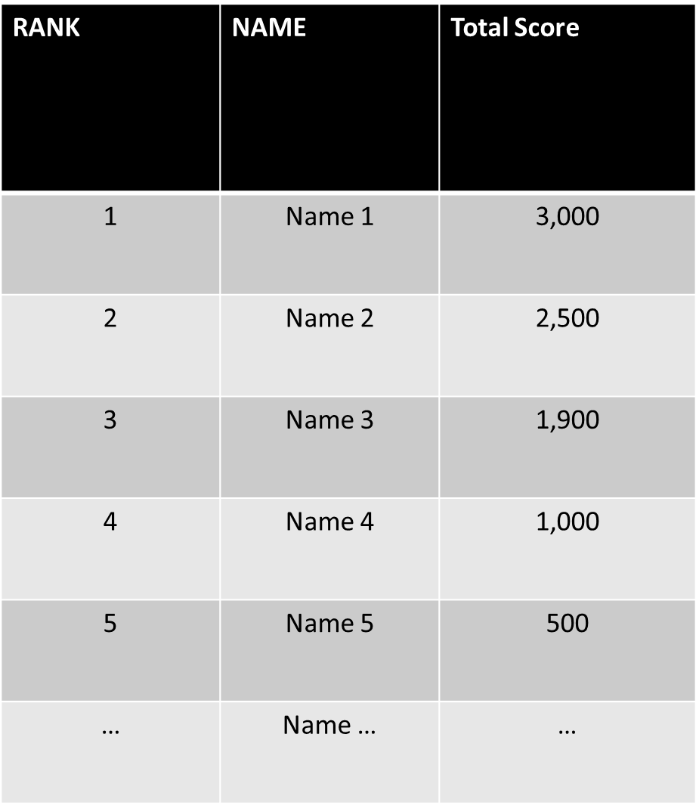
Fit or Fail
Play! About Leaderboard
Fit or Fail!
The new revolutionary fitness trivia game
PLAY
REGISTER

Slide 2
Fit or Fail
Play! About Leaderboard
Play
This is the game screen
Enter Fullscreen

Slide 3
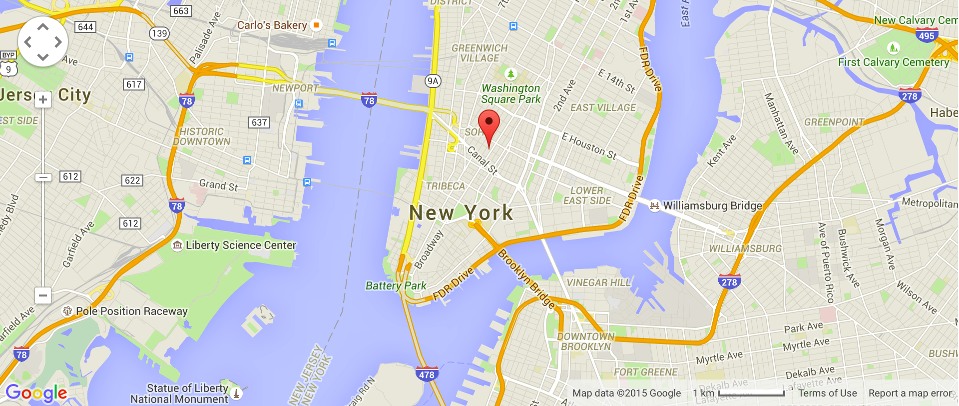
Fit or Fail
Play! About Leaderboard
About
Company: type here
Mission: type here
Founders: type here
Contact Us:
Phone Number: type here
Email: type here
Location
Address: type here

Slide 4
Fit or Fail
Play! About Leaderboard
Leaderboard
RANK | NAME | Total Score
1 | Name 1 | 3,000
2 | Name 2 | 2,500
3 | Name 3 | 1,900
4 | Name 4 | 1,000
5 | Name 5 | 500
… | Name … | …

Slide 5
Fit or Fail
Play! About Leaderboard
Create and Account
Email
TYPE HERE
Password
TYPE HERE
Confirm Password
TYPE HERE
I accept the Terms of Services and Privacy policy
SIGN UP

Slide 6
Fit or Fail
START
EXIT

Slide 7
Fit or Fail
Mode
Solo
Team

Slide 8
Fit or Fail
Game Will Start

