Slide 1
ADMINISTRATORS FILE FOR ENROLLEE STUDENTS
Canabatuan, lovely jane a.
Prada, nonelyn B.
Quipot, kevin ivan A.
Monte, aldien L.

Slide 2
FUNCTIONAL REQUIREMENTS PROTOTYPE
ADMINISTRATOR LOG IN
CAN CHOOSE SHS TRACKS
CRUD STUDENTS FILE
NETBEANS
JAVA INHERITANCE
JFRAME

Slide 3
OUTPUT

Slide 4
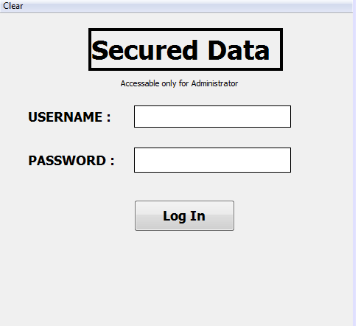

Slide 5
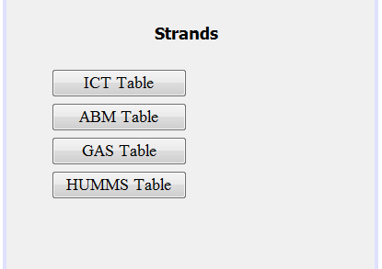

Slide 6
