Slide 1
Powerpoint

Slide 2
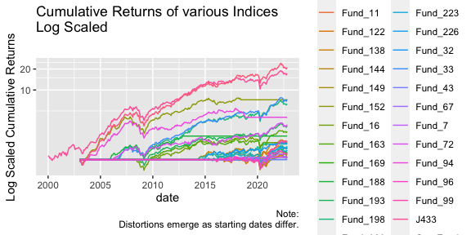
Cumulative log returns
print(LogReturns)
Log returns

Slide 3
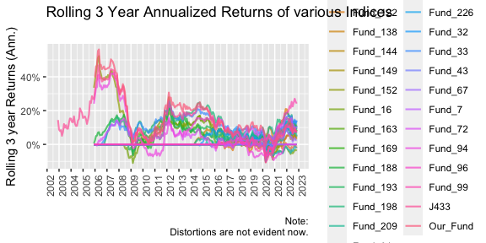
Rolling returns
print(RollingReturns)
Rolling returns

Slide 4
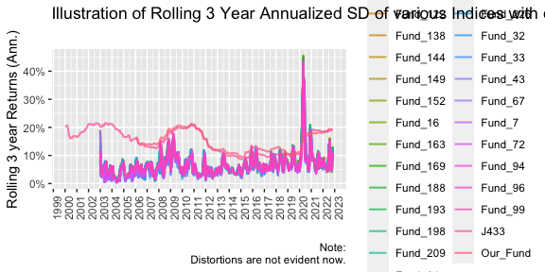
Standard deviation of rolling returns
print(StandardDeviation)
Standard deviation

