Slide 1
AI Driven IDS for Smart Homes using Edge Computing & Federated- Ensemble Learning Algorithm
Presented By: Joshua Suriyan N
Department of Computer Science & Engineering

Slide 2
Introduction
Smart homes are increasingly vulnerable to cyber-attacks due to the rapid growth of interconnected IoT devices.
Traditional centralized intrusion detection systems suffer from privacy risks, scalability issues, and high communication overhead.
To address these challenges, this project proposes an AI-driven IDS that combines edge computing with federated and ensemble learning techniques.

Slide 3
Problem Statement
Centralized IDS systems have latency and privacy risks
Smart home devices are highly vulnerable to attacks
Cloud-based detection requires higher bandwidth
Difficulty identifying advanced IoT-specific attacks
Need for real‑time, distributed, privacy‑preserving IDS

Slide 4
Objectives
The main objectives of this project are to detect IoT-based cyber-attacks with accuracy greater than 90%, preserve user data privacy through federated learning, reduce latency using edge-based processing, and improve robustness through ensemble learning across multiple IoT datasets.

Slide 5
Dataset Used
The proposed system is evaluated using four benchmark IoT intrusion detection datasets:
CIC-IoT-2023
TON-IoT
IoT-23,
BoT-IoT.
These datasets contain diverse attack types and realistic network traffic, enabling comprehensive evaluation of the IDS under heterogeneous attack scenarios.

Slide 6
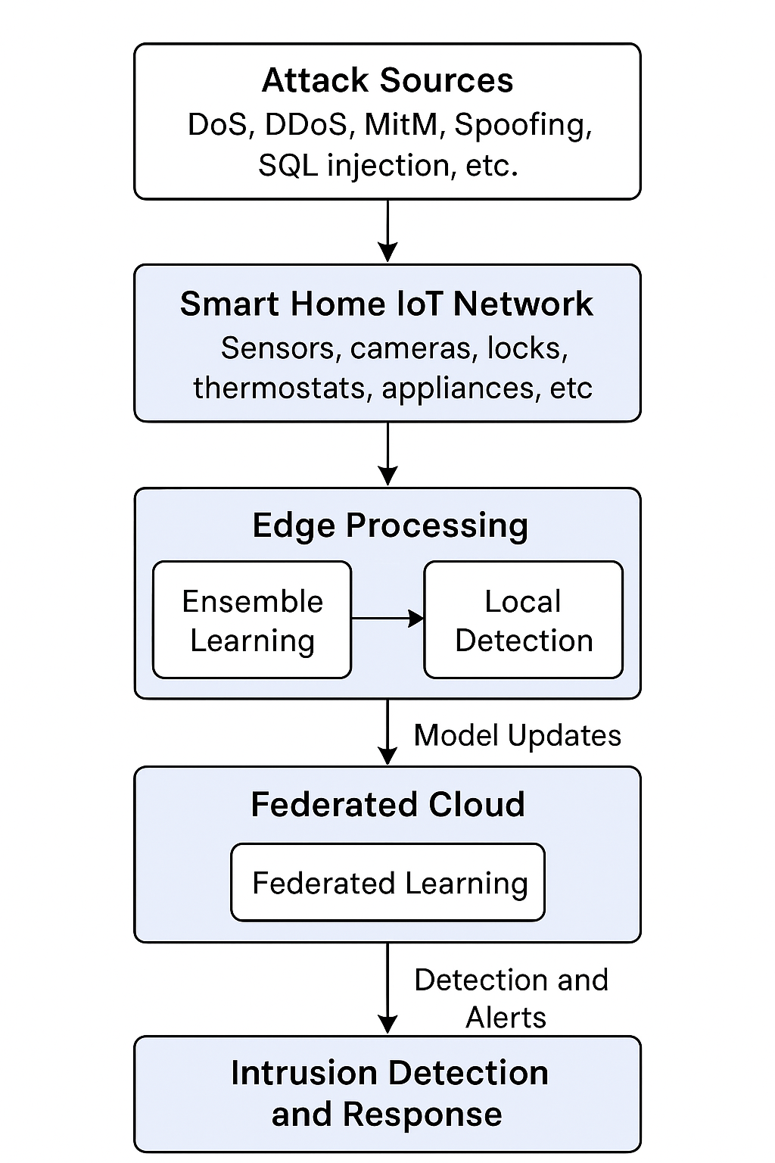
Methodology / Workflow
The IDS is implemented using a modular architecture where each edge client locally trains machine learning models and shares only model parameters with the server.
Federated and ensemble learning techniques are integrated to detect intrusions efficiently while preventing the exposure of sensitive smart home data.

Slide 7
Testing
The system is validated using functional testing to ensure correct attack detection, integration testing to verify module interaction, performance testing to measure accuracy and latency, security testing to evaluate data privacy, and user acceptance testing to confirm system reliability in smart home scenarios.
Functional and Integration Testing: The system is tested to verify correct preprocessing, federated model training, ensemble-based prediction, and seamless interaction between edge nodes and the aggregation server.
Performance and Security Testing: The IDS is evaluated using accuracy, precision, recall, F1-score, ROC-AUC, and attack detection count, while ensuring data privacy and secure model parameter exchange in the federated environment.

Slide 8
Results & Discussions
Experimental results demonstrate that the proposed federated-ensemble IDS achieves detection accuracy exceeding 90% across all datasets.
Among them, the BoT-IoT dataset shows the highest number of attacks detected, indicating its effectiveness in evaluating intrusion detection performance.
ROC-AUC scores and confusion matrices further confirm strong classification reliability.

Slide 9
Conclusion & Future Scope
The proposed AI-driven IDS successfully combines edge computing, federated learning, and ensemble learning to provide accurate, privacy-preserving intrusion detection for smart homes.
Future work can extend this system by incorporating real-time deployment, deep learning models, blockchain-based security, and adaptive learning for zero-day attack detection.

