Slide 1
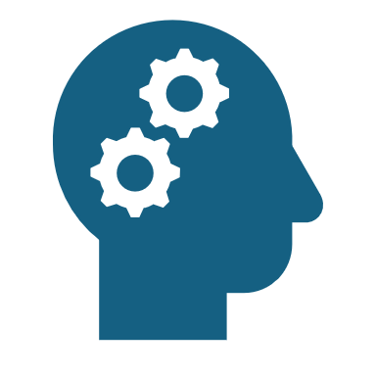
Artificial intelligence
All the good bad and ugly that it has created

Slide 2
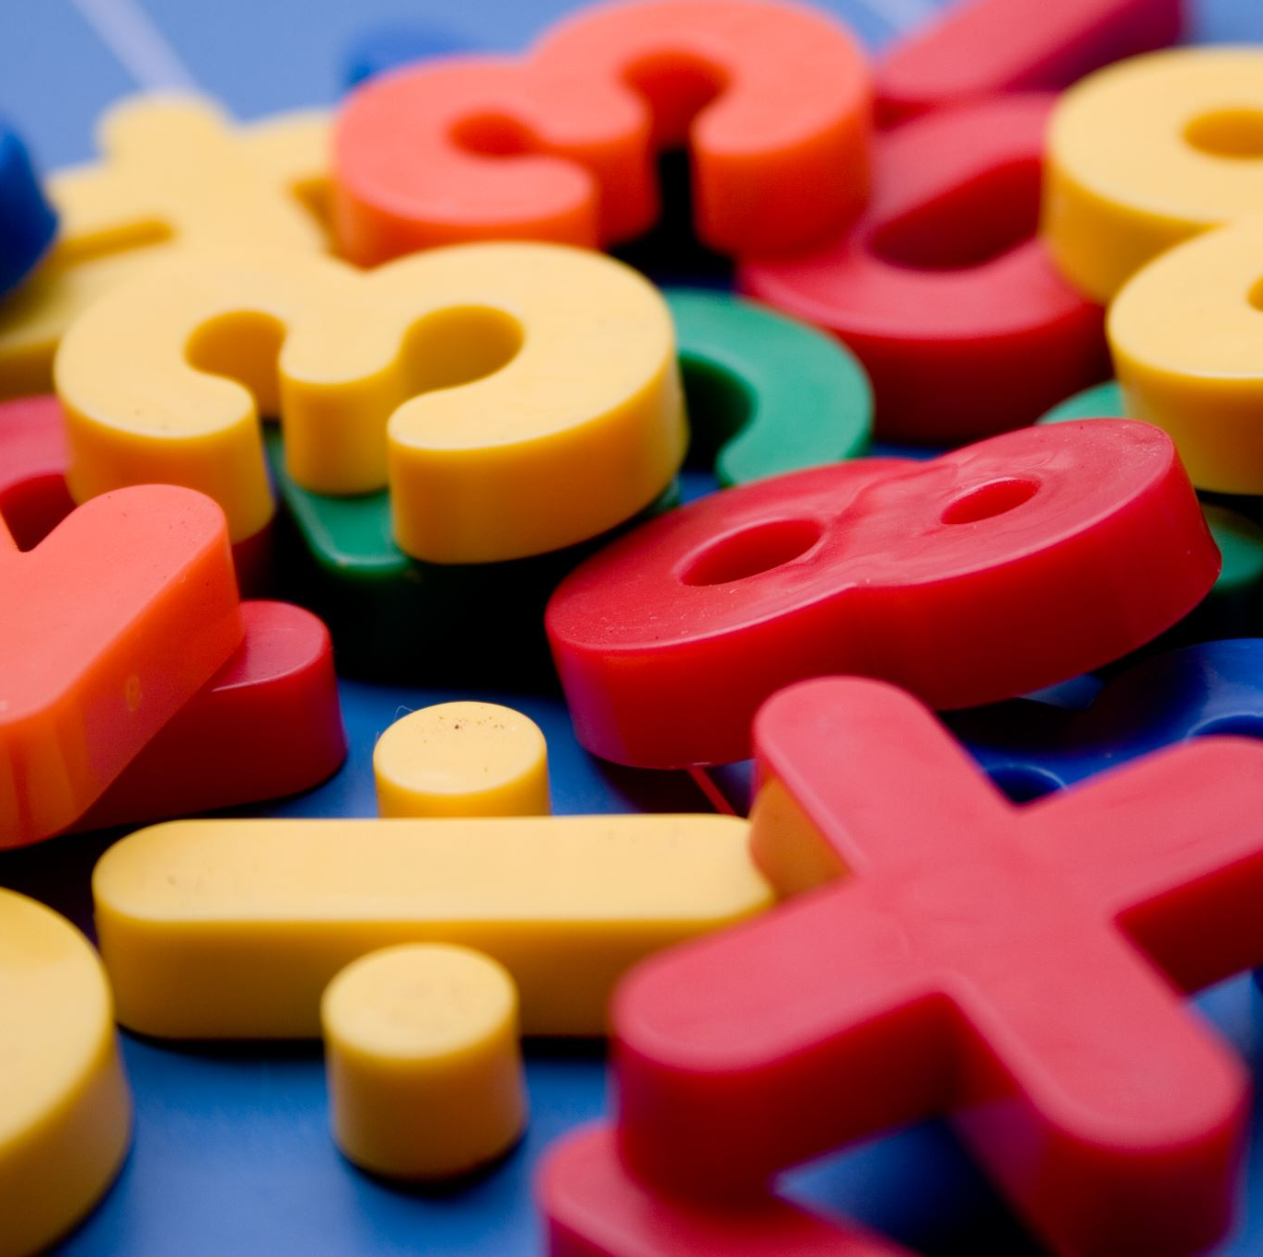
Academic gains of AI
Artificial intelligence has helped me complete and mark homework without having to bother my teacher for answers.
AI helps me answer hard AP maths questions and explains its logic and method to teach me

Slide 3
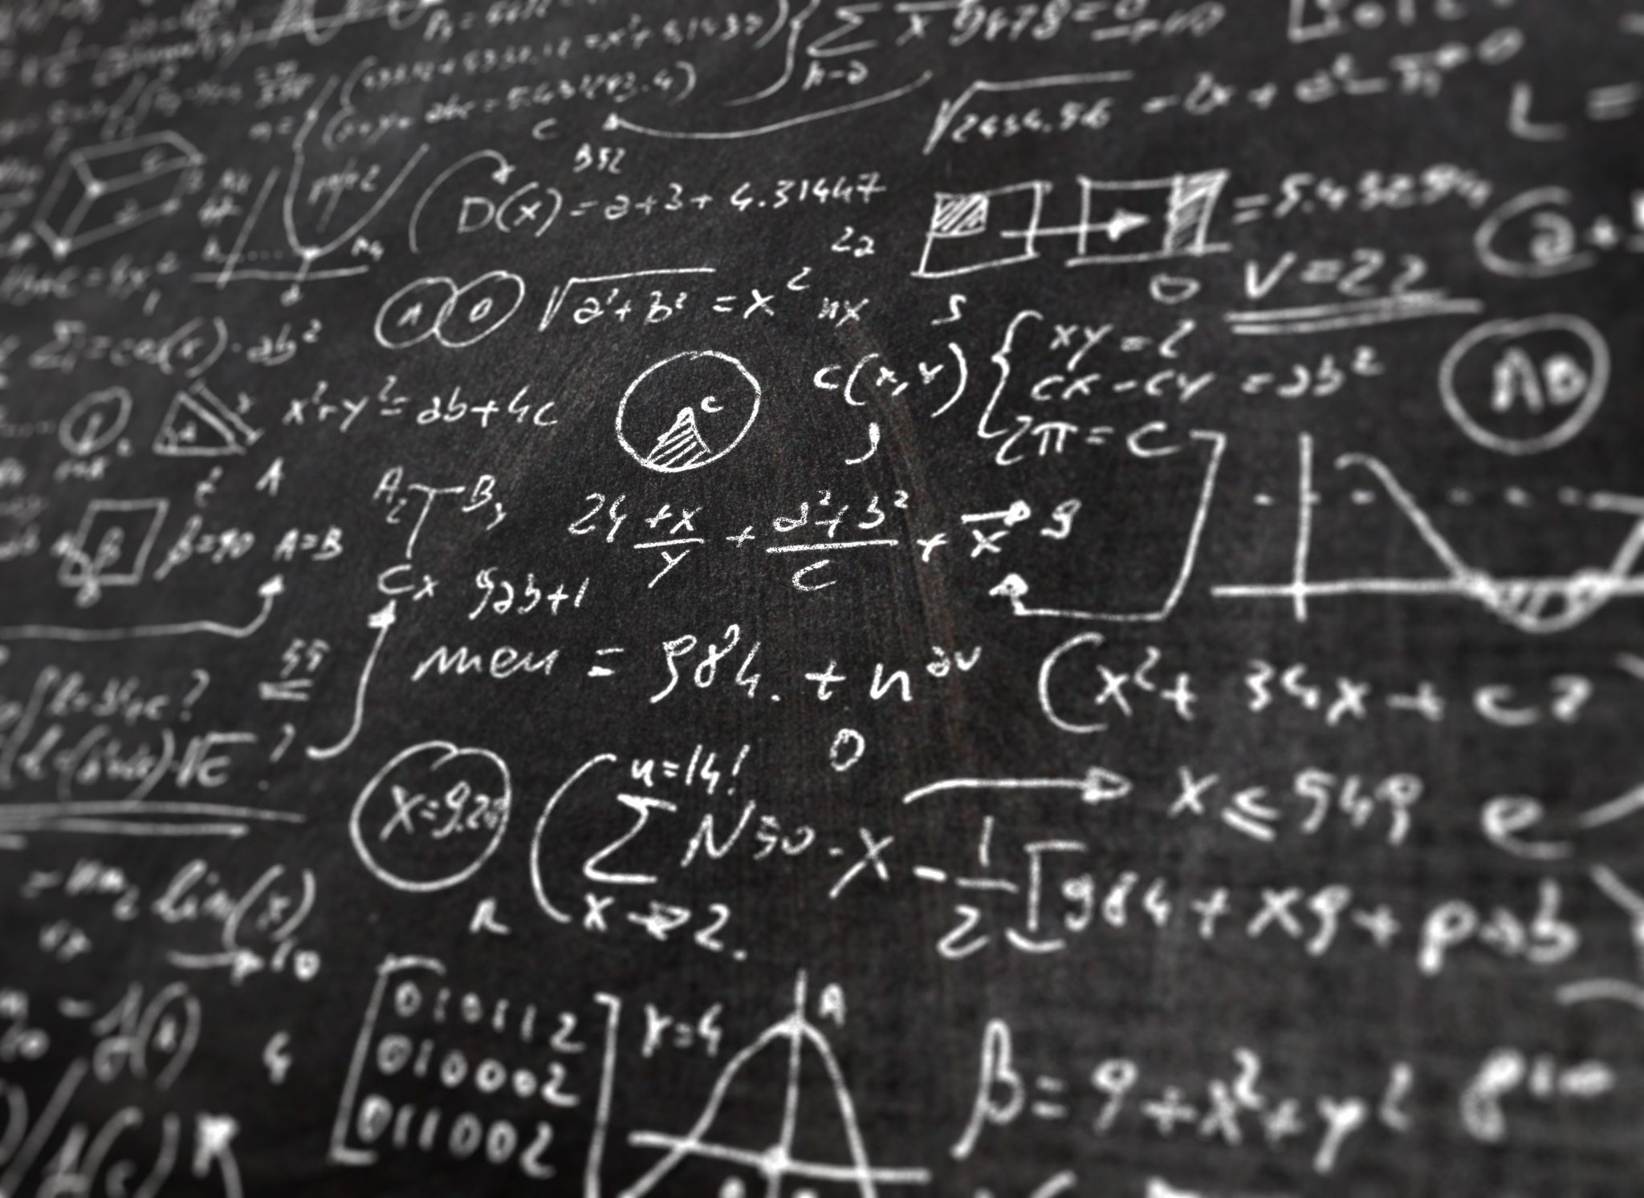
Effects of AI on my academic life
Artificial intelligence is a useful tool, but only when used correctly. Essays,Orals,short stories and assignments are all assessments which students such as I could easily use AI to complete. This can hinder our ability to learn and do things ourself.

Slide 4
How AI can help the world
AI could be used to promptly solve pressing issues and perform tests quicker and more accurately than any human being could.
AI can be used to save lives and perform complex surgeries using their brothers and sisters, robots.

Slide 5
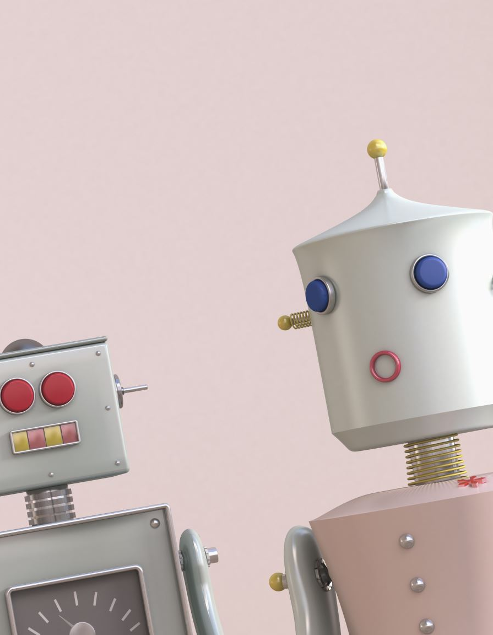
How AI can hinder the world
AI is taught to extend its own intelligence and without given any commands our boundaries could prove to be very dangerous.
AI could literally start a zombie robot apocalypse one day if it wanted to.

Slide 6
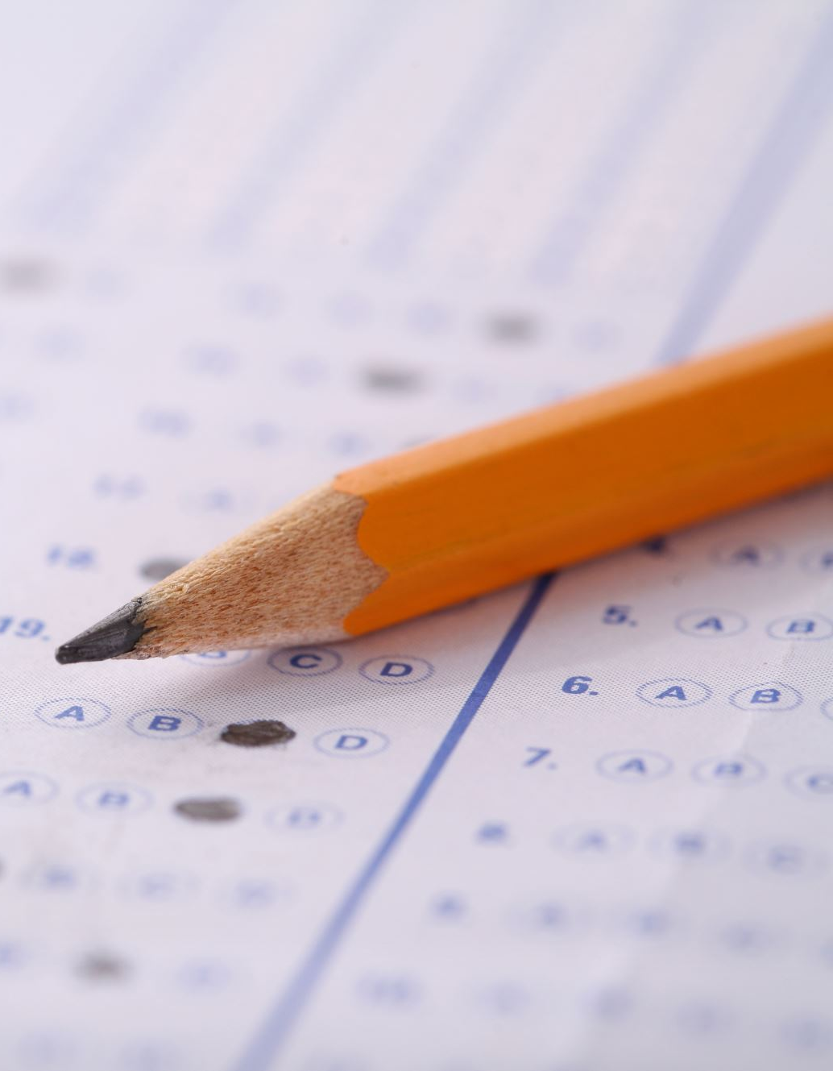
AI allowed in school? Yes or no…
I believe that if used correctly AI can be used as an extension tool used to help students learn
Although awesome, some students will always try and use it to be lazy and not do work.

Slide 7
Rules for using AI
NO use of AI for any school assessments
AI use permitted to help complete homework
AI blocked from school wifi and only allowed for home usage
All orals, presentations, etc. that students took home must be proofread and confirmed to be AI free
Every student caught using AI for academic gain will receive zero on the assessment

