Slide 1
Crypto Trading Bot
© Templateswise.com
Jacob Jalomo, Joshua Bond, TJ Azodeh

Slide 2
Motivation & Summary
For our project, we wanted to apply Deep Learning and Algorithmic Trading to create an automated Trading Bot that we could use in real-life.
We hypothesized that we could use a RNN to accurately predict buy and sell signals on various Cryptocurrencies.

Slide 3
Project Map
Data Collection / Processing
Engineering Variables
Model Analysis / Backtesting
Kraken API for data collection.
Cleaned historical data.
Computing predictive variables.
Defining Y.
Principal component analysis.
Scaling variables.
Building Neural Network.
Fitting multiple models with different PCs.
Comparing Accuracies.
Testing model on unseen data.

Slide 4
Data Collection / Processing
Kraken API
Our model utilizes Kraken API to pull historical data for Cryptocurrencies (BTC)
Minimal data cleaning required because Kraken pulls clean data.
Open, high, low, close all used as features in deep learning model.

Slide 5
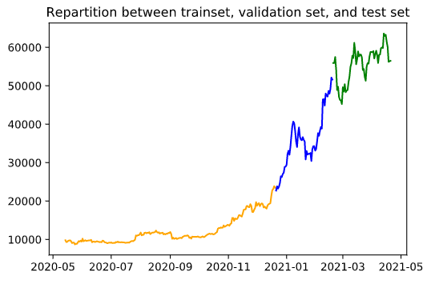
Variable Engineering
Predictive features computed for the model:
EMA, RSI, JWWMA, ATR
(Also included candle shadow and body size, min, max, volume, modulos at differing levels, differences, percentage change, week day, and day)
Results calculated based on stoploss of -5% and take profit calculated based on +12%.
Variables created using multiple window sizes: (8, 13, 21, 34, 55, 89, 144, 377)
Train, test, and validation sets created after variables computed.
Variables scaled for use in model.

Slide 6
Model Architecture
Built a function to create multiple models at once using different numbers of principal components (7 models created).
We used a Sequential model with Dense layers and the relu activation function to allow for greater adaptability in the model.
Four hidden layers in each model
Output layer used Sigmoid for activation
Neural Network was compiled using the Adam optimizer and binary cross-entropy for loss.

Slide 7
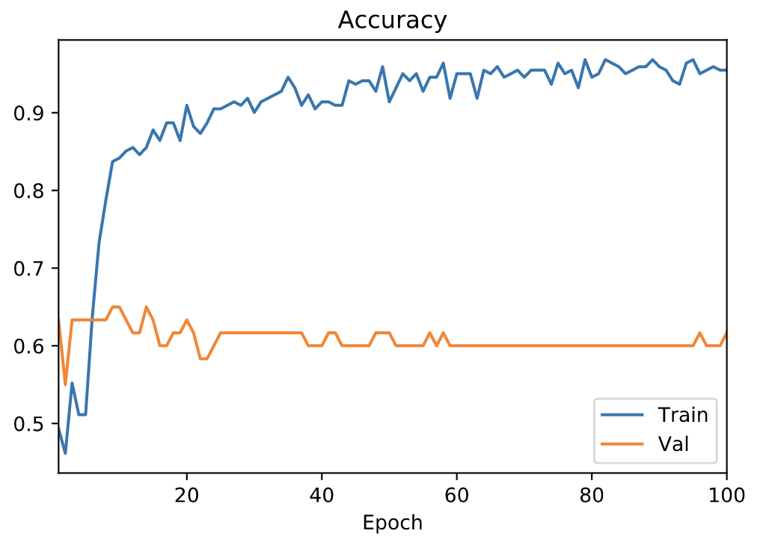
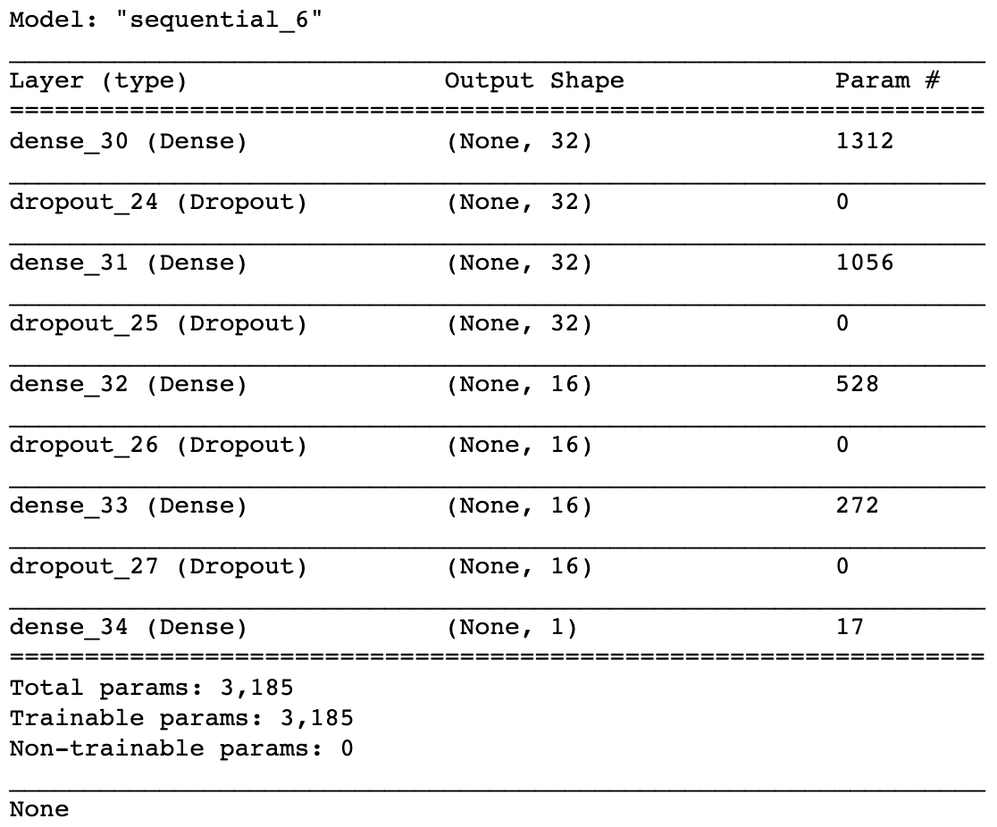
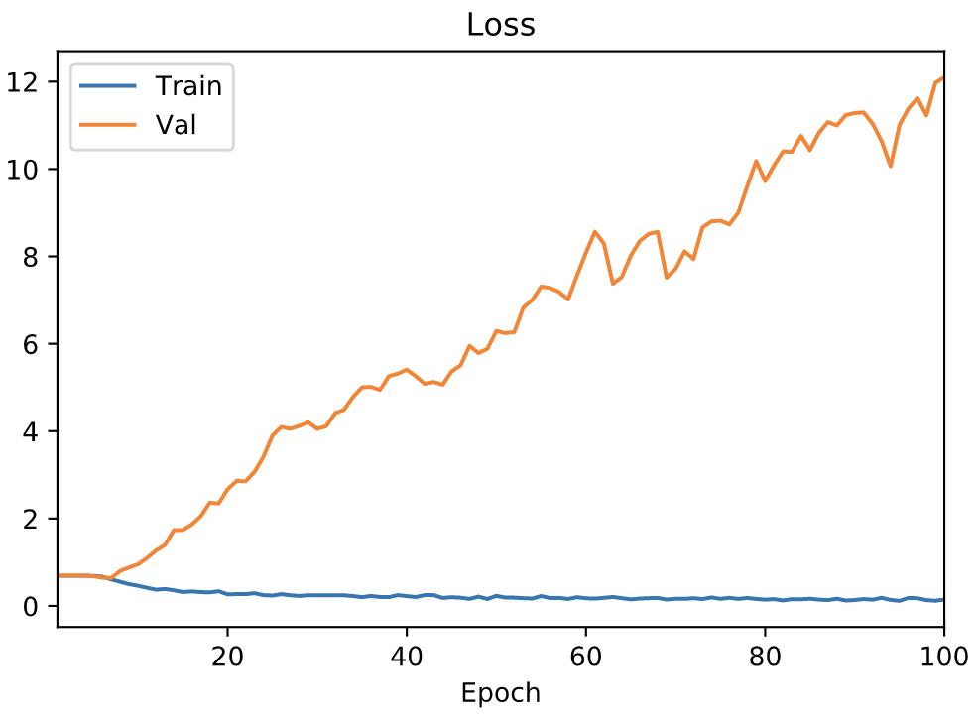
Model Analysis

Slide 8
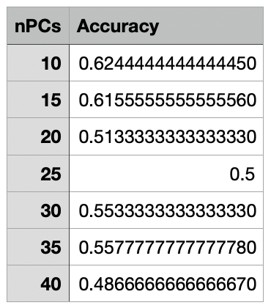
Model Results
Accuracy Report
The accuracy report shows how accurate our model was at predicting a take profit scenario (1 vs 0 in our result column). When predicting only 1, this is the accuracy.

Slide 9
Backtesting
As a final step of our process, we backtested the models on data that was never before seen in the model.
This allowed us to test our model and strategy to see if it is accurately predicting on new data.
This was used on the last 17.5% of the original data.

Slide 10
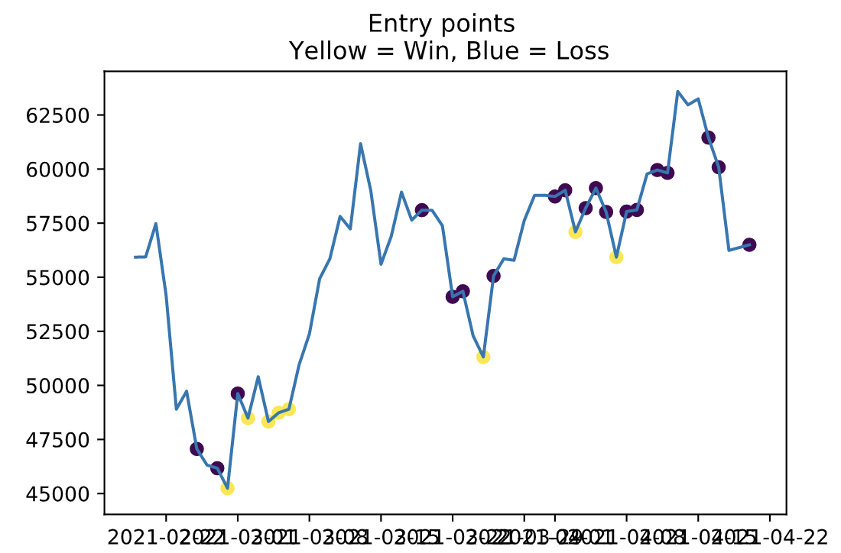
Model Results
The result of our most accurate model was a ROI of - 0.16% while trading blindly bullish over the same period yielded a ROI of - 1.514 %. This leads us to believe that there is room for growth in the model and that more data and testing is needed in order to increase the accuracy of the model.

Slide 11
Postmortem / Q&A
Some unexpected issues we experienced included:
Finding a method to run, save, and load multiple models
We used the pickle package in Python but had to seek out a fix online to enable pickling of keras models as it is not supported by default
The models are not accurate, given more time we would adjust the model architecture more to see if that makes an impact on the accuracy of the model.
With more time, we would also deploy our model across a larger range of Cryptocurrencies other than just BTC (ie. Etherum, Ripple, etc.)
Questions?

