Slide 1

Renewable Energy
Joshua Bond, Harry Torres, Raquel Quaglia

Slide 2
Why Renewable Energy?
Our motivation for choosing renewable energy as a topic for research and analysis was partially attributed to living in one of the largest energy capitals in the World, but also, because of the ever-growing effort to transition away from non-renewable resources. We seek to better understand the effect of renewable energy on electricity generation and prices, industry, and financial markets.
We were able to answer our questions to varying degrees. Understanding the connection between energy sources and costs was difficult to fully accomplish due to the complexity of the relationship dynamic. However, we found evidence of a strong relationship between the consumption of renewable energy and the increase in manufacturing output over the same period. Likewise, we were able to gain valuable insights into the potential of renewable energy in relation to financial markets and investment.

Slide 3
Our Questions
How has electricity generation from non-renewable and renewable sources changed over time, what percentage of the total electricity generation does each source account for, and what is the relationship between electricity sources and the costs associated with getting electricity to the end user and retail cost of electricity?
How has renewable energy consumed in the industrial sector influenced the manufacturing output within the U.S., and what impact does it have on industry in the financial markets?
What could be more profitable, a Renewable Energy Stocks Portfolio in a scope of 5y, 10y and 15y, a Traditional Energy Stocks Portfolio for the same time, or a Diversified Energy Portfolio?
Data:
To accomplish our goal of answering these questions, we needed data on energy consumption, energy generation, energy prices, manufacturing and industrial output, and financial market data relating to companies and funds that fell within the scope of our inquiries.
Fortunately, much of the energy data was available through the U.S. Energy Information Administration website. To find data on manufacturing and industry, we took advantage of information provided by the U.S. Bureau of Labor Statistics. The financial data was acquired from the Google Finance and ETF Database websites.

Slide 4
1. Electricity Generation and Prices How has electricity generation from non-renewable and renewable sources changed over time, what percentage of the total electricity generation does each source account for, and what is the relationship between electricity sources and the costs associated with getting electricity to the end user and retail cost of electricity?

Slide 5
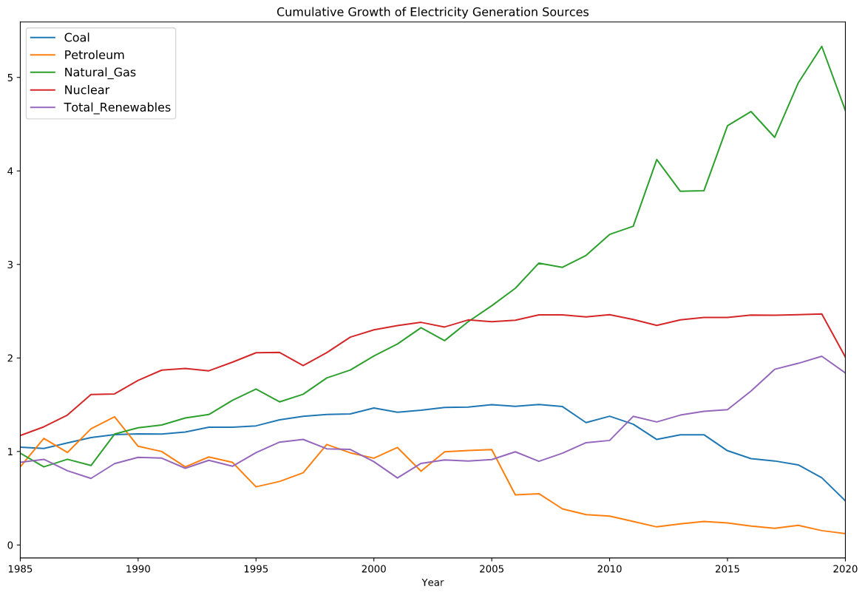
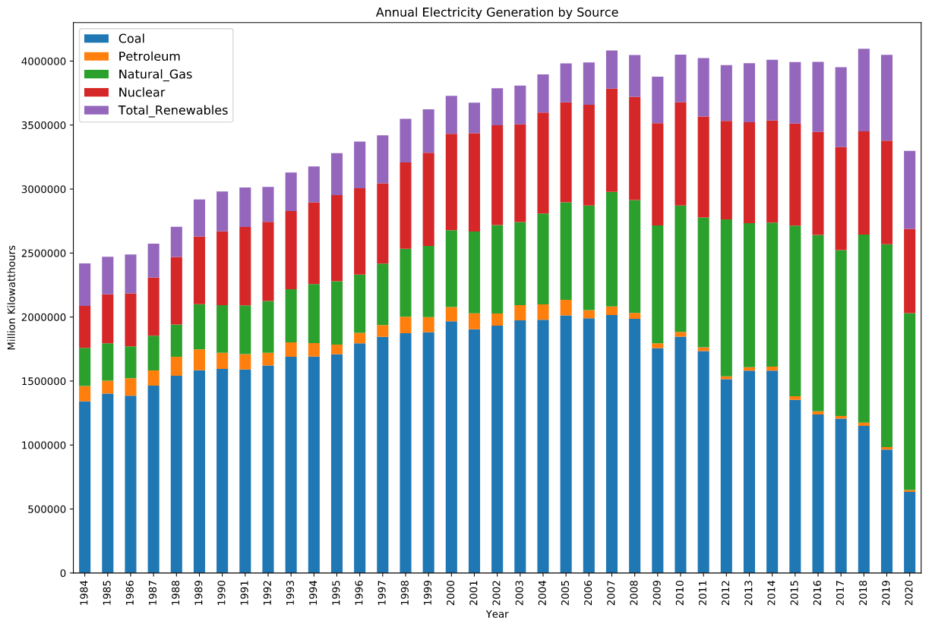
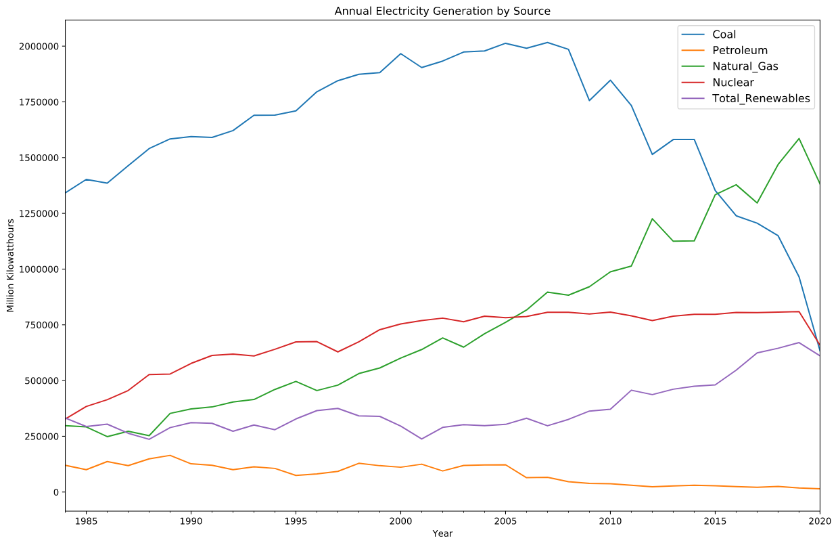
Electricity Generation

Slide 6
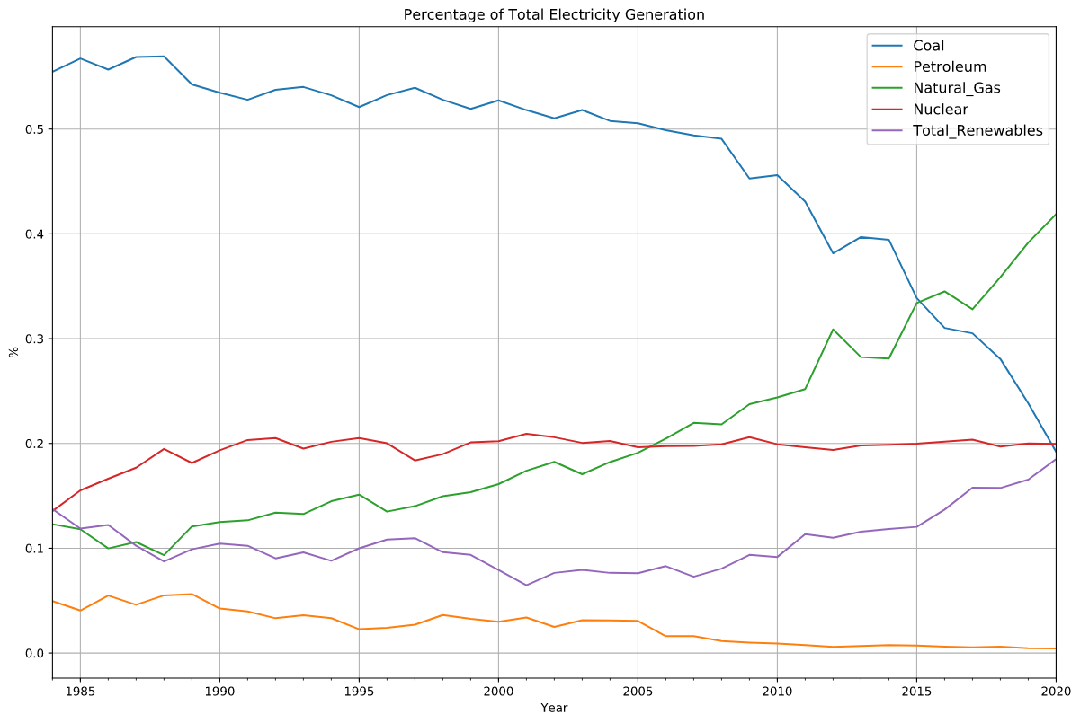
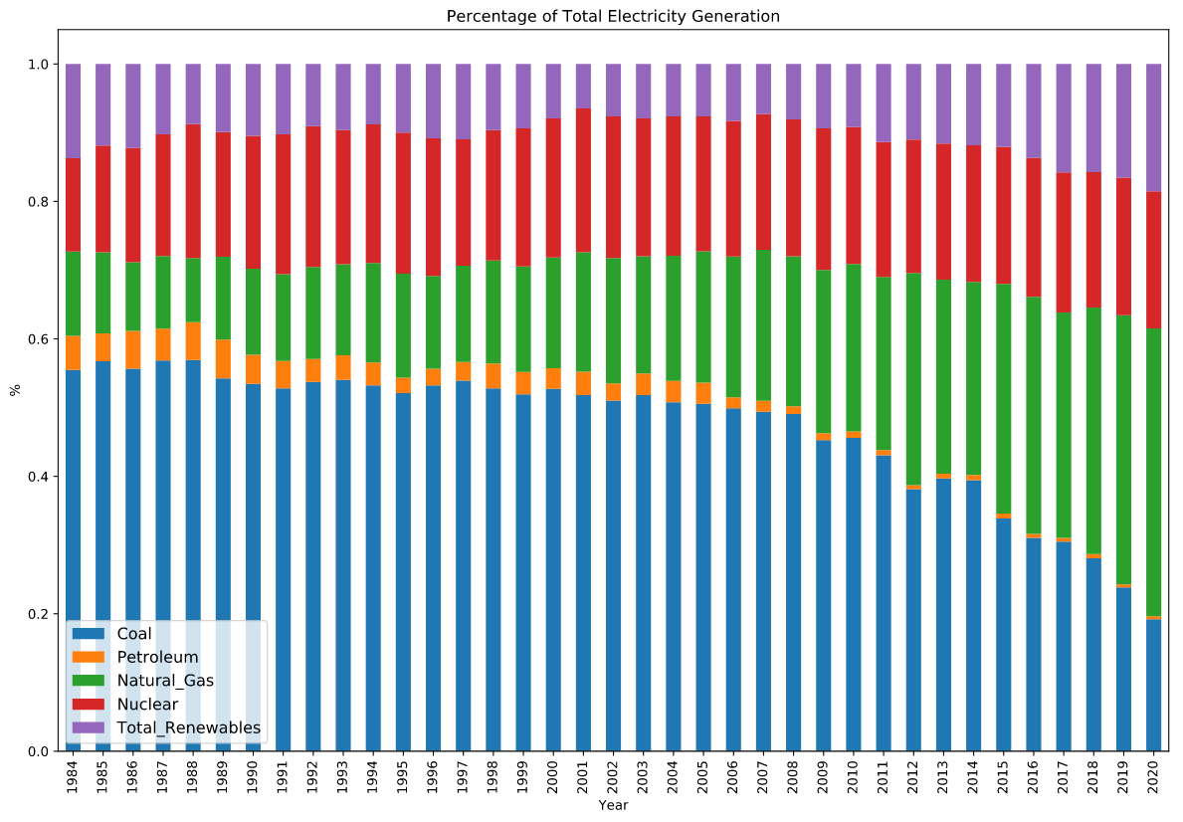
Electricity Generation Sector Composition

Slide 7
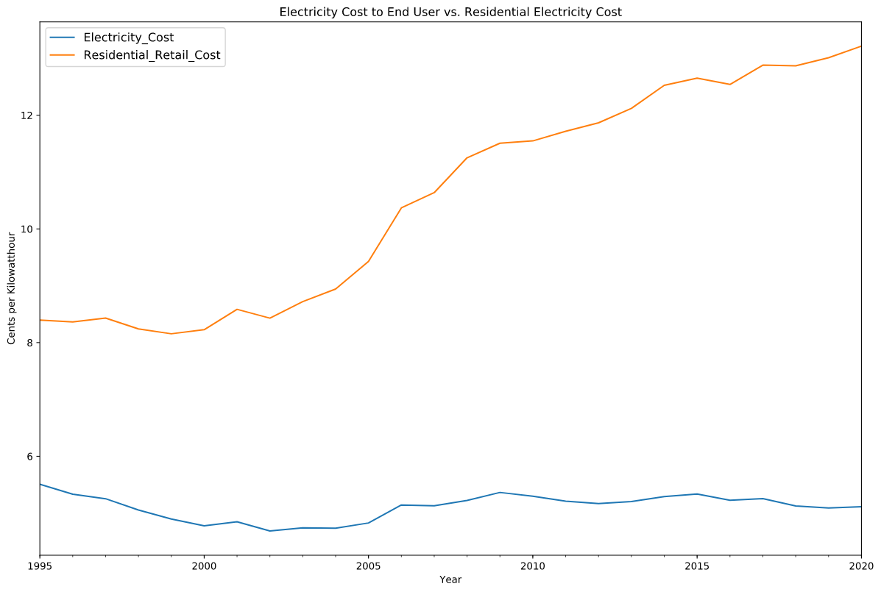
Their Cost vs. Our Cost
57% Increase

Slide 8
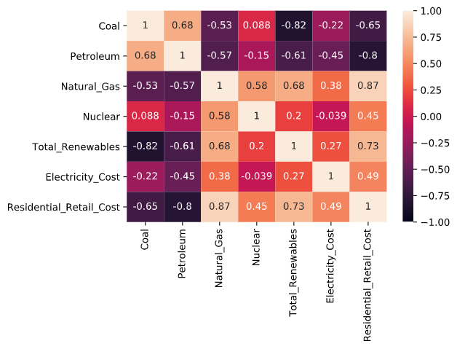
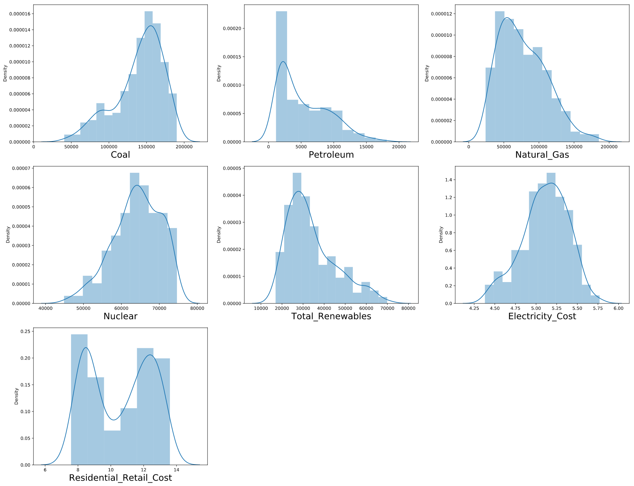
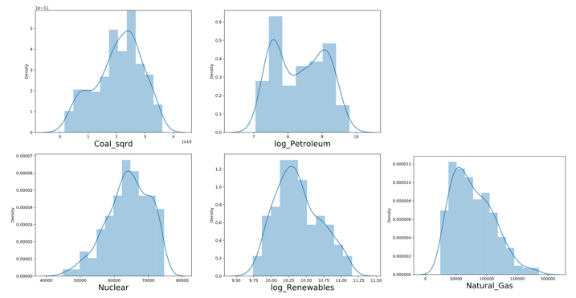
Correlation or Causation?
Original data distributions
Transformed data distributions

Slide 9
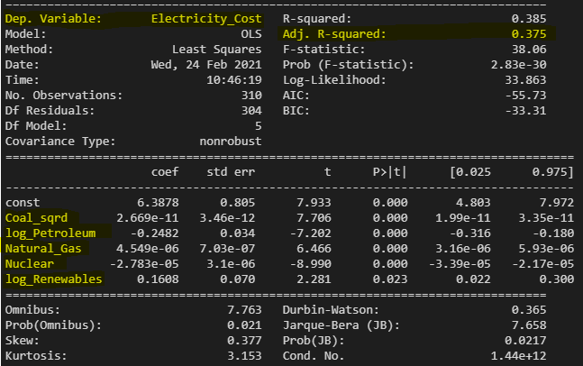
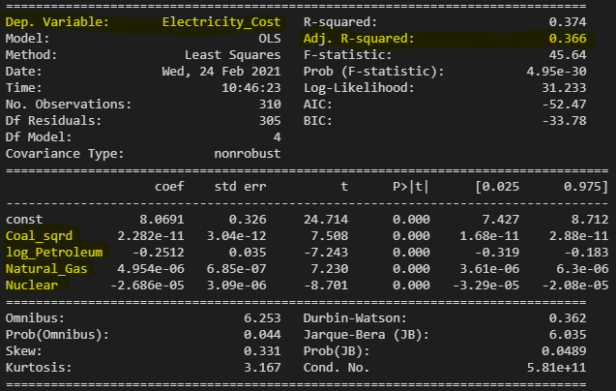
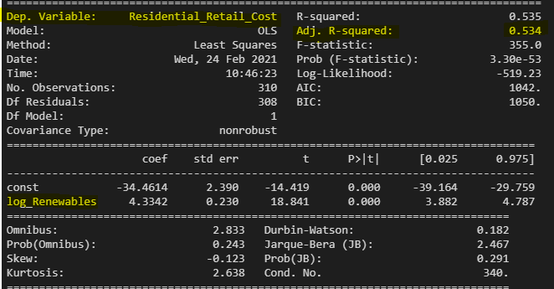
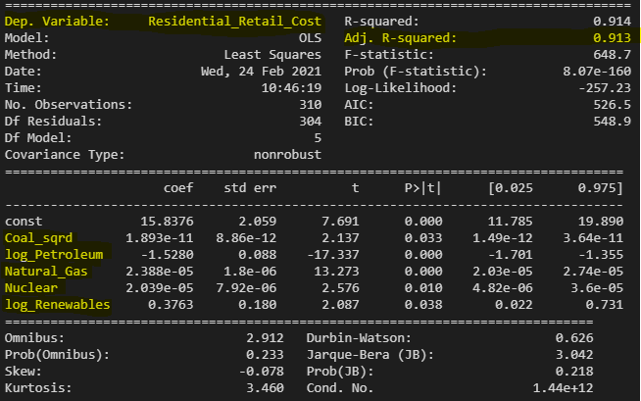
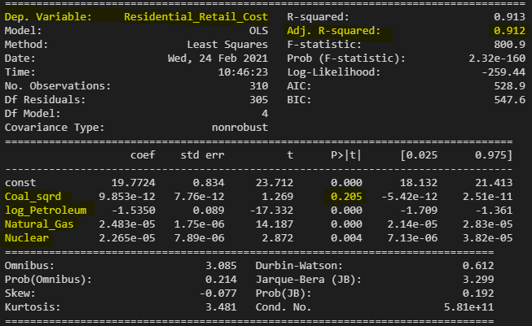
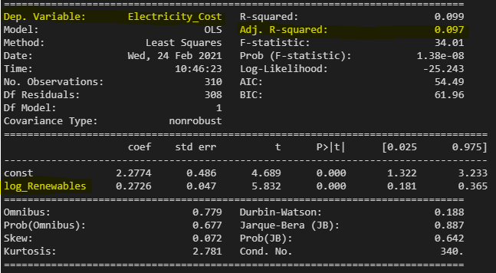
OLS Regression Results
All Energy Sources
Non-renewable Energy Sources
Renewable Energy Sources
Electricity Cost to End User
Residential Retail Cost

Slide 10
2. Renewable Energy and Industry How has renewable energy consumed in the industrial sector influenced the manufacturing output within the U.S., and what impact does it have on industry in the financial markets?

Slide 11
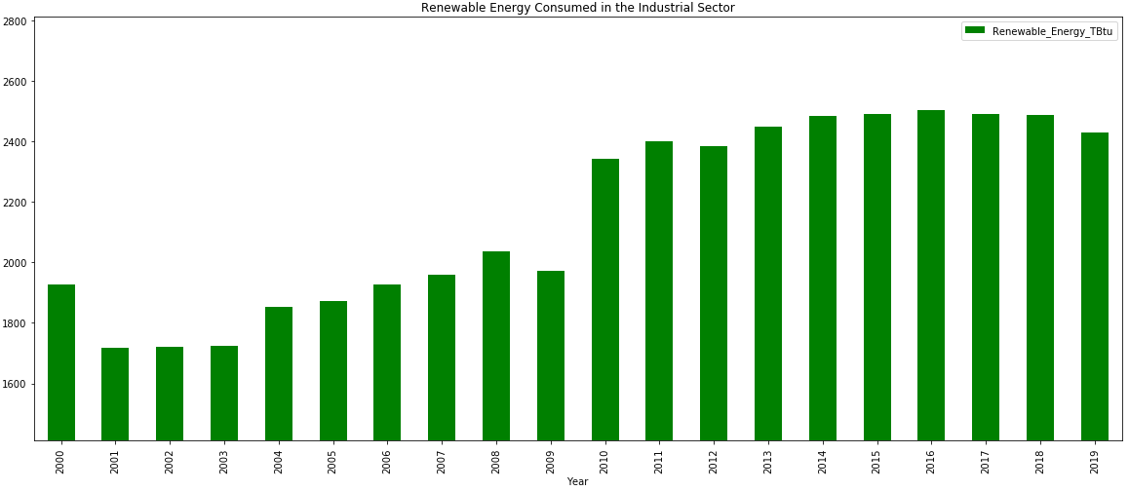
The Great Recession of 2009
26% Increase over 19 years

Slide 12
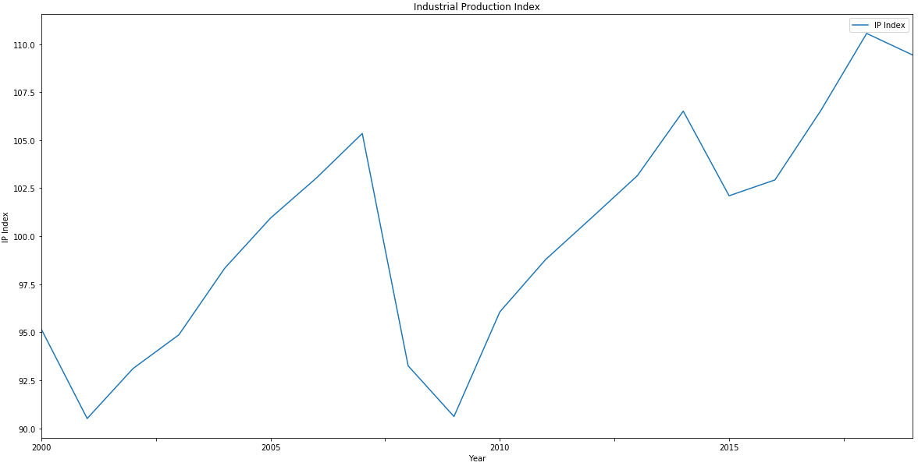
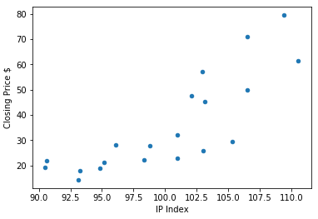

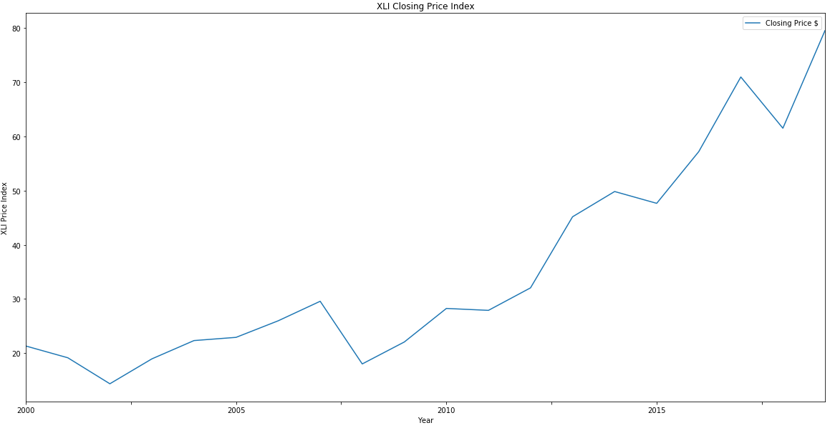
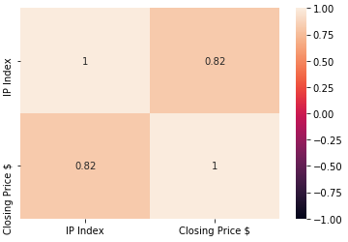

The Great Recession of 2009
The Great Recession of 2009

Slide 13
3. Energy Portfolio Data Analysis What could be more profitable, a Renewable Energy Stocks Portfolio in a scope of 5y, 10y and 15y, a Traditional Energy Stocks Portfolio for the same time, or a Diversified Energy Portfolio?

Slide 14
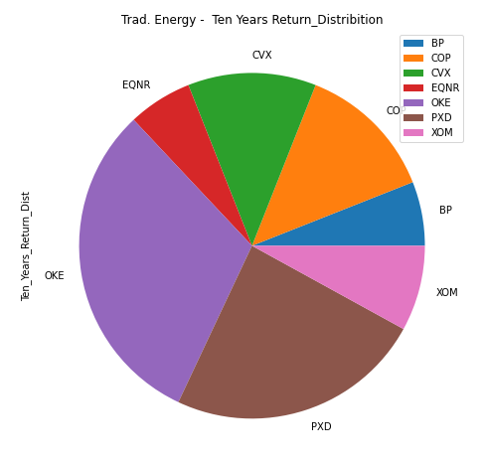
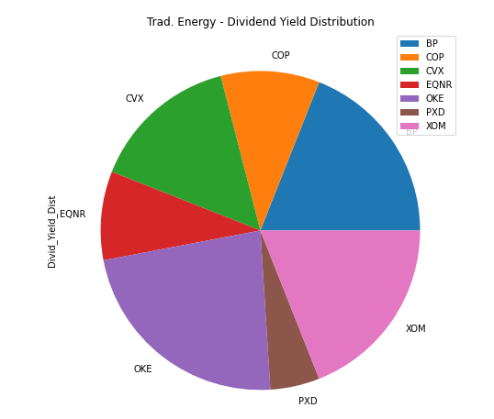
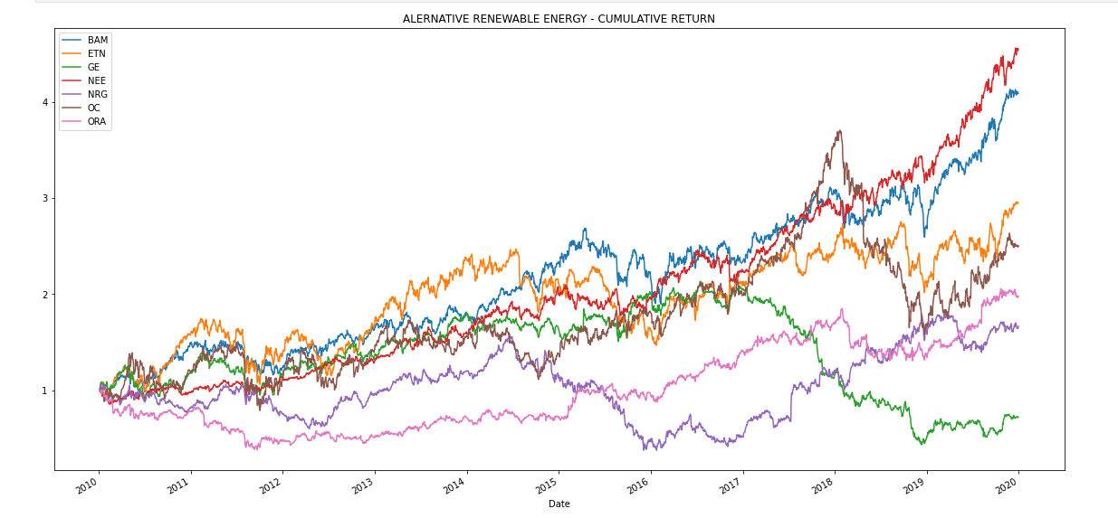
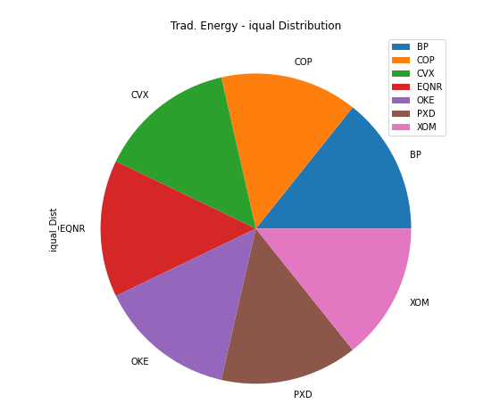
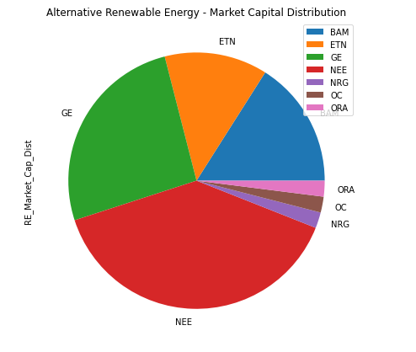
Portfolio Data Analysis: Data Imported from Google Finance (as.csv file)
Alternative Renewable Energy
Traditional Energy Stocks
Symbol | Description | Exchange | Sector
SPY | Spdr S&P 500 | NYSE ARCA | --
BAM | Brookfield Asset Mgm F | NYSE | Financials
ETN | Eaton Corp Plc F | NYSE | Industrials
GE | General Electric Co | NYSE | Industrials
NEE | Nextera Energy Inc | NYSE | Utilities
NRG | Nrg Energy Inc | NYSE | Utilities
OC | Owens Corning Fiberglas | NYSE | Industrials
ORA | Ormat Technologies | NYSE | Utilities
Symbol | Description | Exchange | Sector
SPY | Spdr S&P 500 | NYSE ARCA | --
BP | Bp | NYSE | Energy
COP | Conocophillips | NYSE | Energy
CVX | Chevron Corp | NYSE | Energy
EQNR | Equinor A S A | NYSE | Energy
OKE | Oneok Inc | NYSE | Energy
PXD | Pioneer Natural Res | NYSE | Energy
XOM | Exxon Mobil Corp | NYSE | Energy
Date | BAM | ETN | GE | NEE | NRG | OC | ORA
1/4/2010 | 9.43 | 32.16 | 15.45 | 13.31 | 23.87 | 26.01 | 37.87
1/5/2010 | 9.58 | 31.97 | 15.53 | 13.18 | 24.24 | 26.11 | 38
1/6/2010 | 9.48 | 31.83 | 15.45 | 13.31 | 24.77 | 25.96 | 38
10Y cum Return
Dividend Yield
Equal Weight
Market Cap W

Slide 15
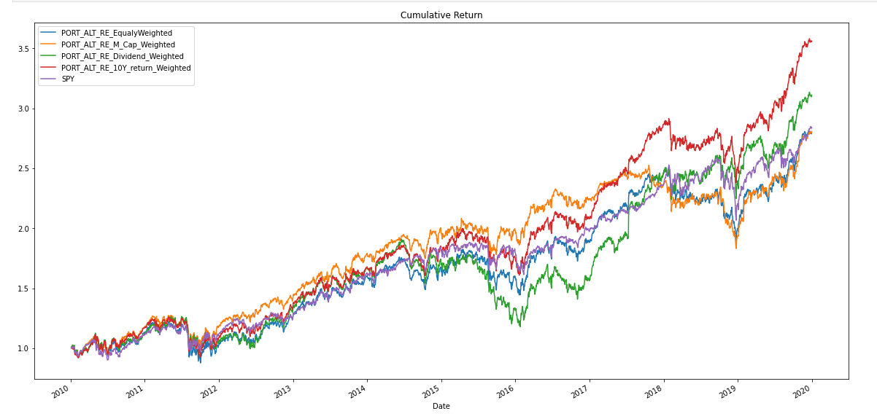
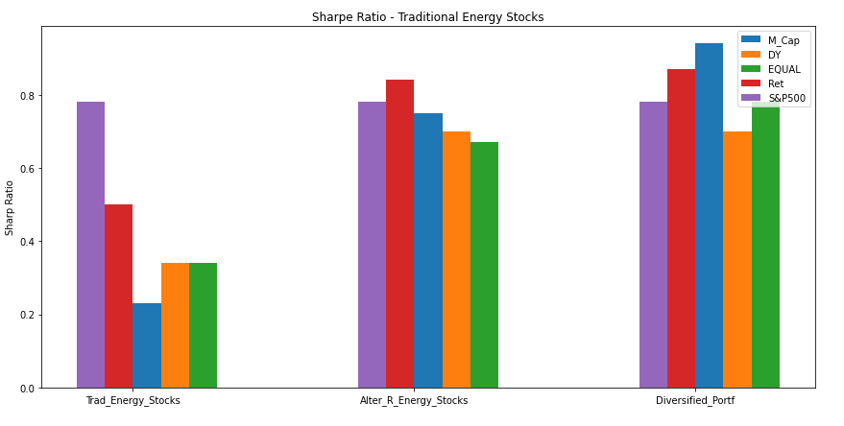
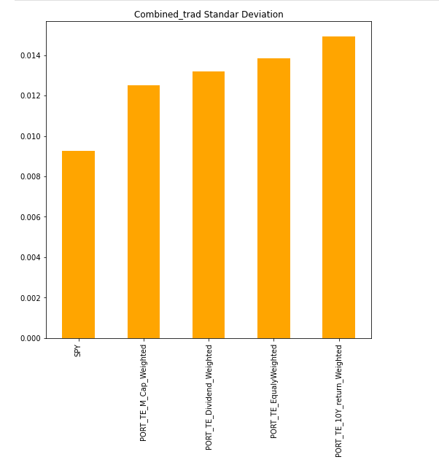
Volatility & Risk / Return
Best Relation Risk/Reward
Market
Capital
S&P500
10Y. Cum-Return
10Y. Cum-Return
S&P500
S&P500
10Y. CReturn

Slide 16
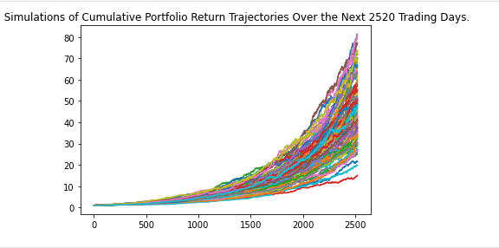
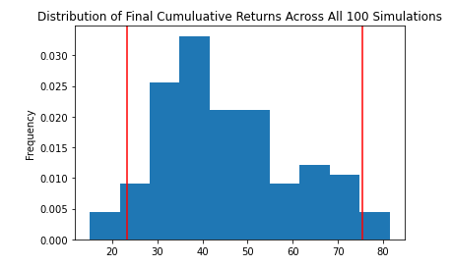
Monte Carlo Simulation: Data imported using ALPACA-IPA
Investment : $10,000.00
Equal Weight
4 models= Market Cap W
Dividend Y W.
10 Years cumulated Return
3-time lapse : 10, 20, 30 years
Lower and Upper `95%` Confidence Intervals

Slide 17
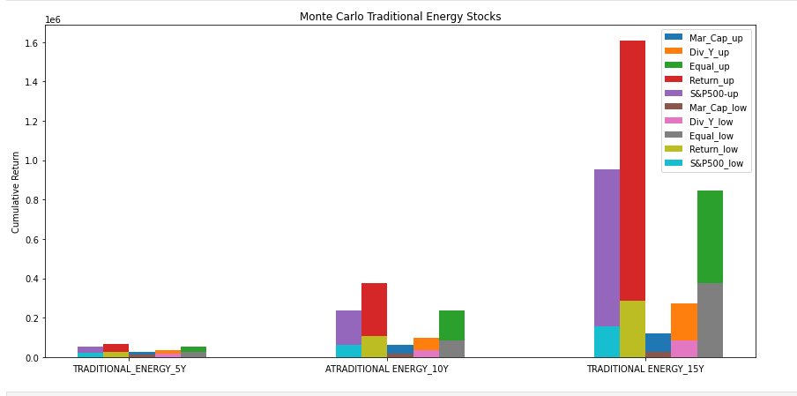
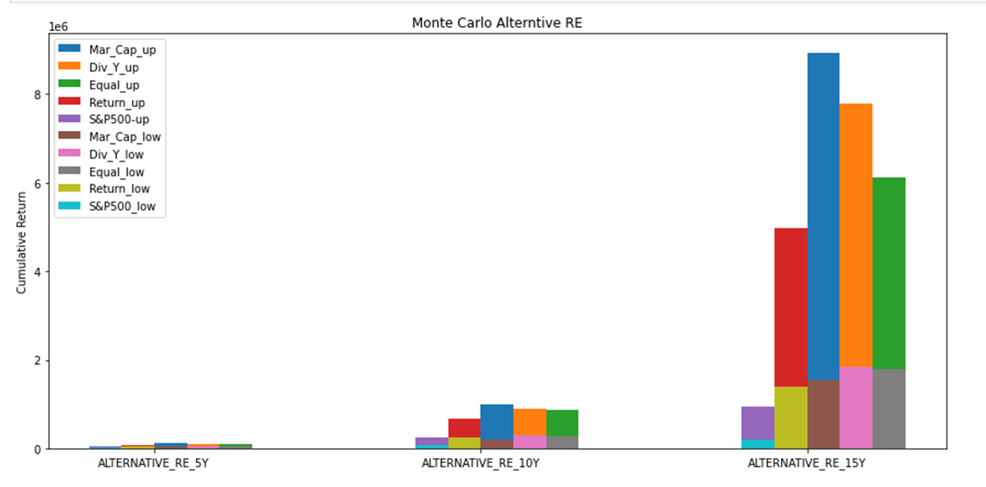
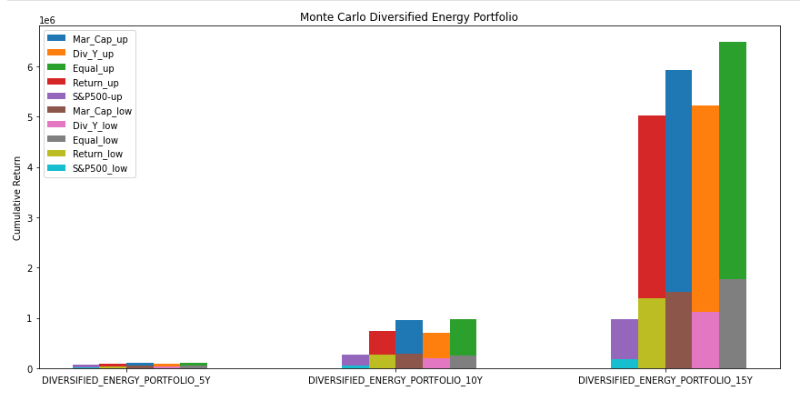
Monte Carlo Simulation: Results
** Monte Carlo simulation weighted by Stock 10 years Cumulated Return
95% ci Upper (5 Years) = $25506.99 and 95% ci Lower (5 Years) = $68846.43
95% ci Upper (10 Years) = $108105.55 and 95% ci Lower (10 Years) = $375724.94
95% ci Upper (15 Years) = $286204.82 and 95% ci Lower (15 Years) = $1606266.28

Slide 18
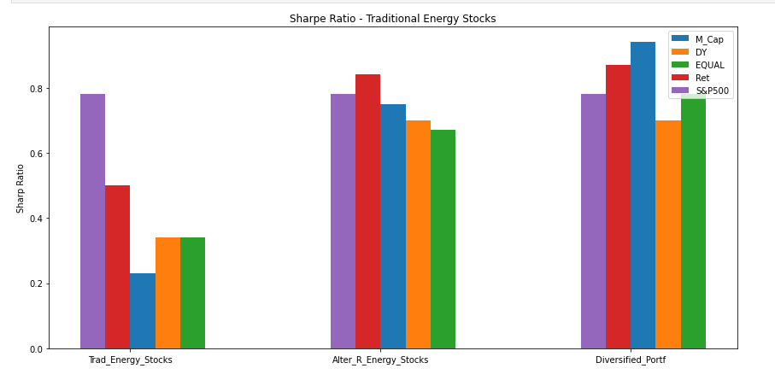
What could be more profitable, a Renewable Energy Stocks Portfolio in a scope of 5y, 10y and 15y, a Traditional Energy Stocks Portfolio for the same time, or a Diversified Energy Portfolio?
Best Relation Risk/Reward
Market
Capital
10Y. Cum-Return
S&P500

Slide 19
Questions?

