Slide 1
SOFE 3650 – Software Architecture Design Process
Notes created from “Designing Software Architectures- A practical Approach”, H. Cervantes and R. Kazman, Chapter 3, the Attribute-Driven Design Approach and reproduced fom Carnegie Mellon SEI presentation by Cervantes and Kazman.
https://resources.sei.cmu.edu/library/asset-view.cfm?assetid=436536

Slide 2
Why is a design method necessary?
Architecture design is notoriously difficult to master
Many aspects need to be considered when making design decisions
It requires extensive knowledge of the domain and existing solutions
However, design can (and should) be performed in a systematic way
To ensure that decisions are made with respect to the drivers.
To ensure that decisions are recorded and justified and to make the architect accountable for them
To provide guidance to less experienced people
Otherwise, architecture design may end up being seen a mystic activity performed by gurus.

Slide 3

Architecture design methods
There exist several architecture development methods
Viewpoints and Perspectives
Microsoft
Process of Software Architecting
ACDM
RUP
ADD
Most of them cover the whole architecture lifecycle and provide few details on how to perform the design activity
Architectural drivers
<<precedes>>
Architectural design
<<precedes>>
Architectural documentation
<<precedes>>
Architectural evaluation

Slide 4
The Attribute-Driven Design Method
Packaging of many of the techniques already discussed.
An iterative method. At each iteration you
Choose a part of the system to design.
Marshal all the architecturally significant requirements for that part.
Generate and test a design for that part.
ADD does not result in a complete design
Set of containers with responsibilities
Interactions and information flow among containers
Does not produce an API or signature for containers.

Slide 5
ADD Inputs and Outputs
Requirements
Functional
Quality
Constraints
ADD Process
Containers
Responsibilities
Interactions
Information flow

Slide 6



















Steps in ADD
Design objectives
Primary functional requirements
Quality attribute scenarios
Constraints
Concerns
Step 1: Review Inputs
Step 2: Establish iteration goal by selecting drivers
Step 3: Choose one or more elements of the system to decompose
Step 8: Refine as necessary
Step 4: Choose one or more design concepts that satisfy the selected drivers
Step 5: Instantiate architectural elements, allocate responsibilities and define interfaces
Step 6: Sketch views and record design decisions
Input/output artifact Process step
Step 7: Perform analysis of current design and review iteration goal and design objectives
Software architecture design

Slide 7


ADD Step 1 – Review Inputs
Design objectives
Primary functional requirements
Quality attribute scenarios
Constraints
Concerns
Step 1: Review Inputs
Step 2: Establish iteration goal by selecting drivers
Step 3: Choose one or more elements of the system to decompose
Before starting with design, ensure that there is clarity on the overall design problem that needs to be
Step 8: Refine as necessary
Step 4: Choose one or more design concepts that satisfy the inputs considered in the iteration
Step 5: Instantiate architectural elements, allocate responsibilities and define interfaces
solved.
Step 6: Sketch views and record design decisions
Step 7: Perform analysis of current design and review iteration goal and design objectives
Software architecture design

Slide 8
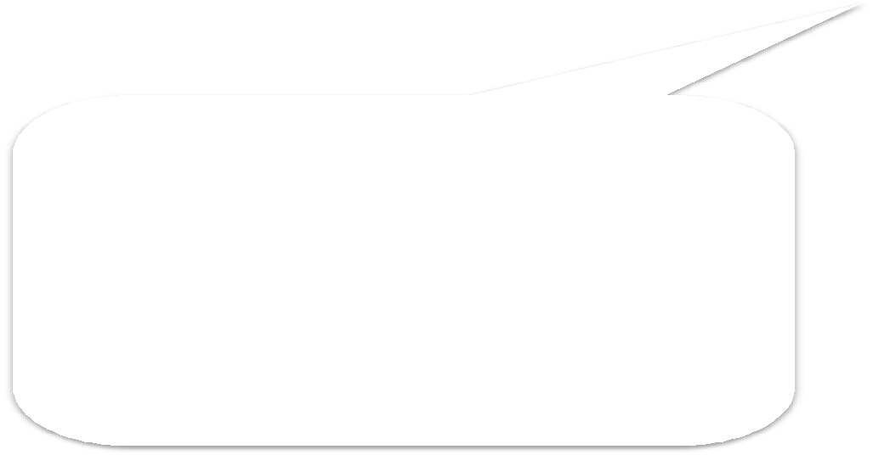
ADD Step 1 – Select Drivers
Design objectives
Primary functional requirements
Quality attribute scenarios
Constraints
Concerns
Step 1: Review Inputs
Step 2: Establish iteration goal by selecting drivers
Step 3: Choose one or more elements of the system to decompose
The design problem is divided into several sub-
Step 8: Refine as necessary
Step 4: Choose one or more design concepts that satisfy the selected drivers
problems.
Step 5: Instantiate architectural elements, allocate responsibilities and define interfaces
An iteration
starts by sub-
Step 6: Sketch views and record design decisions
deciding which problem to address.
Step 7: Perform analysis of current design and review iteration goal and design objectives
Software architecture design

Slide 9
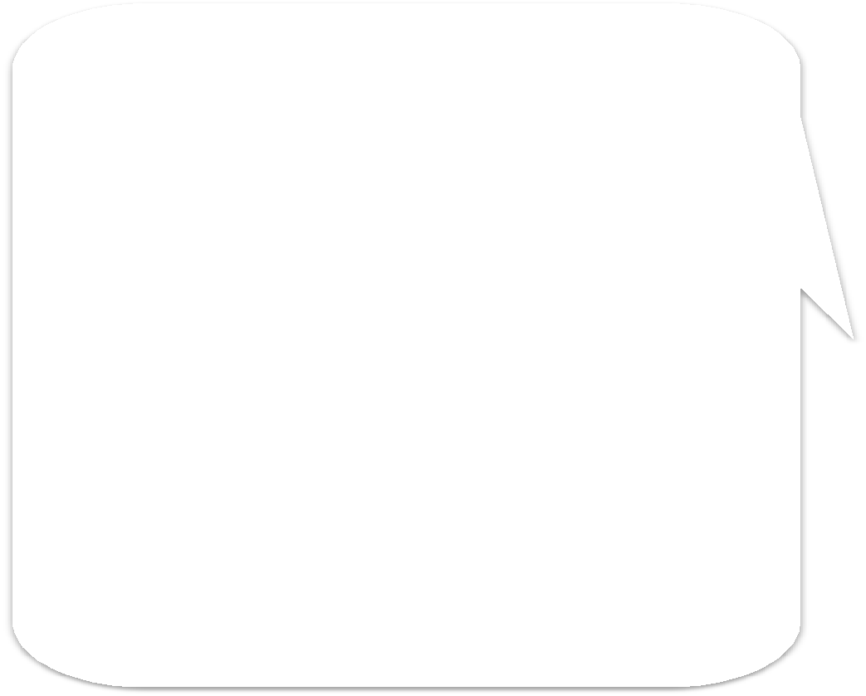

Steps 3-5
Design objectives
Primary functional requirements
Quality attribute scenarios
Constraints
Concerns
3 types of decisions are
made to address the sub- problem:
Step 1: Review Inputs
Step 2: Establish iteration goal by selecting drivers
1.- Selection of the parts
that need to be
decomposed
Step 3: Choose one or more elements of the system to decompose
Step 8: Refine as necessary
Step 4: Choose one or more design concepts that satisfy the selected drivers
2.- Identification and selection of existing solutions that support the decomposition
Step 5: Instantiate architectural elements, allocate responsibilities and define interfaces
Step 6: Sketch views and record design decisions
3.- Creation of elements from the existing solution and establishment of their
Step 7: Perform analysis of current design and review iteration goal and design objectives
responsibilities and
Software architecture design
interfaces

Slide 10



Step 6
Design objectives
Primary functional requirements
Quality attribute scenarios
Constraints
Concerns
Step 1: Review Inputs
Step 2: Establish iteration goal by selecting drivers
The “blueprint” is refined. This may be done in parallel with step 5.
Step 3: Choose one or more elements of the system to decompose
Step 8: Refine as necessary
Step 4: Choose one or more design concepts that satisfy the selected drivers
Note: This is not full blown documentation but rather
Step 5: Instantiate architectural elements, allocate responsibilities and define interfaces
sketches.
Step 6: Sketch views and record design decisions
Step 7: Perform analysis of current design and review iteration goal and design objectives
Software architecture design

Slide 11


Step 7
Design objectives
Primary functional requirements
Quality attribute scenarios
Constraints
Concerns
Step 1: Review Inputs
Step 2: Establish iteration goal by selecting drivers
Decisions made at this point are analyzed along with the advances in the overall design process in order to decide if more iterations are necessary.
Step 3: Choose one or more elements of the system to decompose
Step 8: Refine as necessary
Step 4: Choose one or more design concepts that satisfy the selected drivers
Step 5: Instantiate architectural elements, allocate responsibilities and define interfaces
Step 6: Sketch views and record design decisions
Step 7: Perform analysis of current design and review iteration goal and design objectives
Software architecture design

Slide 12



A Design is Produced
Design objectives
Primary functional requirements
Quality attribute scenarios
Constraints
Concerns
Step 1: Review Inputs
Step 2: Establish iteration goal by selecting drivers
Step 3: Choose one or more elements of the system to decompose
Step 8: Refine as necessary
Step 4: Choose one or more design concepts that satisfy the selected drivers
A design is produced.
Step 5: Instantiate architectural elements, allocate responsibilities and define interfaces
Note: This may be only a partial architecture design and is not Big Design Up
Step 6: Sketch views and record design decisions
Step 7: Perform analysis of current design and review iteration goal and design objectives
Front (BDUF)!
Software architecture design

Slide 13

Design decisions
The design process involves different making design decisions
Step 3: Selecting elements to decompose
Step 4: Choosing one or more design concepts that satisfy the inputs considered in the iteration
Step 5: Instantiating architectural elements, allocating responsibilities and defining interfaces
Step 4 (selecting design decisions) can be particularly challenging…

Slide 14


Design Concepts
Most sub-problems that are addressed during an iteration can be solved using existing solutions, i.e. design concepts
We want to avoid re-inventing the wheel
It is better (and faster) to use a proven solution to a problem for which we may not be experts
Creativity in design involves identifying, adapting and combining them
There are several categories of design concepts, some are abstract and some more concrete. Here we consider:
Reference Architectures
Deployment Patterns
Architectural / Design Patterns
Tactics
Externally developed components (e.g. Frameworks)
VS.

Slide 15
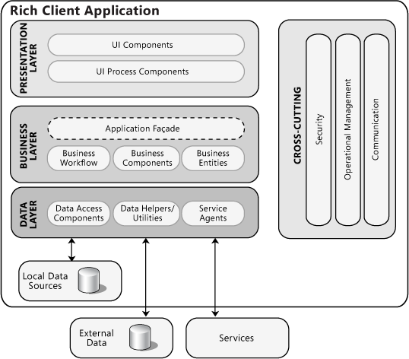
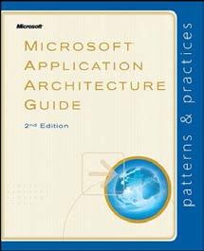
Reference Architectures
They provide a blueprint for structuring an application. Examples for the enterprise application domain include
Mobile applications
Rich client applications
Rich internet applications
Service Applications
Web applications
https://docs.microsoft.com/en-us/previous-versions/msp-n-p/ff650706(v%3dpandp.10)

Slide 16
Deployment Patterns
Deployment patterns provide guidance on how to structure the system from a physical standpoint. Good decisions with respect to the deployment of the software system are essential to achieve quality attributes such as availability.
Examples
2, 3, 4 and n-tier deployment
Load balanced cluster
Failover cluster
Private/public cloud
Etc…

Slide 17
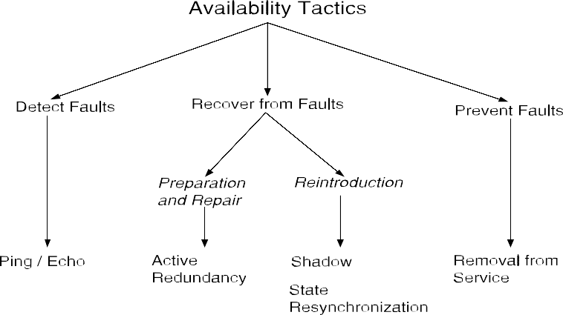






Tactics
What are tactics?
Design decisions that influence the control of a quality attribute response.
There are tactics categorizations for the quality attributes of:
Availability
Interoperability
Modifiability
Performance
Security
Testability
Usability

Slide 18
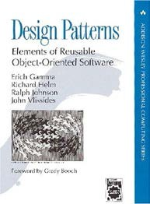



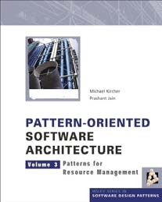
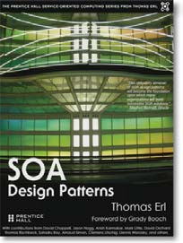
Architectural / Design patterns
Patterns are proven (conceptual) solutions to recurring design problems. Originated in building architecture.
Many patterns exist (thousands), and they are documented across several pattern catalogs.
It is difficult to draw a clear boundary between “design” and “architectural” patterns.

Slide 19
Externally developed components
These are reusable code solutions
E.g. Middleware, frameworks
A Framework is a reusable software element that provides generic functionality, addressing recurring concerns across a range of applications.
Examples for Java:
Concern | Framework | Usage
Local user interface | Swing | Inheritance
Web UI | Java Server Faces (JSF) | XML, Annotations
Component connection | Spring | XML, Annotations
Security (authentication, auth) | Spring-Security | XML, Annotations
OO – Relational Mapping | Hibernate | XML, annotations

Slide 20








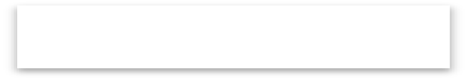










Selecting design concepts (step 4)
Design concept
Design concept Design concept
Design concept
Iteration goal
Design concept
Design concept
Design concept
Design concept Design concept
Generation of candidates
Selection

Slide 21
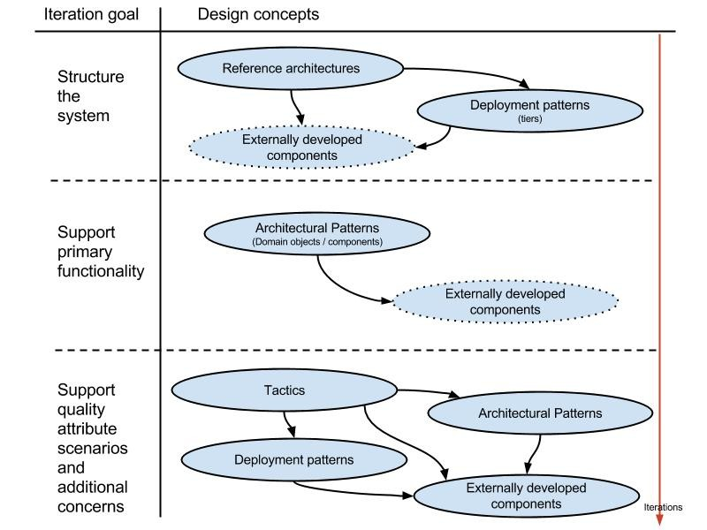



Selection roadmap
Greenfield systems in mature domains
Design concept
Design concept (optional) Design concept

Slide 22
In-Class Exercise
Download the slides on ADD located at
https://resources.sei.cmu.edu/library/asset-view.cfm?assetid=436536
Commencing on slide 38 there is a good example of using ADD to design an architecture for a Network Management System.
Go through the slides for one iterations and answer the following questions:
What is a Greenfield Systems for Mature Domains?
Explain why QA-3 might be chosen over the other scenarios.
Is the Quality Scenario table on slide 42 a representation of a Utility Tree?
Note that there are no requirements listed for this example. Why not?
Design decisions are made on slide 49. One choice is the Rich client reference architecture based on the Microsoft Architecture guide. https://docs.microsoft.com/en-us/previous-versions/msp-n-p/ff650706(v%3dpandp.10)
Why is a rich user interface be a requirement?
Does a rich user interface offer portability?
How are the major architectural entities being represented in Step 5 slide 51?
Step 7 in slide 54 is a Kanban diagram. We have not studied but they are a relatively simple tool. What are they and what is their role in this step?

Slide 23
Following a Design Roadmap According to System Type
In the last lecture and class exercise you studied an example of the software architectural design for a network management system based on the the design of a greenfield system for a mature (i.e., well-known) domain.
This is a very typical type of system.
Design of software systems falls into three broad categories:
The design of a greenfield system for a mature (i.e., well-known) domain;
the design of a greenfield system for a domain that is novel (i.e., a domain that has a less established infrastructure and knowledge base);
the design for making changes to an existing system (brownfield).

Slide 24
Greenfield systems in mature domains
Types of applications:
Traditional desktop applications
Image Interactive applications that run on a mobile device
Image Enterprise applications accessed from a web browser,
Design concept
Design concept (optional) Design concept

Slide 25
Advantages of Using the Greenfield Systems in Mature Domains Roadmap
The process of starting an architectural design is always complex.
Many of the steps in this roadmap are frequently overlooked or done in an intuitive and ad hoc way, rather than in a well-considered, reflective way.
Different types of design concepts exist, and it is not always clear at which point in the design they should be used.

Slide 26
Design of Greenfield Systems for Novel Domains
These applications are novel so reference architectures may not exist and there may be few, if any, externally developed components that you can use.
You are, more than likely, working from first principles and creating your own home-grown solutions.
Your design goal will focus on the creation of prototypes so that you can explore possible solutions to the challenge that you are facing.
In particular, you may need to focus on quality attributes and design challenges oriented toward issues such as performance, scalability, or security.

Slide 27
Design for an Existing System (Brownfield)
These are existing system that are being modified:
satisfy new requirements, correct issues, refactoring.
Refactoring
Changes in the architecture of an existing system, without altering its functions, to reduce technical debt, to introduce technology updates, or to fix quality attribute problems (e.g., the system is too slow, or insecure, or frequently crashes).

Slide 28
Design for an Existing System (Brownfield)
To be able to choose elements to decompose as part of the design process (step 3 of ADD), you need to first identify which elements are present in the architecture of the existing system.
Your first goal should be to make sure that you have a clear understanding of the existing architecture of the system.
You can perform design similar to what is done for greenfield systems after the initial design iteration.

Slide 29
Design for an Existing System (Brownfield)
Your design iteration goals here will be to identify and refine structures to satisfy architectural drivers, including new functionality and quality attributes, and to address specific architectural concerns.
These design iterations will typically not involve establishing a new overall system structure unless you are dealing with a major refactoring.

Slide 30
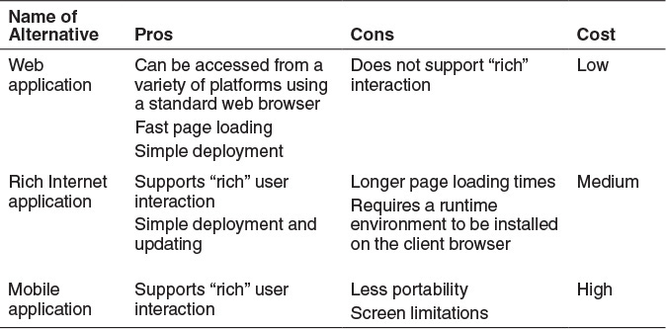
Selection of Design Concepts
Once you have identified a list of alternative design concepts, you need to select which one is the most appropriate to solve the design problem at hand.
Table to Support the Selection of Alternatives

Slide 31
Cost Benefit Analysis Method (CBAM)
An alternative to the table when deeper analysis is required.
Uses a quantitative approach.
Each architectural strategy provides a different level of utility, but also has a cost and takes time to implement.
The idea behind the CBAM is that by studying levels of utility and costs of implementation, particular architectural strategies can be selected based on their associated return on investment (ROI).

Slide 32
CBAM
The CBAM takes as its input a collection of prioritized traditional quality attribute scenarios, which are then analyzed and refined with additional information. The addition is to consider several levels of response for each scenario:
The worst-case scenario, which represents the minimum threshold at which a system must perform (utility = 0)
The best-case scenario, which represents the level after which stakeholders foresee no further utility (utility = 100)
The current scenario, which represents the level at which the system is already performing (the utility of the current scenario is estimated by stakeholders)
The desired scenario, which represents the level of response that the stakeholders are hoping to achieve (the utility of the desired scenario is estimated by stakeholders)

Slide 33
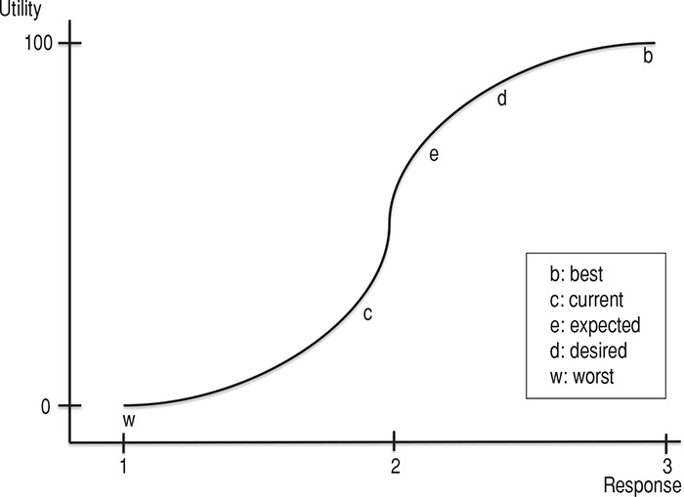
CBAM
Using these data points, we can draw a utility–response curve, as shown below.
After the utility–response curve is mapped for each of the different scenarios, a number of contemplated design alternatives may be considered, and their expected response values can be estimated.

Slide 34
CBAM Example
If we are concerned about mean time to failure, we might consider three different architectural strategies (i.e., redundancy options)
no redundancy, cold spare, and hot spare.
For each of these strategies, we could estimate their expected responses (i.e., their expected mean times to failure). In the prior graph, the “e” represents one such option, placed on the curve based on its expected response measure.
Using these response estimates, the utility values of each architectural strategy can now be determined via interpolation, which provides its expected benefit.
The costs of each architectural strategy are also elicited—one would expect hot spare to be the most costly, followed by cold spare and no redundancy.
One can now make decisions between benefits and cost.

Slide 35
Prototype Development
In case the previous analysis techniques do not guide you to make an appropriate selection, you may need to create throwaway prototypes and collect measurements from them.
Aspects that you should consider when deciding whether you will create a prototype include the following:
Does the project incorporate emerging technologies?
Is the technology new in the company?
Are there certain drivers, particularly quality attributes, whose satisfaction using the selected technology presents risks (i.e., it is not understood if they can be satisfied)?
Is there a lack of trusted information, internal or external, that provides some degree of certainty that the selected technology will be useful to satisfy the project drivers?
Are there configuration options associated with the technology that need to be tested or understood?
Is it unclear whether the selected technology can be integrated with other technologies that are used in the project?

Slide 36
Defining Interfaces
Once components are identified in the SAD design method the Architect should be looking at defining the component interfaces.
Interfaces are the externally visible properties of elements that establish a contractual specification that allows elements to collaborate and exchange information.
There are two categories of interfaces:
external and internal.

Slide 37
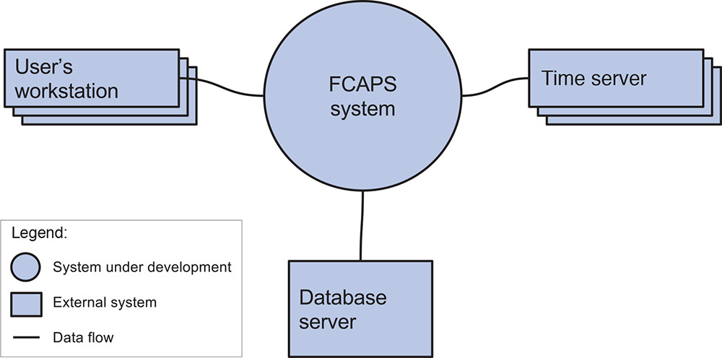
External Interfaces
External interfaces include interfaces from other systems that are required by the system that you are developing and interfaces that are provided by your system to other systems.

Slide 38
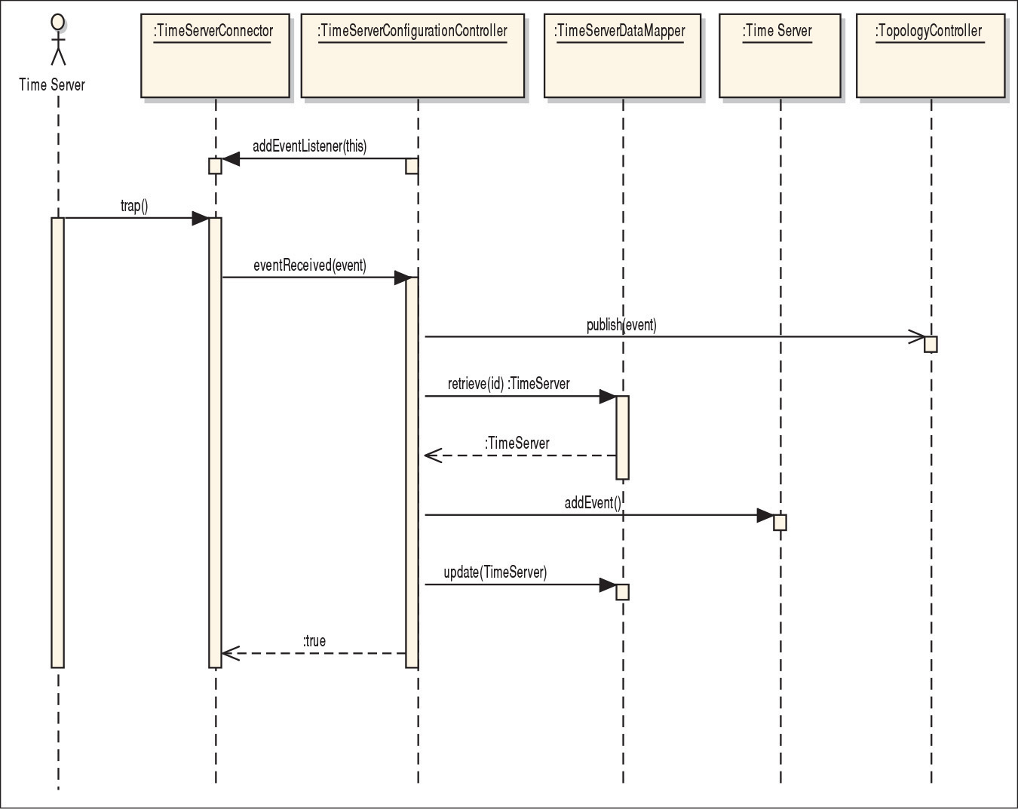
Internal Interfaces
Internal interfaces are interfaces between the elements that result from the instantiation of design concepts.
To identify the relationships and the interface details, you generally need to understand how the elements exchange information at runtime.
A UML sequence diagram is good to use to define these interfaces
This is the sequence diagram for UC-2 (detect fault) for the FCPAS system.

Slide 39
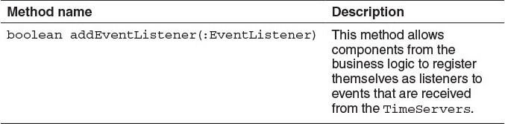
Internal Interfaces
From this interaction, initial methods for the interfaces of the interacting elements can be identified:
Name: TimeServerConnector

Slide 40
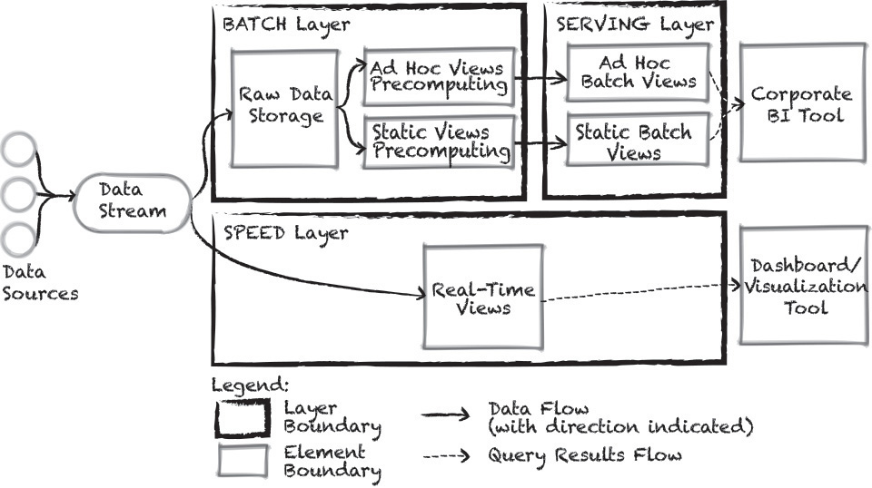
Creating Preliminary Documentation During Design
A software architecture is typically documented as a set of views, which represent the different structures that compose the architecture.
The formal documentation of these views is not part of the design process.
Structures, however, are produced as part of design. Capturing them, even in an informal manner (i.e., as sketches), along with the design decisions that led you to create these structures, is a task that should be performed as part of normal design activities.
The sketches that you produce are the initial documentation for your architecture that you should capture and may flesh out later, if necessary.

Slide 41
Capturing Component Responsibility
You should develop discipline in writing down the responsibilities that you allocate to the elements as you create the structures.
The reasons for this are simple: As you identify an element, you are determining some responsibilities for that element in your mind.
Writing it down at that moment ensures that you won’t have to remember it later.
It is easier to write down the responsibilities associated with your elements gradually, rather than compiling all of them at a later time.
The three purposes of documentation are analysis, construction, and education.
Decide which one is your priority for the stage of your design.

Slide 42
Minimal Design Documentation
During the design process, you should at least try to capture the following elements in a single document:
The primary presentation: the diagram that represents the structure that you produced
The element responsibilities table: it will help you record the responsibilities of the elements that are present in the structure
The relevant design decisions, and their rationales
You might also capture two other pieces of information:
A runtime representation of the element’s interaction—for example, a sequence diagram
The initial interface specifications (which can also be captured in a separate document)

Slide 43
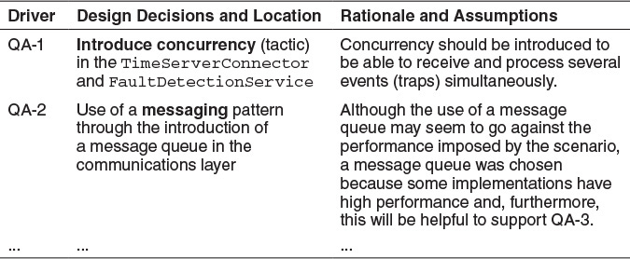
Recording Design Decisions
When you study a diagram that represents an architecture, you see the end product of a thought process, but it may not be easy to understand the decisions that were made to achieve this result.
You might think that recording design decisions is a tedious task.
In reality, depending on the criticality of the system being developed, you can adjust the amount of information that is recorded.
Use a Table to Document Design Decisions

Slide 44
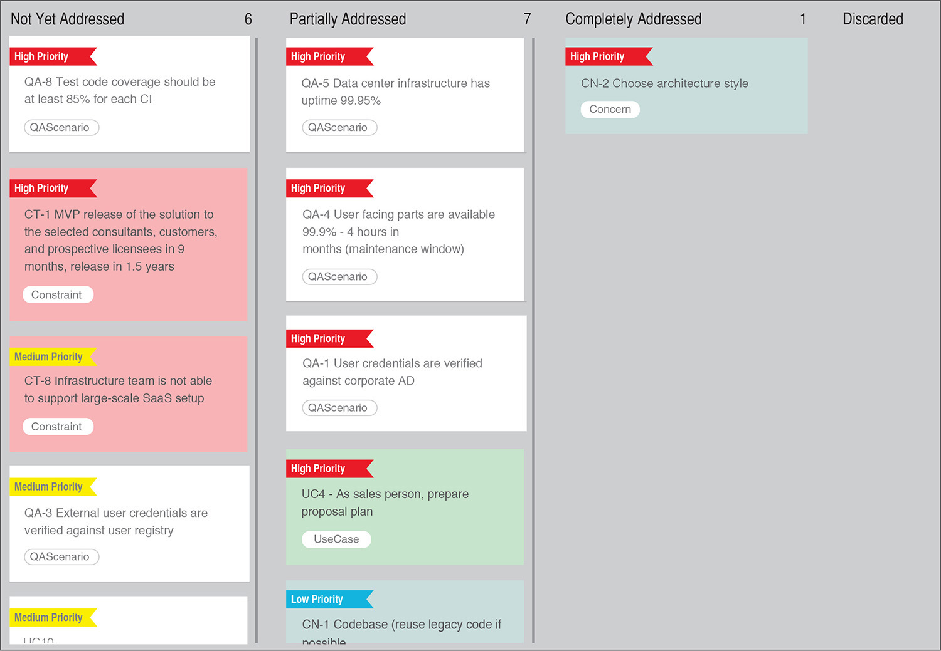
Use of a Design Kanban Board
As design is performed in rounds and as a series of iterations within these rounds, you need to have a way of tracking the design’s degree of advancement.

