Slide 1

[application name]
Task
How sustainable are your fashion choices? Play to find out! Your task is to dress your avatar in the most sustainably outfit possible, out of the options provided.

Slide 2
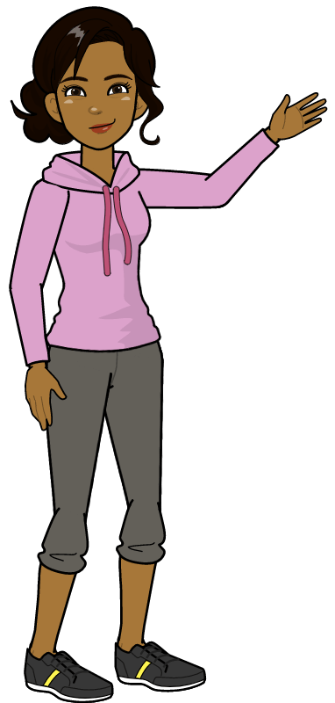
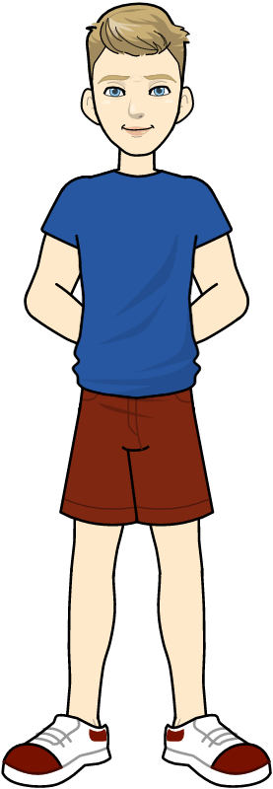
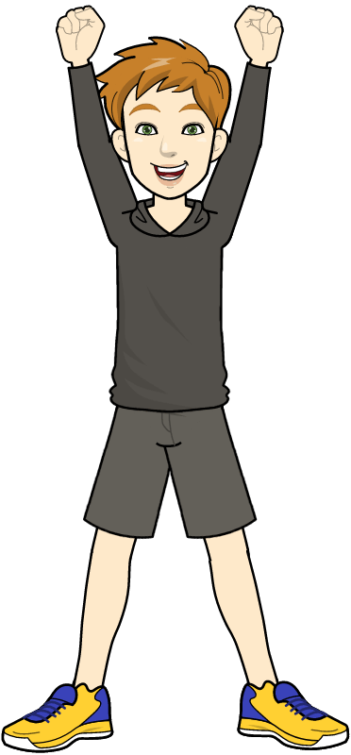
[Application Name]
Choose your avatar!
(Customise features)
Gender Skin Colour Hair Colour Hair Style etc…..
M F N Other

Slide 3
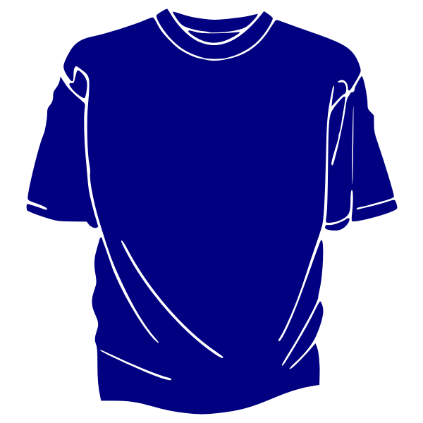
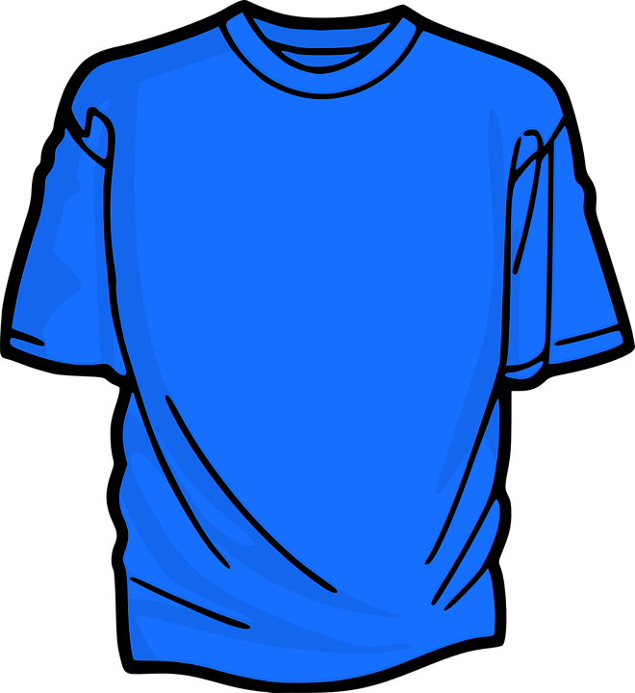
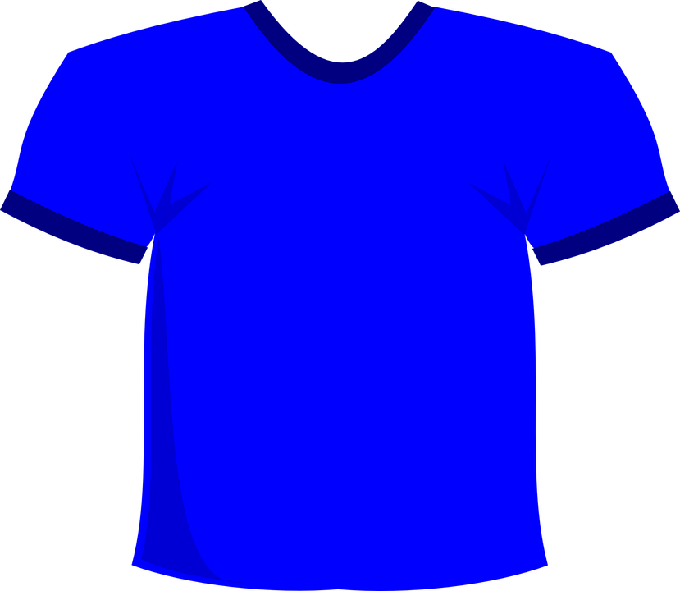
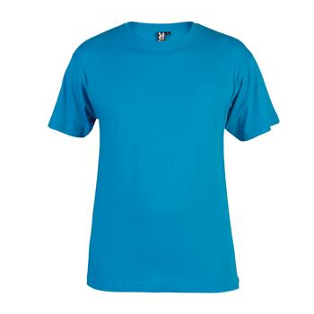
[application name]
Blue shirts
[stage of game]
[brand]
[brand]
[brand]
[brand]

Slide 4
[application name]
Blue shirts
[stage of game]
[brand]
[brand]
[brand]

Slide 5
https://www.agame.com/game/bffs-dressing-room
[application name]
Blue shirts
[stage of game]
[brand]
shoes
jeans
[brand]
[brand]
Scroll down

Slide 6
https://www.agame.com/game/bffs-dressing-room
[application name]
[stage of game]
Drop menu
Blue
Red
Yellow
green
shirts
jeans
Skirts
shoes
[brand]
[brand]
[brand]

Slide 7
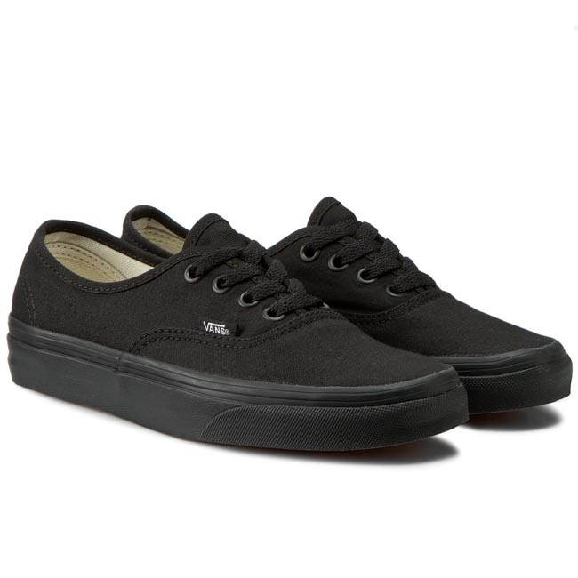
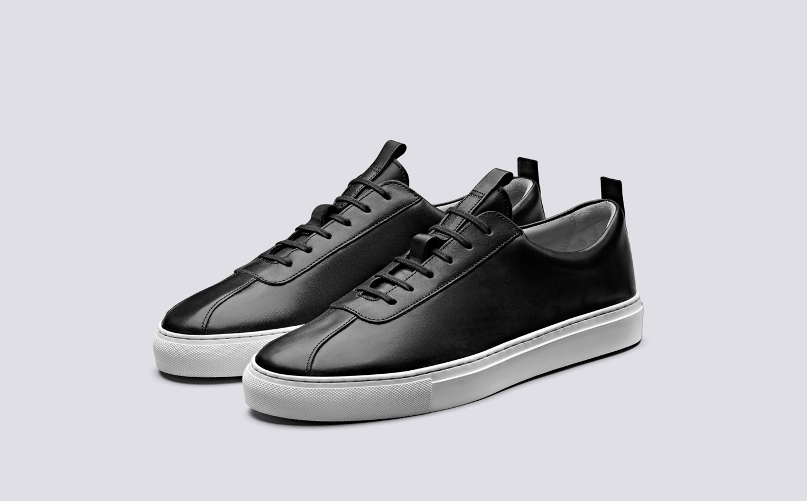
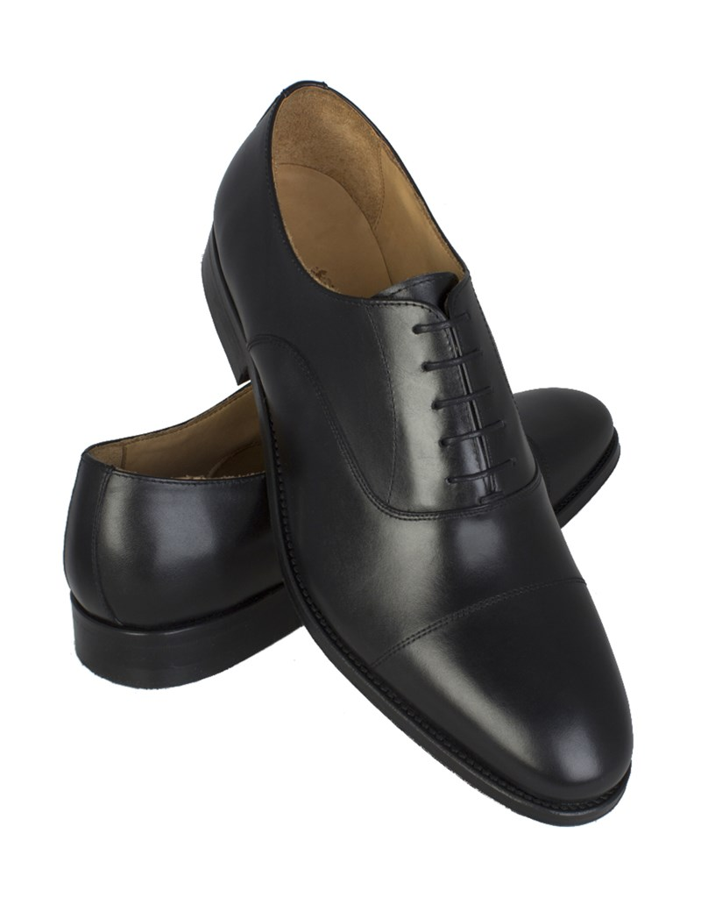
https://www.agame.com/game/bffs-dressing-room
[application name]
Shoes
[stage of game]
[brand]
jeans
shirts
[brand]
[brand]
Scroll down

Slide 8
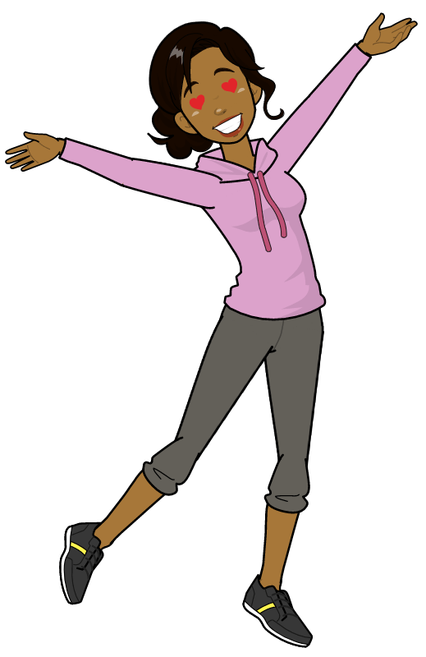

[application name]
Save and share your avatar!
Like what you’ve made?
Share or save your avatar by using the generated code!
bdBNHF3JNAdNSJND2A90fj
ctJDKW2OALpAJWDQ1K77lp

Slide 9
[application name]
Your final score!
7/10
PLAY AGAIN

