Slide 1
Estimating High Dimensional Covariance Matrix and Volatility Index by making Use of Factor Models
Celine Sun
R/Finance 2013

Slide 2
Outline
Introduction
Proposed estimation of covariance matrix:
  Estimator 1: Factor-Model Based
  Estimator 2: SVD based
  Empirical testing results
Proposed volatility estimation:
  Cross-section volatility (CSV)
  Empirical Results
Conclusion

Slide 3

Two new estimators are proposed in this work:
We propose two new covariance matrix estimators :
  Allow non-parametrically time-varying:
    Estimate the monthly realized covariance matrix using daily data
  Allow full rank for N>T:
  Using the factor model and SVD to estimate such that the covariance estimator is full rank
  The new estimators are different from the commonly used estimators and approaches

Slide 4
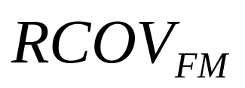
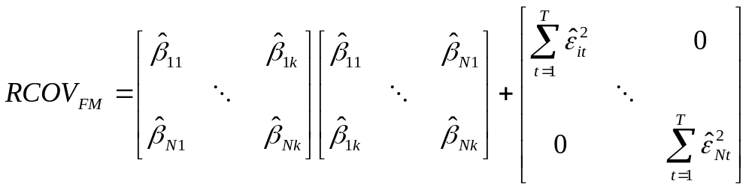


Covariance matrix estimation based on FM (factor models)
  We propose an estimation of covariance matrix, based on a statistical factor model with k factors (k < N).
  Here, { } are the loadings,
  { } are the regression errors.
  Note: The estimator matrix is full rank.

Slide 5
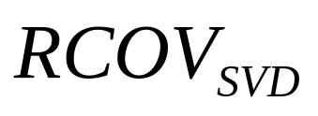
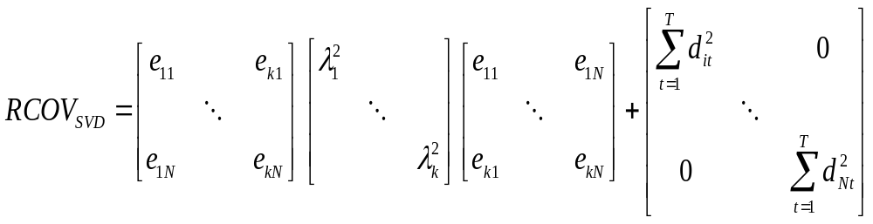


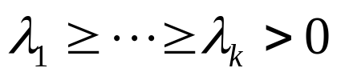


Covariance matrix estimation based on SVD method
  I propose the 2nd estimation of covariance matrix, based on SVD:
  Here, { } and { } are from the usual eigen decomposition of the NxN realized variance matrix, and having , with k < N.
  { } = the remaining terms from reconstructing the return matrix by { } and { }

Slide 6
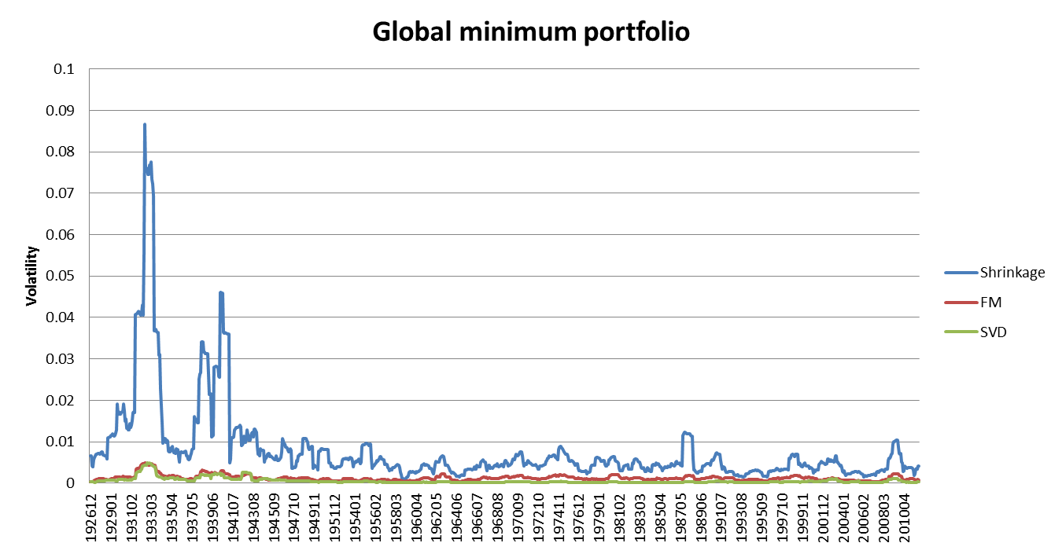
Empirical testing:
1 Year Rolling Volatility for S&P 500

Slide 7
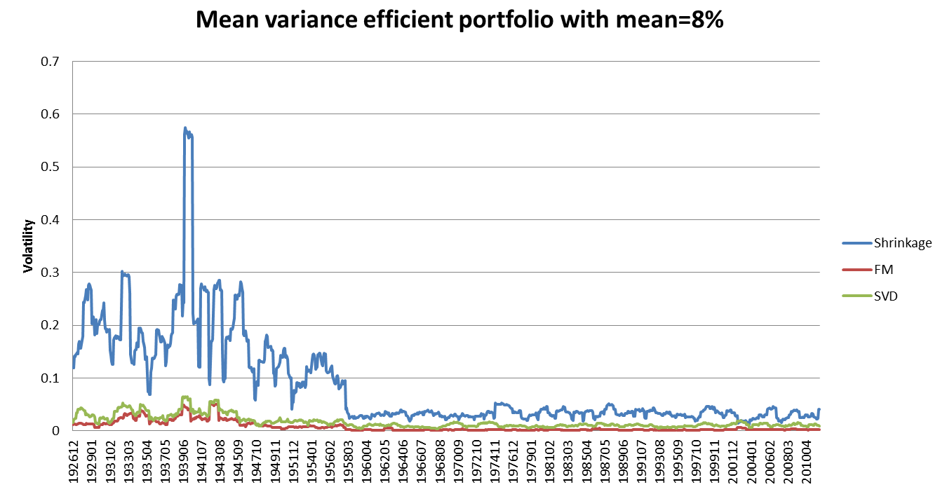
Empirical testing:
1 Year Rolling Volatility for S&P 500

Slide 8
Volatility Index
A number of drawbacks of current volatility index
  Not based on actual stock returns
  The index only available to liquid options
  Only available at broad market level
Advantage of CSV
  Observable at any frequency
  Model-free
  Available for every region, sector, and style of the equity markets
  Don't need to resort option market
Notes:
VIX is the measure of the implied volatility of S&P 500 index options
Represents the market's expectation of stock market volatility over the next 30 day period
Is CSV a good proxy for VIX?
Calculate the CSV of daily return for S&P 500 stocks
From Jan. 1990 to Nov. 2011
The correlation between VIX and CSV of daily return is 0.18
CSV of daily return is not a good proxy for VIX

Slide 9
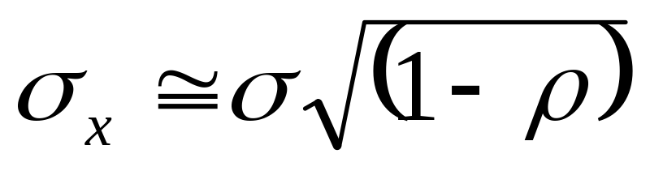
Cross-sectional volatility
Cross-sectional volatility (CSV) is defined as the standard deviation of a set of asset returns over a period.
The relationship between cross-sectional volatility, time-series volatility and average correlation is given by:

Slide 10
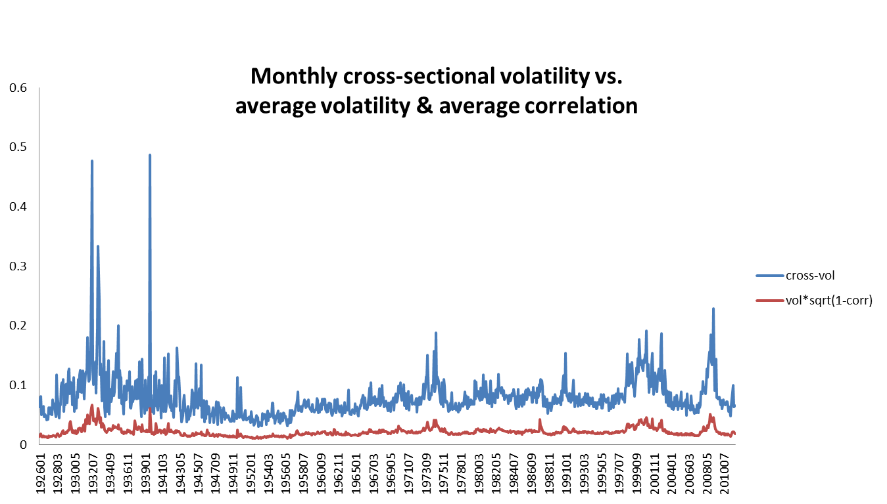
Empirical testing:
1 Year Rolling Volatility for S&P 500
Correlation: 0.85

Slide 11
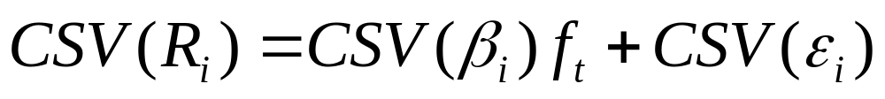
Decomposing Cross-Sectional Volatility
Apply the factor model on return
The change of beta is more persistent
Cross-sectional volatility of the specific return is a proxy for the future volatility
The correlation between VIX and CSV of specific return is 0.62.
Notes:
We could use CSV for specific return as a measure of the volatility for any set of stocks at any frequency

Slide 12
Conclusion
Constructed covariance matrix estimators which are full rank
The portfolios constructed based on my estimators have lower volatility
Applying factor model structure to CSV gives us a good estimation of the volatility.
It could be used at any frequency and at any set of stocks

