Slide 1
The Financial Impact of Oil Prices on the Housing Market in the Houston Economy
Rachel Ang
Xiaobing Shuai
Applied Finance with R
April 30th 2011
The Financial Impact of Oil Prices on the Housing Market in the Houston Economy
Notes:
Financial Risk Management between Oil Prices and Housing Market in Houston Economy

Slide 2
Agenda
Why Houston – what have I learned?
Research Definitions and Framework
Research Design, Data and Collections
Research Findings and Future Applications
The Financial Impact of Oil Prices on the Housing Market in the Houston Economy
Notes:
Financial Risk Management between Oil Prices and Housing Market in Houston Economy

Slide 3
Research Purpose
Research examines the relationship between the impact of oil prices to housing prices, unemployment rate, and population in Houston.
How market determines the prices of individual assets
Comprehend the proxy of the relationship
Successful investment mitigate risk to secure high returns on assets, benefit decision makers
The Financial Impact of Oil Prices on the Housing Market in the Houston Economy
Notes:
Financial Risk Management between Oil Prices and Housing Market in Houston Economy

Slide 4
Houston
Founded in 1836, largest city in Texas, 4th largest in the nation, Gross Area Product in 2008 = $440.4b (COH, 2010; GHP, 2010; (Hively, 2010)
Largest global petrochemical industry, home to major oil companies (Cash, 2010)
Low unemployment rate, e.g. in 2009 7.2% vs. 9.3% nation (BLS, 2010)
#1 city increase in population from 1990 to 2009 (COH, 2010)
Minor housing bubbles and recession, home prices 26% below nation average, 42% below Metropolitan area (FRBD, 2010; REC, 2010)
The Financial Impact of Oil Prices on the Housing Market in the Houston Economy
Notes:
Financial Risk Management between Oil Prices and Housing Market in Houston Economy

Slide 5
Data and Collection
Oil prices - Federal Reserve Bank of Dallas
Housing prices* - Texas A&M University
Unemployment rate - Bureau Labor Statistics
Population - Census Bureau, Moody Freelunch
240 monthly datapoints from January 1, 1990 to December 31, 2009
*Median prices
The Financial Impact of Oil Prices on the Housing Market in the Houston Economy
Notes:
Financial Risk Management between Oil Prices and Housing Market in Houston Economy

Slide 6
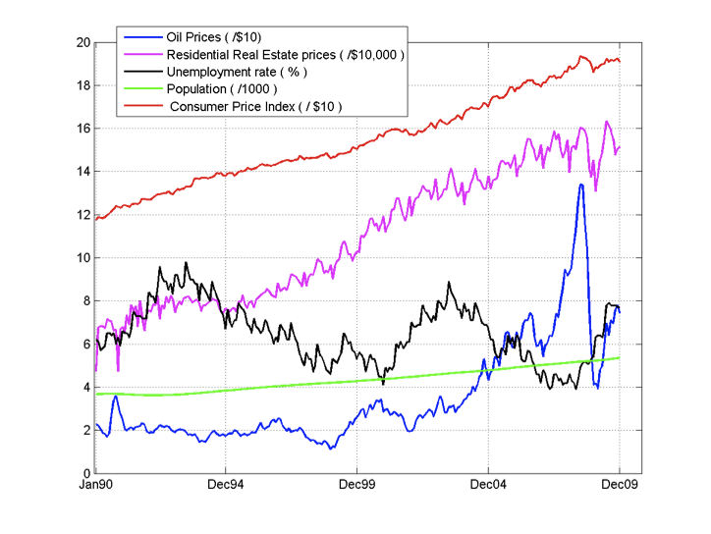
Time Series for All Variables
The Financial Impact of Oil Prices on the Housing Market in the Houston Economy
Notes:
Financial Risk Management between Oil Prices and Housing Market in Houston Economy

Slide 7
Descriptive Statistics (20 years)
January 1, 1990 to December 31, 2009
 | Mean | Minimum | Maximum
Oil Prices | $35.40 | $11.28 | $133.93
Housing Prices* | $109,406 | $47,300 | $163,400
Unemployment Rate | 6.50% | 3.90% | 9.80%
Population (in thousands) | 4,430 | 3,623.16 | 5,365.55
* Median Mean Housing Prices
The Financial Impact of Oil Prices on the Housing Market in the Houston Economy
Notes:
Financial Risk Management between Oil Prices and Housing Market in Houston Economy

Slide 8
Research Question 1
To what degree are oil prices correlated with housing prices in Houston?
Pearson Correlation |  | Regression Model | P
Raw Data Adjusted-for-Inflation
0.77 | 0.60 | HP = 57,393 + 555OP | 0.00
HP = Housing Prices; OP = Oil Prices
t_{0.05, 238} = 18.86 > 1.960 -> Reject Ho1
Ha1: There is a significant correlation between oil prices and housing prices in Houston.
The Financial Impact of Oil Prices on the Housing Market in the Houston Economy
Notes:
Financial Risk Management between Oil Prices and Housing Market in Houston Economy

Slide 9
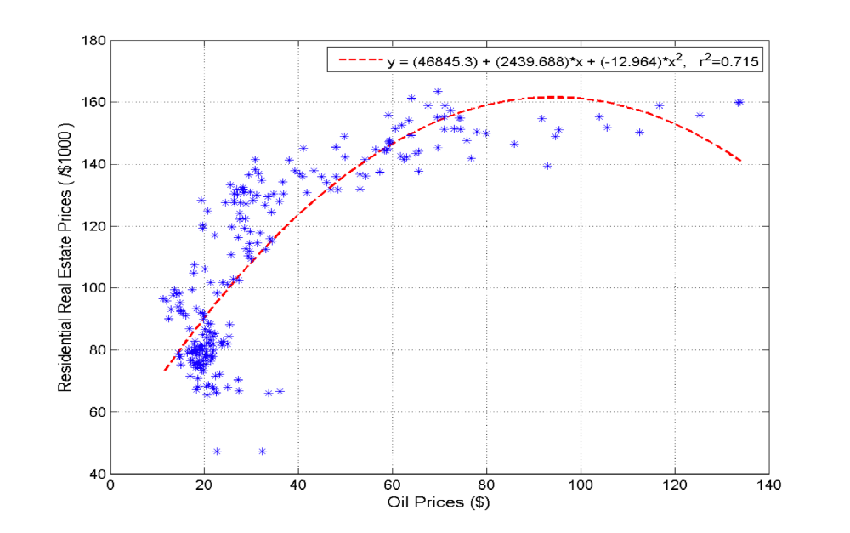
Research Question 1
Curvilinear Relationship in Oil Prices and Housing Prices
The Financial Impact of Oil Prices on the Housing Market in the Houston Economy
Notes:
Financial Risk Management between Oil Prices and Housing Market in Houston Economy

Slide 10
Research Question 2
To what degree are oil prices correlated with unemployment rate in Houston?
Pearson Correlation |  | Regression Model | P
Raw Data Adjusted-for-Inflation
-0.43 | -0.41 | UR = 7.55 – 0.05OP | 0.00
UR = Unemployment Rate; OP = Oil Prices
t_{0.05, 238} = -7.36 > 1.960 -> Reject Ho2
Ha2: There is a significant correlation between oil prices and unemployment rate in Houston.
The Financial Impact of Oil Prices on the Housing Market in the Houston Economy
Notes:
Financial Risk Management between Oil Prices and Housing Market in Houston Economy

Slide 11
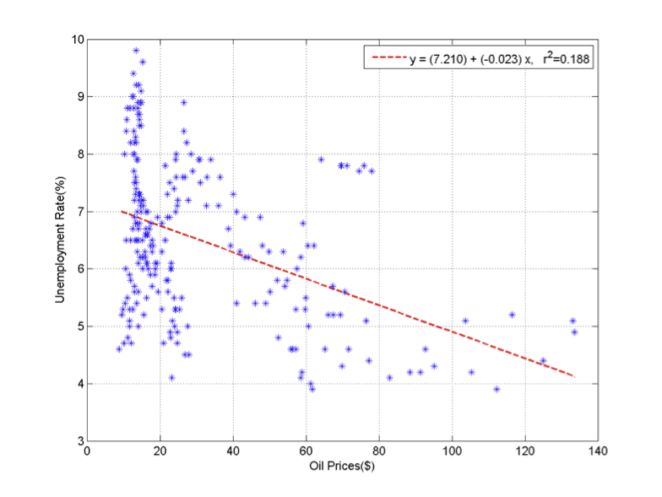
Research Question 2
Scatter Plot on Regression Equation (red dashed line) linking Oil Prices and Unemployment Rate
The Financial Impact of Oil Prices on the Housing Market in the Houston Economy
Notes:
Financial Risk Management between Oil Prices and Housing Market in Houston Economy

Slide 12
Research Question 3
To what degree are oil prices correlated with population in Houston?
Pearson Correlation |  | Regression Model | P
Raw Data Adjusted-for-Inflation
0.80 | 0.74 | POP = 3,608 – 33.70OP | 0.00
POP = Population; OP = Oil Prices
t_{0.05, 238} = 20.44 > 1.960 -> Reject Ho3
Ha3: There is a significant correlation between oil prices and population in Houston.
The Financial Impact of Oil Prices on the Housing Market in the Houston Economy
Notes:
Financial Risk Management between Oil Prices and Housing Market in Houston Economy

Slide 13
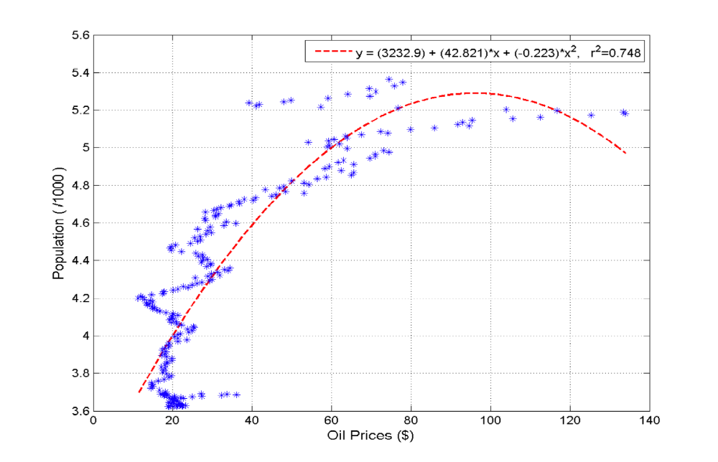
Research Question 3
Curvilinear Relationship in Oil Prices and Population
The Financial Impact of Oil Prices on the Housing Market in the Houston Economy
Notes:
Financial Risk Management between Oil Prices and Housing Market in Houston Economy

Slide 14
Future Research
Broader set of factors: GDP, national income, country growth, mortgage interest rates, loans, savings, renting
Cross-region: NY, LA, Chicago, Venezuela, Austria, Romania, Russia, China, India
Finding suitable β for Capital Asset Pricing Model, for example interest rates, T-bills
Different research method for example mixed study
Different research design for example causation
The Financial Impact of Oil Prices on the Housing Market in the Houston Economy
Notes:
Financial Risk Management between Oil Prices and Housing Market in Houston Economy

Slide 15

The Financial Impact of Oil Prices on the Housing Market in the Houston Economy
Notes:
Financial Risk Management between Oil Prices and Housing Market in Houston Economy

Slide 16
References
Cash, M. H. (2010). Houston market overview. Retrieved from http://www.law.northwestern.edu/career/jobsearch/documents/Houston_Market_ Report.pdf
City of Houston. (2010a). Demographics. Retrieved from http://www.houstontx.gov/planning/Demographics/dem_links.htm
City of Houston. (2010b). Houston facts. Retrieved from http://
www.houstontx.gov/abouthouston/houstonfacts.html
Federal Reserve Bank of Dallas. (2010a). West Texas intermediate crude oil price. Retrieved from http://www.dallasfed.org/data/data/oilp.tab.htm
Federal Reserve Bank of Dallas. (2010b). Economic data. Retrieved from http://www.dallasfed.org/data/index.html
Greater Houston Partnership. (2010). Economic development: Basic fact sheets. Retrieved from http://www.houston.org/economic-development/about-us/basic-fact-sheets/index.aspx
Hively, T. (2010). Houston. Our states: Texas, 1.
The Financial Impact of Oil Prices on the Housing Market in the Houston Economy

