Slide 1
Covariance forecasting for portfolio optimisation
R/Finance
Chicago
May 2013

Slide 2
Package aa
Package aa: repeatable backtest simulation for equities
Three inputs (universe, library, parameters) all logged in the database
The user’s ‘alpha library’ operates on zoo/xts objects from SQL database
Estimation and forecasting of covariance is central
Bloomberg Terminal API
Input
Intermediate
Rdata files: bui.rdata
Minimally processed
Timeseries
Reference
Universe
Library
Parameters
Covariance
Return component
Portfolio
Report
Covariance
Peer comparison
GUI
Constituent
Setup
Execution
Report browsing
Performance
PORT upload
RDCOMClient
MySQL tables via RODBC
RGtk2
Package | Scope | https://amberalpha@bitbucket.org/amberalpha/
aabb | Download via API | aabb.git
aace | Covariance estimation | aace.git
aa | Backtest simulation | aa.git
pcalib | Examples here/on website | pcalib.git
Notes:
This schema is an informal overview [do it as a build]
Large performance improvements are possible

Slide 3
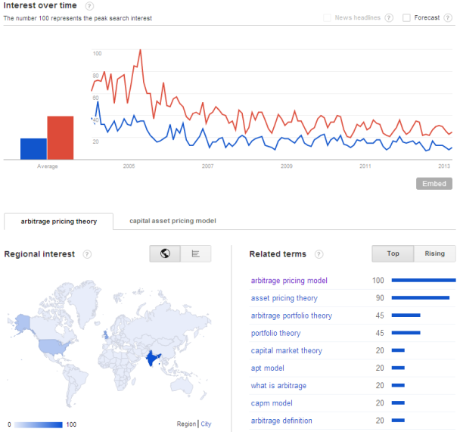
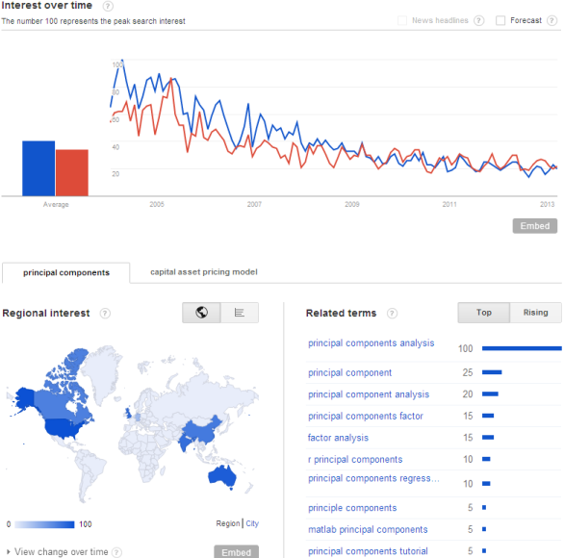

APT and PCA
CAPM, the APT, PCA and all that
Arbitrage Pricing Theory (APT)
  If factor 1 is ‘the market’, CAPM nests into APT
  factors 2:k remain to be specified
Identifying the factors
  Regression: cross-sectional loadings known a priori
    Size
    Value etc …
    Industry (directional)
  Regression: timeseries scores known a priori
    Market (directional)
    Bond yield changes
    Oil price changes
    Surprises in general
  PCA-type: scores are ‘portfolio’ returns
    Exists a choice: ‘the answer in finite samples is not clear’
      Factor Analysis
      Principal Components Analysis
returns
loadings scores specific returns
$$R=a+ B . f + ε$$
APT (blue) CAPM (red)
PCA (blue) CAPM (red)
These Google trends graphs are for entertainment only!
Notes:
Starting from the fundamentals (CAPM early 60s, APT 1976)
Issues: economic, econometric
Plus and minus points of each type
Missing: tests on each type for objective comparison, here consider PCA-type, tests, results, applications

Slide 4
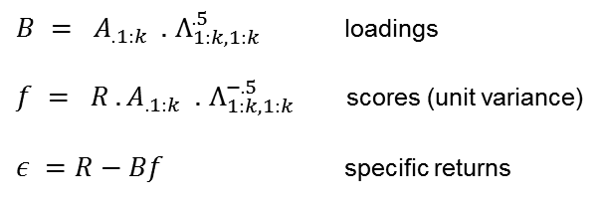


PCA
Principal Components Analysis
PCA as ‘dimension reduction’
  eigenvalues are descending in magnitude
  covariance can be summarised with the first k
  precisely fits the bill for APT if stated as follows:
Remove off-diagonals for specific returns
Covariance Eigenvectors Eigenvalues
Covariance illustration
Example:
67 utilities
230 weeks
20 factors
$$Σ = { A}^{T} . Λ . A$$
$$I = A^{T}. A$$
eigenvectors are orthonormal
$B = A_{.1:k} .$ $Λ_{1:k,1:k}^{.5}$ loadings
$f = R . A_{.1:k} .$ $Λ_{1:k,1:k}^{−.5}$ scores (unit variance)
$ε =R−Bf$ specific returns
$$Σ^{∗} ={ A}_{.1:k}^{T}. E_{1:k} .A_{.1:k}+diag(A_{.k+1:n}^{T}. E_{k+1:n} .A_{.k+1:n})$$
Notes:
PCA applied to investment risk is one example of the dimension reduction technique
The question of how many factors to include is vexing, has no unique answer, but not crucial
The modelling step is the removal of off-diagonals

Slide 5
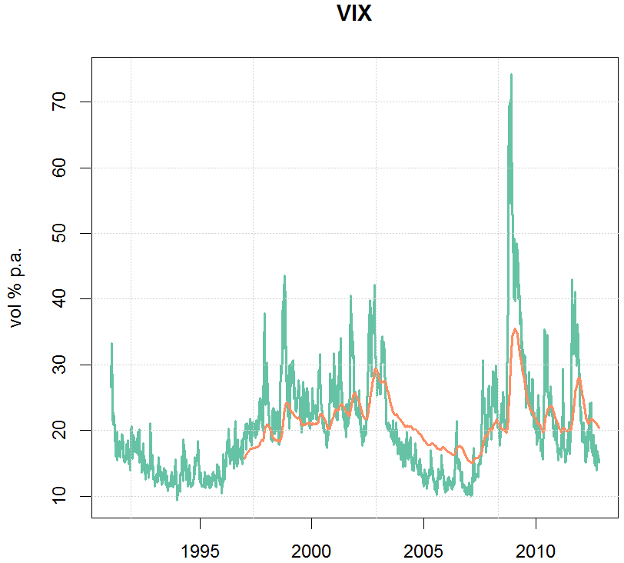
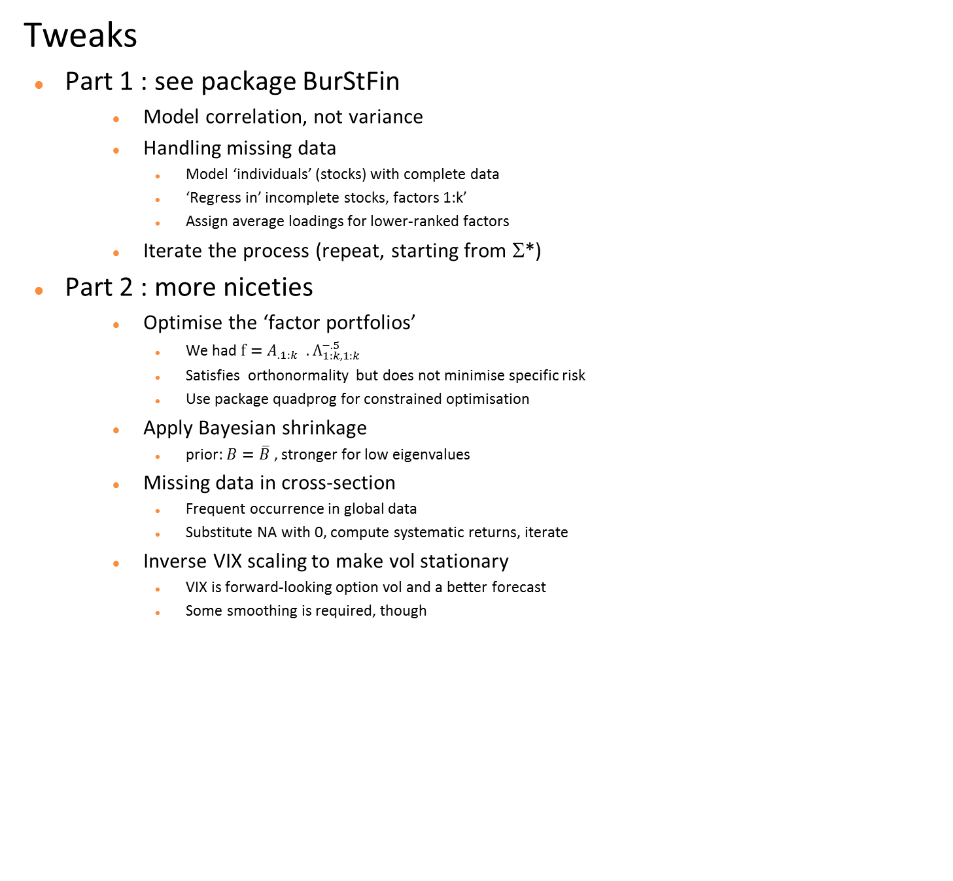
PCA tweaks
Tweaks
Part 1 : see package BurStFin
  Model correlation, not variance
  Handling missing data
    Model ‘individuals’ (stocks) with complete data
    ‘Regress in’ incomplete stocks, factors 1:k’
    Assign average loadings for lower-ranked factors
  Iterate the process (repeat, starting from Σ*)
Part 2 : more niceties
  Optimise the ‘factor portfolios’
    We had $f=A_{.1:k} .$ $Λ_{1:k,1:k}^{−.5}$
    Satisfies orthonormality but does not minimise specific risk
    Use package quadprog for constrained optimisation
  Apply Bayesian shrinkage
    prior: $B=\overline{B}$ , stronger for low eigenvalues
  Missing data in cross-section
    Frequent occurrence in global data
    Substitute NA with 0, compute systematic returns, iterate
  Inverse VIX scaling to make vol stationary
    VIX is forward-looking option vol and a better forecast
    Some smoothing is required, though
Notes:
Part 1 is derives from PB’s package – this is a description and not an appraisal
Part 2 features some additional tweaks, know issues in modelling
Move on to look at how tweaks can be assessed

Slide 6
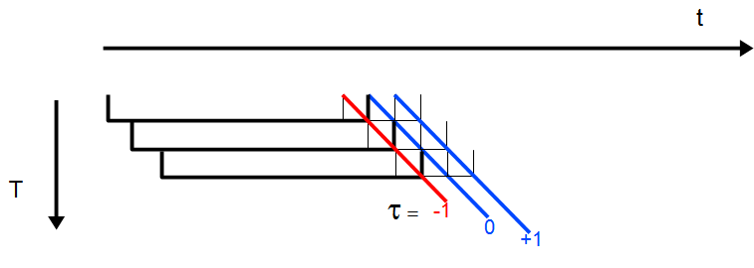
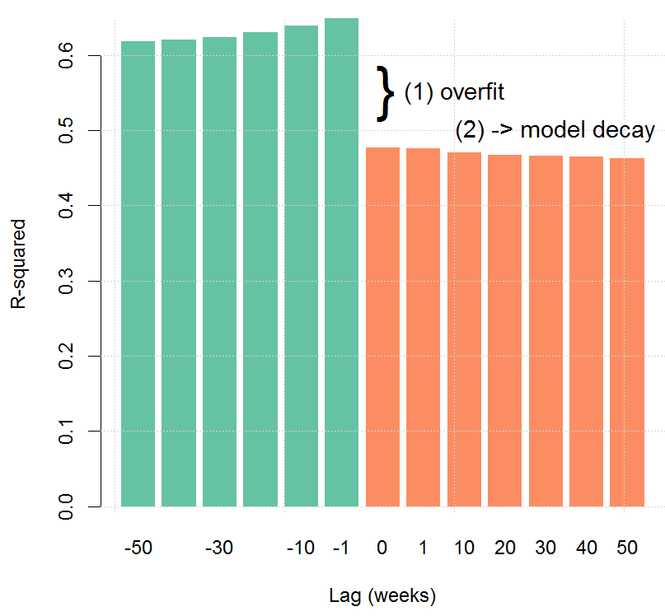


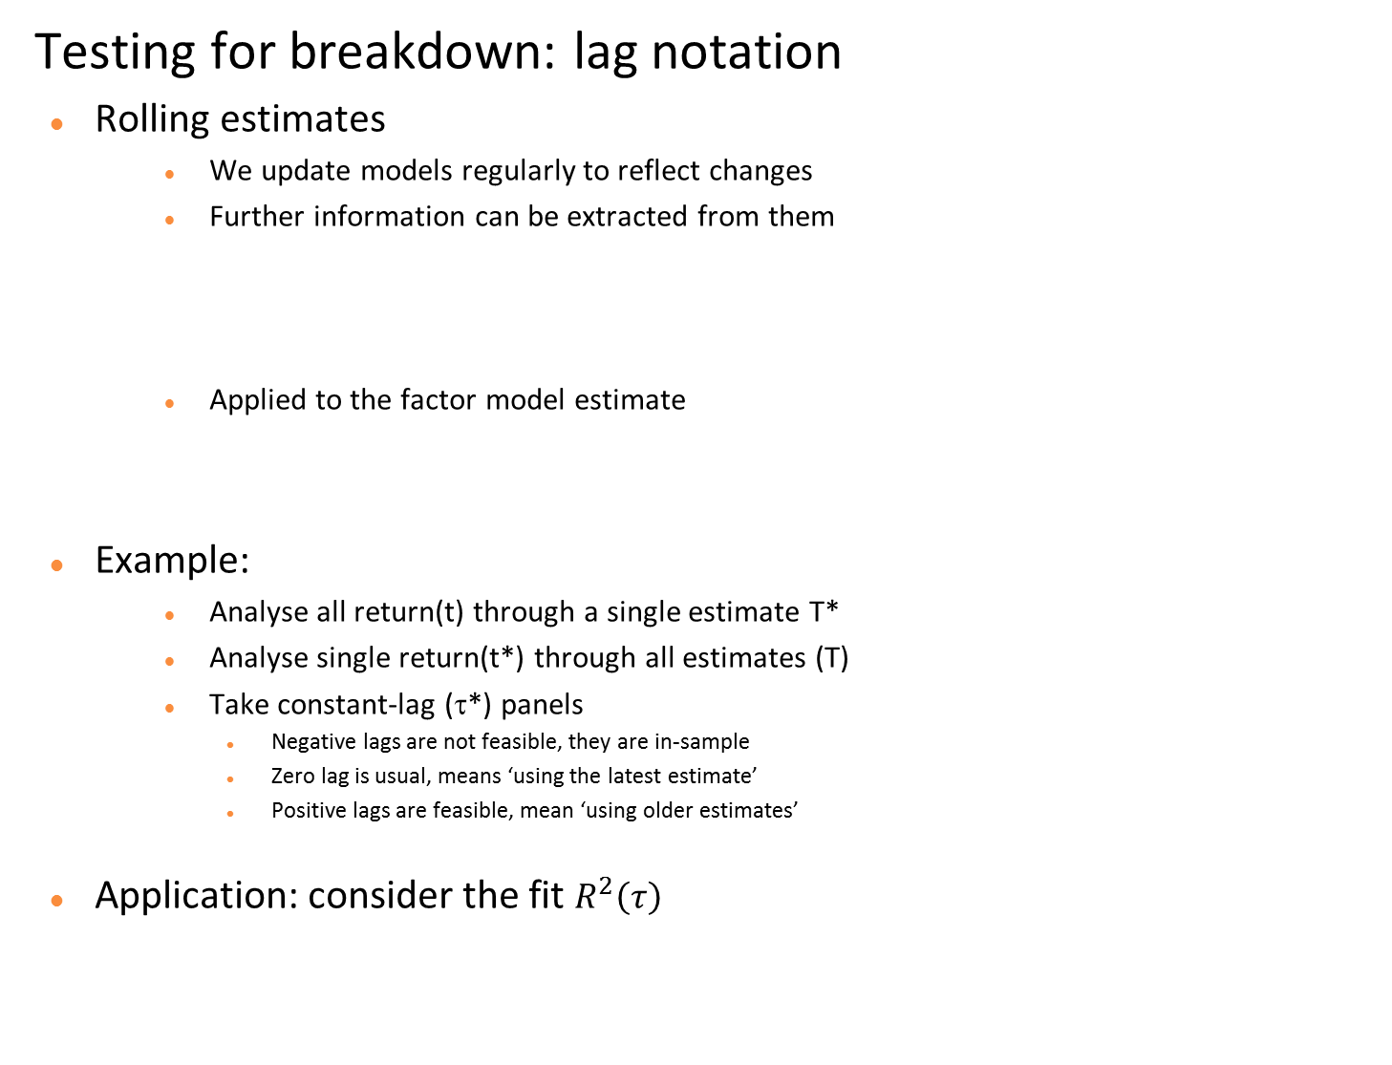
Lag notation
Testing for breakdown: lag notation
Rolling estimates
  We update models regularly to reflect changes
  Further information can be extracted from them
  Applied to the factor model estimate
Example:
  Analyse all return(t) through a single estimate T*
  Analyse single return(t*) through all estimates (T)
  Take constant-lag (τ*) panels
    Negative lags are not feasible, they are in-sample
    Zero lag is usual, means ‘using the latest estimate’
    Positive lags are feasible, mean ‘using older estimates’
Application: consider the fit $R^{2}\left(τ\right)$
Notation for rolling estimates
lag return date model estimation date
$$τ = t − T$$
$$R(t)= B(T). f(T,t) + ε(T,t)$$
R²(τ)
Notes:
[develop the notation following the slide]
The R² example is from fitting the equation [needs number]
Overfit results from estimation error in the VCV, model decay is due to real-world changes
[numbers to quantify both]
Fit is good oos, and decay is slow – why so slow?

Slide 7
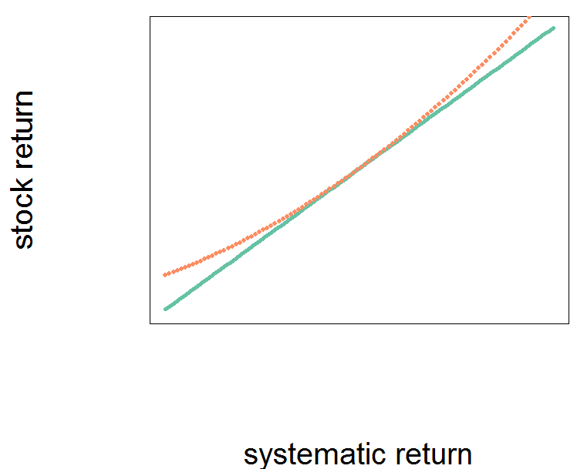
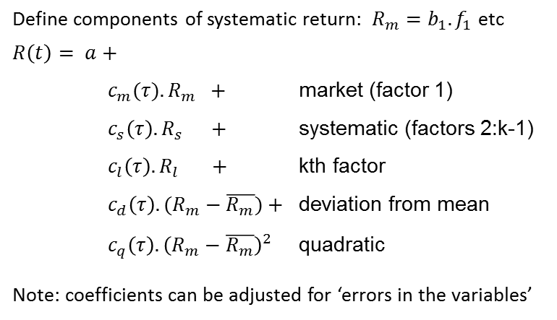
Regression equation
Testing for breakdown: regress returns on components
An augmented factor regression
kth factor: the ‘marginal’ explanatory power
deviation: c_{d}<0 implies mean-reversion
quadratic: option-like payoff
#Testing the null
res <- summary(m1 <- lm(returns ~ Rm + Rs + Rl + Rd+ Rq -1))
linearHypothesis(m1,c(0,0,0,1,1))["Pr(>F)"]
linearHypothesis(m1,diag(5),c(1,1,1,0,0))["Pr(>F)"]
Define components of systematic return: ${R_{m}=b}_{1}. f_{1}$etc
$$R\left(t\right)= a+$$
$c_{m}(τ). R_{m} +$ market (factor 1)
$c_{s}\left(τ\right). R_{s} +$ systematic (factors 2:k-1)
$c_{l}\left(τ\right). R_{l} +$ kth factor
$c_{d}\left(τ\right). (R_{m}−\overline{R_{m}})+$ deviation from mean
$c_{q}\left(τ\right).{\left(R_{m}−\overline{R_{m}}\right)}^{2}$ quadratic
Note: coefficients can be adjusted for ‘errors in the variables’
0<c_{q} for +ve gamma
Notes:
The symmetries between OLS and PCA in pure form => cs=cm=cl=1
Ck for insight into order, cd for shrinkage, cq for insight

Slide 8
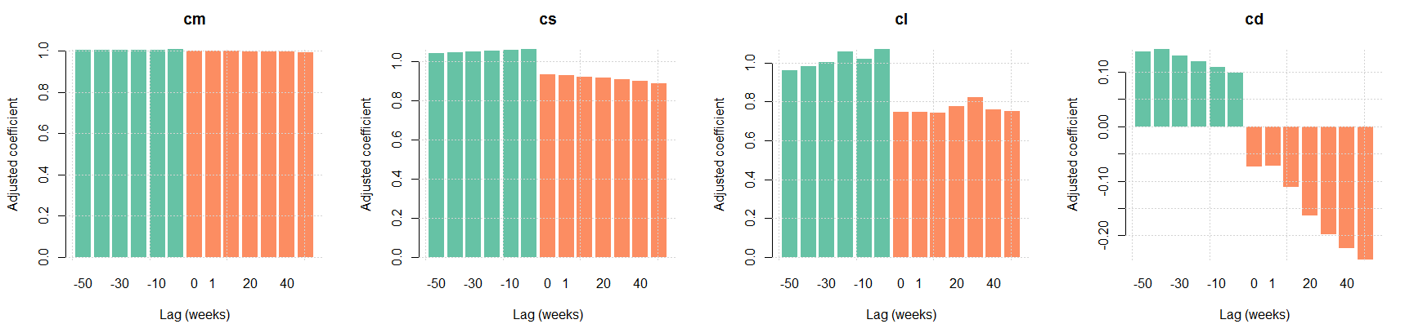
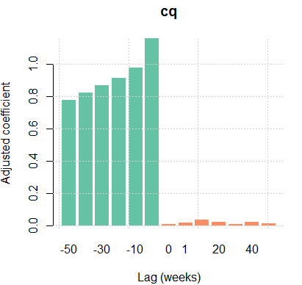
Regression test results
Results from testing the model
Coefficients
Market and systematic components have coefficients close to 1 at lag 0
Deviation shows
  In-sample, less shrinkage for better fit (as expected)
  Out of sample, more shrinkage for better fit (about -0.07 more, on top of -0.3 applied)
  Evidence of mean-reversion as the coefficient decreases for greater lags
Quadratic term is pure noise
Notes:
Overall we see what we expect

Slide 9
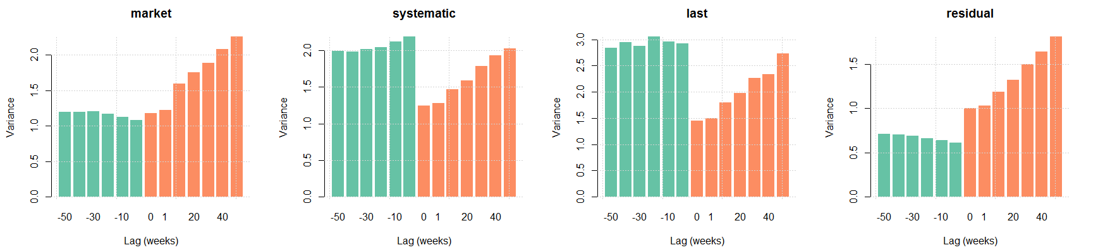
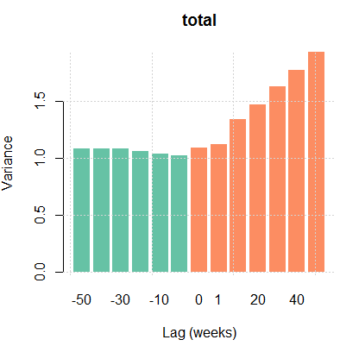
Variance test results
Results from testing the model
Return variance/forecast variance
In general the lag-zero normalised variance is very close to 1
Some evidence of slight under-forecasting of systematic components
(The trend upwards out-of-sample is period-specific, has no significance)

Slide 10
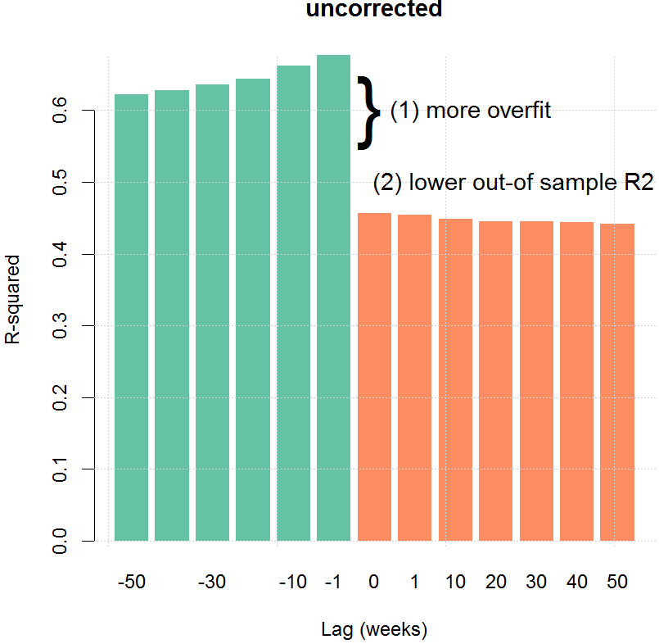
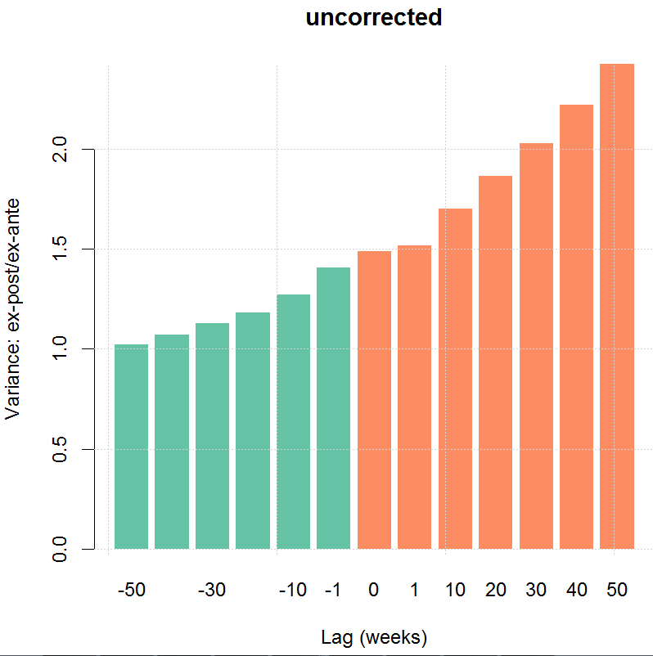
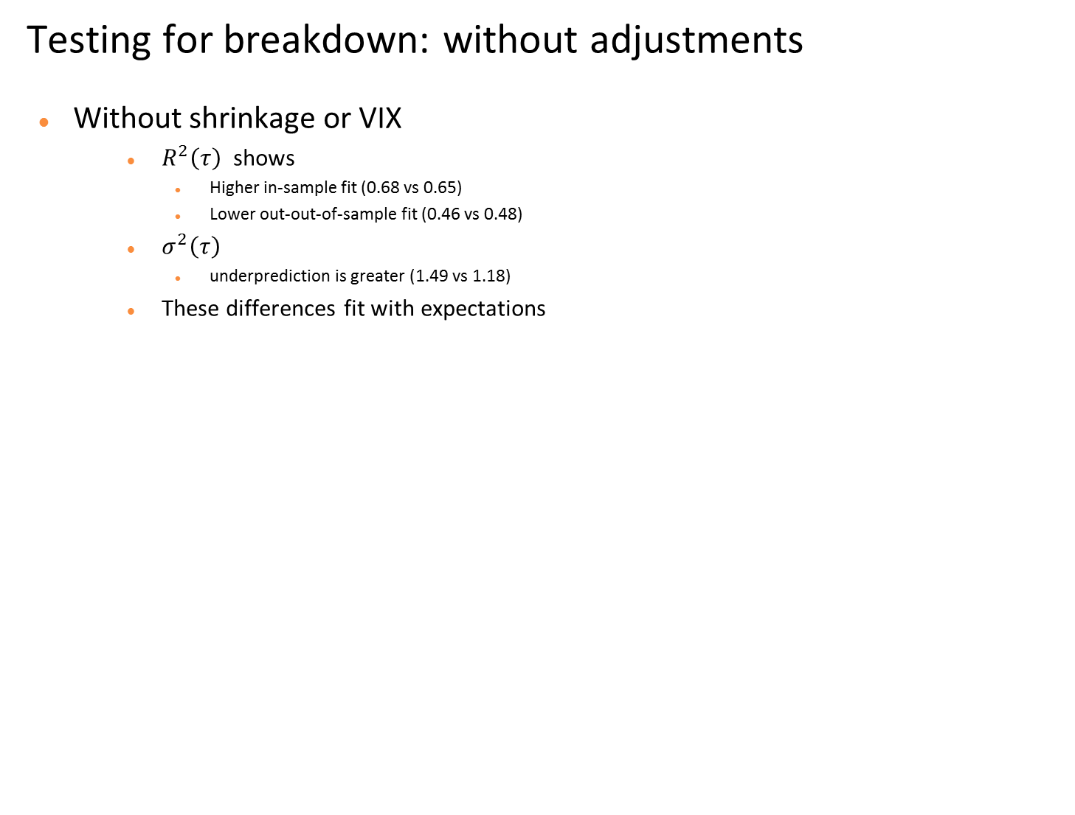
VIX and shrinkage
Testing for breakdown: without adjustments
Without shrinkage or VIX
  $R^{2}\left(τ\right)$ shows
    Higher in-sample fit (0.68 vs 0.65)
    Lower out-out-of-sample fit (0.46 vs 0.48)
  $σ^{2}\left(τ\right)$
    underprediction is greater (1.49 vs 1.18)
  These differences fit with expectations
Notes:
[may want to have with/without in one graphic]

Slide 11
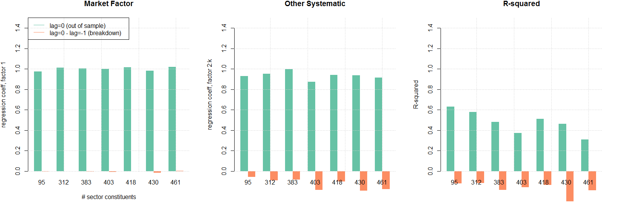
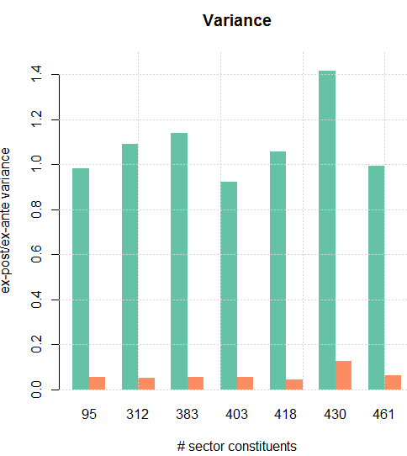
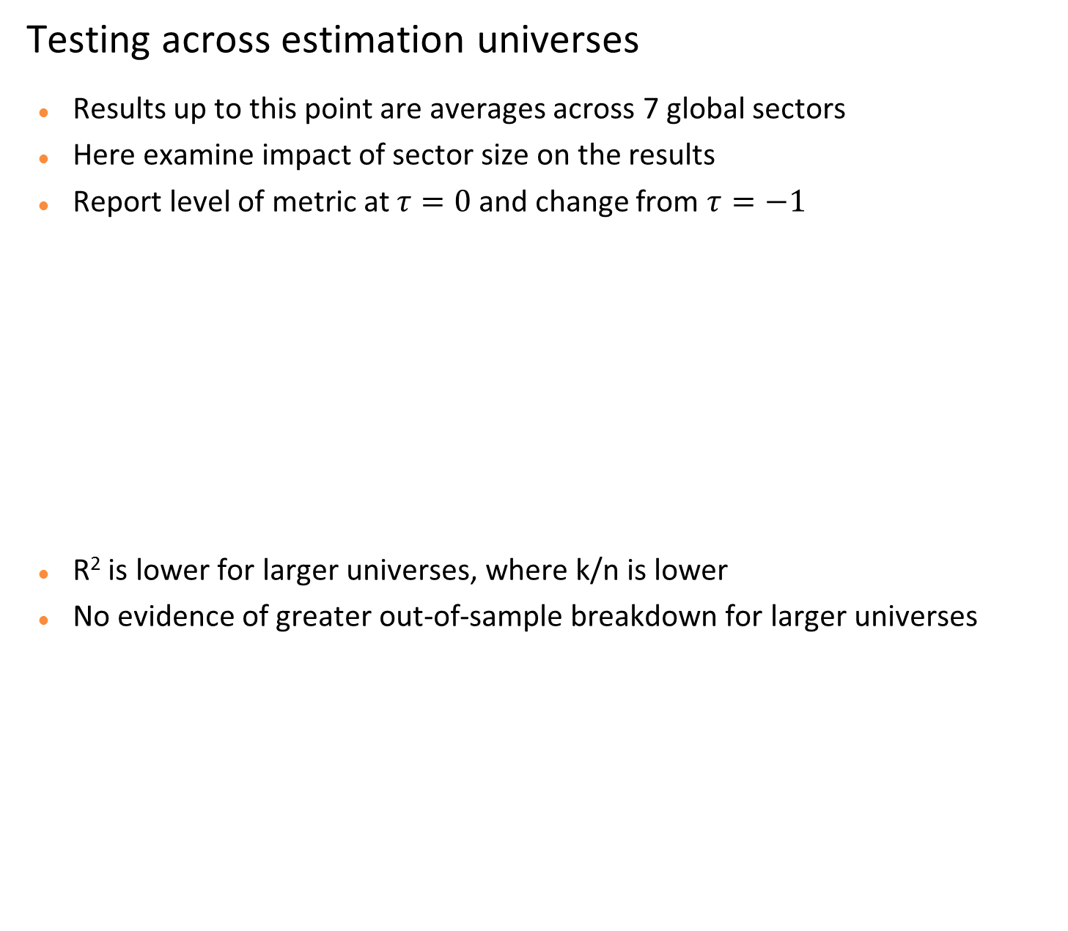
Performance across universes
Testing across estimation universes
Results up to this point are averages across 7 global sectors
Here examine impact of sector size on the results
Report level of metric at $τ=0$ and change from $τ=−1$
R² is lower for larger universes, where k/n is lower
No evidence of greater out-of-sample breakdown for larger universes
Notes:
Conclude the small universe may be appropriate
Take a brief detour to talk about the challenges of universe selection and how they are addressed

Slide 12
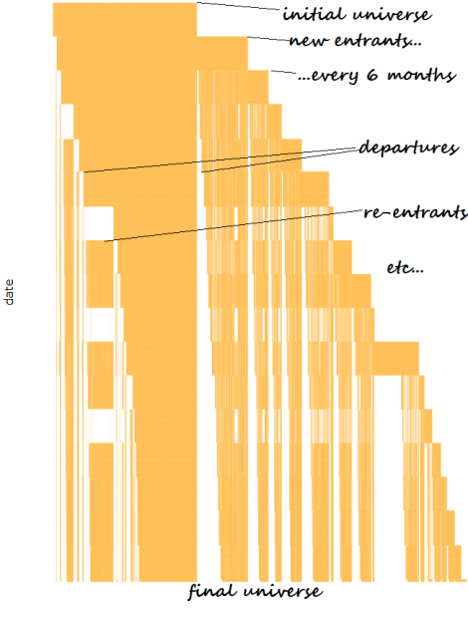
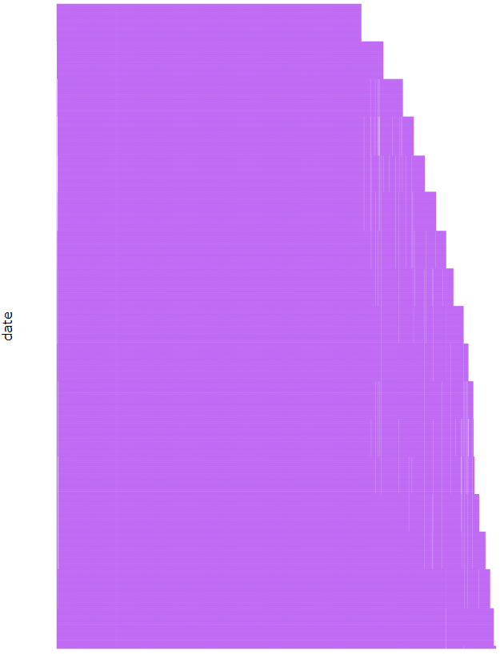
Universe selection
Universe selection
Requirements
  No survivorship bias
  Stable identifiers
  Stationary screening criteria
A possible solution
  Historical index constituents, screened
  Issues with criteria, licencing
A specific solution
  Bloomberg bworld = bworldus+bworldeu+bworldpr
  Identifier ‘unique identifier’ or ‘open symbology’
  Screen on
    Exchange, geographical, sector classification
    Weight – maintains a fairly stationary universe composition
    Liquidity
    Alpha data coverage
Impact of eliminating biases
  ‘distress’ type performance is sensitive
  Turnover is higher
Realistic ex-ante Universe
Date
“Screened current constituents” Universe
Date

Slide 13
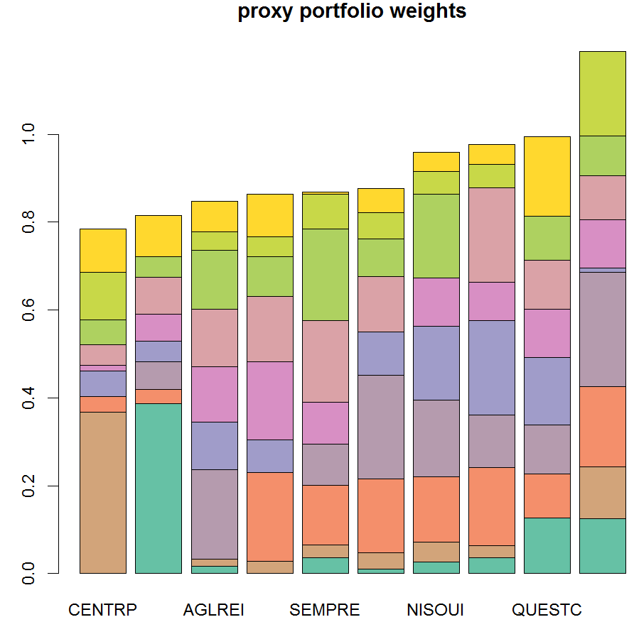
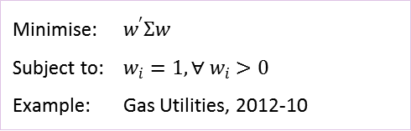
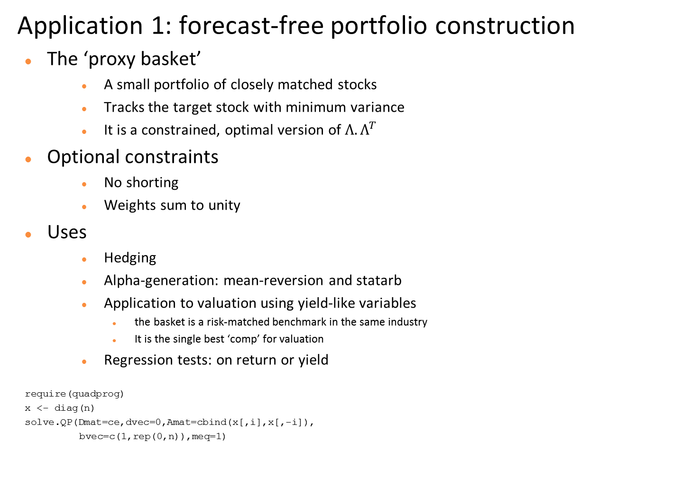
Proxy Basket
Application 1: forecast-free portfolio construction
The ‘proxy basket’
  A small portfolio of closely matched stocks
  Tracks the target stock with minimum variance
  It is a constrained, optimal version of$Λ.Λ^{T}$
Optional constraints
  No shorting
  Weights sum to unity
Uses
  Hedging
  Alpha-generation: mean-reversion and statarb
  Application to valuation using yield-like variables
    the basket is a risk-matched benchmark in the same industry
    It is the single best ‘comp’ for valuation
  Regression tests: on return or yield
require(quadprog)
x <- diag(n)
solve.QP(Dmat=ce,dvec=0,Amat=cbind(x[,i],x[,-i]),
bvec=c(1,rep(0,n)),meq=1)
Minimise: $w^{′}Σw$
Subject to: $w_{i}=1, ∀ w_{i}>0$
Example: Gas Utilities, 2012-10
Notes:
The example is ‘no shorting’, but sum weights unconstrained
Applications….

Slide 14
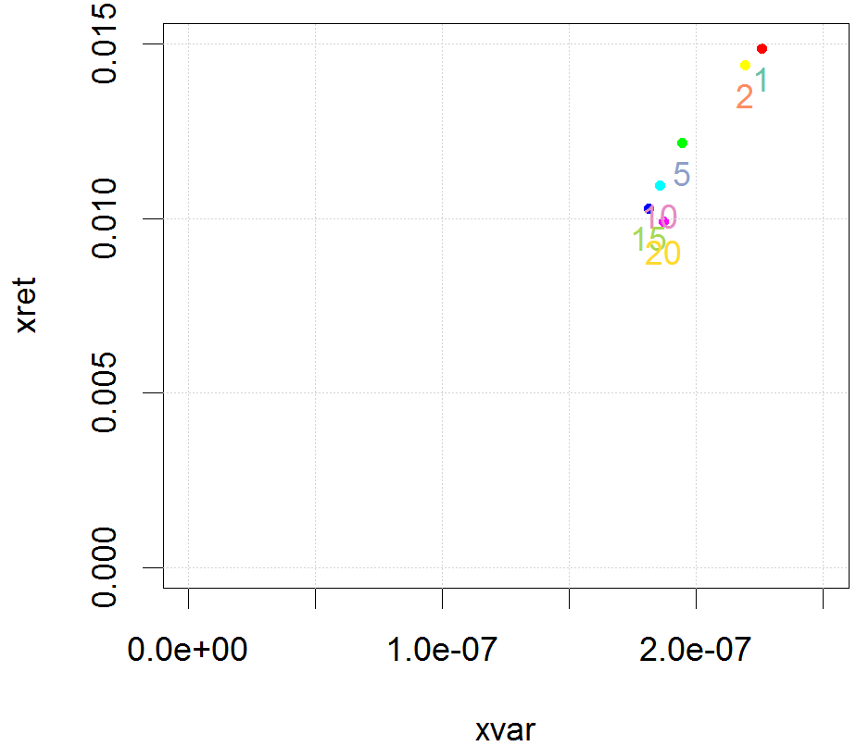
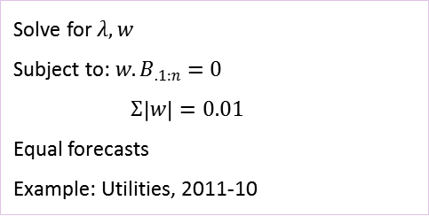
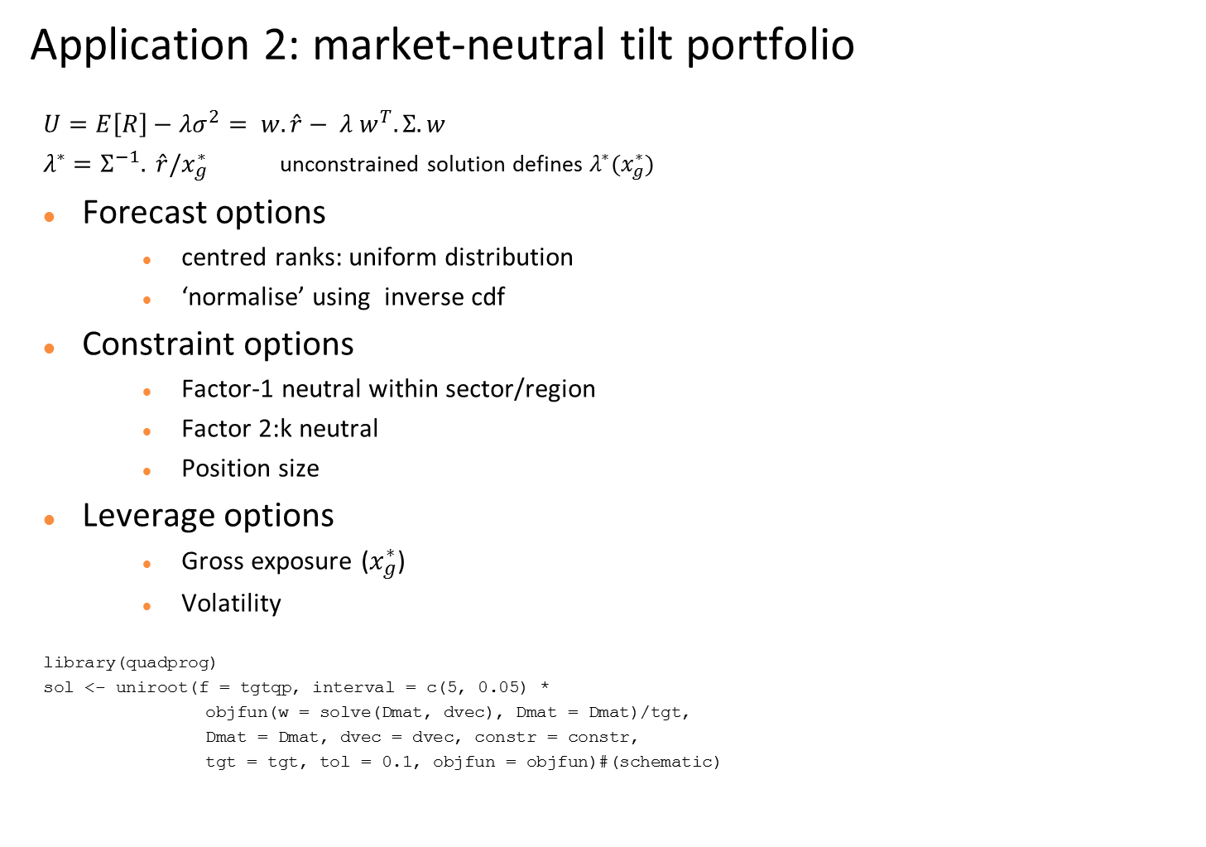
Market-neutral tilt
Application 2: market-neutral tilt portfolio
$$U=E\left[R\right]−λσ^{2}= w.\hat{r}− λ w^{T}.Σ.w$$
$λ^{∗}=Σ^{−1}. \hat{r}/x_{g}^{∗}$ unconstrained solution defines $λ^{∗}(x_{g}^{∗})$
Forecast options
  centred ranks: uniform distribution
  ‘normalise’ using inverse cdf
Constraint options
  Factor-1 neutral within sector/region
  Factor 2:k neutral
  Position size
Leverage options
  Gross exposure ($x_{g}^{∗}$)
  Volatility
library(quadprog)
sol <- uniroot(f = tgtqp, interval = c(5, 0.05) *
objfun(w = solve(Dmat, dvec), Dmat = Dmat)/tgt,
Dmat = Dmat, dvec = dvec, constr = constr,
tgt = tgt, tol = 0.1, objfun = objfun)#(schematic)
tar
Solve for $λ, w$
Subject to: $w.B_{.1:n}=0$
$Σ\left|w\right|=0.01$
Equal forecasts
Example: Utilities, 2011-10
Notes:
Unconstrained solution provides certain insights and an initial estimate for risk-aversion
Practical matters – the bullets
Numerically the solution is derived in the schema shown – requires converting initial lambda to an interval
The most constrained are the most interesting

Slide 15
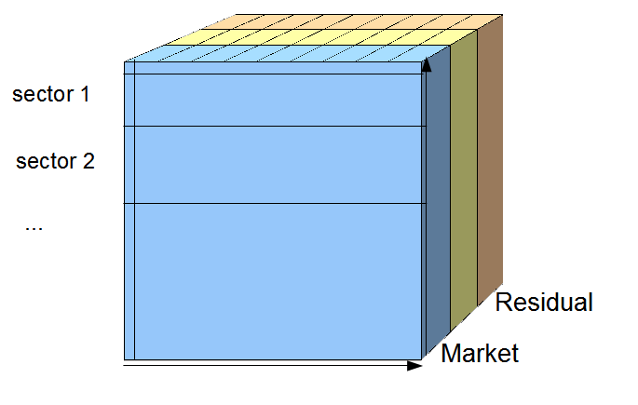
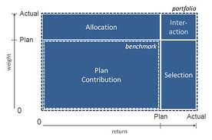
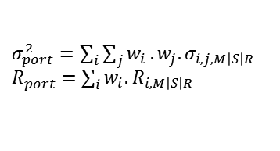
Attribution
Attribution
For a single period
  Variance and return have the same components
    Market (factor 1)
    Systematic (factors 2:k)
    Residual
  Drilldown into category trees
    Geographical tree (region, country, state)
    Industrial classification tree (GICS, ICB, BICS)
    Long, short subportfolios
  Option to apply different trees on the two axes
Multi-period treatment of returns
  ‘Simple’ with no compounding, or…
  ‘Smoothing’ scheme, redistributing interactions
Contrast with Brinson/Fachler and extensions
  No benchmark (cash benchmark)
  Consequently no selection/allocation/interaction
  Currency easy:
    local returns vs local cash (hedged)
    $ returns vs $ cash (unhedged)
  Leverage easy: premia are self-financing
Cash benchmark
$σ_{port}^{2}=\sum_{i}{\sum_{j}{w_{i}}.w_{j}.σ_{i,j,M\left|S\right|R} }$
$R_{port}^{}=\sum_{i}{{w_{i}.R}_{i,M\left|S\right|R}}$
Brinson/Fachler

Slide 16
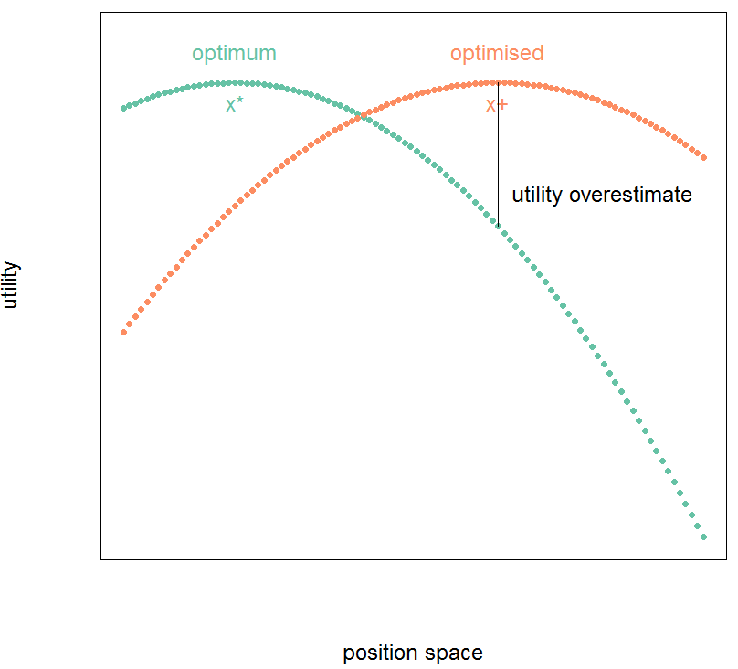
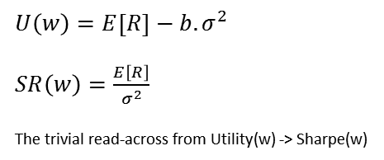
Optimisation
Mean-variance optimisation criticisms
Markowitz optimisation
  Ignores sampling errors in the covariance matrix
  Solves a mis-specified problem
Portfolio weights
  Sensitive to sampling errors in covariance
  Do not follow intuition
  Are distant from true optimality
Utility and Sharpe Ratio
  Variance is underestimated
  Expected return is overestimated
‘Solutions’ have been proposed
  But how serious is the problem?
  Might the answer depend on the risk model type?
$U\left(w\right)=E\left[R\right]−b.σ^{2}$
$SR\left(w\right)=\frac{E\left[R\right]}{σ^{2}}$
The trivial read-across from Utility(w) -> Sharpe(w)
Notes:
Point 1 is valid
Portfolio weights, utility and sharpe will be investigated a bit

Slide 17
Optimisation monte-carlo
Optimisation: a monte-carlo test (1)
Using ‘vanilla’ PCA without shrinkage
From an estimated covariance matrix
  Generate synthetic data
  Re-estimate covariance from this
  Draw expected return from a uniform distribution
  Optimise
    subject to industry group neutrality constraint
    Adjusting risk-aversion to target volatility
  Repeat for seven global equity sectors
Results
  optimum and optimised weights correlate highly
  True vol is 1.16x expected vol from the estimate
  Expected return is 1.09x the true optimum
sector | number of stocks in model | euclidean length of optimal portfolio | euclidean length of error | correlation of x* and x+ | expected return of optimal | expected return of optimised | true variance of optimised
1 | 213 | 0.37 | 0.13 | 0.95 | 1.48 | 1.63 | 1.41
2 | 246 | 0.31 | 0.09 | 0.97 | 1.32 | 1.44 | 1.32
3 | 306 | 0.39 | 0.10 | 0.97 | 1.77 | 1.91 | 1.29
4 | 179 | 0.36 | 0.10 | 0.97 | 1.25 | 1.35 | 1.30
5 | 290 | 0.37 | 0.10 | 0.97 | 1.71 | 1.86 | 1.31
6 | 196 | 0.36 | 0.10 | 0.97 | 1.34 | 1.45 | 1.30
7 | 60 | 0.67 | 0.26 | 0.95 | 1.40 | 1.57 | 1.46
mean | 213 | 0.41 | 0.13 | 0.96 | 1.47 | 1.60 | 1.34
Notes:
[not much time for this one]

Slide 18
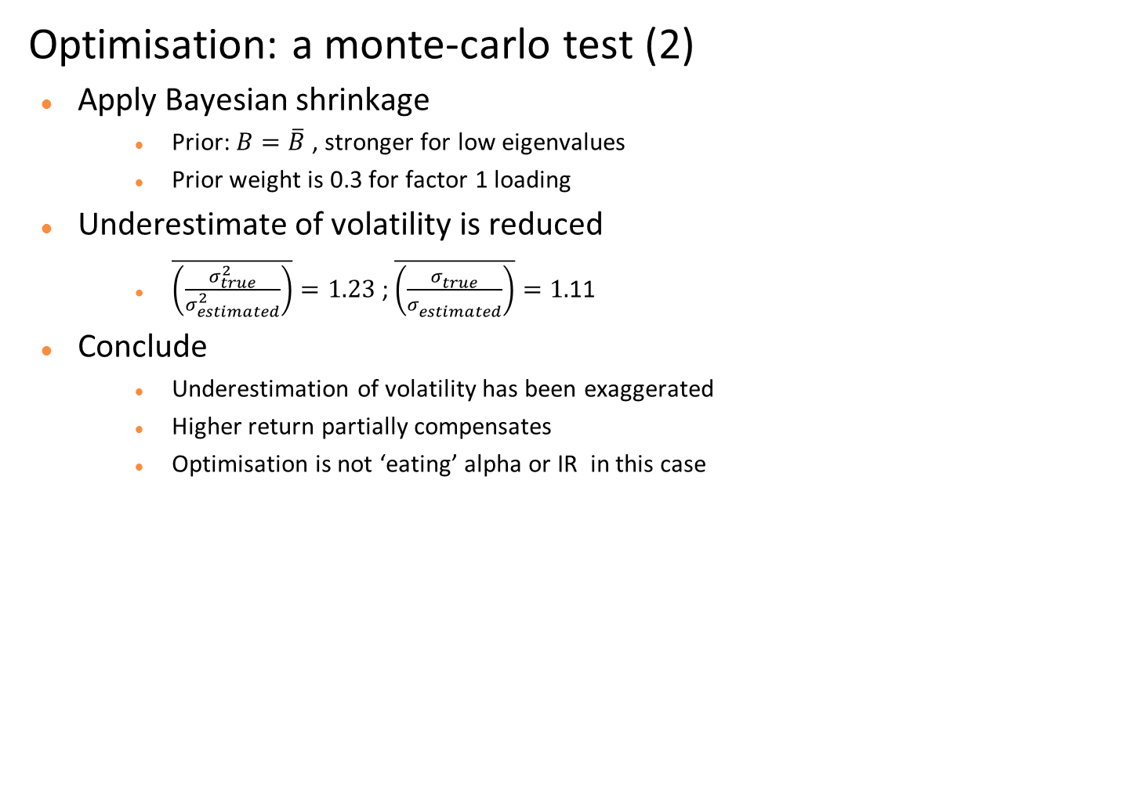
Optimisation monte-carlo
Optimisation: a monte-carlo test (2)
Apply Bayesian shrinkage
  Prior: $B=\overline{B}$ , stronger for low eigenvalues
  Prior weight is 0.3 for factor 1 loading
Underestimate of volatility is reduced
  $\overline{\left(\frac{σ_{true}^{2}}{σ_{estimated}^{2}}\right)}=1.23$ ; $\overline{\left(\frac{σ_{true}^{}}{σ_{estimated}^{}}\right)}=1.$11
Conclude
  Underestimation of volatility has been exaggerated
  Higher return partially compensates
  Optimisation is not ‘eating’ alpha or IR in this case
sector | number of stocks in model | euclidean length of optimal portfolio | euclidean length of error | correlation of x* and x+ | expected return of optimal | expected return of optimised | true variance of optimised
1 | 213 | 0.38 | 0.11 | 0.96 | 1.56 | 1.59 | 1.20
2 | 246 | 0.31 | 0.09 | 0.96 | 1.25 | 1.30 | 1.19
3 | 306 | 0.41 | 0.10 | 0.97 | 1.86 | 1.89 | 1.16
4 | 179 | 0.36 | 0.11 | 0.95 | 1.25 | 1.29 | 1.21
5 | 290 | 0.36 | 0.11 | 0.96 | 1.77 | 1.82 | 1.22
6 | 196 | 0.37 | 0.11 | 0.96 | 1.41 | 1.45 | 1.21
7 | 60 | 0.69 | 0.28 | 0.93 | 1.23 | 1.32 | 1.43
mean | 213 | 0.41 | 0.13 | 0.95 | 1.48 | 1.52 | 1.23
Notes:
Conclusions only

Slide 19
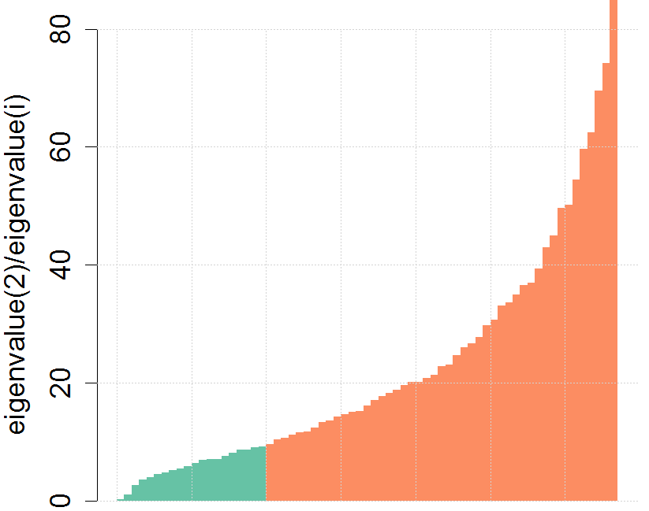
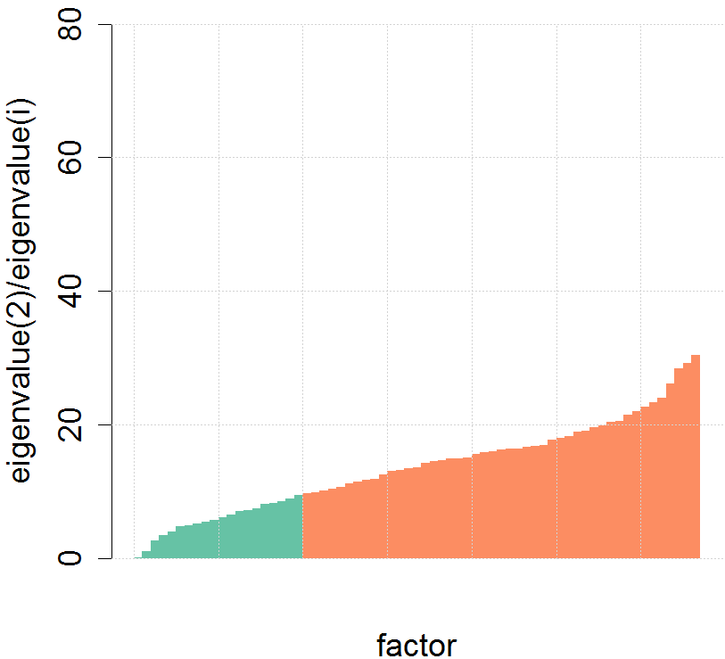


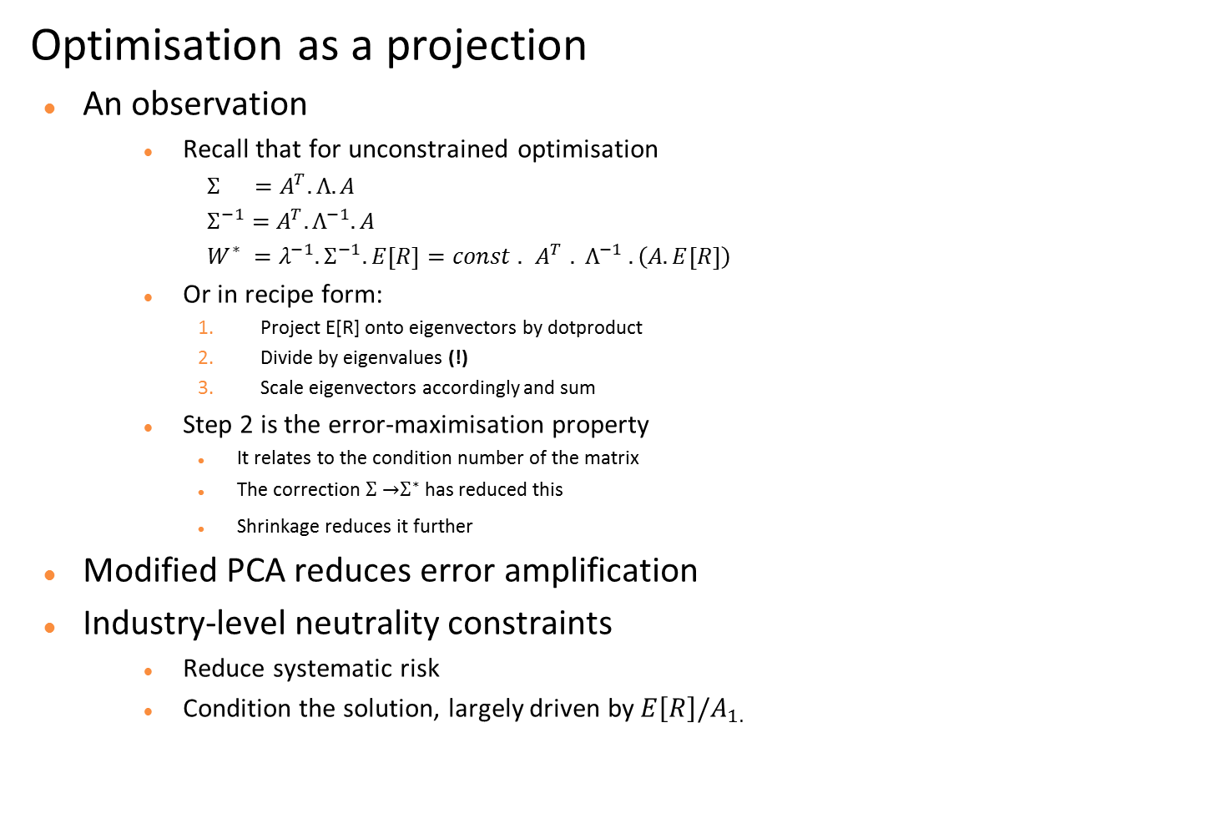
Optimisation as projection
Optimisation as a projection
An observation
  Recall that for unconstrained optimisation
$Σ =A^{T}.Λ. A$
$Σ^{−1}={ A}^{T}.Λ^{−1}.A$
$W^{∗} ={λ^{−1}.Σ}^{−1}.E\left[R\right]=const . { A}^{T} . Λ^{−1} . \left(A.E\left[R\right]\right)$
  Or in recipe form:
    Project E[R] onto eigenvectors by dotproduct
    Divide by eigenvalues (!)
    Scale eigenvectors accordingly and sum
  Step 2 is the error-maximisation property
    It relates to the condition number of the matrix
    The correction $Σ \overset{→}{ }Σ^{∗}$ has reduced this
    Shrinkage reduces it further
Modified PCA reduces error amplification
Industry-level neutrality constraints
  Reduce systematic risk
  Condition the solution, largely driven by$E\left[R\right]/A_{1.}$
$$Σ$$
$$Σ^{∗}$$
Notes:
Take-aways: a different view of ‘error maximisation’
Why modified PCA, and why industry-level constraints
What is the ‘spectrum’ of my IC, when projected onto the eigenvectors? This is an attribution we can do.

Slide 20
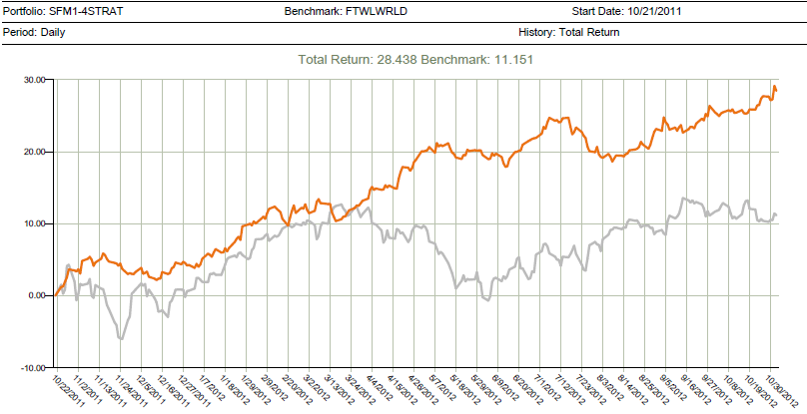
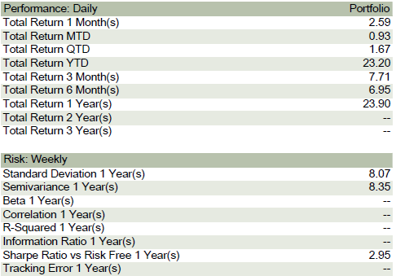
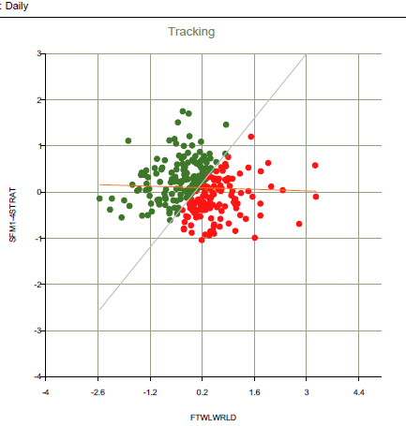
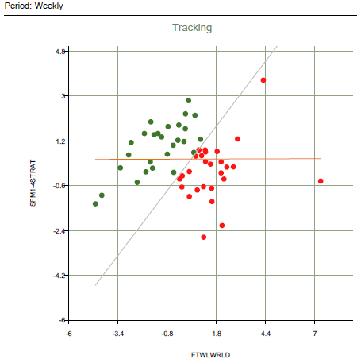
Live Application
A live application in real time: global equity market neutral
A contrarian low-frequency strategy run in real time as a ‘paper portfolio’ performed in-line with backtest
But too low vol: 8% for 8x leverage and net long, not $-neutral so not ‘market neutral’ despite beta=0
Moral: be careful what your client asks for (diversification, hedging) - you might get it and still not like it
source: Bloomberg PORT
Sharpe Ratio 2.91
Return/trade 0.72%
Return/gross 3.30%
Volatility/gross 1.14%
Holding period 23 weeks
Net/gross 6.3%
source: internal
Notes:
The tool was used to design a four-strategy global market-neutral strategy, ultra-low-frequency
It was assessed for one year in real time at a market-neutral specialist hedge fund, on their investment universe
It performed in-line with backtest and zero correlation with indices
But was canned, or was it copied?

Slide 21
Cap intro
Application: the open source talent contest
There exists a severe barrier to entry in the capital management industry
  Backtests have no credibility due to deliberate or unwitting exercise of hindsight options
  Paper portfolios are a waste of time – trade at the touch, and one can run many
Move to a clear and transparent process with detailed reporting
  Anonymous enrolment into accredited paper portfolios, executed at VWAP
  Detailed drill-down reporting on positions, risk, liquidity , performance
  Capital introduction / seeding from early investors
No capital
No track record
Process Development
Anonymous
Enrolment
Trading
At VWAP
Capital
Selection
Introduction

Slide 22
Review
Not just another backtest
We have seen
  A framework for rigorous testing of an equity covariance model
  Applications in backtest simulation of equity market neutral strategies
The latent demand for an open source equity risk and backtest system
  The market for trading talent is highly imperfect due to secrecy
  This is the missing mechanism for matching talent with capital whilst respecting IP
  A bias-free backtest + paper portfolio executed at VWAP can form the reference point
  Traction at last for the backtest?
‘Open Backtest’
Rigorous Paper Portfolio
Seed Capital
Talent
Notes:
The package is available!

Slide 23
Process
Process: review and timings
Bloomberg Terminal API
Input
Intermediate
Rdata files: bui.rdata
Minimally processed
Timeseries
Reference
Universe
Library
Parameters
Covariance
Return component
Portfolio
Report
Covariance
After-costs
GUI
Constituent
Setup
Execution
Report browsing
Contributions
PORT upload
RDCOMClient
MySQL tables via RODBC
RGtk2
Step | Time (100-stocks 500 periods) | Possible improvement
Download timeseries updates | 1 min | alternative delivery (Datalicence)
Update & extend historical data | 1 min | - ditto -
Covariance estimation | 2 min | In-memory
Return and yield decomposition | 2 min | data.table / other in-memory
Portfolio construction and trading | 2.5 min/strategy | Remove stopifnot() checks
Report generation | 1 min/strategy | data.table
Notes:
This schema is an informal overview
Large performance improvements are possible

Slide 24
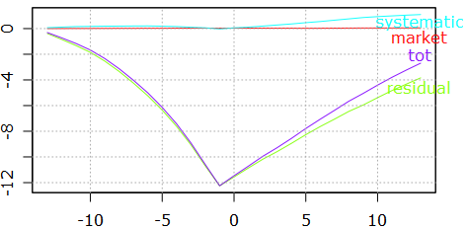
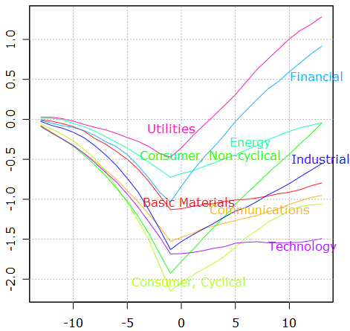
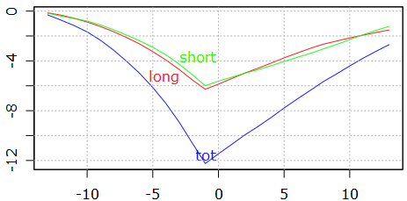
Attributing performance
Attribution of performance, risk, position, directional vol
Attributions shown are derived by lagging position with respect to returns, similar to earlier lag of covariance
Shows that the strategy is contrarian, market neutral, residual risk, and symmetrical across long and short
The three shown are a subset of approximately 300 tabulations warehoused for rapid browsing
Sector contribution
Risk component contribution
Cumulative performance (%)
Long / Short contribution
Lag (weeks)
Live running 1-year period, all sectors average, bworld US + EU screened
Notes:
This slide would need further explanation and motivation

