Slide 1
All Words Are Not Made Equal
Sid Bhattacharyya
John Pendergrass
Nitish Ranjan Sinha
Presented by
Nitish Ranjan Sinha
Nitish R. Sinha

Slide 2
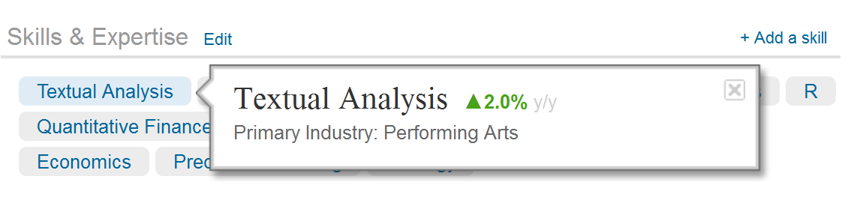
Textual analysis is a popular skill among quants
From Linked In

Slide 3
J.P. Morgan's $2 Billion Blunder
A massive trading bet boomeranged on J.P. Morgan Chase & Co., leaving the bank with at least $2 billion in trading losses and its chief executive, James Dimon, with a rare black eye following a long run as what some called the “King of Wall Street.”
The losses stemmed from wagers gone wrong in the bank's Chief Investment Office, which manages risk for the New York company. The Wall Street Journal reported early last month that large positions taken in that office by a trader nicknamed "the London whale" had roiled a sector of the debt markets.
A typical news article:
1130 words, 28 numbers!

Slide 4
Motivation
Most financial information is in form of text
  Aim to quantify textual information
  Distinguish fact from opinion
Better quantification of textual content lets us answer:
  How does textual information come into prices?
    Immediately? Grossman-Stiglitz Paradox
    Slowly? Sinha(2011) Underreaction to News in the US Stock Market
  What do people react to when they read news, after all?
    All news articles report is old news
Provide a simple yet robust way of identifying tone of news articles

Slide 5
Preview of Results
Create a corpus of hand classified articles from financial press
Almost 75% agreement among humans on “opinion” of the article
Substantial disagreement between “Bag of Words”
  Optimism and Positive facts: ND Dictionary is better
  Pessimism and Negative facts: Harvard dictionary is better
Easier to classify facts
  Almost 80% agreement with humans using “Bag of Words”
Harder to classify opinion
  Optimism: 67% agreement from simple variations of Naïve Bayes classifier
  Pessimism: 60% agreement from simple variations of Naïve Bayes classifier

Slide 6
Early Classifiers
  Tetlock (2007),
    Harvard IV dictionary, from psychologists and sociologists. Developed by Philip Stone (1966)
  Loughran and McDonald (2010)
    Chose almost 5000 most frequent words in 10-K
    Hand tagged them as positive or negative
  Both widely used to measure tone of news articles
  Tone= (Positive Words- Negative Words)/Total Words

Slide 7
Tone has multiple sources
Fact
  “..at least $2 billion in trading losses”
Opinion/Speculation
  “.. with a rare black eye ”
An article can have at least two kinds of information: Present two different categorization problems

Slide 8
Articles have target audience
News articles and 10K : two different audiences (and protections)
  Newspapers often legally protected for speculation or providing opinion
  Firms liable for opinion in 10K (some safe harbors)
Harvard Dictionary is from vernacular English
Notre Dame dictionary is from 10K

Slide 9
Can we quantify textual information more accurately?
Problems with “Bag of Words” method
  Language in Financial Newspapers is not similar to language in 10-Ks
  “Bag of Words” methods do not distinguish facts from opinions
  Opinions are subjective but humans reliably understand them
  All words are not made equal (for classifying an article)
    “bad” and “horrible” have the same weight
Our solution:
  Use a classifier that assigns different weights for different words
  Distinguish fact from opinion

Slide 10
We use text data from two sources
“Abreast of the market” column from WSJ, 1984-2000
All the unique words in 10K, provided by Bill McDonald
  Includes word, word count, # of documents in which the word occurs

Slide 11
Language in Financial Newspapers is not similar to language in 10-Ks
Among top 7000 words in “Abreast of the Market” and 10Ks, 3534 not unique to the source
3466 top words in “Abreast of the Market” do not appear in 10Ks
  Market Condition: “rally”, “yesterday”, “jumped”, “eased”, “slid”
  Opinion: “think”, “rumors”, “speculation”,
  State of mind: “worried”, ”anxiety”
3466 top words in 10 K do not occur in the “Abreast of the Market”
  Accounting: “deferred”, “goodwill”, ”expenditures”, “receivable”
  Legal: “accordance”, “reference”, “impairment”, “materially”

Slide 12
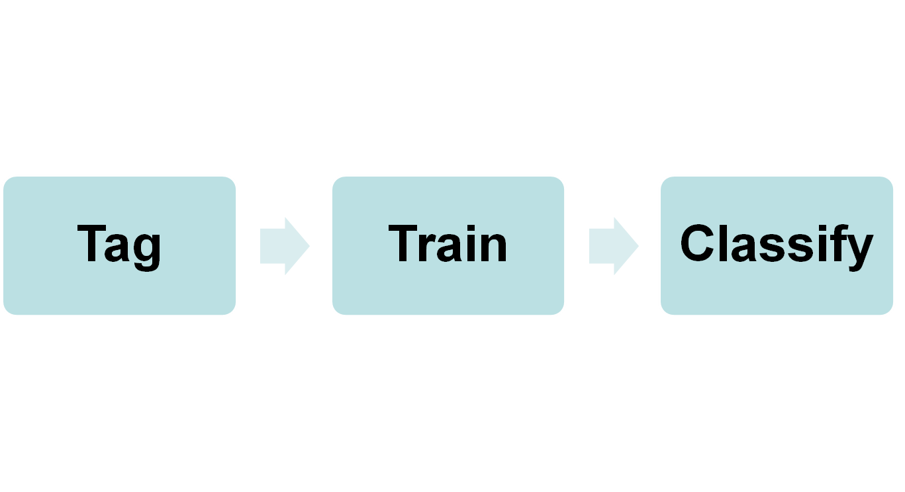
We propose using naïve Bayesian classification for quantifying textual information
Tag news articles as positive/negative
Learns probability associated with a positive document given the word/feature
Obtains probability of document being positive given the word/feature

Slide 13
How to tag news articles?
Two possibilities
Market Reaction to individual articles
  Nature of these articles poses a problem
  We are interested in whether news affects prices, using prices to tag news is a joint test of market efficiency and classifier efficacy
  Market may not incorporate information right away
    Use minute by minute return, hourly return, weekly return…
Human tagged articles

Slide 14
Tagging: Continued
We obtained tags for articles in two stages
  First Stage
    A finance professor with management consulting and equity research experience classified each article on a scale of 1 to 5 for the following questions
      Opinion
        After reading this article I feel optimistic about the future.
        After reading this article I feel pessimistic about the future.
      Facts
        I think this article presents positive developments in the market.
        I think this article presents negative developments in the market.
    The five point scale corresponds to
      Strongly agree, Agree, Hard to say, Disagree, Strongly disagree

Slide 15
Tagging: Continued
We obtained tags for articles in two stages
  First Stage
  Second Stage
    Another professor read the same articles

Slide 16
Hand coded data: Summary Statistics
 | Optimism | Pessimism | Positive | Negative
No | 102 | 88 | 28 | 36
Yes | 50 | 64 | 124 | 116
Relatively rare to have opinion of either kind.

Slide 17
Can we distinguish between opinion and fact
Opinion
Fact
 | Optimism | Pessimism | Positive | Negative
Optimism | 1
Pessimism | -0.6 | 1
Positive | 0.05 | -0.15 | 1
Negative | -0.17 | 0.26 | -0.19 | 1
Is optimism different from pessimism?
Is optimism different from positive?

Slide 18
How often do humans agree with each other?
Another coder read all 152 articles
  Similar level of agreement on opinion as reported in other sentiment analysis studies
Sample of 152 human tagged articles | Optimism | Pessimism | Positive | Negative
Agreement | 73.3% | 79.3% | 57.3% | 63.3%

Slide 19
At the training stage, the classifier learns informative features
Naïve Bayes assigns different weights to individual words/features
We defined features four different ways
  Most frequent 3000 words among tagged articles
  Words from the Harvard IV dictionary
  Words from the Notre Dame dictionary
  Most frequent 10,000 Character N-Grams

Slide 20
Example of Ngrams
“good news”
  N=4: “good”, “ood ”, “od n”, “d ne”, “ new”, “news”
  N=3: “goo”, “ood”, “od ”, “d n”, “ ne”, “new”, “ews”
  ..
  .
Do not need to model sequence of words
  “od n”, “d n” etc.
Do not need to model inflections
  “has” and “have” – “ha”

Slide 21
Optimism: Results from classification
CATEGORY: OPTIMISM
Sample of 152 human tagged articles (120 for training, 32 for held out) | Harvard IV word count | Notre Dame dictionary word count | Naïve Bayes (Harvard IV) | Naïve Bayes (Notre Dame dictionary) | Naïve Bayes (Most frequent 3000 words)
Accuracy | 50% | 60.53% | 67.48% | 65.94% | 67.10%
Sample of 152 human tagged articles | Optimism | Pessimism | Positive | Negative
Agreement | 73.3% | 79.3% | 57.3% | 63.3%

Slide 22
Pessimism: Results from classification
CATEGORY: PESSIMISM
Sample of 152 human tagged articles (120 for training, 32 for held out) | Harvard IV word count | Notre Dame dictionary word count | Naïve Bayes (Harvard IV) | Naïve Bayes (Notre Dame dictionary) | Naïve Bayes (Most frequent 3000 words)
Accuracy | 59.87% | 31.58% | 56.87% | 57.13% | 59.45%
Sample of 152 human tagged articles | Optimism | Pessimism | Positive | Negative
Agreement | 73.3% | 79.3% | 57.3% | 63.3%

Slide 23
Positive: Results from classification
CATEGORY: POSITIVE FACTS
Sample of 152 human tagged articles (120 for training, 32 for held out) | Harvard IV word count | Notre Dame dictionary word count | Naïve Bayes (Harvard IV) | Naïve Bayes (Notre Dame dictionary) | Naïve Bayes (Most frequent 3000 words)
Accuracy | 56.58% | 59.21% | 81.16% | 81.16% | 82.00%
Sample of 152 human tagged articles | Optimism | Pessimism | Positive | Negative
Agreement | 73.3% | 79.3% | 57.3% | 63.3%

Slide 24
Negative: Results from classification
CATEGORY: NEGATIVE FACTS
Sample of 152 human tagged articles (120 for training, 32 for held out) | Harvard IV word count | Notre Dame dictionary word count | Naïve Bayes (Harvard IV) | Naïve Bayes (Notre Dame dictionary) | Naïve Bayes (Most frequent 3000 words)
Accuracy | 53.29% | 35.53% | 76.87% | 75.74% | 75.13%
Sample of 152 human tagged articles | Optimism | Pessimism | Positive | Negative
Agreement | 73.3% | 79.3% | 57.3% | 63.3%

Slide 25
Overall comments
The classifier is only as good as
  Tagged data
  Feature set
    Ngrams perform better than word or word N-grams
Be sensitive to the vocabulary of your text source
  10K, News articles, and Twitter have different vocabularies

Slide 26
Software: State of Progress
Word Count: Python
Naïve Bayes Classifier: Python+NLTK
Plan to release estimated classifier
  Even a better plan: Tag your own articles, will get better results for your application
R-package coming, stay tuned

Slide 27
Some textual analysis of textual analysis
Linked In thinks

