Slide 1
Benchmarking parallel loops in R and predicting index returns
R/Finance 2011
University of Illinois at Chicago
30.4.2011
10:50 - 11:10
Mikko Niemenmaa
Aalto University School of Economics
(Formerly known as Helsinki School of Economics)

Slide 2
1
t+1
T
t-10
t
Each analysis is independent. Meaning:
  There is no data dependency
  The results from one analysis are not used in the next one.
For example, ~T repetitions of the analysis with one time series

Slide 3
1
N
1
T
For example, ~T x N repetitions of the analysis

Slide 4
Problem: large datasets (e.g. long time-series) require lengthy processing times
Solution: Parallelize the analysis
Full set
Part 1
Part N
Collate results

Slide 5
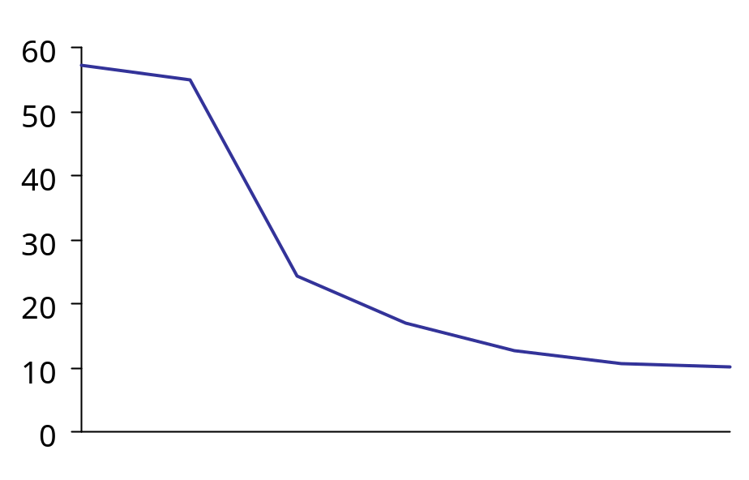
Doing naively parallel tasks in parallel is significantly faster
User time (seconds)
-56%
Number of threads
NP
1
2
3
4
6
8
Using R with the R/parallel package
One desktop box, Intel Core 2 Duo processor
Adding one thread cuts calculation time in half
Surprisingly, slight performance gains with more threads
Source: Niemenmaa, 2011, ”Benchmarking parallel loops without data dependency in R, and predicting index returns with technical indicators”
Notes:
Amdahl's Law

Slide 6
Parallelizing is easy to implement in most cases
Matlab code
R code
matlabpool
clear A
parfor i = 1:20
A(i) = i;
end
A
clear
matlabpool close
parfunc <- function() {
A <- NULL
for( i in 1:20 ) {
A <- rbind( A, i )
}
return( A )
}
out <- parfunc()
out
library(rparallel)
if( "rparallel" %in%
names( getLoadedDLLs() ) )
{
runParallel(
resultVar = "A",
resultOp = "rbind" )
} else {
}

Slide 7
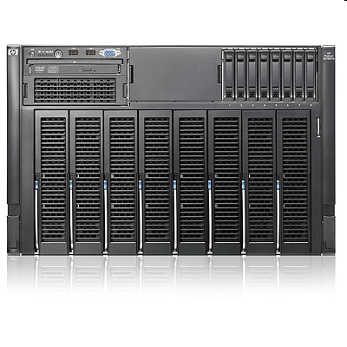
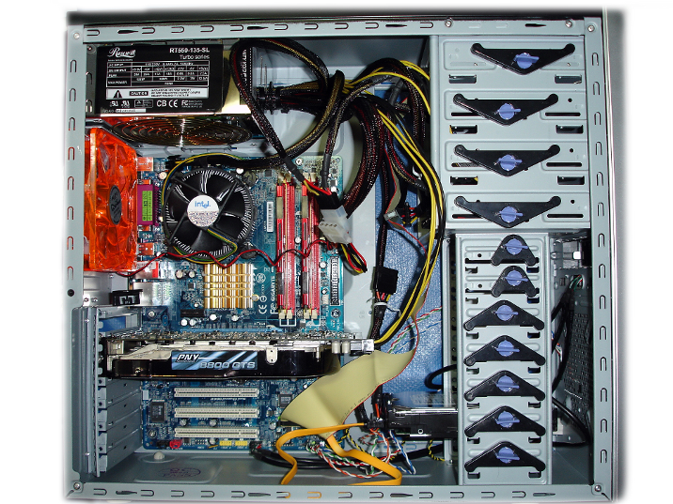
And you can get performance gains without breaking the budget
HP ProLiant DL785 G6 Server
DIY Computer
Starting at: $ 28,999
up to: $ 140,000
Starting at: $ 1,500
up to: $ 3,000

Slide 8
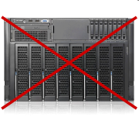
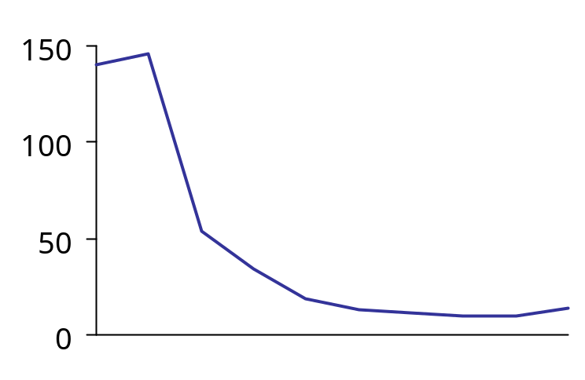
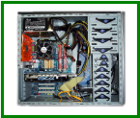
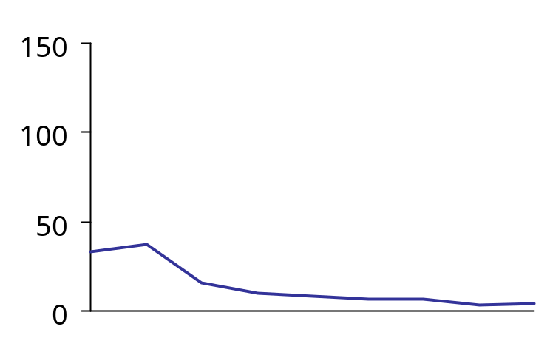
Dedicated DIY machine might even be faster than a shared memory server with other users
150
User time (seconds)
User time (seconds)
NP
1
2
3
4
6
8
16
32
64
NP
1
2
3
4
6
8
16
32
Number of threads
Number of threads
HP ProLiant DL785 G5
8 quad-core AMD Opteron 8360 SE (Barcelona), 2.5 GHz, 512 GB
DIY quad-core Intel Core i7, 3.4 Ghz, 16 GB
Source: Niemenmaa, 2011, ”Benchmarking parallel loops without data dependency in R, and predicting index returns with technical indicators”

Slide 9
Key takeaways
Caveats
No more waiting for analysis to run
Try more model specifications in the same amount of time
Not necessarily expensive
Publish faster ☺
There are lots of other ways to parallelize, however this is quickest to implement on a single machine (check out Schmidberger et al. 2009, “State-of-the-art in parallel computing with R” for other options)
Good coding practice
Passing data to functions
Nested functions seem to cause some difficulties if variable names are not unique across functions
Use “Verbose” to track errors
Does not always exit gracefully after errors
On windows check that all threads exited nicely
Especially on *NIX can leave stale shells and clutter up your max processes and fail to start, ps and kill frequently
Don't expect results to come in order, store iteration counters in results
I don't know how this interacts with database interfaces, test before production

Slide 10
That was the benchmarking part, now for an example application
Motivated by this:
"We found that this approach was very inefficient because it required too much computer power and time."
Source: Germán Creamer and Yoav Freund, 2010, “Automated Trading With Boosting And Expert Weighting”, Quantitative Finance, Vol. 10, Issue 4, pp. 401–420

Slide 11
Turns out forecasting returns could be thought of as a classification problem
Day | Var 1 | Var 2 | Var N | Return
1 |  |  |  | +
2 |  |  |  | -
3 |  |  |  | +
4 |  |  |  | +
5 |  |  |  | +
6 |  |  |  | -
7 |  |  |  | +
8 |  |  |  | -
... |  |  |  | ...
t |  |  |  | +
t+1 |  |  |  | ?
Training
data
”New sample
data”

Slide 12
Boosting regressions for classification use many hypothesis combined in to one
h_{fin}(X)
h_{fin}(X)=∑(a_{n}h_{n}(X))
a₁
a₂
a_{N}
Weighted, ensemble, final hypothesis
h₁(X)
h₂(X)
h_{N}(X)
Hypothesis 1
Hypothesis N
New data
sample
C₁
C₂
Combine
votes
Class
prediction
Data
.
.
.
C_{T}

Slide 13
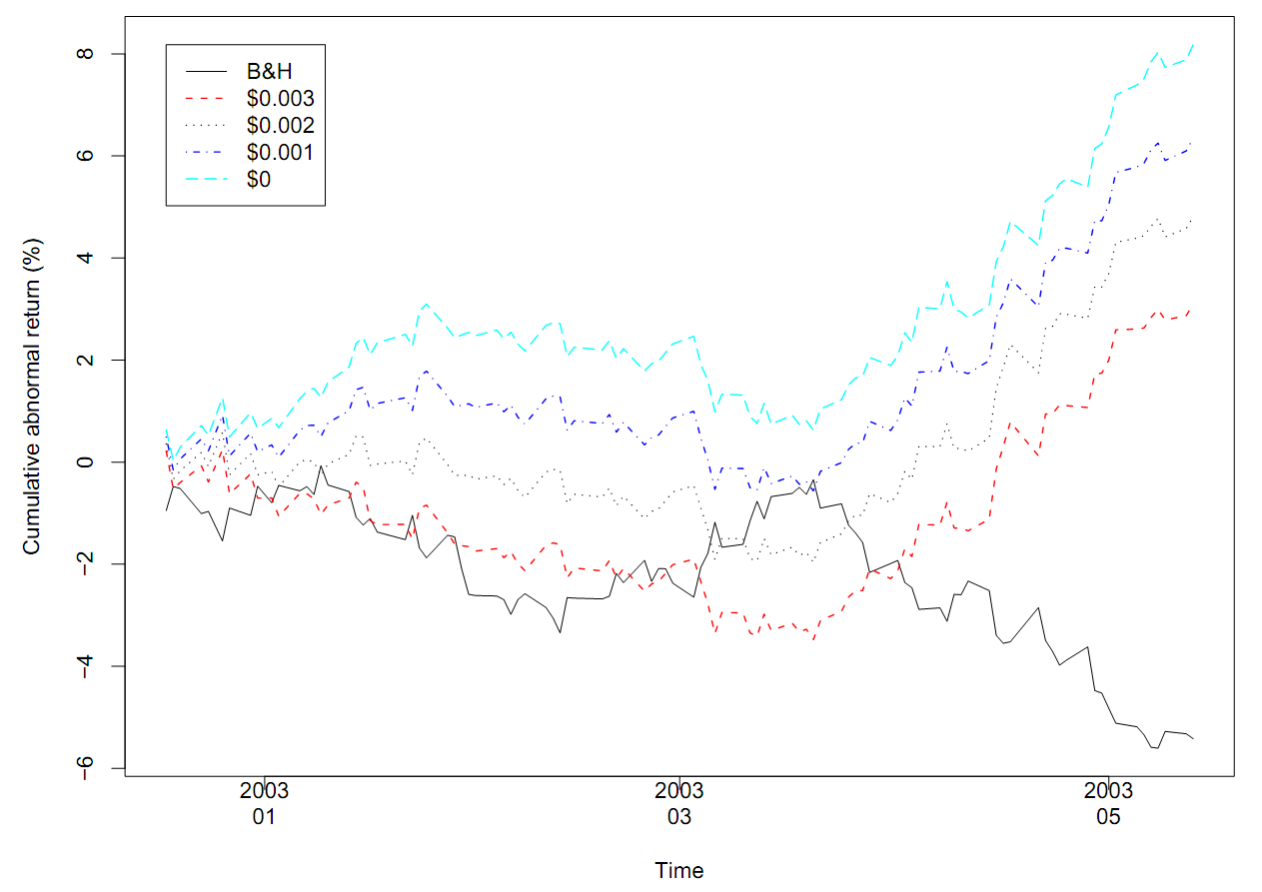
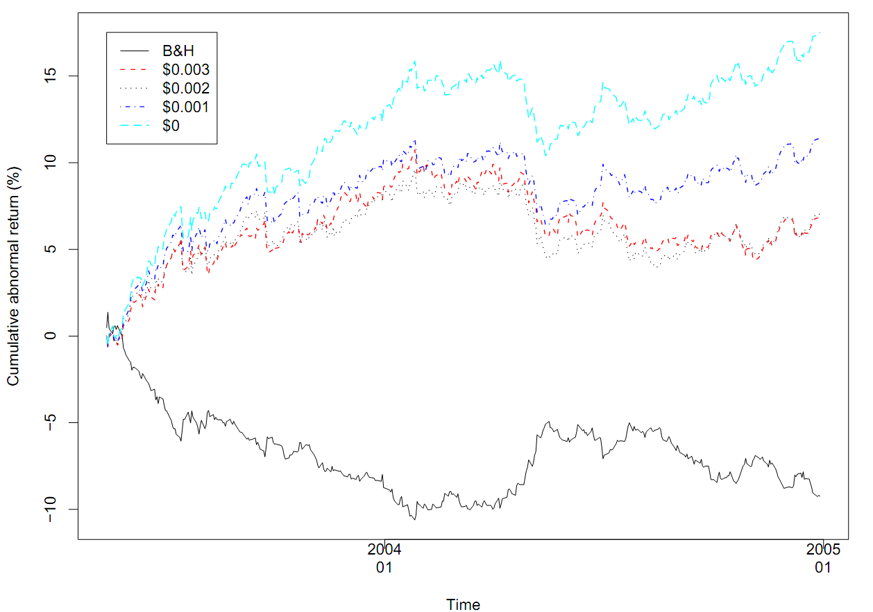
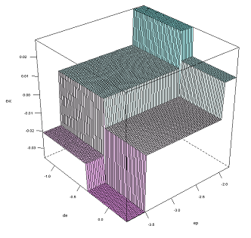
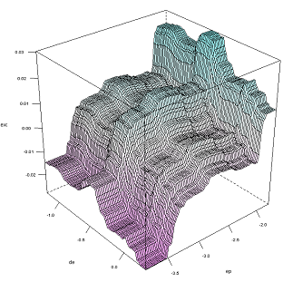
Some papers that have applied boosting to financial problems
Paper
Selected results
Creamer and Freund, 2010, “Automated Trading With Boosting And Expert Weighting”, Quantitative Finance
Rossi and Timmermann, 2010, ”What is the Shape of the Risk-Return Relation?”, AFA

Slide 14
For the sake of argument, let’s ignore the typical problems and caveats with forecasting
Close-to-close returns are not really possible
Indices are a group of underlying return series, no reason to be forecastable, even if companies might be
Trading cost accounting
Shorting might not be as trivial as often implied
Even if returns are guessed correct you might lose:
  Liquidity can be a problem
  Volatility can wipe you out
  Skewness and kurtosis might cause you to wipe out

Slide 15
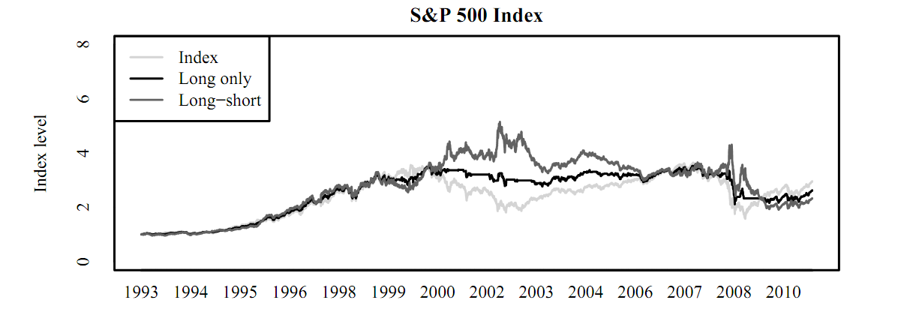
Analyzed the numbers for a longer time period (with r/parallel to speed it up)
Days guessed correctly
Using t-1 Using TA % Increase
S&P 500 48.70 % 52.51 % 7.84 %
Source: Niemenmaa, 2011, ”Benchmarking parallel loops without data dependency in R, and predicting index returns with technical indicators”

Slide 16
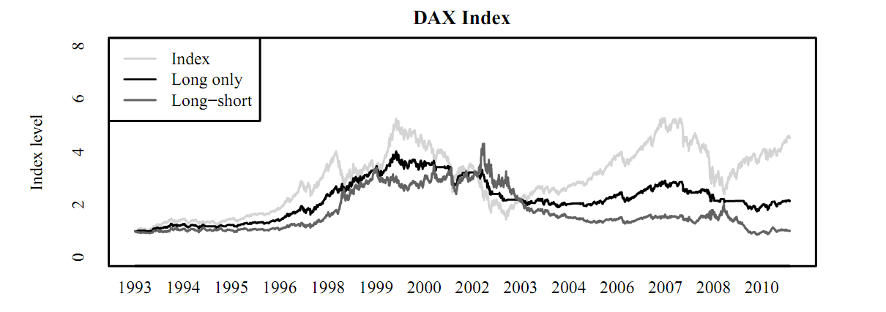
Analyzed the numbers for a longer time period (with r/parallel to speed it up)
Days guessed correctly
Using t-1 Using TA % Increase
DAX 49.60 % 51.65 % 4.13 %
Source: Niemenmaa, 2011, ”Benchmarking parallel loops without data dependency in R, and predicting index returns with technical indicators”

Slide 17
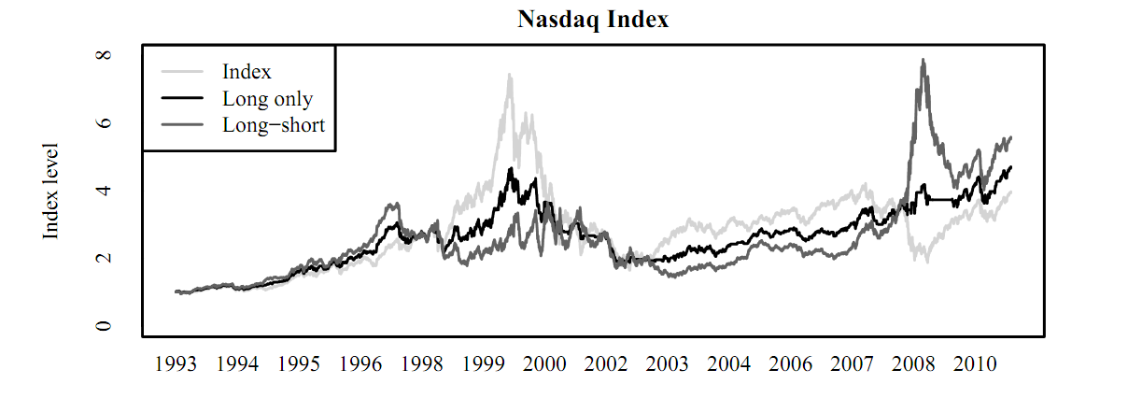
Analyzed the numbers for a longer time period (with r/parallel to speed it up)
Days guessed correctly
Using t-1 Using TA % Increase
Nasdaq 52.50 % 53.53 % 1.96 %
Source: Niemenmaa, 2011, ”Benchmarking parallel loops without data dependency in R, and predicting index returns with technical indicators”

Slide 18
Conclusion
Doing analysis in parallel can be really efficient
It is simple to implement in R with the rparallel package
Using technical analysis indicators on the index does not enable you to beat the market consistently
However, the analysis does uncover interesting dynamics that might be researched further

Slide 19
END OF FILE

