Slide 1
R and Hadoop Integrated Processing Environment
Using RHIPE for Data Management

Slide 2
R and Large Data
.Rdata format is poor for large/many objects
  attach loads all variables in memory
  No metadata
Interfaces to large data formats
  HDF5, NetCDF
To compute with large data we need well designed storage formats

Slide 3
R and HPC
Plenty of options
  On a single computer: snow, rmpi, multicore
  Across a cluster: snow, rmpi, rsge
Data must be in memory, distributes computation across nodes
Needs separate infrastructure for balancing and recovery
Computation not aware of the location of the data

Slide 4
Computing With Data
Scenario:
  Data can be divided into subsets
  Compute across subsets
  Produce side effects (displays) for subsets
  Combine results
Not enough to store files across a distributed file system (NFS, LustreFS, GFS etc)
The compute environment must consider the cost of network access

Slide 5
Using Hadoop DFS to Store
Open source implementation of Google FS
Distributed file system across computers
Files are divided into blocks, replicated and stored across the cluster
Clients need not be aware of the striping
Targets write once ,read many – high throughput reads

Slide 6
client
File
Namenode
Block 1
Block 2
Block 3
Blocks
Replication
Datanode 1
Datanode 2
Datanode 3

Slide 7
Mapreduce
One approach to programming with large data
Powerful tapply
  tapply(x, fac, g)
  Apply g to rows of x which correspond to unique levels of fac
Can do much more, works on gigabytes of data and across computers

Slide 8
Mapreduce in R
If R could, it would:
Map:
imd <- lapply(input,function(j)
list(key=K1(j), value=V1(j)))
keys <- lapply(imd,"[[",1)
values <- lapply(imd, "[[",2)
Reduce:
tapply(values,keys, function(k,v)
list(key=K1(k,v), value=V1(v,k)))

Slide 9
File
Divide into Records of K V pairs
Divide into Records of K V pairs
Divide into Records of K V pairs
Map
For each record, return key, value
For each record, return key, value
For each record, return key, value
Sort
Shuffle
Reduce
For every KEY reduce→ K,V
For every KEY reduce→ K,V
For every KEY reduce→ K,V
Write K,V to disk
Write K,V to disk
Write K,V to disk

Slide 10
R and Hadoop
Manipulate large data sets using Mapreduce in the R language
Though not native Java, still relatively fast
Can write and save a variety of R objects
  Atomic vectors,lists and attributes
  … data frames, factors etc.

Slide 11
Everything is a key-value pair
Keys need not be unique
Block
  Run user setup R expression
  For key-value pairs in block:
  run user R map expression
Each block is a task
Tasks are run in parallel (# is configurable)
Reducer
  Run user setup R expression
  For every key:
  while new value exists:
  get new value
  do something
Each reducer iterates through keys
Reducers run in parallel

Slide 12
Airline Data
Flight information of every flight for 11 years
~ 12 Gb of data, 120MN rows
1987,10,29,4,1644,1558,1833,1750,PS,1892,NA,109,112,NA,43,46,SEA,..

Slide 13
Save Airline as R Data Frames
1. Some setup code, run once every block of e.g. 128MB (Hadoop block size)
setup <- expression({
convertHHMM <- function(s){
t(sapply(s,function(r){
l=nchar(r)
if(l==4) c(substr(r,1,2),substr(r,3,4))
else if(l==3) c(substr(r,1,1),substr(r,2,3))
else c('0','0')
})
)}
})

Slide 14
Save Airline as R Data Frames
2. Read lines and store N rows as data frames
map <- expression({
y <- do.call("rbind",lapply(map.values,function(r){
if(substr(r,1,4)!='Year') strsplit(r,",")[[1]]
}))
mu <- rep(1,nrow(y))
yr <- y[,1]; mn=y[,2];dy=y[,3]
hr <- convertHHMM(y[,5])
depart <- ISOdatetime(year=yr,month=mn,day=dy,hour=hr[,1],min=hr[,2],sec=mu)
....
....
Cont’d

Slide 15
Save Airline as R Data Frames
2. Read lines and store N rows as data frames
map <- expression({
.... From previous page ....
d <- data.frame(depart= depart,sdepart = sdepart
,arrive = arrive,sarrive =sarrive
,carrier = y[,9],origin = y[,17]
,dest=y[,18],dist = y[,19]
,cancelled=y[,22], stringsAsFactors=FALSE)
rhcollect(map.keys[[1]],d)
})
Key is irrelevant for us
Cont’d

Slide 16
Save Airline as R Data Frames
3. Run
z <- rhmr(map=map,setup=setup,inout=c("text","sequence")
,ifolder="/air/",ofolder="/airline")
rhex(z)

Slide 17
Quantile Plot of Delay
120MN delay times
Display 1K quantiles
For discrete data, quite possible to calculate exact quantiles
  Frequency table of distinct delay values
  Sort on delay value and get quantile

Slide 18
Quantile Plot of Delay
map <- expression({
r <- do.call("rbind",map.values)
delay <- as.vector(r[,'arrive'])-as.vector(r[,'sarrive'])
delay <- delay[delay >= 0]
unq <- table(delay)
for(n in names(unq)) rhcollect(as.numeric(n),unq[n])
})
reduce <- expression(
pre = {
summ <- 0
},
reduce = {
summ <- sum(summ,unlist(reduce.values))
},
post = {
rhcollect(reduce.key,summ)
}
)

Slide 19
Quantile Plot of Delay
Run
z=rhmr(map=map, reduce=reduce,ifolder="/airline/",ofolder='/tmp/f'
,inout=c('sequence','sequence'),combiner=TRUE
,mapred=list(rhipe_map_buff_size=5))
rhex(z)
Read in results and save as data frame
res <- rhread("/tmp/f",doloc=FALSE)
tb <- data.frame(delay=unlist(lapply(res,"[[",1))
,freq = unlist(lapply(res,"[[",2)))

Slide 20
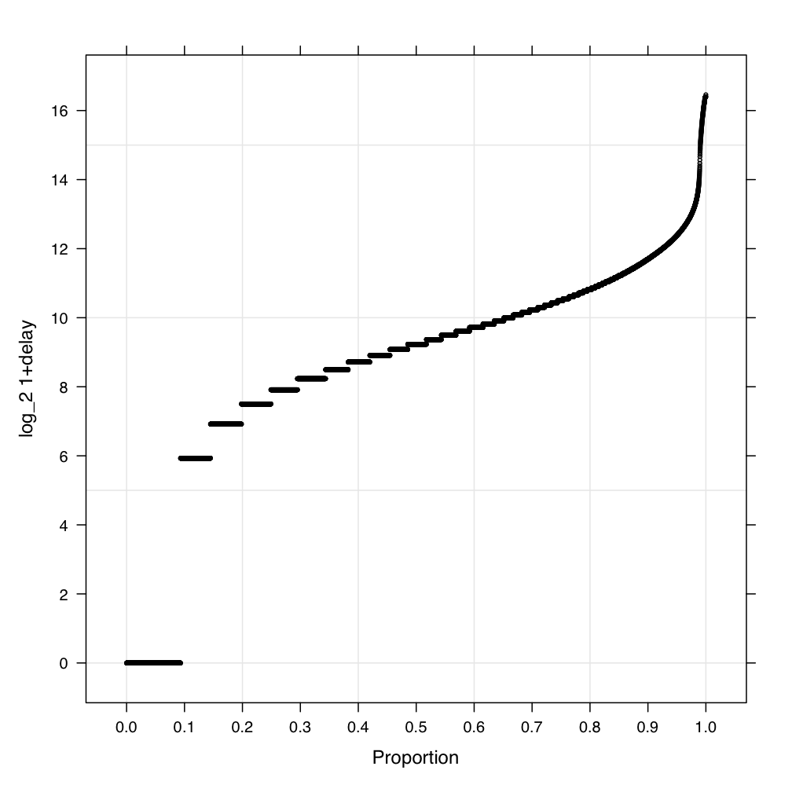

Slide 21
Conditioning
Can create the panels, but need to stitch them together
Small change …
map <- expression({
r <- do.call("rbind",map.values)
r$delay <- as.vector(r[,'arrive'])-as.vector(r[,'sarrive'])
r-r[r$delay>=0,,drop=FALSE]
r$cond <- r[,'dest']
mu <- split(r$delay, r$cond)
for(dst in names(mu)){
unq <- table(mu[[dst]])
for(n in names(unq)) rhcollect(list(dst,as.numeric(n)),unq[n])
}
})

Slide 22
Conditioning
After reading in the data (list of lists)
list( list(“ABE”,7980),15)
We can get a table, ready for display
dest delay freq
1 ABE 7980 15
2 ABE 61800 4
3 ABE 35280 5
4 ABE 56160 1

Slide 23
Running a FF Design
Have an algorithm to detect keystrokes in a SSH TCP/IP flow
Accepts 8 tuning parameters, what are the optimal values?
Each parameter has 3 levels, construct a 3^(8-3) FF design which spans design space
243 trials, each trial an application of algorithm to 1817 connections (for a given set of parameters)

Slide 24
Running an FF Design
1809 connections in 94MB
439,587 algorithm applications
Approaches
Each connection run 243 times? (1809 in parallel)
  Slow, running time is heavily skewed
Better: chunk 439,587

Slide 25
Chunk == 1, send data to reducers
  m2 <- expression({
  lapply(seq_along(map.keys),function(r){
  key <- map.keys[[r]]
  value <- map.values[[r]]
  apply(para3.r,1,function(j){ rhcollect(list(k=key,p=j), value) })
  })
  })
map.values is a list of connection data
map.keys are connection identifiers
para3.r is list of 243 parameter sets

Slide 26
Reduce: apply algorithm
  r2 <- expression(
  reduce={
  value <- reduce.values[[1]];
  params <- as.list(reduce.key$p)
  tt=system.time(v <- ks.detect(value,debug=F,params=params
  ,dorules=FALSE))
  rhcounter('param','_all_',1)
  rhcollect(unlist(params)
  ,list(hash=reduce.key$k,numks=v$numks, time=tt))
  })
rhcounter updates “counters” visible on Jobtracker website and returned to R as a list

Slide 27
FF Design … cont’d
Sequential running time: 80 days
Across 72 cores: ~32 hrs
Across 320 cores(EC2 cluster, 80 c1.medium instances): 6.5 hrs ($100)
A smarter chunk size would improve performance

Slide 28
FF Design … cont’d
Catch: Map transforms 95MB into 3.5GB! (37X).
Soln: Use Fair Scheduler and submit(rhex) 243 separate MapReduce jobs. Each is just a map
Upon completion: One more MapReduce to combine the results.
Will utilize all cores and save on data transfer
Problem: RHIPE can launch MapReduce jobs asynchronously, but cannot wait on their completion

Slide 29
Large Data
Now we have 1.2MN connections across 140GB of data
Stored as ~1.4MN R data frames
  Each connection as multiple data frames of 10K packets
Apply algorithm to each connection
m2 <- expression({
params <- unserialize(charToRaw(Sys.getenv("myparams")))
lapply(seq_along(map.keys),function(r){
key <- map.keys[[r]]
value <- map.values[[r]]
v=ks.detect(value,debug=F,params=params,dorules=FALSE)
….

Slide 30
Large Data
Can’t apply algorithm to huge connections – takes forever to load in memory
For each of 1.2 MN connections, save 1st (time) 1500 packets
Use a combiner – this runs the reduce code on the map machine saving on network transfer and the data needed in memory

Slide 31
Large Data
lapply(seq_along(map.values), function(r) {
v <- map.values[[r]]
k <- map.keys[[r]]
first1500 <- v[order(v$timeOfPacket)[1:min(nrow(v), 1500)],]
rhcollect(k[1], first1500)
})
r <- expression(
pre={
first1500 <- NULL
},
reduce={
first1500 <- rbind(first1500, do.call(rbind, reduce.values))
first1500 <- first1500[order(first1500$timeOfPacket)[1:min(nrow(first1500), 1500)],]
},
post={
rhcollect(reduce.key, first1500)
}
)
min(x,y,z) = min(x,min(y,z))

Slide 32
Large Data
Using tcpdump, Python, R and RHIPE to collect network data
  Data collection in moving 5 day windows(tcpdump)
  Convert pcap files to text, store on HDFS (Python/C)
  Convert to R data frames (RHIPE)
  Summarize and store first 1500 packets of each
  Run keystroke algorithm on first 1500

Slide 33
Hadoop as Key-Value DB
Save data as a MapFile
Keys are stored in sorted order and fraction of keys are loaded
E.g 1.2 MN (140GB) connections stored on HDFS
Good if you know the key, to subset (e.g SQL’s where) run a map job

Slide 34
Hadoop as a Key-Value DB
Get connection for key
‘v’ is a list of keys
alp<-rhgetkey(v,"/net/d/dump.12.1.14.09.map/p*")
Returns a list of key-value pair
>alp[[1]][[1]]
[1] "073caf7da055310af852cbf85b6d36a261f99" "1”
>head(alp[[1]][[2]][,c(“isrequester”,”srcip”)]
isrequester srcip
1 1 71.98.69.172
2 1 71.98.69.172
3 1 71.98.69.172

Slide 35
Hadoop as a Key-Value DB
But if I want SSH connections?
Extract subset:
lapply(seq_along(map.keys),function(i){
da <- map.values[[i]]
if('ssh' %in% da[1,c('sapp','dapp')])
rhcollect(map.keys[[i]],da)
})
rhmr(map,... inout=c('sequence','map'),....)

Slide 36
EC2
Start a cluster on EC2
python hadoop-ec2 launch-cluster –env \\ REPO=testing --env HADOOP_VERSION=0.20 test2 5
python hadoop-ec2 login test2
R
Run simulations too – rhlapply – wrapper round map/reduce

Slide 37
EC2 - Example
EC2 script can install custom R packages on nodes e.g.
function run_r_code(){
cat > /root/users_r_code.r << END
install.packages("yaImpute",dependencies=TRUE,repos='http://cran.r-project.org')
download.file("http://ml.stat.purdue.edu/rpackages/survstl_0.1-1.tar.gz","/root/survstl_0.1-1.tar.gz")
END
R CMD BATCH /root/users_r_code.r
}
State of Indiana Bioterrorism - syndromic surveillance across time and space
Approximately 145 thousand simulations
Chunk: 141 trials per task

Slide 38
EC2 - Example
library(Rhipe)
load("ccsim.Rdata")
rhput("/root/ccsim.Rdata","/tmp/")
setup <- expression({
load("ccsim.Rdata")
suppressMessages(library(survstl))
suppressMessages(library(stl2))
})
chunk <- floor(length(simlist)/ 141)
z <- rhlapply(a,cc_sim, setup=setup,N=chunk,shared="/tmp/ccsim.Rdata”,aggr=function(x) do.call("rbind",x),doLoc=TRUE)
rhex(z)

Slide 39
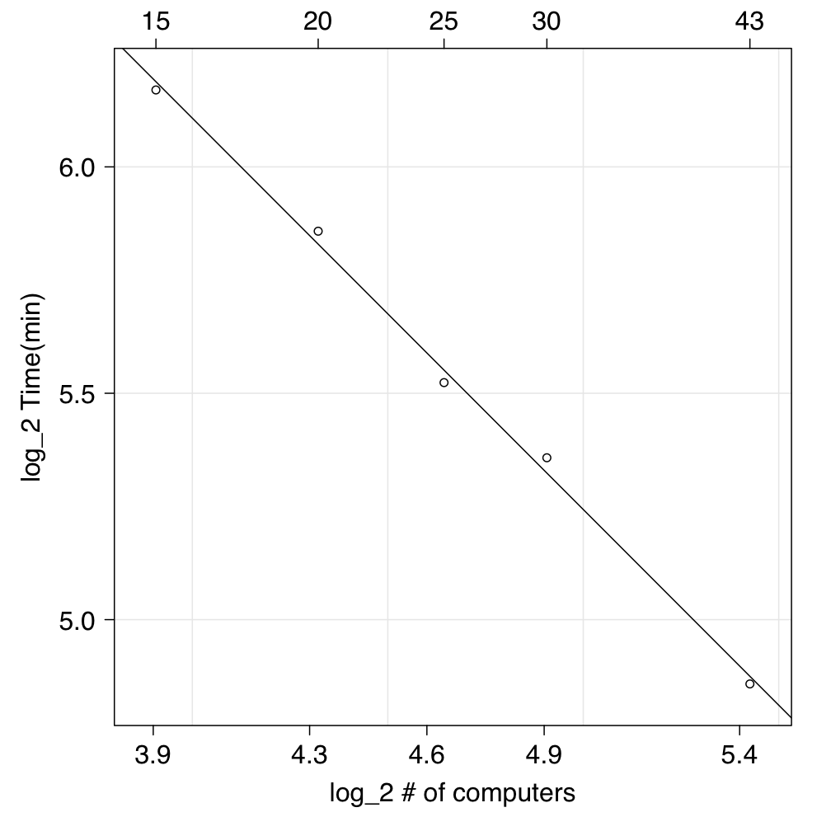
Log of ‘Time to complete’ vs. log of ‘Number of computers’ , the solid line is the least square fit to the data. The linear fit is what we expect in an ideal non preemptive world with constant time per task.

Slide 40
Todo
Better error reporting
A ‘splittable’ file format that can be read from/written to outside Java
A better version of rhex
  Launch jobs asynchronously but monitor their progress
  Wait on completion of multiple jobs
Write Python libraries to interpret RHIPE serialization
A manual

