Slide 1
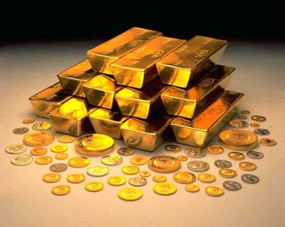
A Golden Future?
Goose Hollow Capital kris.kumar@goosehollowcapital.com
May 2012

Slide 2
Disclaimer
This presentation is for informational purposes only, responsibility for all trading decisions lies solely with the reader. If we really knew what would happen, we wouldn’t be telling you for free, now would we?
Further some information contained herein, while not guaranteed by us, has been obtained from sources which have not in the past proved particularly reliable. Trading could be injurious to your wealth.
When the facts change we will change our opinion and so should you sir!
2012

Slide 3
"If you don't trust gold, do you trust the logic of taking a beautiful pine tree, worth about $4,000 - $5,000, cutting it up, turning it into pulp and then paper, putting some ink on it and then calling it one billion dollars?"
-- Kenneth J. Gerbino, investment manager
2012

Slide 4
Summary
Current macro environment and the case for Gold as an investment.
Can we build a fair value model for Gold?.
Gold linked investments.
2012

Slide 5
Current Macro Environment
2012

Slide 6
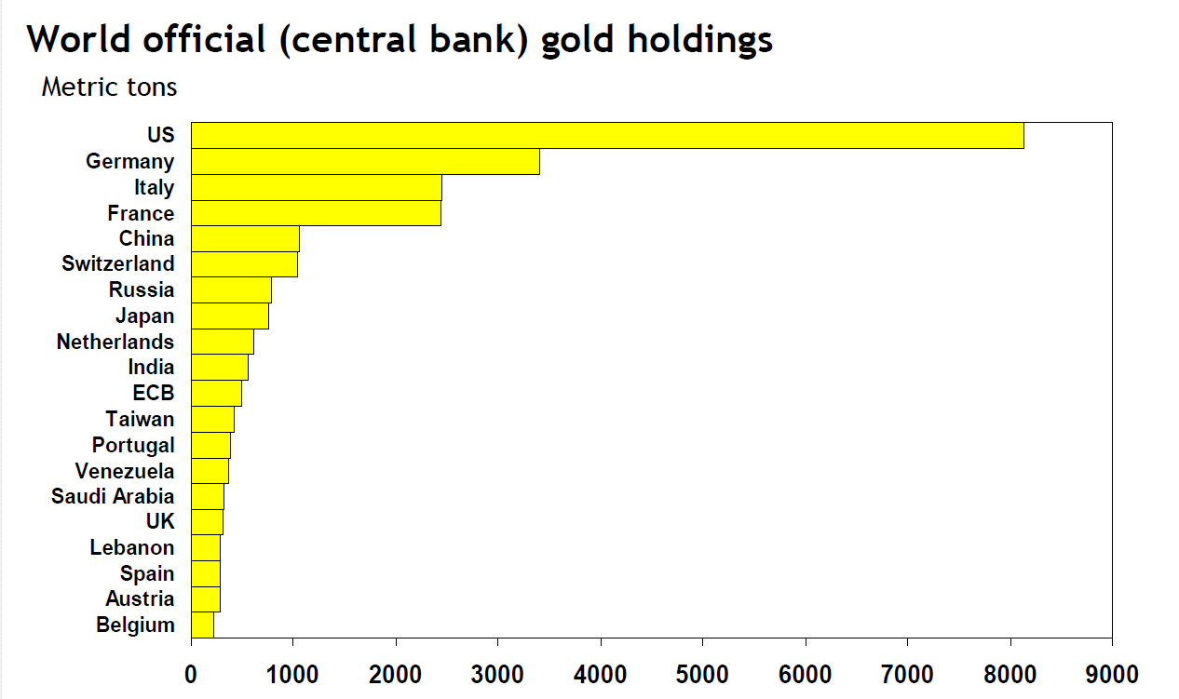
Macro Overview:
Great Financial Crisis (GFC) - Developed economies are struggling with debt and struggle to recover with below trend growth.
Most of the indebted developed economies are looking to devalue their currency to lower their debt burden and/or on course to monetize their debt – QE in the US, UK and LTRO in Europe.
Emerging Markets (EM) are catching a cold and slowing down.
By 2050, emerging markets are expected to increase fivefold, be larger than the developed world and represent 19 of the 30 top economies by GDP. (Source: Economist)
Global Capital Flows has led to reserve accumulation by EM central banks.
EM reserve managers continue to diversify their inflows in to other safe haven assets including Gold. Notable gold buyers are India, Korea, Russia & China.
2012

Slide 7
Macro Overview – Economic Challenges
Financial balances & economic performance compared
2011 % GDP (unless otherwise stated) |  | US | Japan | UK | Can. | Euro | Belg. | France | Germ. | Greece | Ire. | Italy | Port. | Spain
GOVERNMENT BALANCES
1 | Government gross debt | 100 | 233 | 81 | 84 | 89 | 95 | 87 | 83 | 145 | 109 | 121 | 106 | 67
2 | Government net debt | 73 | 131 | 73 | 35 | 69 | 80 | 81 | 57 | 113 | 99 | 100 | 102 | 56
3 | General government balance* | -9.6 | -10.3 | -8.5 | -4.3 | -4.2 | -3.5 | -5.9 | -1.5 | -8.5 | -10.3 | -4.0 | -5.9 | -6.0
4 | Gross financing need* | 27.3 | 57.8 | 15.5 | 17.5 | 17.4 | 21.6 | 20.0 | 10.7 | 23.7 | 19.0 | 22.6 | 22.0 | 19.6
5 | Primary government balance | -8.0 | -8.9 | -5.6 | -3.7 | -1.5 | -0.3 | -3.4 | 0.4 | -1.3 | -6.8 | 0.5 | -1.9 | -4.4
6 | Required fiscal adjustment*² | 16.4 | 15.0 | 11.6 | 6.8 | 5.6 | 8.1 | 7.1 | 3.7 | 14.5 | 11.4 | 3.6 | 8.4 | 7.6
7 | Government debt held abroad | 30 | 15 | 19 | 16 | 25 | 58 | 50 | 41 | 91 | 61 | 51 | 53 | 28
PRIVATE SECTOR BALANCES
8 | Households’ gross debt | 92 | 77 | 101 | ... | 70 | 53 | 61 | 60 | 71 | 123 | 50 | 106 | 87
9 | Households’ net financial debt³ | -232 | -236 | -184 | ... | -126 | -195 | -137 | -132 | -57 | -67 | -178 | -123 | -78
10 | Nonfin. corporates’ gross debt⁴ | 90 | 143 | 118 | ... | 138 | 175 | 150 | 80 | 74 | 245 | 110 | 149 | 192
11 | Nonfin. firms' debt/equity ratio (%) | 92 | 181 | 83 | 70 | 106 | 48 | 69 | 92 | 182 | 90 | 125 | 136 | 134
12 | Bank leverage (aasets/equity ratio)⁵ | 12 | 24 | 24 | 18 | 26 | 30 | 26 | 32 | 17 | 18 | 20 | 17 | 19
13 | Bank claims on public sector | 8 | 80 | 9 | 19 | ... | 23 | 17 | 23 | 28 | 25 | 32 | 24 | 24
EXTERNAL BALANCES
14 | Current account* | -3.5 | 1.8 | -0.7 | -2.4 | -0.7 | -0.6 | -2.4 | 5.1 | -9.3 | -0.4 | -3.7 | -9.4 | -3.8
15 | Net external liabilities | 16 | -54 | 11 | 12 | 13 | -40 | 10 | -41 | 104 | 98 | 26 | 106 | 88
POTENTIAL GROWTH
16 | Real GDP growth, 2001-11 % ar* | 1.6 | 0.6 | 1.3 | 1.9 | 1.1 | 1.5 | 1.1 | 1.0 | 1.4 | 1.9 | 0.1 | 0.2 | 1.8
17 | Population growth 2011-2016 % ar* | 1.0 | -0.2 | 0.7 | 0.9 | 0.2 | 0.7 | 0.5 | -0.2 | 0.1 | 0.1 | 0.4 | 0.1 | 0.2
Sources: BIS; EU Consolidated Banking Data; FDIC; IMF, BIS-IMF-OECD-World Bank Joint External Debt Hub (JEDH); IMF staff estimates ; BarCap estimates
1 Cells shaded in dark blue indicate a value in the top 25 percent of a pooled sample of all countries shown in the table from 1990 through 2009 (or longest sample available), except for rows marked * (for which the shading is applied according to a BarCap assessment of riskiness). Mid-blue shading indicates values in the bottom 50 percent, and light blue in the 50th to 75th percentile. The sample for bank leverage data starts in 2008 only. 2 IMF estimate of fiscal adjustment needed to achieve a 60% debt/GDP ratio by 2030, from 2012 onwards as % GDP 3 Household net debt is calculated using financial assets and liabilities from a country’s flow of funds data. 4 Nonfinancial corporates’ gross debt includes intercompany loans and trade credit, and these can differ significantly across countries. 5 5. Tangible assets/common equity (x)
Source: Barclays Capital
2012

Slide 8
By increasing the number of US dollar, or even credibly threatening to do so, the US government can also reduce the value of a dollar in terms of goods and services, which is equivalent to raising the prices in dollars of those goods and services. We conclude that, under a paper-money system, a determined government can always generate higher spending and hence positive inflation.
…says who?

Slide 9
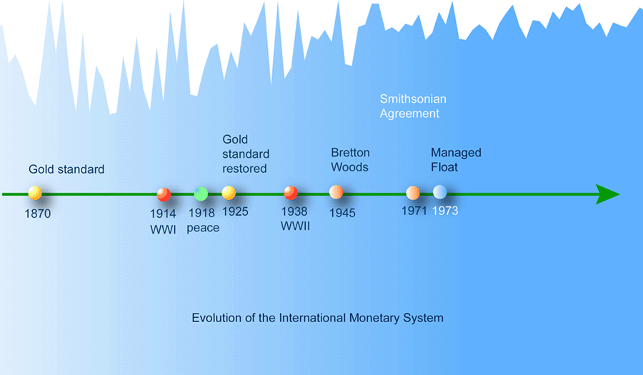
Gold as Currency
History of Gold as a currency unit dates back to China in 1091 BC where Gold was first used as a form of money.
Gold replaced barter and was the first currency unit before we had fiat currencies and the current monetary system. Even the US dollar was first backed by 40% in Gold. (Federal Reserve Act 1913)
Post WW-II we had a fixed exchange rate system (Bretton Woods Agreement 1945) based on setting a fixed dollar price for Gold and pegging the currencies to the dollar.

Slide 10


Gold as Currency - 2
However the Fixed exchange system linked to Gold Failed.
Triffin Dilemma – a national currency that acts as a reserve currency ends up creating a balance of payment deficit.
Gold standard is deflationary.
In a closed economy under the gold standard, a country's money supply is determined by its stock of gold. To increase its money supply, the government must mine more gold.
The annual production of gold is about 2,500 metric tons or 80 million troy ounces and so world GDP cannot grow more than about $120 billion (at $1500/oz), had we been on the gold standard today.
Problem solved ? - new Asteroid mining venture

Slide 11
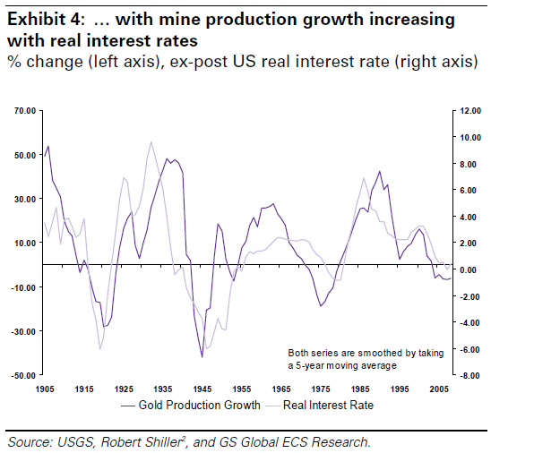
Stylized facts on Gold
Gold demand can be split in to monetary demand (bullion, coins & investment products) & the non-monetary demand. (bling, jewelry)
Monetary demand goes up in periods of financial stress as during the most recent period.
Non-Monetary demand goes down with higher real prices – this can be seen by the lack of demand for Gold out of India
Gold supply and investment in mines tend to be correlated with real interest rates.
Recent run-up in Gold has coincided with securitization of Gold (ETP’s) and run up in size of the ETFs
Gold unlike other fiat currencies is no one’s liability and so it cannot be easily debased with excess supply.

Slide 12
Gold Price – Can we build a Fair value model?
2012

Slide 13
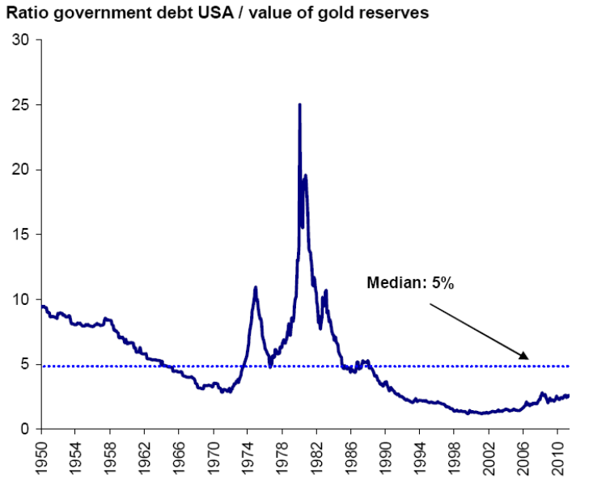
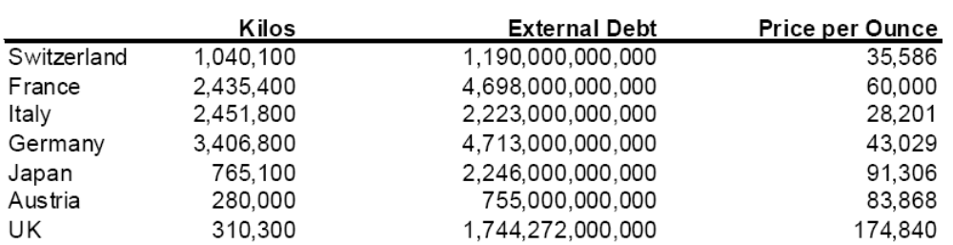
Fair value : Outstanding Debt
Currently less than 2.5% of US government debt is covered by gold, which is clearly below the long-term median of 5%. Should the gold price therefore double, the coverage would only rise to the long-term median.
The highs of the ratio dating from the 1980s would only be reached at a price of about USD15,000
Theoretical price of gold to cover other Sov Debt obligations
2012

Slide 14
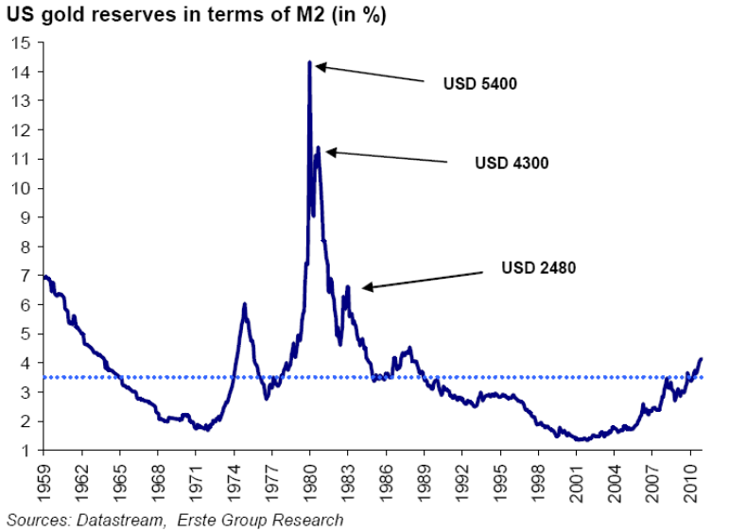
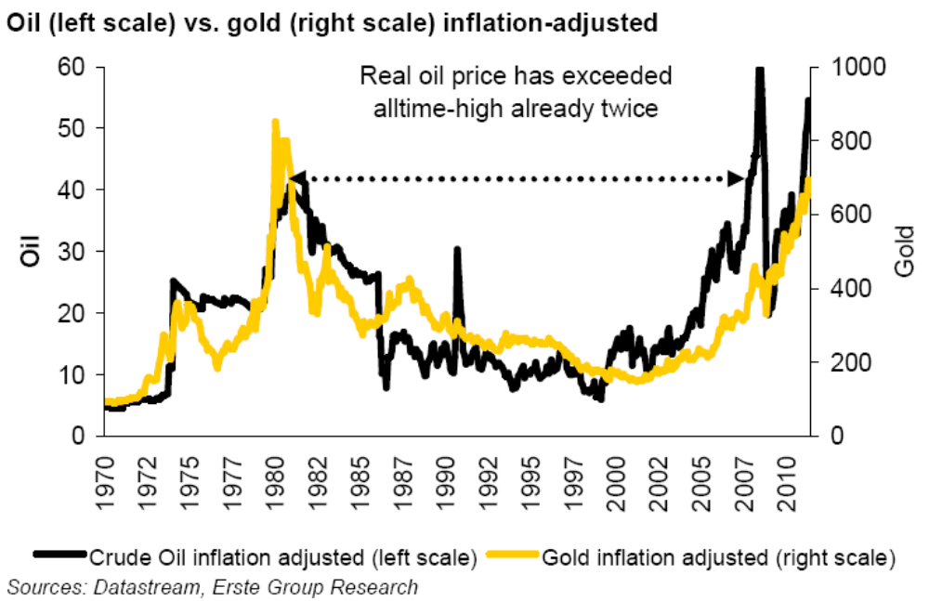
Fair value : M2 & CPI
In spite of the ten year bull market, the ratio of US gold reserves (at market prices) in terms of M2 money supply has only just exceeded the long-term average of 3.4%.
In order for the ratio to reach the former high of 1980, when more than 14% of M2 was covered by gold reserves, the gold price would have to rise to about USD5,400.
Gold is still cheaper when you compare to the real price of Oil.
If we use official BLS data then Gold would have to reach $2300 to make new highs. But if we use inflation data from other sources say shadow-stats then Gold will have to move up to $7000.
(unHedonic adjustments!)
2012

Slide 15
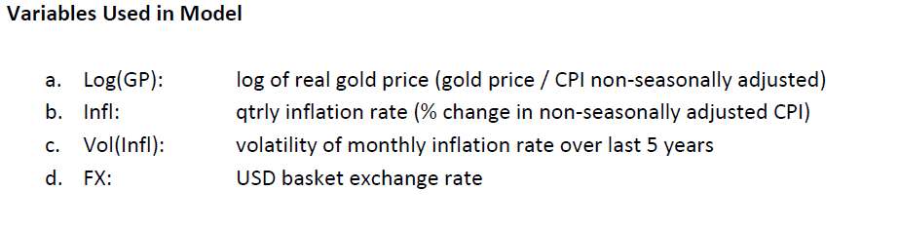
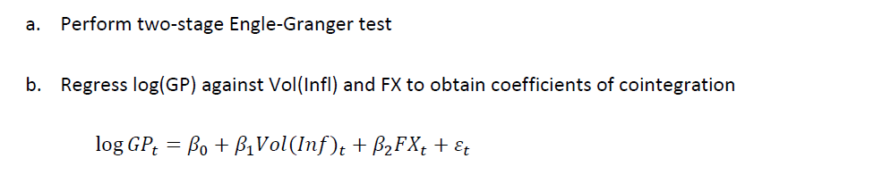
Time series Models -
We looked at a canonical VECM model that is popular in the literature on Gold forecasting.
We first build a structural model with the Price expressed in real terms as a function of the inflation rate, the volatility of inflation, and the strength of the U.S. dollar.
Once the long-run price has been modeled, short-term deviations, or errors, are forecasted using
changes in the real price of gold, the inflation rate, and the USD exchange rate and we fit a dynamic model.
2012

Slide 16
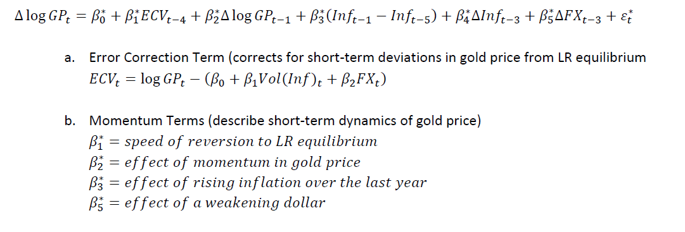
Time series Models - 2
We estimate the following dynamic model
However this model performs poorly when compared to a buy and hold Gold strategy
2012

Slide 17
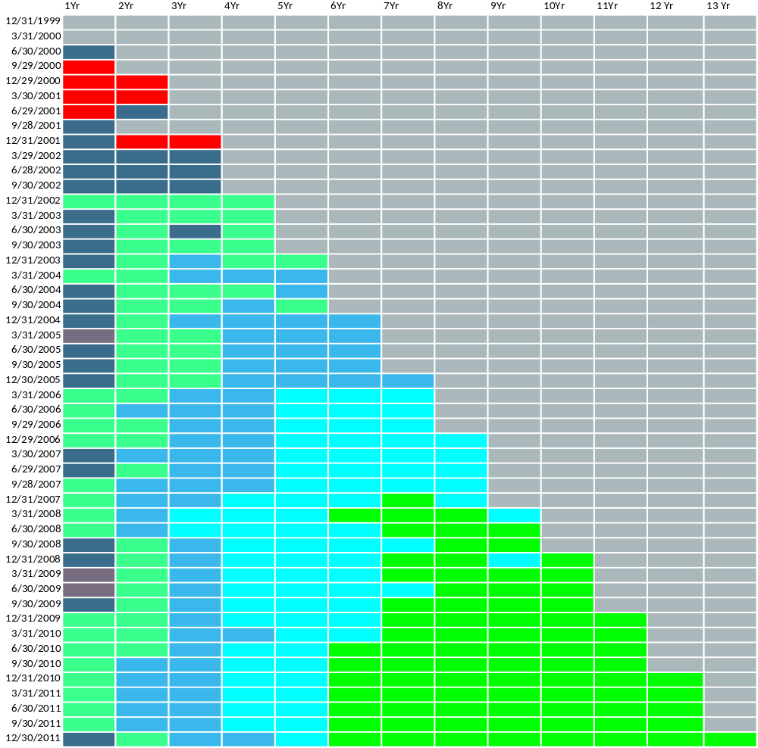
Gold Performance -
Traditional models have difficulty given the strong Bull run in Gold
2012

Slide 18
A Gold Strategy
2012

Slide 19
Gold
Gold exposure via physical Gold for longer term exposure this is the most efficient.
via ETFs and ETPs such as the IAU & GLD etfs
via OTC or exchange traded futures on COMEX.
via gold miners and mutual funds that hold gold mining stock.
Gold ETPs provide a very liquid and efficient way to hold Gold and we have large HFs who have taken positions in GLD.
Bullion - there has been a move towards holding Physical Gold by endowments and pension funds recently.
Gold equities haven’t fared well recently because (1) Volumes are falling (2) Earnings are more volatile with hedging/unhedging of long dated contracts and falling grades of the gold from older mines. (3) Valuations were not attractive.
2012

Slide 20
Investment Process
Explanatory Variables for Gold
Data transformation
Bundling Predictors using LDA, Cart, K-NN
Predictive Model for Gold
Binary Signal for Gold Prices
Buy/Sell + Magic Dust
Input for an Option Overlay as part of Strategy.
2012

Slide 21
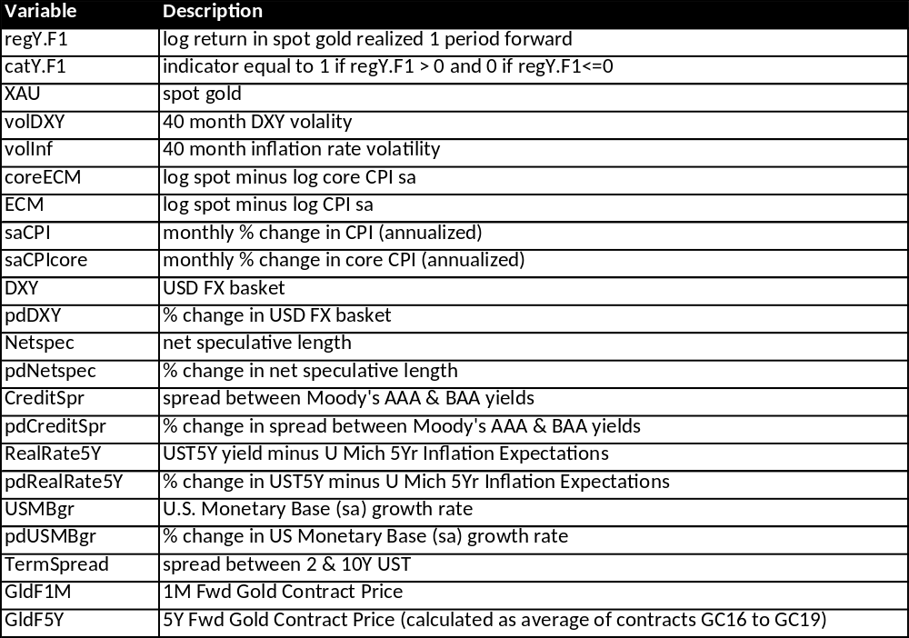
Predictive Model for Forecasting Gold
We transform the above macro variables using popular preprocessing techniques.
2012

Slide 22
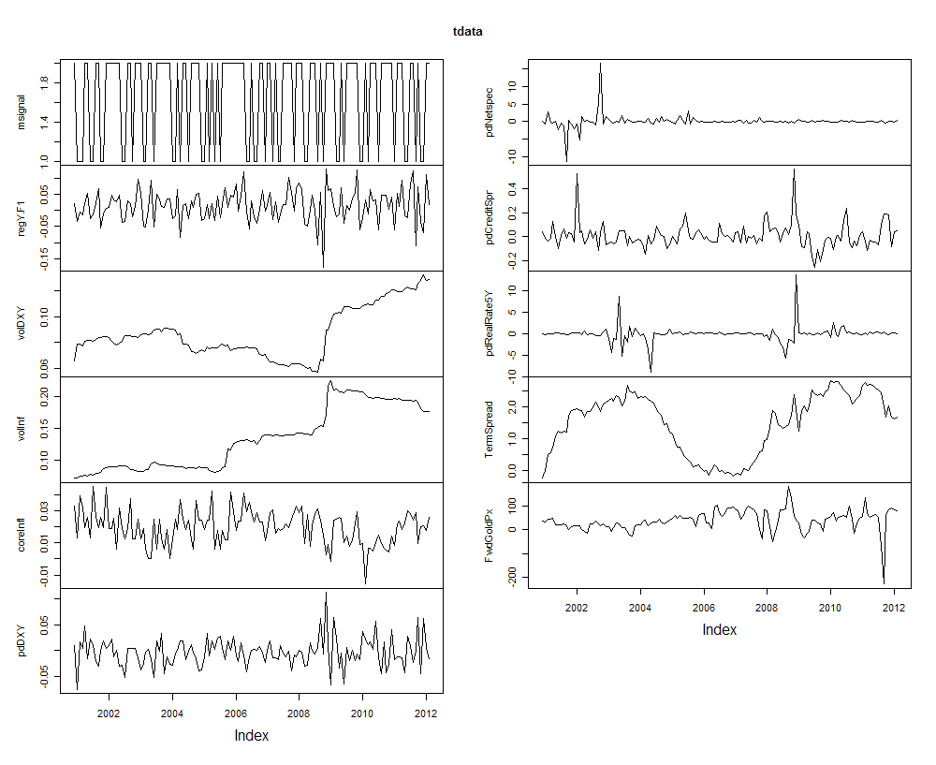
Time-series of Raw Data
2012

Slide 23
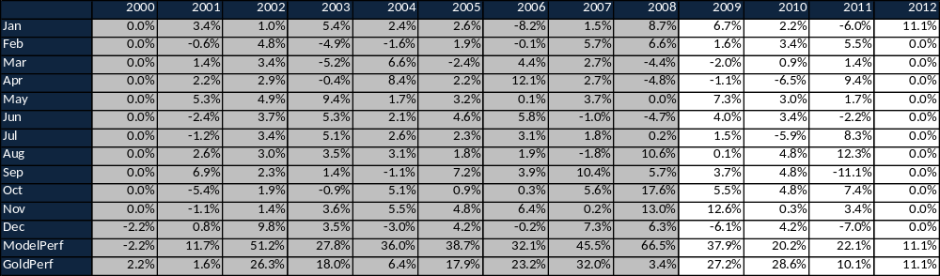
Model Performance – Calendar Returns
Model has slight underperformance in 2010 but appears robust in our testing.
2012

Slide 24
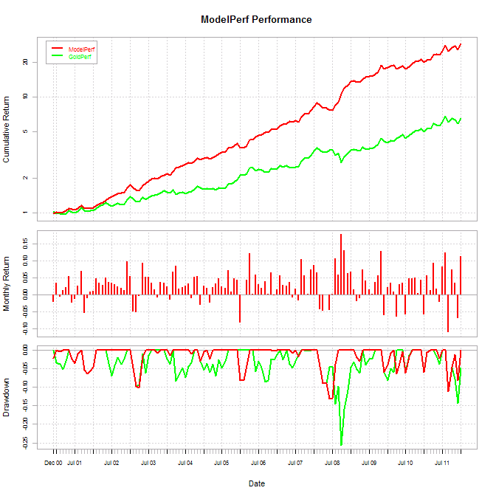
Model Performance -
Model has a much lower drawdown compared to Gold
2012

Slide 25
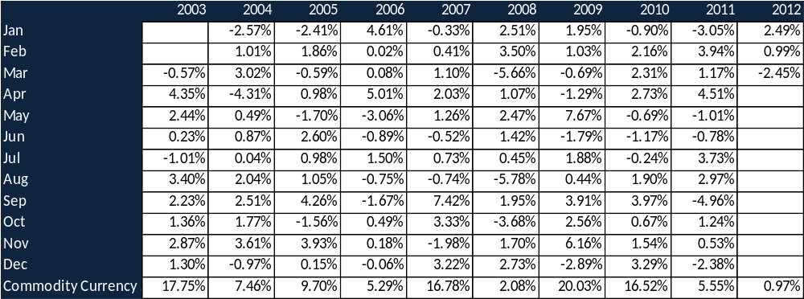
Goose Hollow CCS Monthly Returns
Commodity Currency Strategy trades commodity currencies and Gold. We trade Gold against a basket of currencies
as we find that brings down the overall portfolio volatility. Fundamentally all the developed economies are in the same
boat so more natural to think of Gold against a basket.
 | Annual Returns
All returns are net of management fee & expressed in nominal terms (unleveraged)
Pre-Nov 2011, returns are hypothetical
May 2012

Slide 26
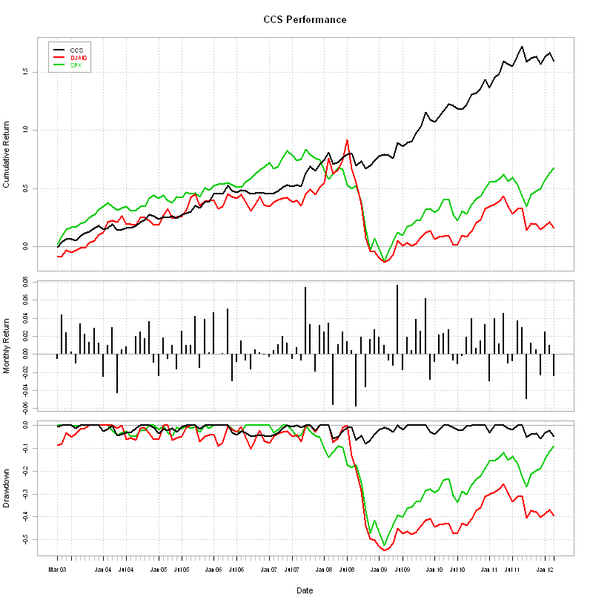
Commodity Strategy Drawdown Analysis
Relative performance
Maximum peak-to-trough drawdown
May 2012

Slide 27
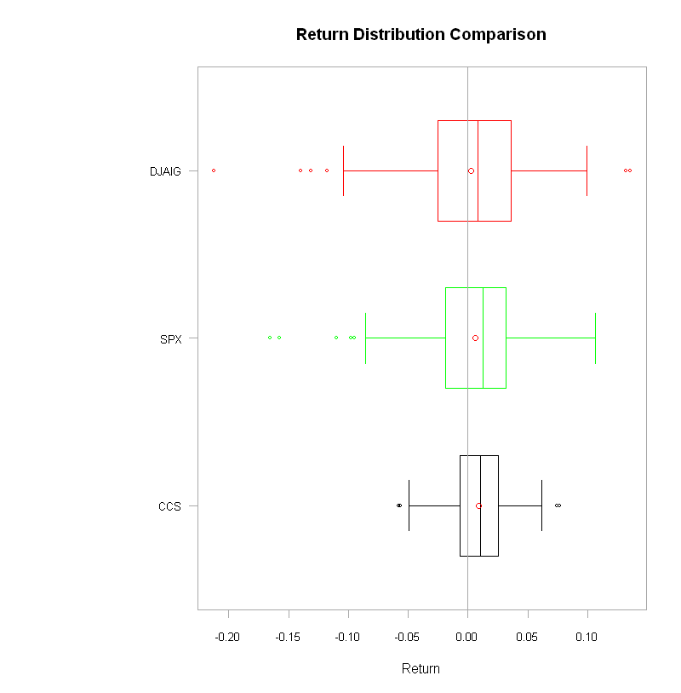
CCS Distribution Analysis
The Commodity currency box plot exhibits some nice distribution characteristics relative to the other monthly return series
May 2012

Slide 28
Gold continues to be an attractive hard currency for savers in the middle-east and Asia and for Central banks looking to diversify their reserves.
Gold can be a store of value and could run a lot higher under current macro economic conditions.
Gold prices in dollars has a lot of volatility due to dollar being a reserve/safe-haven currency. It is attractive to diversify the short USD exposure via a basket.
We find bundling predictors provides a robust model for directional signals. We are looking at ways to improve this model.
Summary
2012

