Slide 1
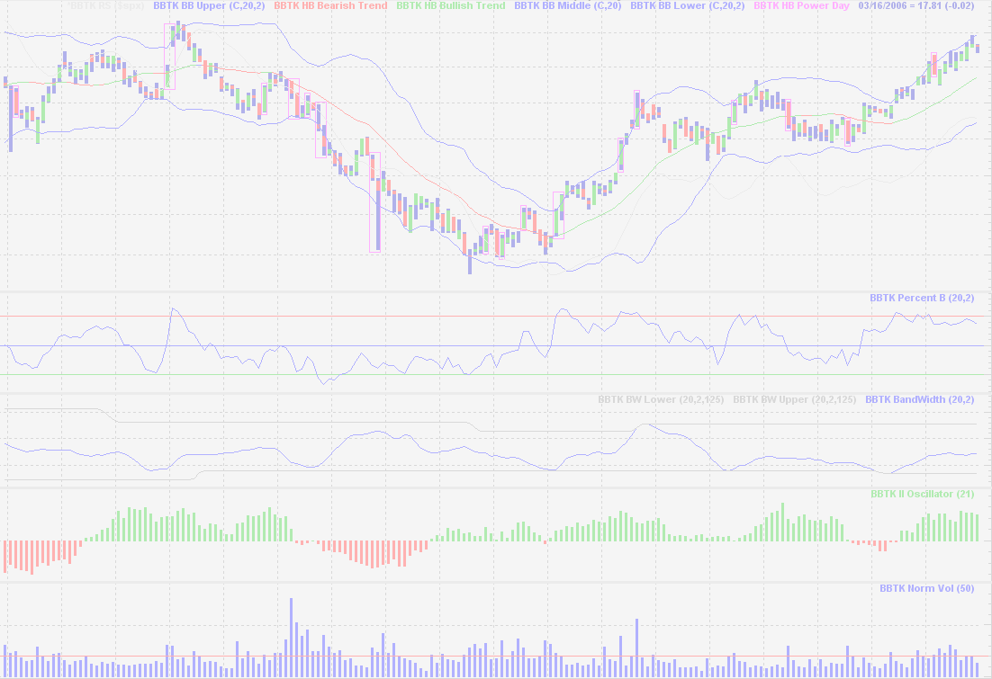
Yesterday, Today and Tomorrow:
A Trip Through Computational Finance
It’s Been a Long Journey and
I’ve Had a Lot of Good Company
John Bollinger, CFA, CMT
R/Finance 2011, April 2011

Slide 2
The First of a New Generation
Robert A. Levy
The Relative Strength Concept of Common Stock Price Forecasting
1968
Investors Intelligence

Slide 3
The Bad Old Days
Pre-1980 computing was mostly mainframes or minicomputers

Slide 4
Main Frames
Options analysis
Data retrieval
AOL
Merlin
FNN
  DEC, VAX, VMS, DECBasic
  Tickers, Cycliphase

Slide 5
Microcomputers
Microcomputers
  S100, 1974
  Apple II 1977
  IBM PC 2001

Slide 6
S100
A backplane or buss to which you added boards
  CPU
  I/O
  Memory
  CP/M operating system

Slide 7
The Architecture Choice
User chooses
  S100
  Intel 8080 series (Zylog Z80)
Memory mapped
  Apple
  MOS 6502
Port driven
  IBM PC
  Intel 8080 series

Slide 8
A Huge Benefit
Quite often one had to write one’s own i/o for peripherals
  Machine code or Assembly language
Learning was not a choice
  Logic
  Octal and hex math
  Register manipulations
  Bitwise operations

Slide 9
Now you could start computing
But there were no programs
Well, there was Adventure and Missile Command...

Slide 10
A Programming Language
BASIC
  Beginners All-purpose Symbolic Instructional Code
  Various flavors
Microsoft
  Microcomputer Software
  Bill Gates’ first product
  MBASIC – BASIC for CP/M

Slide 11
A Database
dBASE II
1979
Aston Tate
A horror, but it pointed the way

Slide 12
A Spreadsheet
SuperCalc
Sorcim
1980
Small, light and agile

Slide 13
And Then Came the PC
With those few tools we accomplished a lot
But the PC really opened up the horizon
The key was its open architecture

Slide 14
BASIC
MBASIC (CP/M)
BASICA / GWBASIC (DOS)
QuickBASIC (Compiler) (DOS) (IDE)
VisualBASIC (Windows) (GUI)

Slide 15
A Reach Too Far
.NET was a step more than I wanted to take
At the time there really weren’t any good cross-platform BASIC alternatives
So Microsoft left me behind and...
I started searching for a new language

Slide 16
My Language Specs
Open / free (gnuplot)
Very high level
Widely adopted
Simple syntax / easy to read
Robust interfaces / play well with others
Compact
Good development tools
Strong community

Slide 17
Python
My choice was Python
A choice I have had no reason to regret
Python remains my main programming language
We also use it in production for our websites as a ‘glue’ language

Slide 18
Crusher
Realizing the power I now had at my beck and call I almost immediately set out on a new project
Crusher
  Technical Analysis tools, testing and deployment
  open source

Slide 19
Crusher
Crusher went quickly and well
Almost immediately someone suggested building Crusher on top of R
After investigating I realized that R was developing into a powerful tool that I could easily access from Python
So, I off-loaded all Crusher’s statistics calculations to R

Slide 20
Crusher
I wasn’t happy leading an open source project
I wanted to get back to trading
So I forked Crusher and continued development in house as an adjunct to my trading / analytical process

Slide 21
So, My Solution Was:
Python / Pyscripter
NumPy / SciPy
R / Tinn-R (moving to RStudio...)
  Tinn was my light editor of choice pre-R
gnuplot
MySQL / SQLite
Various connectors

Slide 22
The Next Logical Step
Write your own very-high-level language
Trade
  The first version – open source
BBScript
  Real-time interactive interpreter
  Written in ActionScript to take advantage of a real-time charting environment also written in ActionScript
  Fully Trade compatible

Slide 23
Speaking of Logic
Write your own logic
Around 1990 FNN’s chief engineer, Gene Stratton, and I wrote a three valued logic for traders
1, 0, -1
long, flat, short
This proved to be VERY useful

Slide 24
The Fuzzy Logical Step
EquityTrader.com needed fuzzy logic for its modeling approach
The problem with being an early adopter is that you have to write it...
And so we did...
That project ultimately led to a long involvement with fuzzy logic

Slide 25
Speaking of being an early adopter and having to write it...

Slide 26
Bollinger Bands
Developed on an S100 computer
  Z80 at 1.1 megahertz
  64 kilobytes memory
  Dual 180k floppy disk drives
  10 megabyte hard disk
  Lear Siegler ADM3a terminal

Slide 27
Volatility
At the time it was believed that volatility was a fixed quantity
A property of a security
Beta
  Measured once a year
  Five years of weekly data
  IBM’s Beta was 1.2

Slide 28
Volatility
If beta changed at all it was thought to change very gradually
For example, over the life cycle of a firm
From high to low as the firm matured
This was GOSPEL

Slide 29
Trading Options
Options, rights, warrants, convertibles...
Volatility estimates were key
Rules of thumb
Not at all efficient
Loads of opportunities

Slide 30
Percentage Bands
A moving average plus/minus a given percent of itself
Different parameters from issue to issue
Different parameters from time to time
Setting the bands allowed emotions into the process

Slide 31
Bollinger Bands
There had to be a better way
One day I copied a formula for volatility down a column in Supercalc and noticed that the values were dynamic...
It was one of those Aha! moments

Slide 32
Bollinger Bands
Russ Herrold (Trading-shim) calls BBs:
Autoscaling variance bands
An apt description

Slide 33
A Nobel Prize
Economics
2003
Robert F. Engle III
“for methods of analyzing economic time series with time-varying volatility (ARCH)”
Tim Bollerslev (GARCH) mentioned, but not awarded

Slide 34
So, what are the opportunities today?
False beliefs create opportunities for the clear sighted
Much of modern finance is simply incorrect
The theories are quite nice
But, they do not model the realities well

Slide 35
Opportunities
Distributions are not normal
Correlations converge on one
Markets are not efficient
Investors and traders are deeply flawed
There is no such thing as a rational investor
There are many anomalies

Slide 36
Opportunities
Volatility is not mean reverting
Using volatility for position sizing is a mistake

Slide 37
Technical Analysis
A numerical approach to the markets
All the way back to Robert Levy technicians and quants have been of a piece

Slide 38
A Bridge
R-SIG-Finance
https://stat.ethz.ch/mailman/listinfo/r-sig-finance
The Markets list
http://mailman.bollingerbands.com/mailman/listinfo/markets

Slide 39
The Markets List
A very old technical analysis forum
Started in 1985 by Curt Kyhl
Many homes over the years
Just won’t die
I have been hosting the Markets list since September 2003

Slide 40
A Giveaway!
“R Cookbook”
Paul Teetor
O’Reilly
2011

Slide 41
First Copy
Who wrote S?
And...
In what year?
And...
Where?

Slide 42
First Copy
John Chambers
1975/6
Bell Labs
  Murray Hill, New Jersey

Slide 43
Second Copy
Who was Nicolaus II Bernoulli
And...
Why do we care?

Slide 44
Second Copy
A Swiss mathematician living in St. Petersburg
St. Petersburg Paradox
Maximize the geometric growth rate
  This is still heretical in some circles
Leads to modern position sizing (Kelly)

Slide 45
Third Copy
Who wrote R?
And...
In what year?
And...
Where?

Slide 46
Third Copy
Ross Ihaka and Robert Gentleman
1976
University of Auckland, New Zealand

Slide 47
Fourth Copy
What was the first spreadsheet program?
And...
Who wrote it?
And...
In what year?
And...
For what platform?

Slide 48
Fourth Copy
VisiCalc
Dan Bricklin and Bob Frankston
1979
Apple ][

Slide 49
Correspondence
BBands@BBands.com

Slide 50
Bollinger Band Websites
www.BollingerBands.com
www.BBands.com
www.BBForex.com

