Slide 1
Introduction to Glm’s for insurance pricing
St. louis R users group
9/16/2020
Sam kloese acas, cspa, aida, dtm

Slide 2
agenda
Context
Some theory behind GLM’s
Why do insurers like GLM’s with a log link?
R Markdowns
GLM vs. Univariate Analysis
Frequency GLM on Motorcycle Insurance Data

Slide 3
Generalized Linear models
GLMs model the relationship between a variable we wish to predict and one or more explanatory variables.
Example of supervised learning, since we have a target variable
The target variable is modeled as a random variable that follows a probability distribution, assumed to be from the exponential family of distributions

Slide 4

Generalized Linear models
Common target variables used for price modeling:
Claim frequency = $\frac{Claim Count}{Exposures}$
Claim Severity = $\frac{Total Loss Dollars}{Claim Count}$
Pure Premium = $\frac{Total Loss Dollars}{Exposures}$
Poisson, Negative Binomial
Gamma
Tweedie

Slide 5
Generalized Linear models
It is common to model frequency and severity separately
This provides more insight than just modeling pure premium alone
Certain variables are predictive of one or the other
Car value may be more predictive for severity than for claim frequency
We don’t want to miss out on frequency and severity variables that offset each other
Crash avoidance technology may simultaneously lower frequency and increase severity
Frequency models are typically “less noisy” than severity
We wouldn’t want to miss out on predictive characteristics just because of the noise in severity
Modeling frequency and severity individually does not double the modeling time
Severity models are typically smaller than Frequency models
Thinking about frequency and severity separately may make analyzing the models easier
It is easy to combine frequency and severity models into a final pure premium model

Slide 6

Components of the glm
The outcome of the target variable is assumed to be driven by both a systematic component as well as a random component
Systematic Component – Captured by our predictors
Random Component – Pure randomness
GLM’s model the relationship between µ and the predictors as follows:
The transformation function on the left side is called the “link function”
The sum of terms on the righthand side is called the linear predictor
Ultimately, we want the prediction µ, so we take the inverse of g(.)

Slide 7


Components of the glm
Insurance pricing model typically use a “log link” function
g(x) = ln(x)
Thus our equation becomes:

Slide 8
Components of the glm
Log link function results in multiplicative factors
Simple and practical to implement
Never result in negative premium (as opposed to additive terms)
Intuitive appeal

Slide 9

GLM equation
$μ_{i}=Our fitted value$
$e^{β_{0}}$ = Our intercept term.
β’s = coefficients related to our predictor variables
β > 0 results in a surcharge
β < 0 results in a discount
x’s = values of the predictor variables from our input dataset

Slide 10
βetas
How many betas are in our model? It depends on…
Which rating variables are modeled
How many levels are in a categorical variable
[# of levels] - 1
Depends on if there is any “curve fitting” for continuous variables
Example:
Our data has number of drivers: 1, 2, 3, 4, 5
Including all of them as unique categories would add 4 betas
Grouping them into 1, 2, and 3+ would only add 2 betas
Fitting the beta with a 1degree polynomial would result in only 1 beta

Slide 11
Text for further reading
Generalized Linear Models for Insurance Rating
https://www.casact.org/pubs/monographs/papers/05-Goldburd-Khare-Tevet.pdf

Slide 12
R Markdowns
GLM Beats Univariate Analysis
Example GLM on Motorcycle Insurance

Slide 13
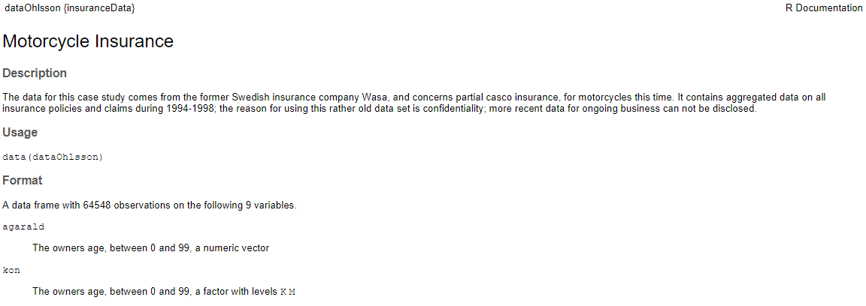
Introduction to our dataset
kön = Gender in Swedish

Slide 14
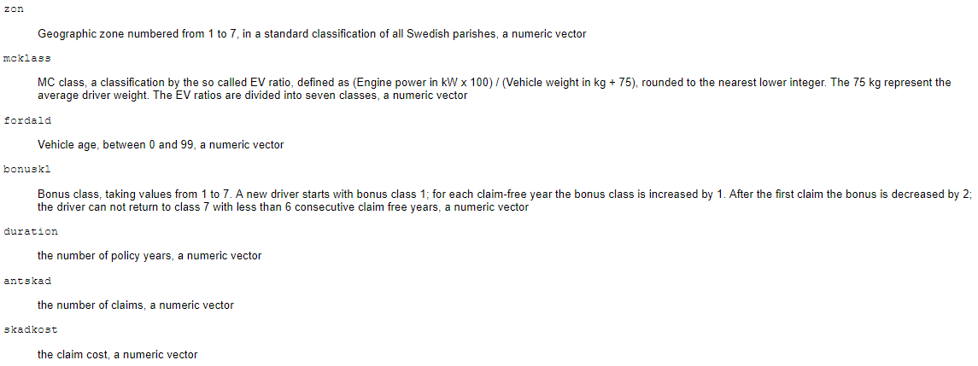
Introduction to our dataset

