Slide 1
ql.io: Putting Node.js to Work
Subbu Allamaraju
eBay Inc.
StrangeLoop, Sep 24-25 2012

Slide 2
Who is Subbu
Code for a living
Building eBay Market Places cloud
Built ql.io on node.js
(formerly) HTTP and REST wonk
Wrote "RESTful Web Services Cookbook"
http://www.subbu.org
@twitter

Slide 3
> http://nodejs.org
> http://ql.io
> https://github.com/ql-io/ql.io

Slide 4
This talk is not a pitch.

Slide 5
This talk is about the journey taken solving some problems.

Slide 6
The basic problem
Computation
Interface
Client
State

Slide 7
C
I
S
A common manifestation
C
I
Client
S
C
I
S

Slide 8
C
I
S
C
I
Client
S
C
I
High latency client
S

Slide 9
C
I
S
C
I
Client
Performance, Scalability,
Reliability
S
C
I
S

Slide 10
C
I
S
C
I
Gateway
I
Client
S
C
I
S

Slide 11
> Performance and scalability

Slide 12
Performance and scalability
> Reliability

Slide 13
Performance and scalability
Reliability
> Operability

Slide 14
C
I
S
I/O Work loads
C
I
Client
S
C
I
S

Slide 15

C
I
S
C
I
Client
S
C
I
An event-driven network stack
S

Slide 16
Why is there no box around node.js?
C
I
S
C
I
Client
S
C
I
S

Slide 17
HTTP client
C
I
S
C
I
Client
S
HTTP server
C
I
S

Slide 18
/* An event-driven HTTP server */
var http = require('http');
http.createServer(function (req, res) {
res.writeHead(200, {'Content-Type': 'text/plain'});
res.write(...);
res.end();
}).listen(3000);

Slide 19
/* An event-driven HTTP client */
var http = require('http');
var options = {
host: '...',
path: '...',
port: ...,
method: '...'
};
var req = http.request(options, function(resp) {
resp.on('data', function(chunk) { ... });
resp.on('end', function() { ... });
});
req.write(...);
req.end();

Slide 20
/* Event-driven fetch from multiple servers */
var http = require('http');
var opts1 = {...};
var req1 = http.request(opts1, function() { ... });
req2.write(...);
req.end();
var opts2 = {...};
var req2 = http.request(opts2, function() { ... });
req2.write(...);
req.end();
var opts3 = {...};
var req3 = http.request(opts1, function() { ... });
req3.write(...);
req.end();

Slide 21
var http = require('http'),
async = require('async'); // http://github.com/caolan/async.git
function send(opts, callback) {
var req = http.request(opts, function(resp) {
resp.on('end', function() {
callback(...)
});
});
req.on('err',callback);
req.end();
}
var funcs = [];
for(...) {
var opts = {...};
funcs.push(function (opts) {
return function (callback) {
send(opts, callback)
};
}(opts));
}
async.parallel(funcs, function(err, all) {
...
});

Slide 22
var http = require('http'),
async = require('async');
function send(opts, callback) {
var req = http.request(opts, function(resp) {
resp.on('end', function() {
callback(...)
});
});
req.on('err',callback);
req.end();
}
var funcs = [];
for(...) {
var opts = {...};
funcs.push(function (opts) {
return function (callback) {
send(opts, callback)
};
}(opts));
}
async.series(funcs, function(err, all) {
...
});

Slide 23

http://images.sodahead.com/polls/001184483/headache_main_full1_xlarge.jpeg

Slide 24
"All problems in computer science can be solved by another level of indirection"

Slide 25
Computation
Interface
Client
State
response
=
request
to
interface

Slide 26
respA
=
request
to
interface A
respB
=
request
to
interface B
respC
=
request
to
interface C

Slide 27
respA
=
request
to
interface A
respB
=
request
to
interface B
respC
=
request
to
interface C
outcome
=
f(respA, respB, respC)

Slide 28
Write programs using an imperative style DSL
Compile programs into event-driven orchestration flows

Slide 29
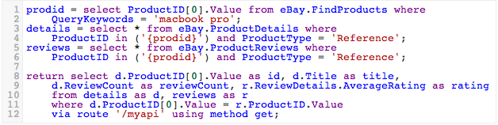

Slide 30
HTTP interface mapped to a "table" – a data source

Slide 31
HTTP interface mapped to a "table" – a data source
CRUD operations in HTTP mapped to SQL

Slide 32
HTTP interface mapped to a "table" – a data source
CRUD operations in HTTP mapped to SQL
Ruby-style variable substitution

Slide 33
HTTP interface mapped to a "table" – a data source
CRUD operations in HTTP mapped to SQL
JSON paths for walking objects
Ruby-style variable substitution

Slide 34
HTTP interface mapped to a "table" – a data source
CRUD operations in HTTP mapped to SQL
Return statements and routes
JSON paths for walking objects
Ruby-style variable substitution

Slide 35
DSLs in node.js?

Slide 36
> Jison - http://zaach.github.com/jison/
> PEG.js - http://pegjs.majda.cz/

Slide 37
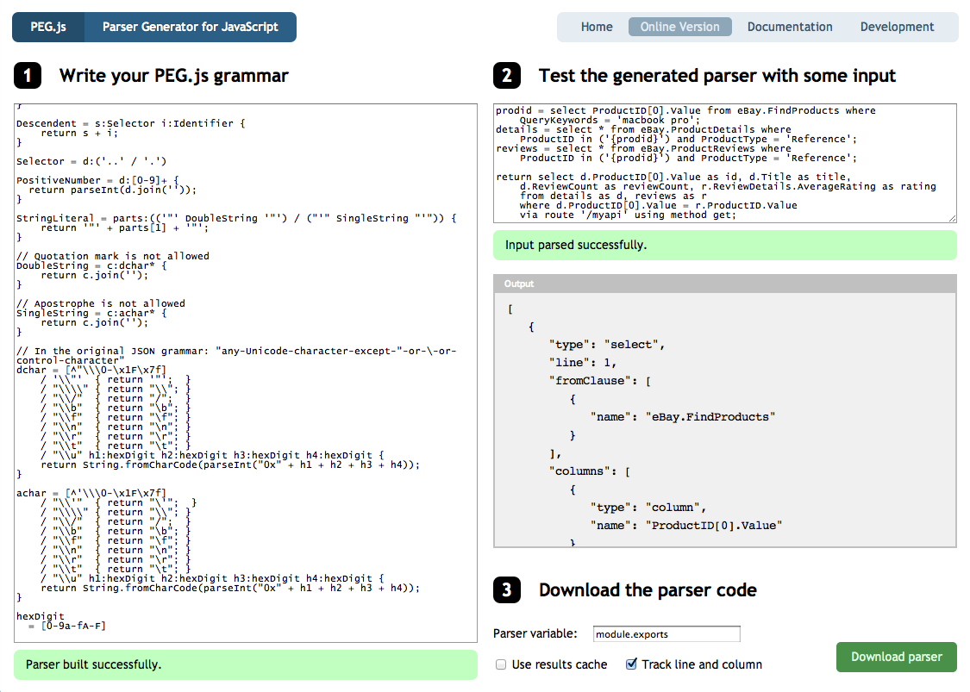

Slide 38
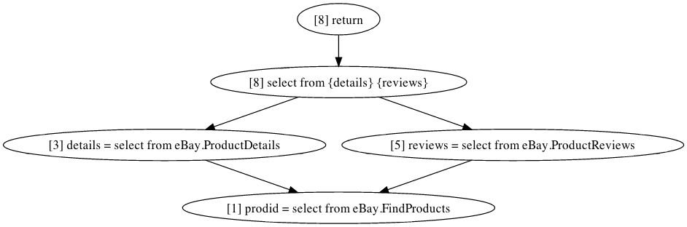

Slide 39
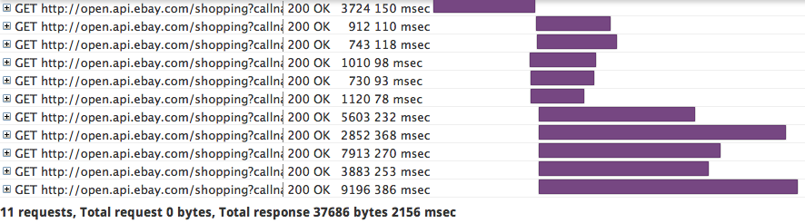

Slide 40
[{id: "84755204",title: "Apple MacBook Pro 13.3" Laptop - MC374LL/A (April, 2010)",reviewCount: 140,rating: 4.5},...
{id: "78092464",title: "Apple MacBook Pro 13.3" Laptop - MB990LL/A (June, 2009)",reviewCount: 112,rating: 4.5},..]

Slide 41
Performance and scalability
> Reliability
Operability

Slide 42
error: { stack: ...,
arguments: ...,
type: ...,
message: 'socket hang up',
uri:
{ value: 'http://xxx.yyy.zzz/...'

Slide 43
Idempotency!

Slide 44
/* An event-driven HTTP client */
var http = require('http');
var options = {
host: '...',
path: '...',
port: ...,
method: '...'
};
var req = http.request(options, function(resp) {
resp.on('data', function(chunk) { ... });
resp.on('end', function() { ... });
});
req.on('error', function(err) {
... retry if the request is idempotent ...
});
req.write(...);
req.end();

Slide 45
/* An event-driven HTTP client */
var http = require('http');
var options = {
...
};
var req = http.request(options, function(resp) {
resp.on('data', function(chunk) { ... });
resp.on('end', function() { ... });
});
req.on('error', function(err) {
... retry if the request is idempotent ...
});
req.setTimeout(someNumber, function() {
... what do I do now? ...
});
req.write(...);
req.end();

Slide 46
var http = require('http'),
charlie = require('charlie);
var decision = charlie.ask([uri], minDelay, maxDelay);
if(decision.state === 'nogo') {
... skip the request ...
}
var req = http.request(options, function(resp) {
charlie.ok([uri]);
resp.on('data', function(chunk) { ... });
resp.on('end', function() {
... });
});
req.setTimeout(someNumber, function() {
charlie.notok([uri]);
});
req.write(...);
req.end();

Slide 47
Performance and scalability
Reliability
> Operability

Slide 48
Why is there no box around node.js?
C
I
S
C
I
Client
S
C
I
S

Slide 49
node.js is not an app server

Slide 50
process.on('uncaughtException',
function(err) {
// Oh no! What do I do now?
});

Slide 51
// Log things
var winston = require('winston');
function createLogger(logdir, name) {
return new (winston.Logger)({
transports: [
new (winston.transports.File)({
filename: process.cwd() + name,
maxsize: 1024000 * 5})
]
});
}
var miscLogger = createLogger(logdir, '/logs/misc.log');
var accessLogger = createLogger(logdir, '/logs/access.log');
var errLogger = createLogger(logdir, '/logs/error.log');
... write to these loggers in your code ...

Slide 52
Watch out in prod!

Slide 53
// Emit events in stead
emitter.emit('WARNING', args for some payload);
emitter.emit('INFO', args for some payload);
// To collect logs
emitter.on('WARNING', function() {
// Write to some external remote logging system
...
// if that fails, write to log files on the disk
});

Slide 54
// Cluster to distribute load on multiple cores
/* An example from http://nodejs.org/api/cluster.html */
var cluster = require('cluster');
var http = require('http');
var numCPUs = require('os').cpus().length;
if(cluster.isMaster) {
// Fork workers.
for (var i = 0; i < numCPUs; i++) {
cluster.fork();
}
cluster.on('exit', function(worker, code, signal) {
console.log('worker ' + worker.process.pid + ' died');
});
}
else {
/// Start your app
http.createServer(function(req, res) {
...
}).listen(8080);
}

Slide 55
> bin/start.sh
... write PID to disk
... start worker
... write worker's PID to the disk
... attach handlers on listen port
to timeout slow clients
to limit number of open sockets
... listen for worker deaths
... recycle workers after processing a set
no of connections

Slide 56
> bin/shutdown.sh
// If command line arg says shutdown
shutdown() {
... send SIGTERM to master
}
// Master
process.on('SIGTERM', function() {
... remove PID files from the disk
... exit after all workers exit
})
// On each worker, stop listening,
// let timeouts drain open sockets, and exit

Slide 57
> bin/stop.sh
// If command line arg says stop
stop() {
... send SIGKILL to master
}
// Master
process.on('SIGKILL', function() {
... remove PID files from the disk
... die
})
// Let workers die

Slide 58
https://github.com/ql-io/cluster2
npm install cluster2
var Cluster2 = require('cluster2'),
express = require('express');
var app = express.createServer();
app.get('/', function(req, res) {
res.send('hello');
});
var c = new Cluster({
port: 3000
});
c.listen(function(cb) {
cb(app);
});

Slide 59
"With great power comes great responsibility"

Slide 60
Thanks StrangeLoop

