Slide 1

Manhattan needs more pho
Capstone Project
June 2019
Josh Wulf

Slide 2
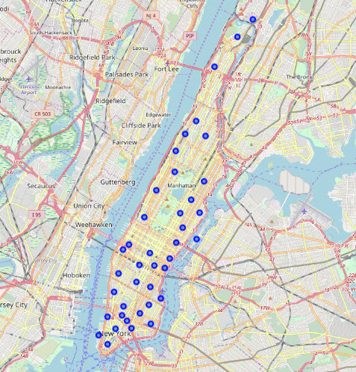
Manhattan neighborhoods

Slide 3
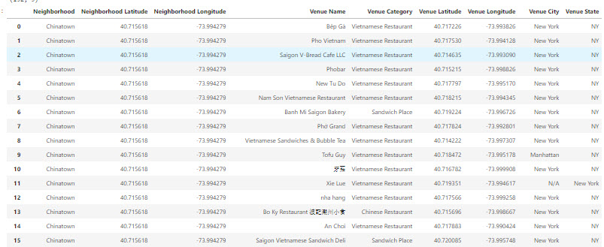
Subset of current pho
15 Vietnamese Restaurants in Manhattan from Foursquare

Slide 4
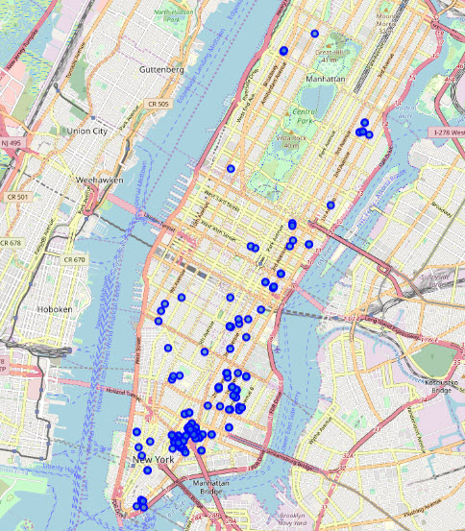
All current manhattan pho
Disproportionate Clustering of Pho in Manhattan

Slide 5
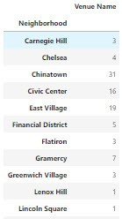
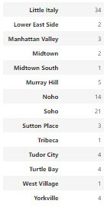
Pho by neighborhood
Number of Pho Restaurants In Each Manhattan Neighborhood

Slide 6
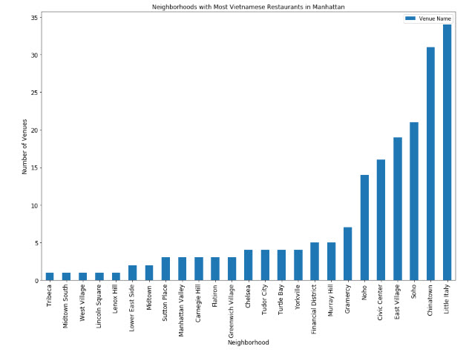
Pho by neighborhood
Another Representation of Pho Restaurants By Neighborhood

Slide 7
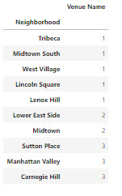
“Pho”verty-Stricken neighborhoods
Get the noodles to these people ASAP!!!

