Slide 1

340 PROJECT
CONTRACT CLAUSE CLASSIFICATION
Josh Yip, Qingyuan Kong

Slide 2

PROBLEM STATEMENT
With the increase of people becoming entrepreneurs/small business owners in recent years, the contracts people read also increased.
However, not everyone is familiar with complex legal terms.
This project is focused on creating a model that helps individuals break down their contract into key clauses.

Slide 3

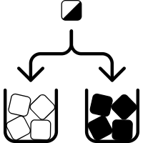



METHODS
Applied transfer learning from CONTRACT Bert
Labelled and original contracts files from CUAD
Sort label columns into groups that fulfills same purpose

Slide 4
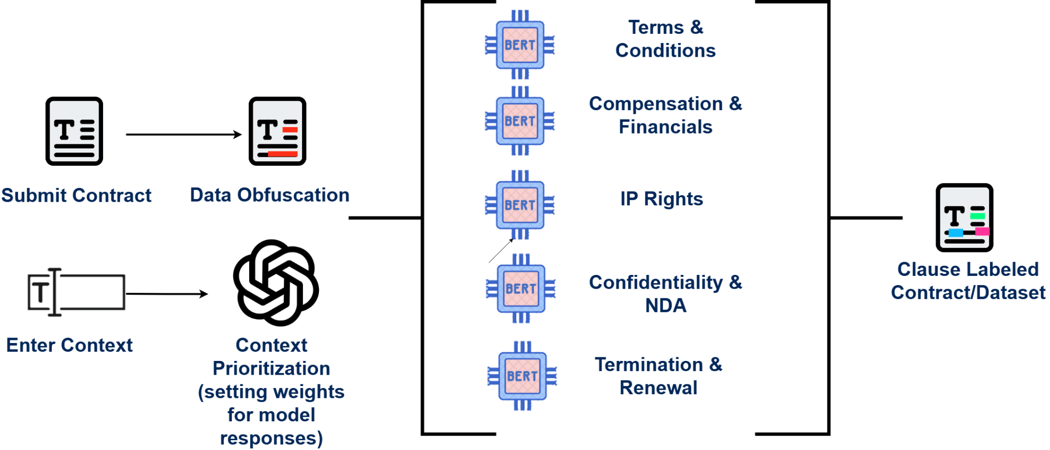
Model Architecture

Slide 5




CHALLENGE
Small Dataset Size: CUAD Dataset only included 510 contracts.
Solution: Conduct data augmentation via paraphrasing
Increased sample size to 3570.
Poor accuracy scores of the original models

Slide 6

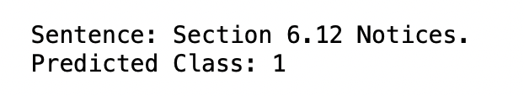

RESULTS
After performing data augmentation to increase data sample size, the accuracy increased significantly.
The highest increase is found in IP rights, increasing from 0.058 to 0.86.
Conducting blind testing on unlabelled contracts resulted in labeling large amounts of information as relevant.
The improved models did better yet still shown this tendency, especially on long sentences.
Improved validation accuracy on IP Rights model
The improved IP Rights Model can successfully pick out irrelevant info

Slide 7
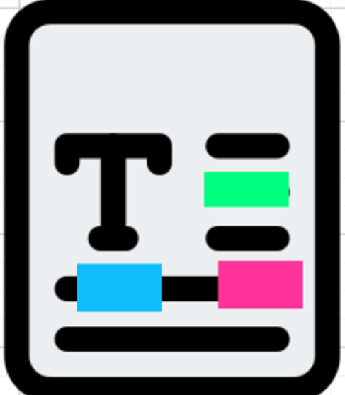



FUTURE WORK
Individual Model Retraining/Updates
Integrating Model with External Features
Acquiring Additional Datasets

Slide 8

FUN FACT
In total, our 3 computers crashed/blue screened 5 times while training/testing.
crashes
model :(

