Slide 1
Yeezy sneaker data
Webscrape of Leading Sneaker Resell Website StockX
Josh Yoon

Slide 2
Introduction
In the past decade, sneaker culture has reached explosive popularity, and as a result given rise to various avenues for buying and selling rare and prized sneakers.
According to a study done by Campless, as of 2014, reselling sneakers is estimated to be a $1 Billion industry.
Retail vs Resell
Retail – Mass release of sneaker models to major sneaker retailers such as Footlocker, Finishline, Adidas Stores, Nike Stores, etc. Otherwise referred to as primary marketplace.
Resell- Secondary marketplace where sellers who have highly coveted sneakers in their possession(usually sold out elsewhere else) can place their shoes to be sold to buyers willing to pay a premium to acquire rare, discontinued sneakers.
Notes:
Original release to general public via major retailers, but usually highly coveted sneakers sell out almost instantly, Huge demand and limited supply caused creation of the resell marketplace where sellers can sell sneakers for profit to buyers who really want a shoe but missed their opportunity to buy for general release.
Resell market we are very familiar with is ebay.

Slide 3
Topic of Focus: Adidas Yeezy Sneakers
Many different brands and styles are available for buying/selling in sneaker resell marketplaces , but for today’s purposes I will focus in on the notorious Adidas Yeezy sneaker line by Kanye West.
Why Yeezys?
After a controversial and abrupt end of partnership with Nike, Kanye jumped shipped to Adidas and his impact was felt almost easily,
Lauching his first model with Adidas ( Yeezy 750) in February 2015, sneaker apps and websites crashed almost instantaneously, and his sneakers sold out in the matter of seconds.
In 12 months, since the launch of the first sneaker, Adidas is estimate to increase total revenue by a whopping $2B.
In addition, Adidas’s stock price went from $63.2 before the launch of Yeezy line to $147.50 as of early 2017. (+133% Increase)
Notes:
Daram filled breakd up of Kanye.
Sneakers so highly anticipated, that apps and websites crashed and the entire inventory was sold out in the matter of seconds.
What are the business implications.

Slide 4
Overview of Adidas Yeezy Line (Feb 2015- Current)
Total Models : 8
Total Styles: 31 (Including individual colorways of models)
Total Sales as of Oct 2017 : 51,460 pairs of sneakers
Avg. Resell Price: $1,103
Avg. Percent Above Retail Price: +366%
Highest Price Reached: $6,000 (+2,456% above retail price)
Notes:
Iphone example model vs style:
If you can get a 24% profit on any investment you shouldn’t be here, you should be in a mansion in Beverly Hills

Slide 5
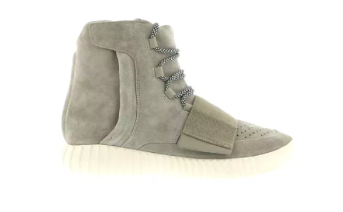
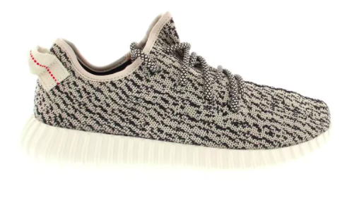
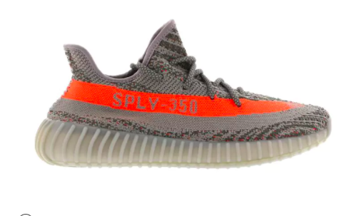
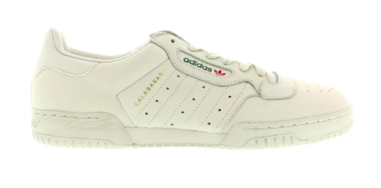
Overview of Adidas Yeezy Line Cont’d
Model Name | 750 | 350 V1 | 350 V2 | Powerphase
Number of Styles(Colors) | 4 | 5 | 8 | 1
First Release Date | Feb 2015 | Jun 2015 | Sep 2016 | Mar 2017
Original Retail Price | $350 | $200 | $220 | $120
Avg. Resell Price | $1,452 | $1,580 | $796 | $233
Avg. Resell Percentage | +315% | +690% | +262% | +94%
Highest Price Reached | $6,000 | $5,112 | $2,562 | $521
Notes:
4 sneaker models we will focus on from left to right is the order of release and some important information by model.
Avg. resell price is still much higher than retail but the later two models of 2016 and 2017 have much lower abg selling price. Variety of reasons that we will dive into in the remaining slides

Slide 6
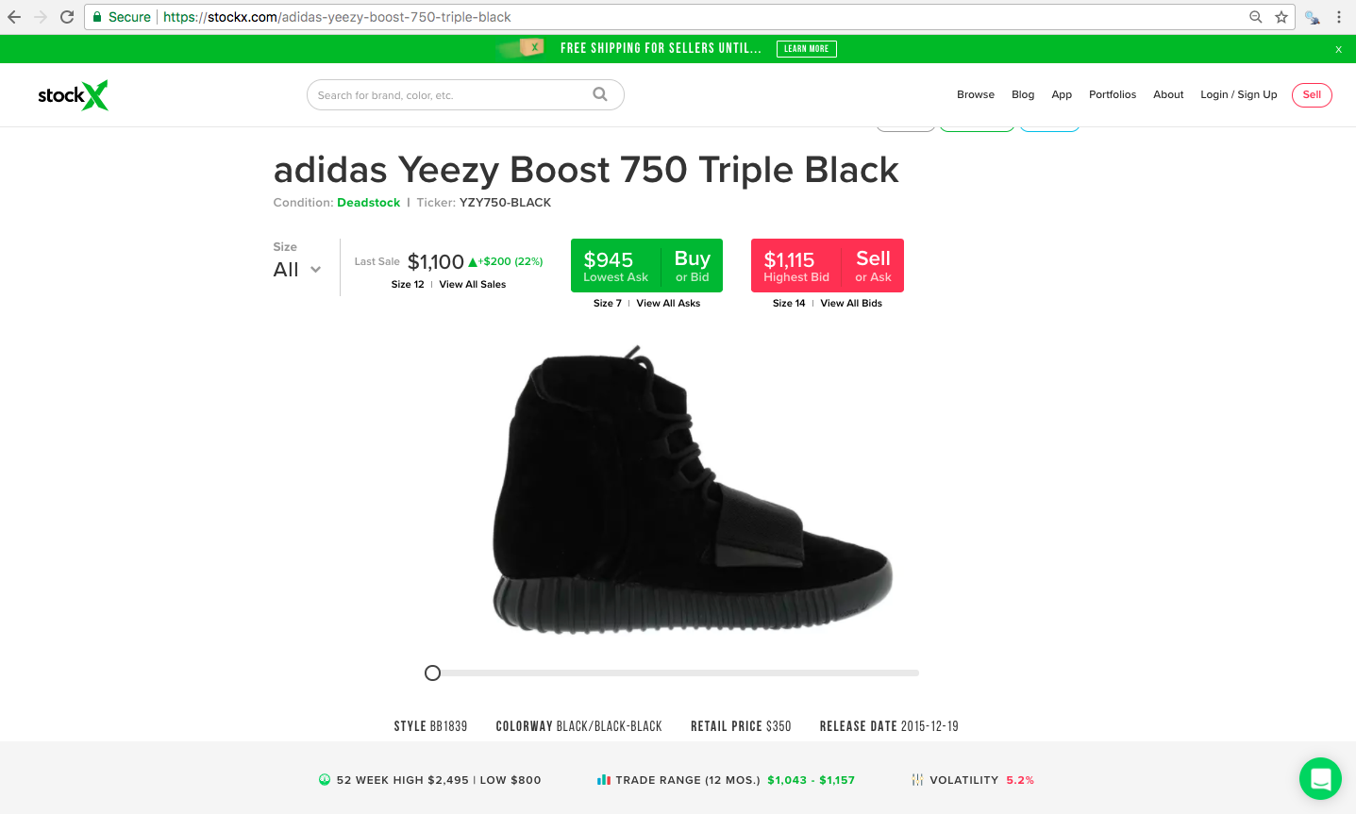
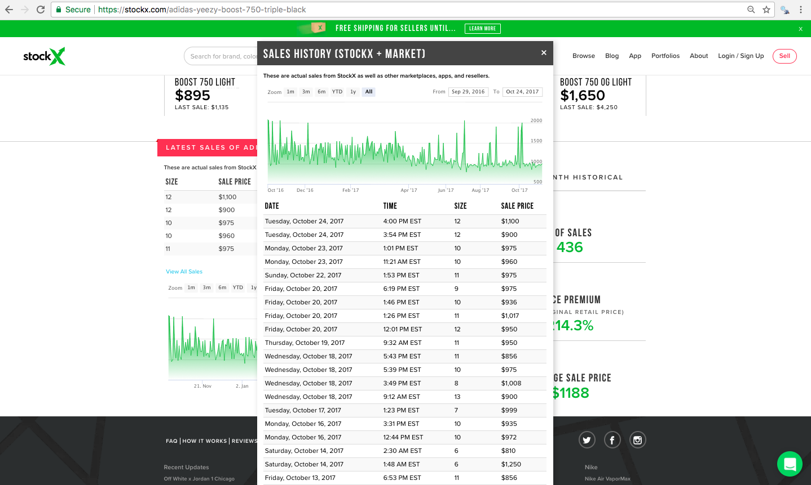
Data Acquisition
used Scrapy and Selenium to scrape historical selling data of sneakers from stockx.com, one of the most popular sneaker resell marketplaces.

Slide 7
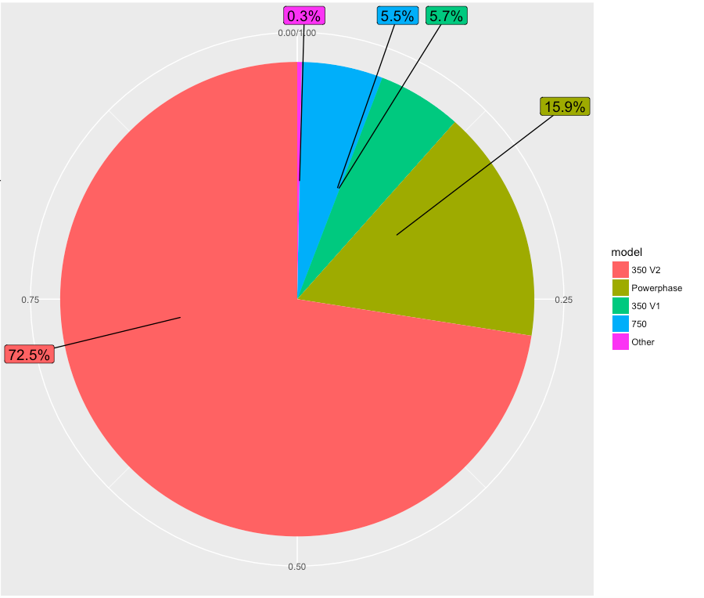
General EDA

