Slide 1
Yeezy sneaker data
Webscrape of Leading Sneaker Resell Website StockX
Josh Yoon

Slide 2
Introduction
In the past decade, sneaker culture has reached explosive popularity, and given rise to various avenues for buying and selling rare and prized sneakers.
According to a study conducted by Campless, as of 2014, reselling sneakers is estimated to be a $1 Billion industry.
Retail vs Resell
Retail – Mass release of sneaker models to major sneaker retailers such as Footlocker, Finishline, Adidas Stores, Nike Stores, etc. Otherwise referred to as primary marketplace.
Resell- Secondary marketplace where sellers who have highly coveted sneakers in their possession(usually sold out elsewhere else) can place their shoes to be sold to buyers willing to pay a premium to acquire rare, discontinued sneakers. Some big names in sneaker resell are Flightclub, StockX, GOAT, Stadium Goods, Ebay, etc.
Notes:
Original release to general public via major retailers, but usually highly coveted sneakers sell out almost instantly, Huge demand and limited supply caused creation of the resell marketplace where sellers can sell sneakers for profit to buyers who really want a shoe but missed their opportunity to buy for general release.
Resell market we are very familiar with is ebay.

Slide 3
Topic of Focus: Adidas Yeezy Sneakers
Many different brands and styles are available for buying/selling in sneaker resell marketplaces , but for today’s purposes I will focus in on the notorious Adidas Yeezy sneaker line by Kanye West.
Why Yeezys?
After a controversial and abrupt end of partnership with Nike, Kanye jumped shipped to Adidas and his impact was felt almost easily,
Lauching his first model with Adidas ( Yeezy 750) in February 2015, sneaker apps and websites crashed almost instantaneously, and his sneakers sold out in the matter of seconds.
In 12 months, since the launch of the first sneaker, Adidas is estimate to increase total revenue by a whopping $2B.
In addition, Adidas’s stock price went from $63.2 before the launch of Yeezy line to $147.50 as of early 2017. (+133% Increase)
Notes:
Daram filled breakd up of Kanye.
Sneakers so highly anticipated, that apps and websites crashed and the entire inventory was sold out in the matter of seconds.
What are the business implications.

Slide 4
Overview of Adidas Yeezy Line (Feb 2015- Current)
Total Models : 8
Total Styles: 31 (Including individual colorways of models)
Total Sales as of Oct 2017 : 51,460 pairs of sneakers
Avg. Resell Price: $1,103
Avg. Percent Above Retail Price: +366%
Highest Price Reached: $6,000 (+2,456% above retail price)
Notes:
Iphone example model vs style:
If you can get a 24% profit on any investment you shouldn’t be here, you should be in a mansion in Beverly Hills

Slide 5
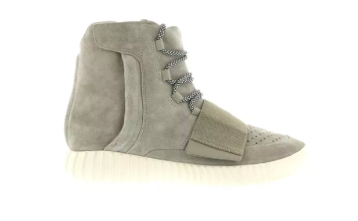
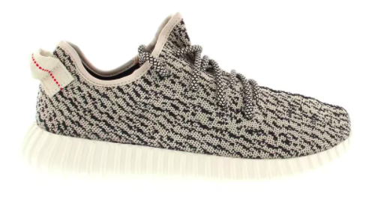
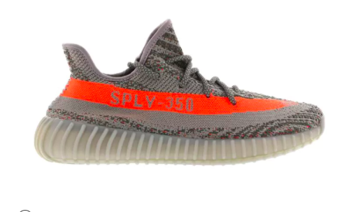
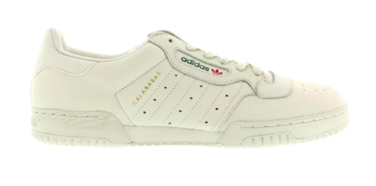
Overview of Adidas Yeezy Line Cont’d
Model Name | 750 | 350 V1 | 350 V2 | Powerphase
Number of Styles(Colors) | 4 | 5 | 8 | 1
First Release Date | Feb 2015 | Jun 2015 | Sep 2016 | Mar 2017
Original Retail Price | $350 | $200 | $220 | $120
Avg. Resell Price | $1,452 | $1,580 | $796 | $233
Avg. Resell Percentage | +315% | +690% | +262% | +94%
Highest Price Reached | $6,000 | $5,112 | $2,562 | $521
Notes:
4 sneaker models we will focus on from left to right is the order of release and some important information by model.
Avg. resell price is still much higher than retail but the later two models of 2016 and 2017 have much lower abg selling price. Variety of reasons that we will dive into in the remaining slides

Slide 6
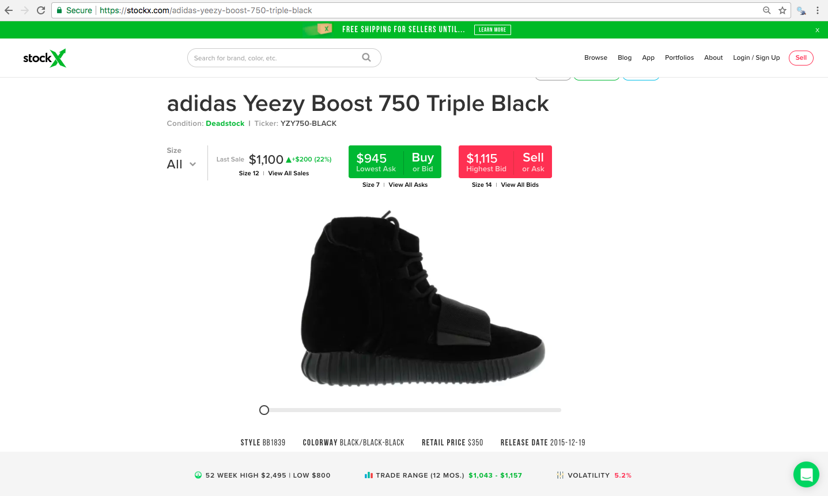
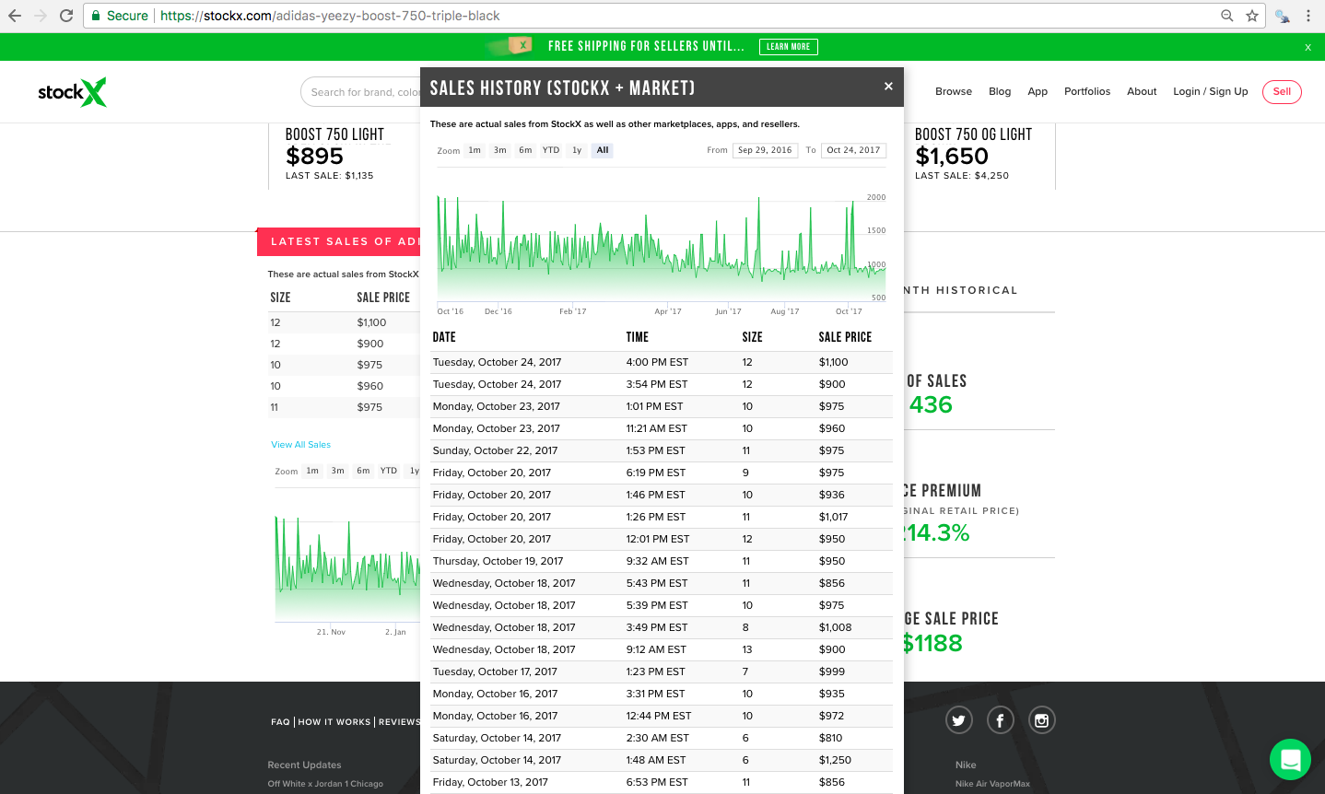
Data Acquisition
used Scrapy and Selenium to scrape historical selling data of sneakers from stockx.com, one of the most popular sneaker resell marketplaces.

Slide 7
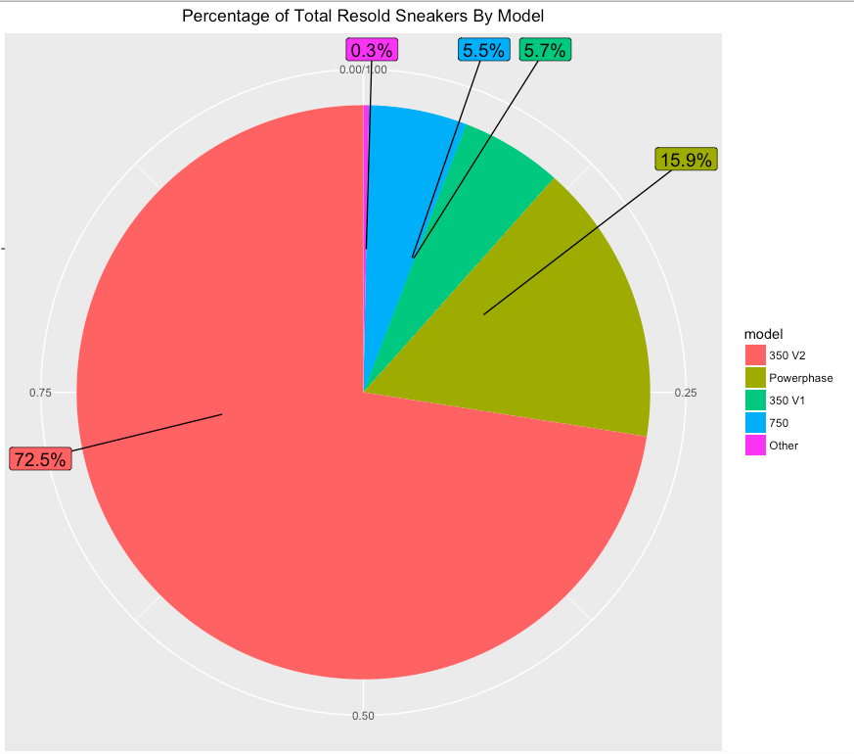
Percentage of Resold Sneakers by Model
72.5% of data is Yeezy 350 V2 model that launched Sep 2016
Second place at 15.9% is the Yeezy Powerphase model which only had 1 colorway(white) released.
The two newer models( 350 V2 and Powerphase), account for over 88% of Yeezy sneakers sold.
What does this mean?
*** “Other” refers to 4 boot models released in Kanye’s high fashion line in extremely limited releases to luxury boutiques. Only account for 0.3% of resell market and will be disregarded.
Notes:
The two newer models, account for over 88% of Yeezy sneakers sold.
What does this mean? Most likely due to great success and popularity of early models, adidas was able to greatly increase the amount of inventory for newer models.

Slide 8
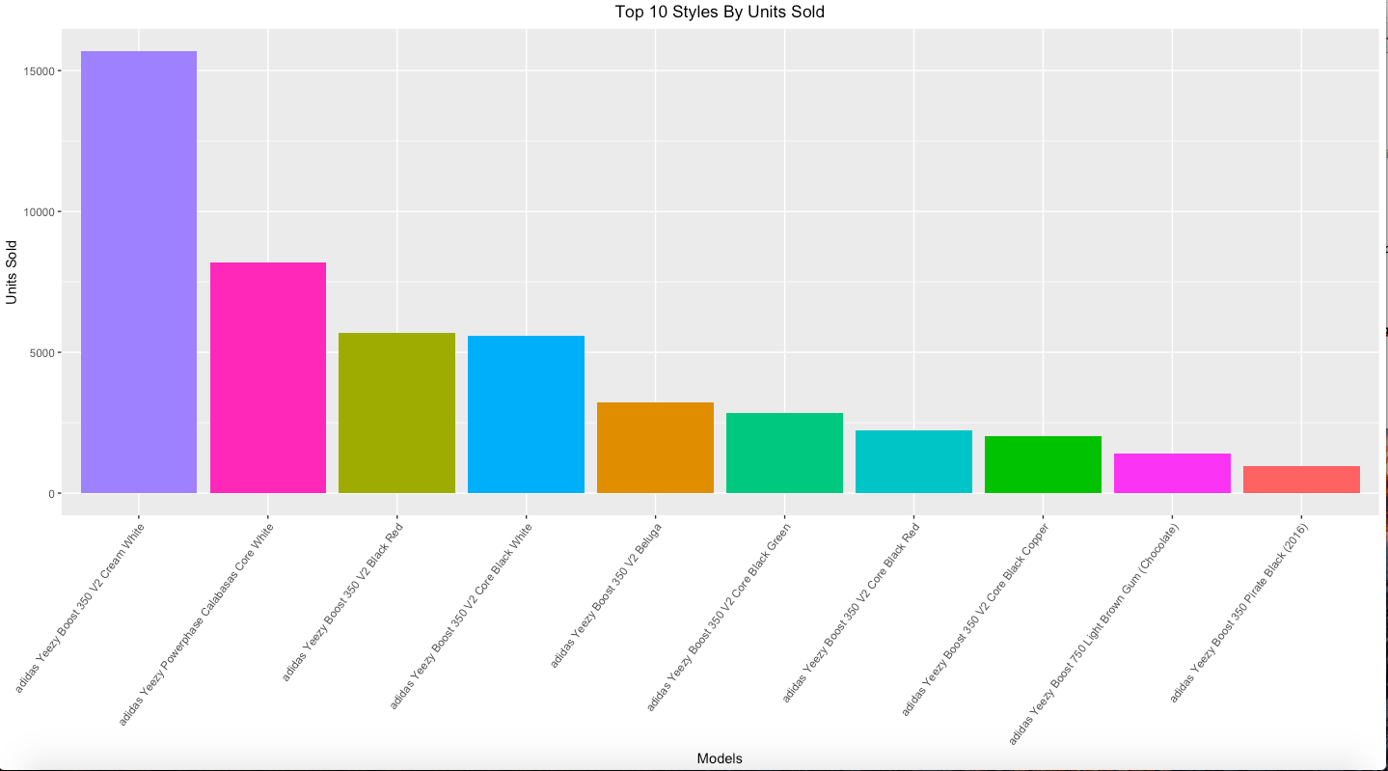
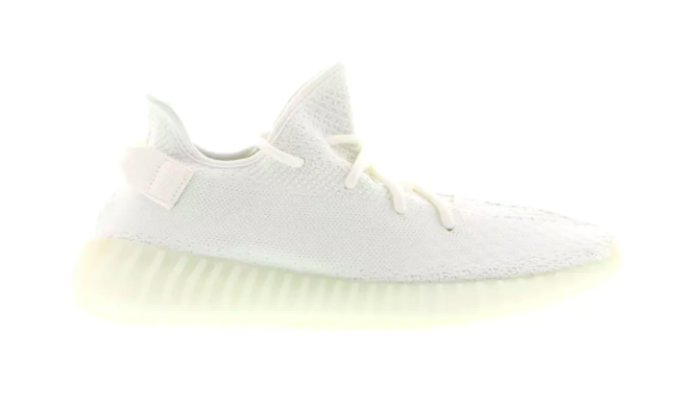
Top 10 Yeezy Styles
350 V2 Cream
Powerphase
Number 1 is Cream Yeezy 350 V2, which doubles the next best selling style.
Number 2 is Yeezy Powerphase which is also all white shoe.
What do top 2 selling styles have in common? Much lower resell price.
Avg Cream Yeezy 250 V2: $536
Avg. Yeezy Powerphase: $233
Avg. of All Yeezy Sneakers: $1,103
Notes:
Lower priced Yeezy’s sell like hotcakes.

Slide 9
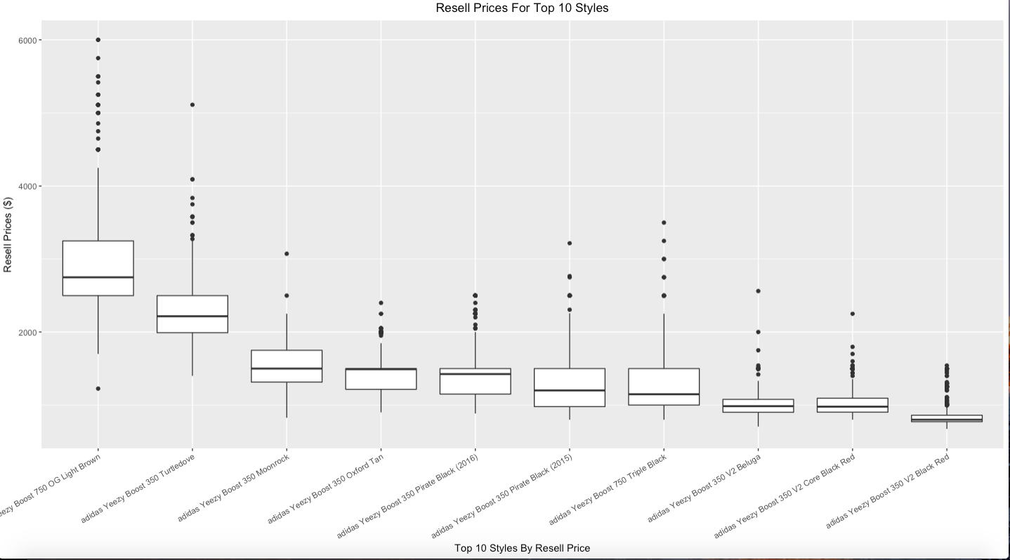
Resell Prices Trends
Visualization of resell prices by individual style
Shows most models have established price range (shown by edges of box) and for most Yeezy sneakers, there are many purchases made well above the median prices.

Slide 10
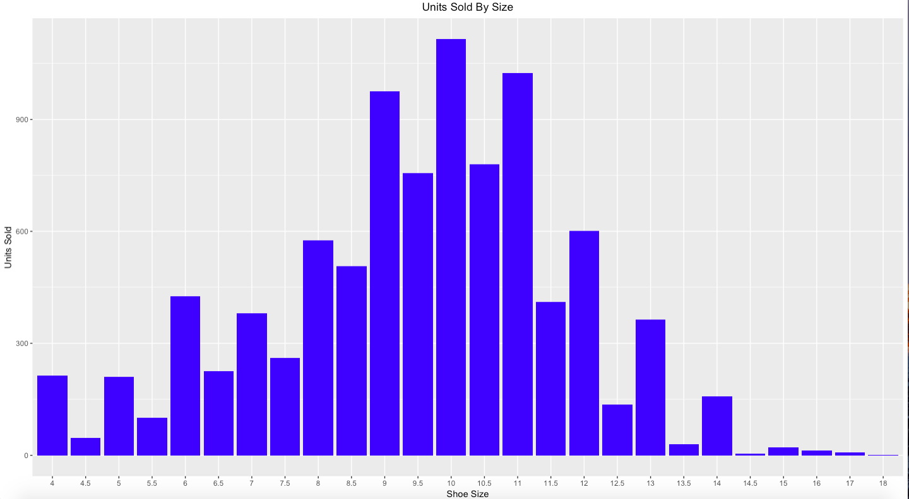
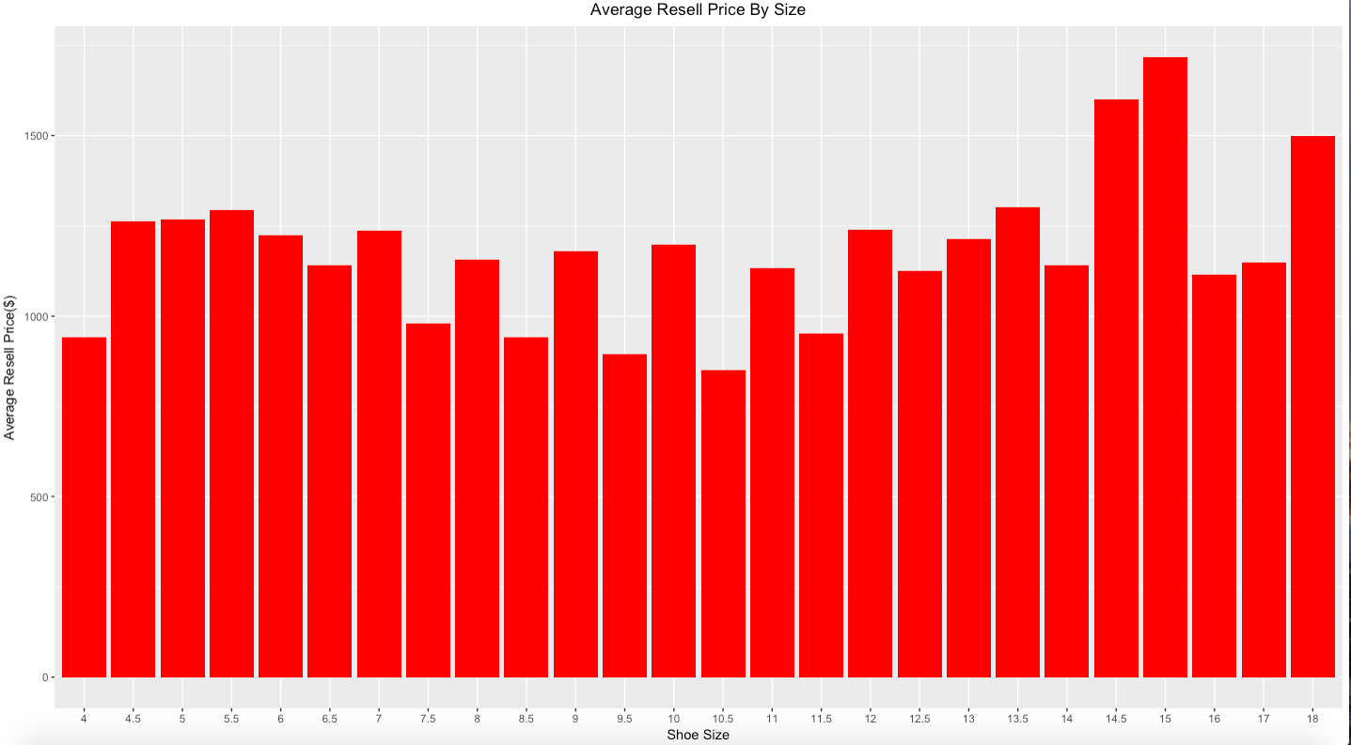
Size- All Yeezy Sneakers
9,10, 11 are most popular sold sizes
Really large sizes are rare on resell platfoms
Is there correlation between how “rare” a sneaker is (low availability on sneaker reselling platforms) with higher price points?

Slide 11
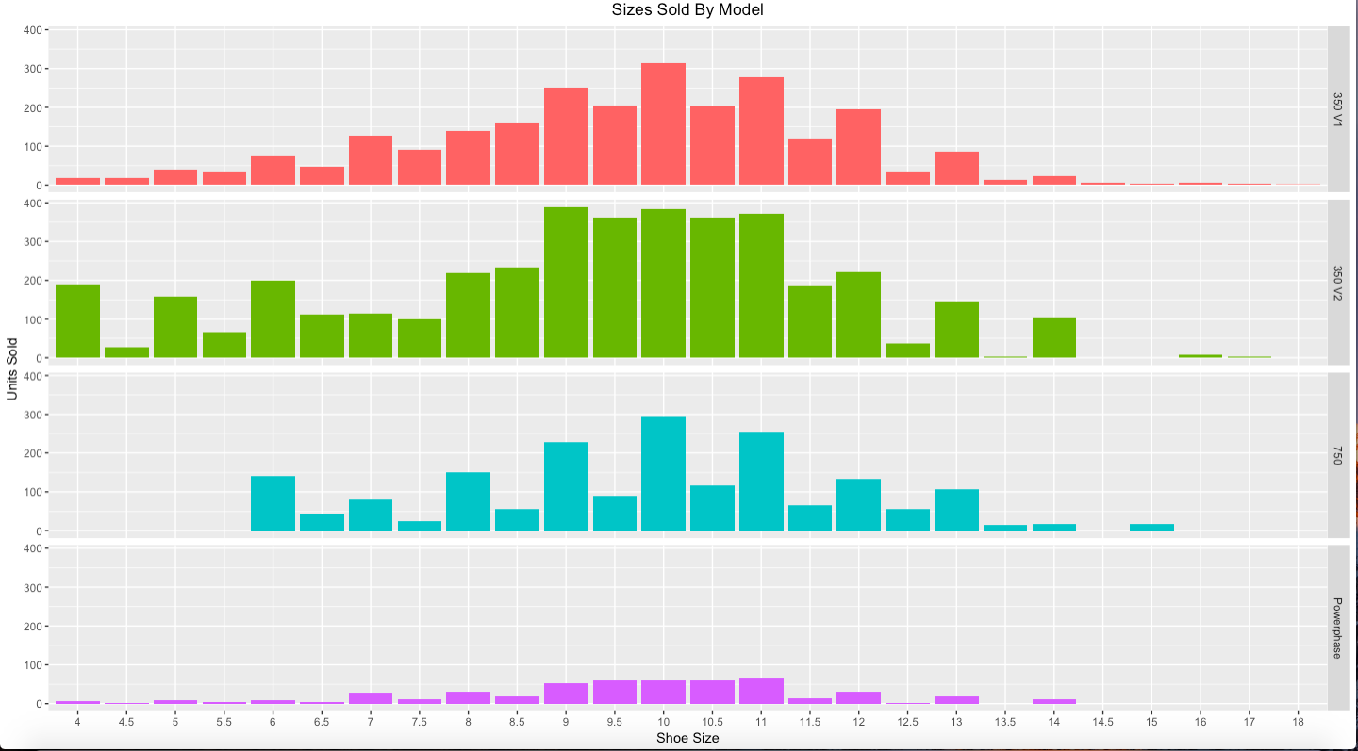
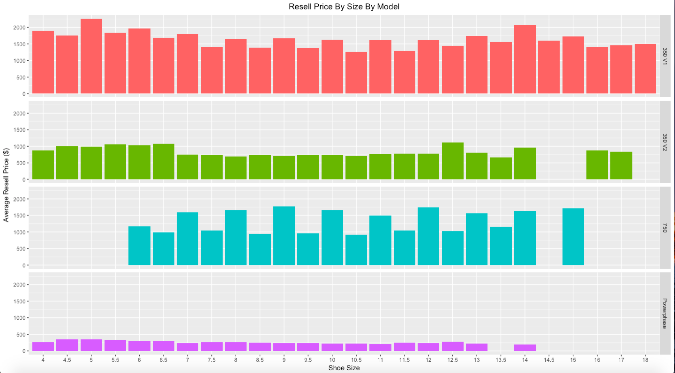
Size By Model
Units Sold and Avg. Resell Price broken out by models.
Interesting trend in 750 model. First colorway had no half sizes!
Notes:
1st Model limited size run as adidas testing appetite of customers for $350 shoes. Did not manufacture half sizes!
-Subsequent 750 Colorways released did have half sizes.

Slide 12
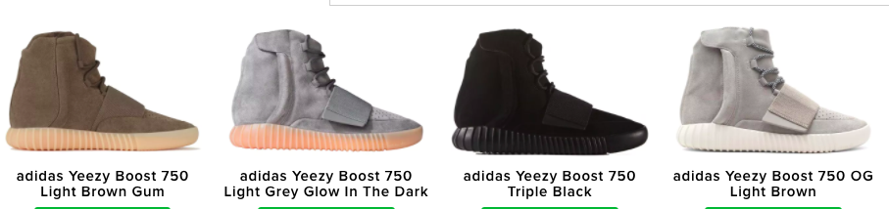
Yeezy 750 Models

Slide 13
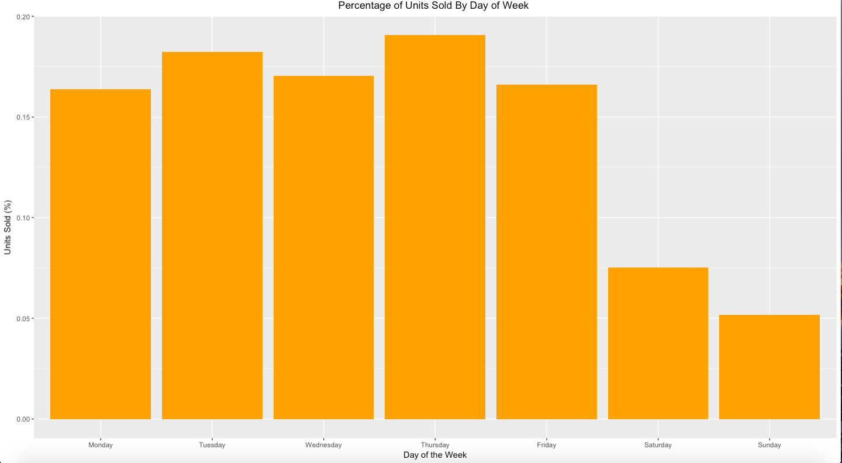
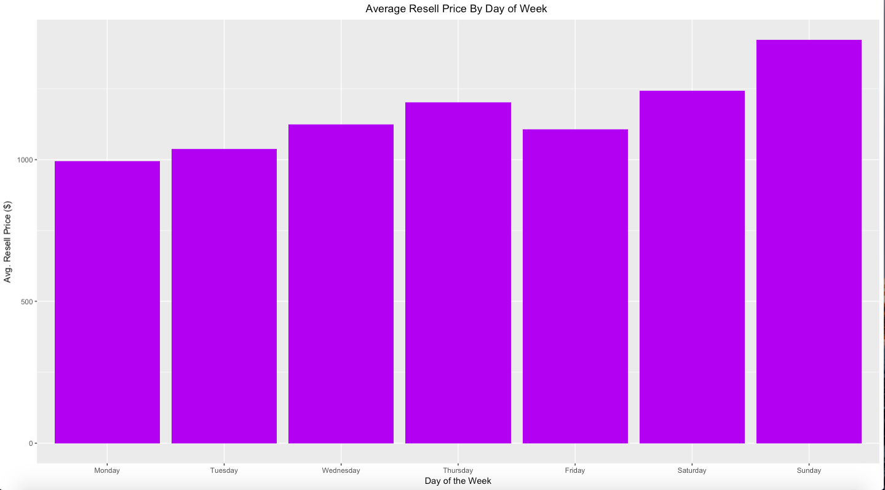
Yeezy Selling By Day of the Week
Interesting finding: significantly less shoes are sold on weekends than on weekdays. Additionally, prices increase almost linearly from Monday to Sunday.
Buyers shop during the week, and not on weekends.
Pricing makes sense, as early shoppers get first dibs on most competitively priced pairs and as the week goes, the remaining offers are more and more expensive.
Notes:
Like ebay, 3 pairs of size 9 available at 100, 110, 120. First buyer gets the 100, and the next buyer gets the next best deal, and the latest shopper is stuck with the most expensive offer.
would love to see pattern of when sellers make shoes available in secondary market, missing link in making final conclusions here.

Slide 14
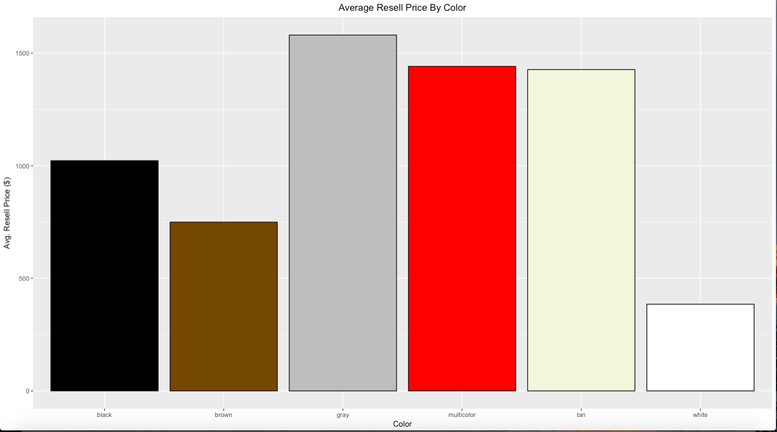
Price By Color
Interesting fact: Almost $1000 difference in price between grey and white Yeezy sneakers!
Chart can be useful in predicting resell prices of future yeezy sneakers.
Notes:
Proudest Acomplishment: Coor Coding Bars
For All the OCD people, you are welcome.

Slide 15
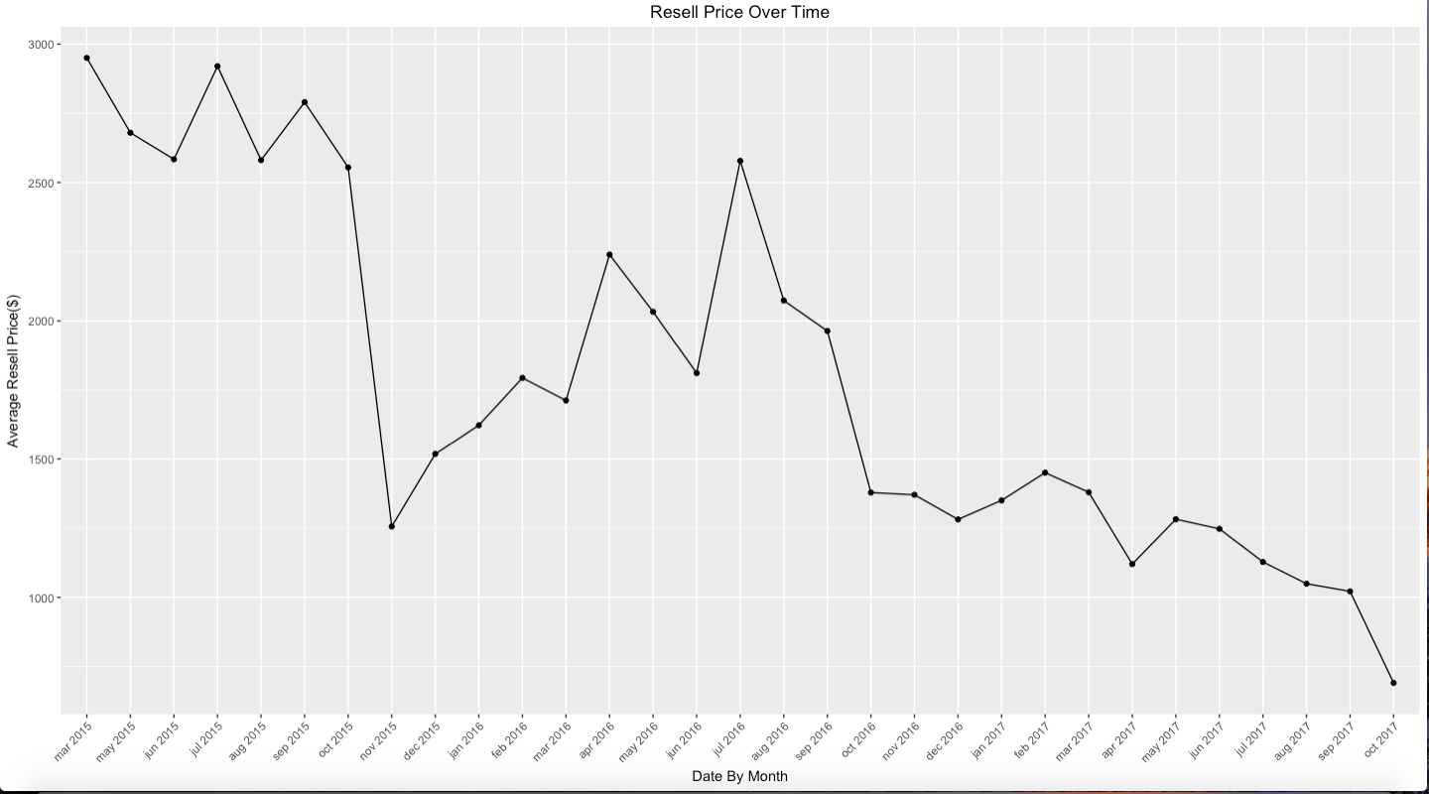
Prices Over Time
Is the value of Yeezy sneakers declining over time?
Notes:
would love to see pattern of when sellers make shoes available in secondary market, missing link in making final conclusions here.

Slide 16
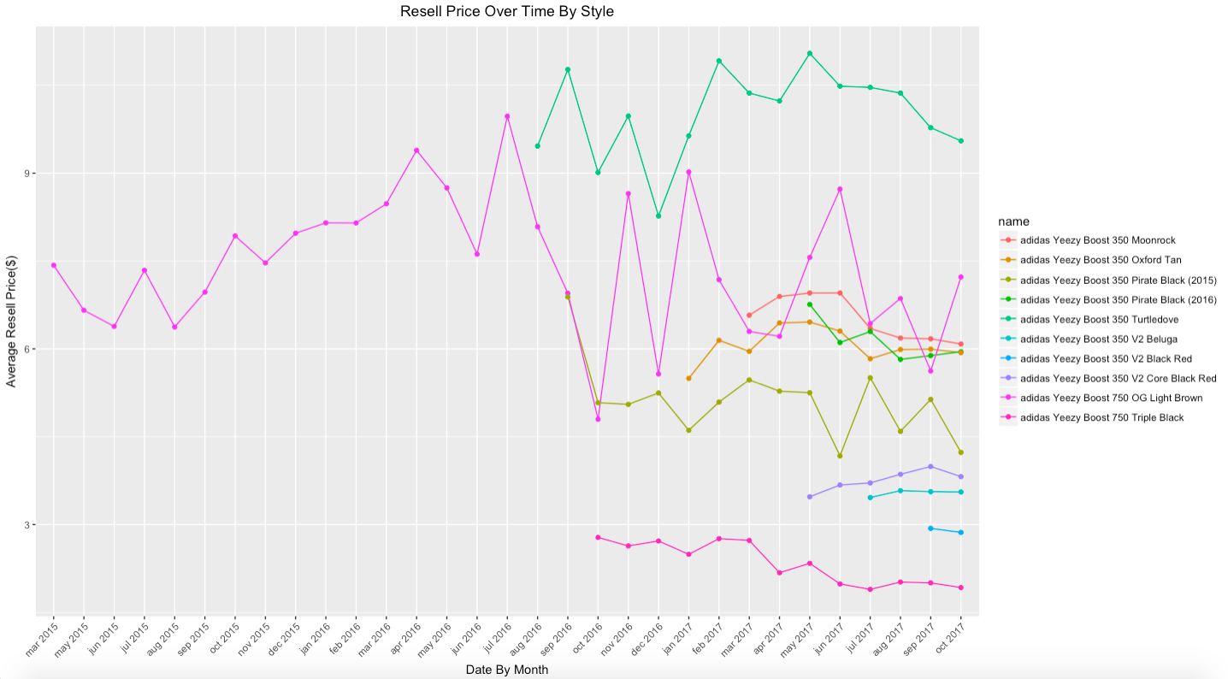
Prices Over Time
Tracking resell prices over time for individual styles (Top 10 Styles) to see if they are depreciating.
Although there is fluctuation, looks like in general individual styles have no negative trend.
Conclusion: Newer styles are reselling at lower prices, bringing down total average price of Yeezy sneakers but sneakers are not declining in resell price.
Notes:
Like ebay, 3 pairs of size 9 available at 100, 110, 120. First buyer gets the 100, and the next buyer gets the next best deal, and the latest shopper is stuck with the most expensive offer.
would love to see pattern of when sellers make shoes available in secondary market, missing link in making final conclusions here.

Slide 17
Conclusions
For Sellers:
Will get most return from either really large sizes or the most common sizes 9, 10, 11.
Gray color sneakers sell at highest pricepoint
Any 750 model will get you rich.
For Buyers:
Shop earlier during the week!
easiest to find 9,10,11 sizes
white colors are most affordable

Slide 18
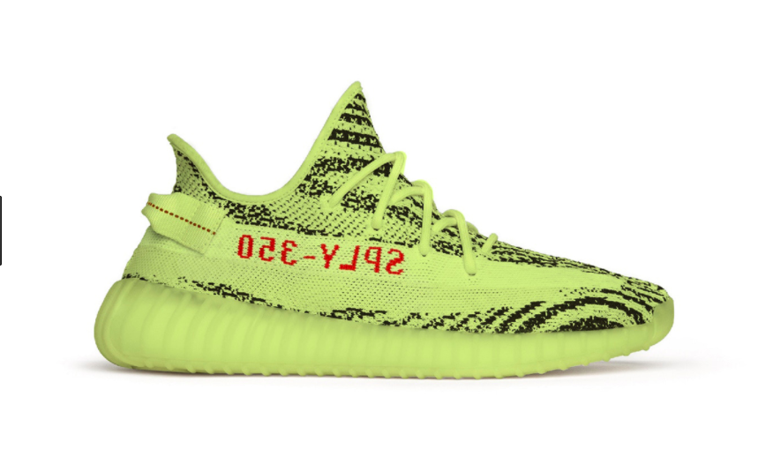
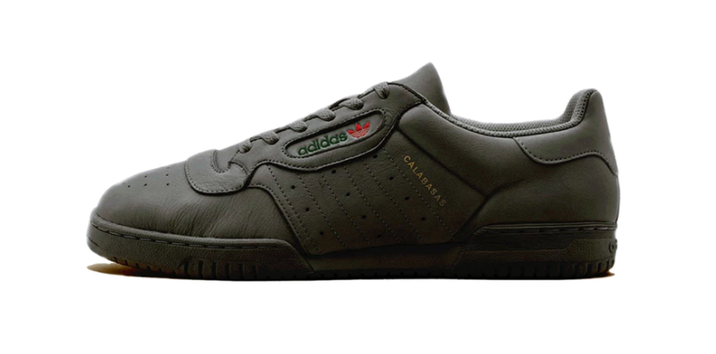
Opportunities For The Future
Analyze larger scope of brands and models (i.e. Jordans, Nikes, etc)
Deep dive into the productivity and growth of each sneaker resell marketplace (StockX vs. Ebay vs Flightclub vs GOAT vs Stadium Goods)
Apply machine learning techniques to predict resell prices for upcoming Yeezy sneaker releases.

Slide 19
Questions?

