Slide 1
Lecture 4 Model Order Selection
EE-uy 4563/EL-GY 9123: Introduction to machine learning
Prof. Sundeep rangan (with modification by Yao Wang)

Slide 2
Learning Objectives
Compute the model order for a given model class
Visually identify overfitting and underfitting of a model in a scatterplot
Determine if there is under-modeling for a given true function and model class
Compute the bias and variance for linear models (advanced)
Perform cross-validation for selecting an optimal order
Use cross-validation for feature selection

Slide 3
Outline
Motivating Example: What polynomial degree should a model use?
Bias and variance
Bias and variance for linear models (Advanced)
Cross-validation
Feature selection

Slide 4
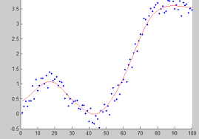
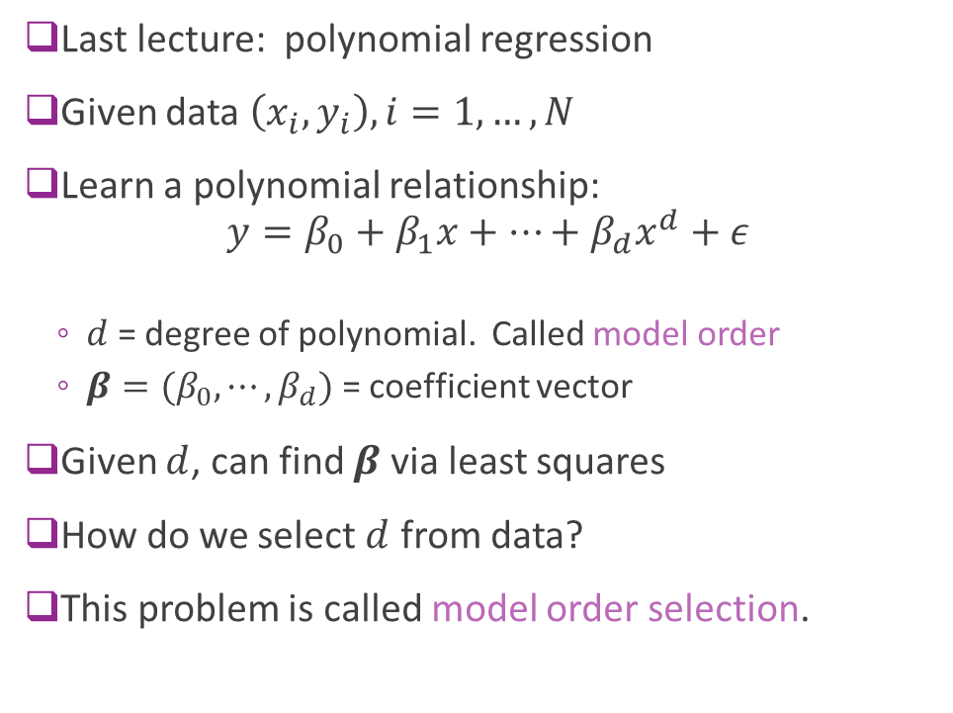
Polynomial Fitting
Last lecture: polynomial regression
Given data $\left(x_{i},y_{i}\right), i=1,…, N$
Learn a polynomial relationship: $y=β_{0}+β_{1}x+⋯+β_{d}x^{d}+ε$
$d$ = degree of polynomial. Called model order
$β=(β_{0},⋯,β_{d})$ = coefficient vector
Given $d$, can find $β$ via least squares
How do we select $d$ from data?
This problem is called model order selection.

Slide 5
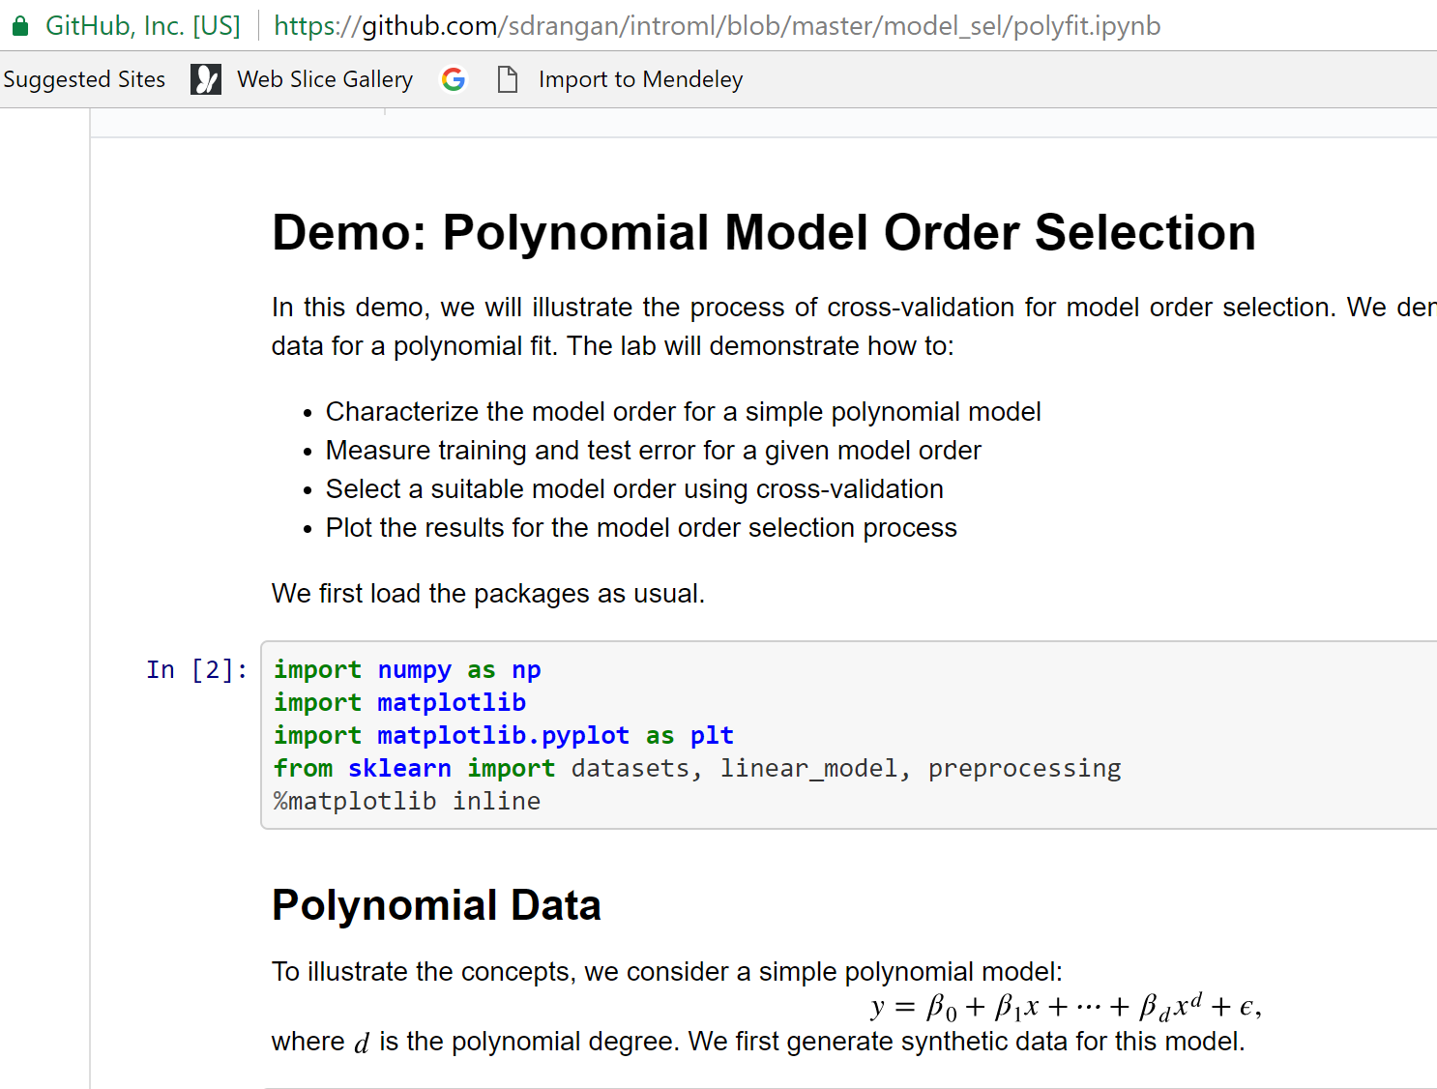
Demo on Github
Demo on github: https://github.com/sdrangan/introml/blob/master/unit04_model_sel/demo1_polyfit.ipynb

Slide 6
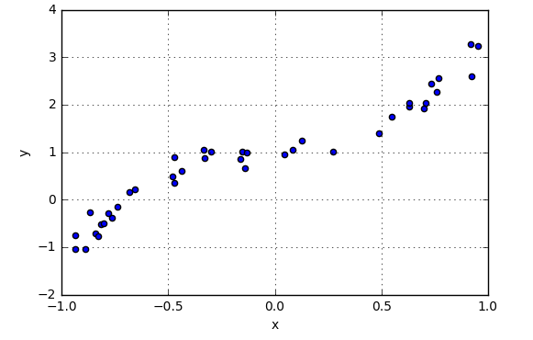
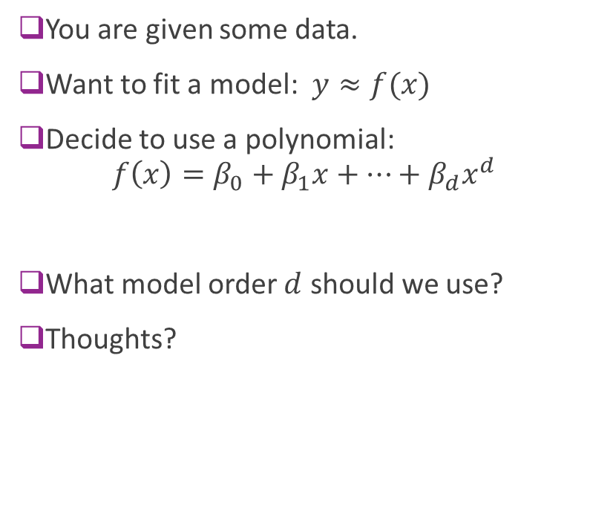
Example Question
You are given some data.
Want to fit a model: $y≈f(x)$
Decide to use a polynomial: $f\left(x\right)=β_{0}+β_{1}x+⋯+β_{d}x^{d}$
What model order $d$ should we use?
Thoughts?

Slide 7
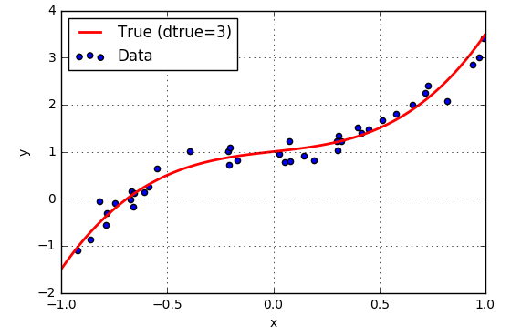
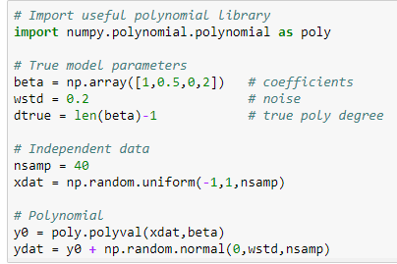
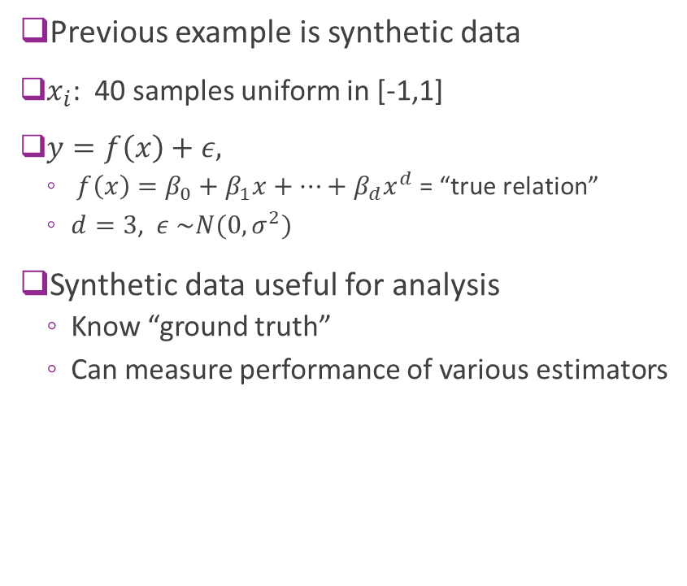
Synthetic Data
Previous example is synthetic data
$x_{i}$: 40 samples uniform in [-1,1]
$y=f\left(x\right)+ε,$
$f\left(x\right)=β_{0}+β_{1}x+⋯+β_{d}x^{d}$ = “true relation”
$d=3$, $ε \sim N(0,σ^{2})$
Synthetic data useful for analysis
Know “ground truth”
Can measure performance of various estimators

Slide 8
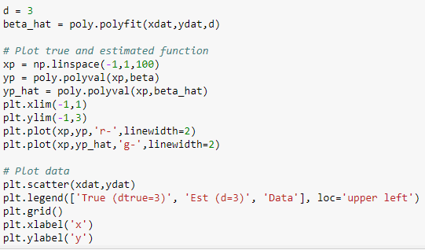
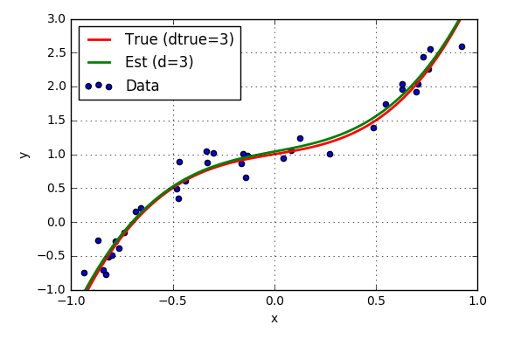
Fitting with True Model Order
Suppose true polynomial order, d=3, is known
Use linear regression
numpy.polynomial package
Get very good fit

Slide 9
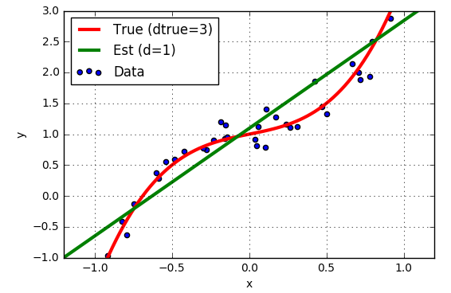
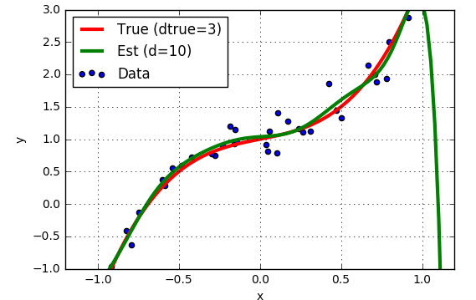
But, True Model Order not Known
Suppose we guess the wrong model order?
d=1 “Underfitting”
d=10 “Overfitting”

Slide 10
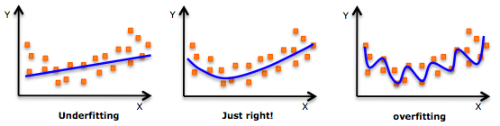
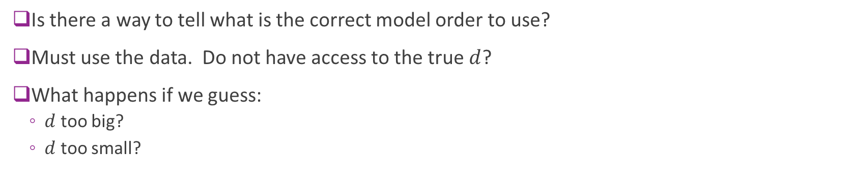
How Can You Tell from Data?
Is there a way to tell what is the correct model order to use?
Must use the data. Do not have access to the true $d$?
What happens if we guess:
$d$ too big?
$d$ too small?

Slide 11
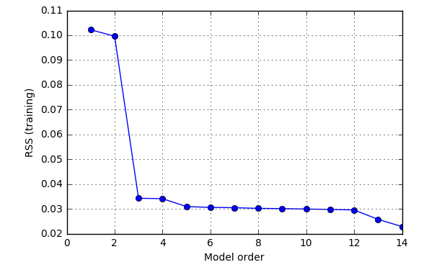
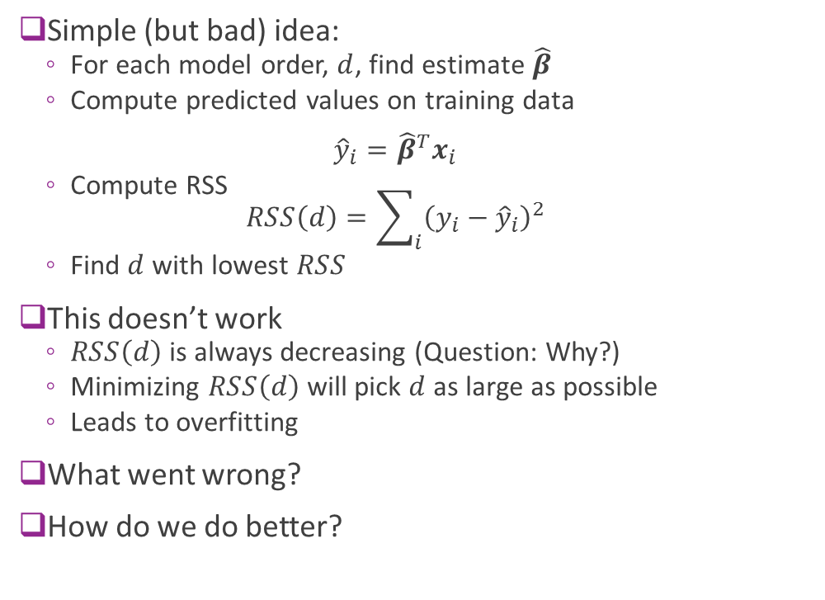
Using RSS on Training Data ?
Simple (but bad) idea:
For each model order, $d$, find estimate $\hat{β}$
Compute predicted values on training data ${\hat{y}}_{i}={\hat{β}}^{T}x_{i}$
Compute RSS $RSS\left(d\right)=\sum_{i}{{\left(y_{i}−{\hat{y}}_{i}\right)}^{2}}$
Find $d$ with lowest $RSS$
This doesn’t work
$RSS\left(d\right)$ is always decreasing (Question: Why?)
Minimizing $RSS\left(d\right)$ will pick $d$ as large as possible
Leads to overfitting
What went wrong?
How do we do better?

Slide 12
Outline
Motivating Example: What polynomial degree should a model use?
Bias and variance
Bias and variance for linear models (Advanced)
Cross-validation
Feature selection

Slide 13
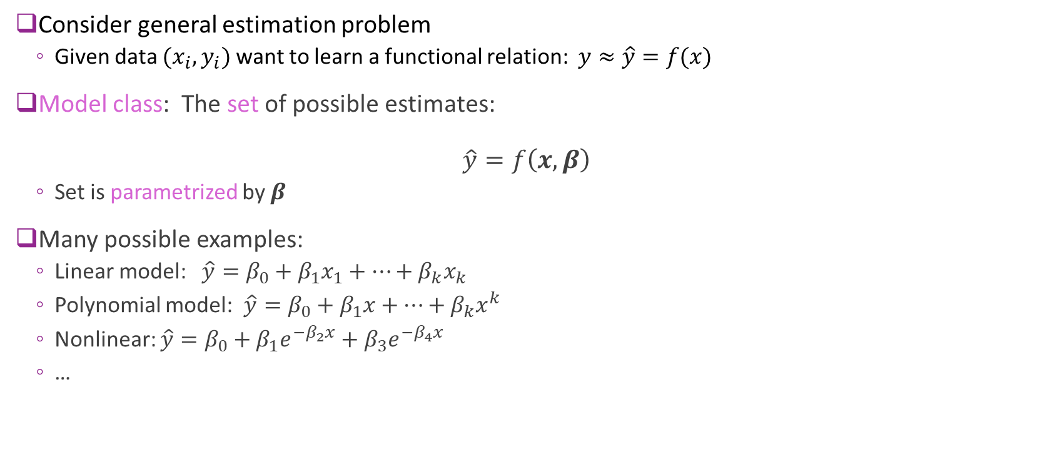
Model Class
Consider general estimation problem
Given data $(x_{i},y_{i})$ want to learn a functional relation: $y≈\hat{y}=f(x)$
Model class: The set of possible estimates: $\hat{y}=f\left(x,β\right)$
Set is parametrized by $β$
Many possible examples:
Linear model: $\hat{y}=β_{0}+β_{1}x_{1}+⋯+β_{k}x_{k}$
Polynomial model: $\hat{y}=β_{0}+β_{1}x+⋯+β_{k}x^{k}$
Nonlinear: $\hat{y}=β_{0}+β_{1}e^{−β_{2}x}+β_{3}e^{−β_{4}x}$
…

Slide 14

Model Class and True Function
Analysis set-up:
Learning algorithm assumes a model class: $\hat{y}=f\left(x,β\right)$
But, data has true relation: $y=f_{0}\left(x\right)+ε, ε\sim N(0,σ_{ε}^{2})$
Will quantify three key effects:
Irreducible error
Under-modeling
Over-fitting

Slide 15
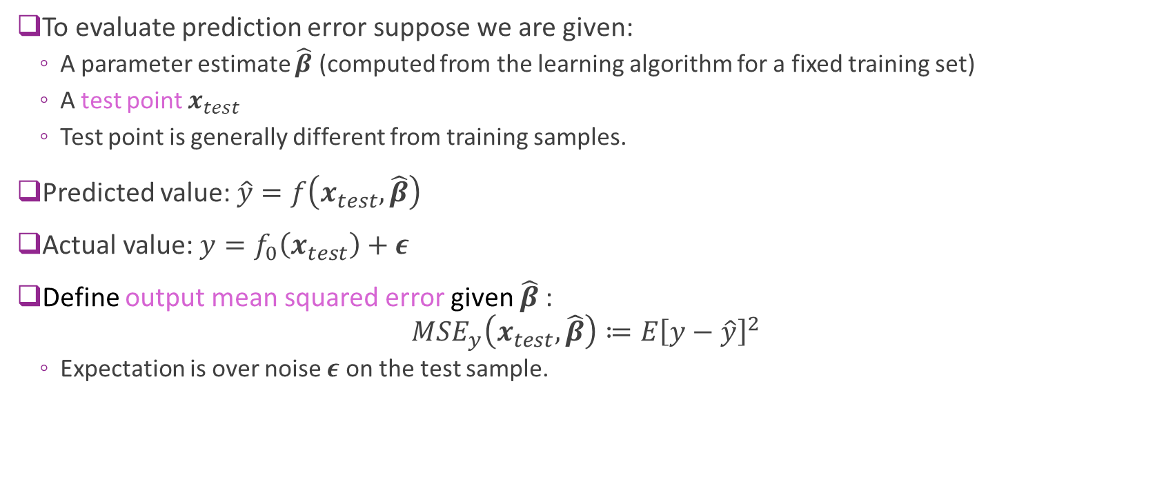
Output Mean Squared Error
To evaluate prediction error suppose we are given:
A parameter estimate $\hat{β}$ (computed from the learning algorithm for a fixed training set)
A test point $x_{test}$
Test point is generally different from training samples.
Predicted value: $\hat{y}=f\left(x_{test},\hat{β}\right)$
Actual value: $y=f_{0}\left(x_{test}\right)+ε$
Define output mean squared error given $\hat{β}$: $MSE_{y}\left(x_{test},\hat{β}\right)≔E{\left[y−\hat{y}\right]}^{2}$
Expectation is over noise $ε$ on the test sample.

Slide 16
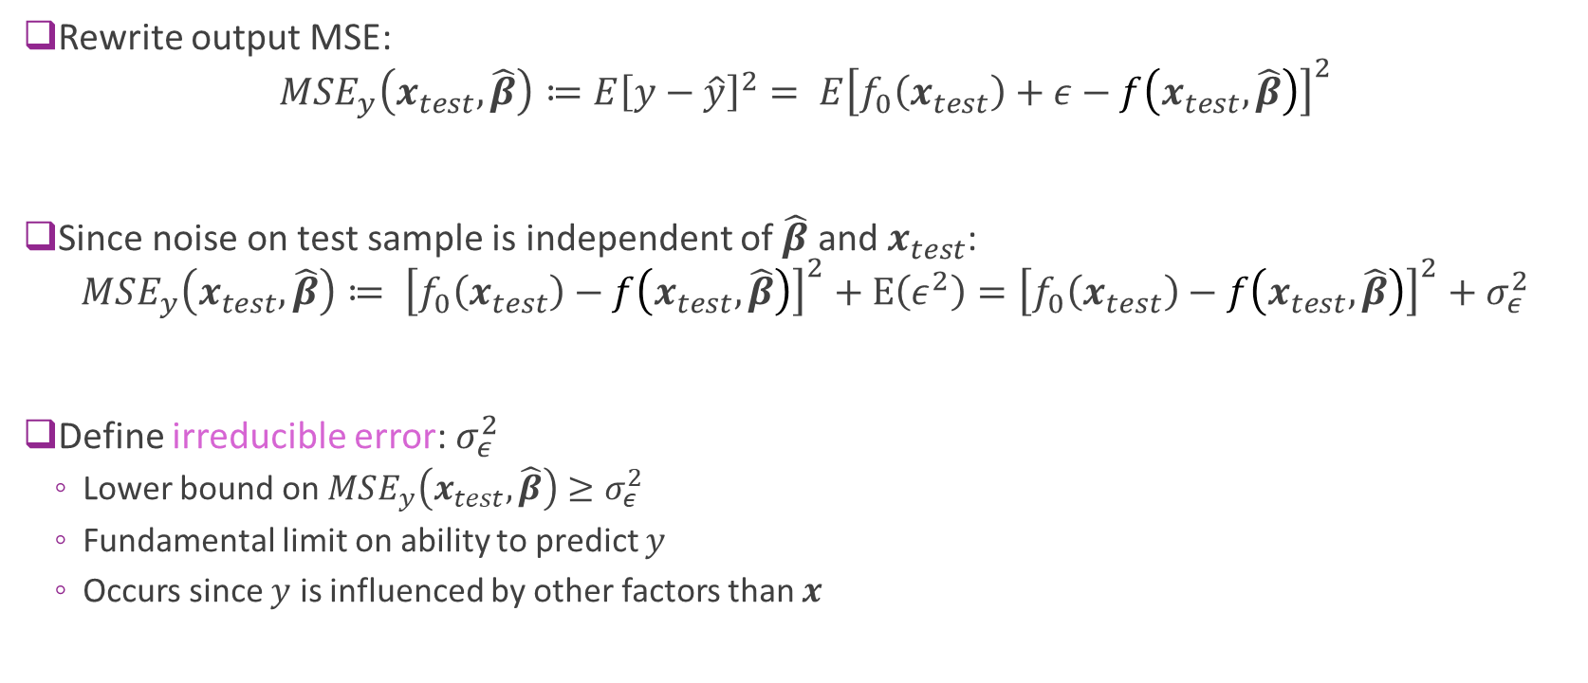
Irreducible Error
Rewrite output MSE: $MSE_{y}\left(x_{test},\hat{β}\right)≔E{\left[y−\hat{y}\right]}^{2}= E{\left[f_{0}\left(x_{test}\right)+ε−f\left(x_{test},\hat{β}\right)\right]}^{2}$
Since noise on test sample is independent of $\hat{β}$ and $x_{test}$: $MSE_{y}\left(x_{test},\hat{β}\right)≔ {\left[f_{0}\left(x_{test}\right)−f\left(x_{test},\hat{β}\right)\right]}^{2}+E\left(ε^{2}\right)={\left[f_{0}\left(x_{test}\right)−f\left(x_{test},\hat{β}\right)\right]}^{2}+σ_{ε}^{2}$
Define irreducible error: $σ_{ε}^{2}$
Lower bound on $MSE_{y}\left(x_{test},\hat{β}\right)≥σ_{ε}^{2}$
Fundamental limit on ability to predict $y$
Occurs since $y$ is influenced by other factors than $x$

Slide 17

Under-Modeling
Definition: A true function $f_{0}\left(x\right)$ is in the model class $\hat{y}=f\left(x,β\right)$ if: $f_{0}\left(x\right)=f\left(x,β_{0}\right) for all x$ for some parameter $β_{0}$.
$β_{0}$ called the true parameter
Under-modeling: When $f_{0}\left(x\right)$ is not in the model class

Slide 18
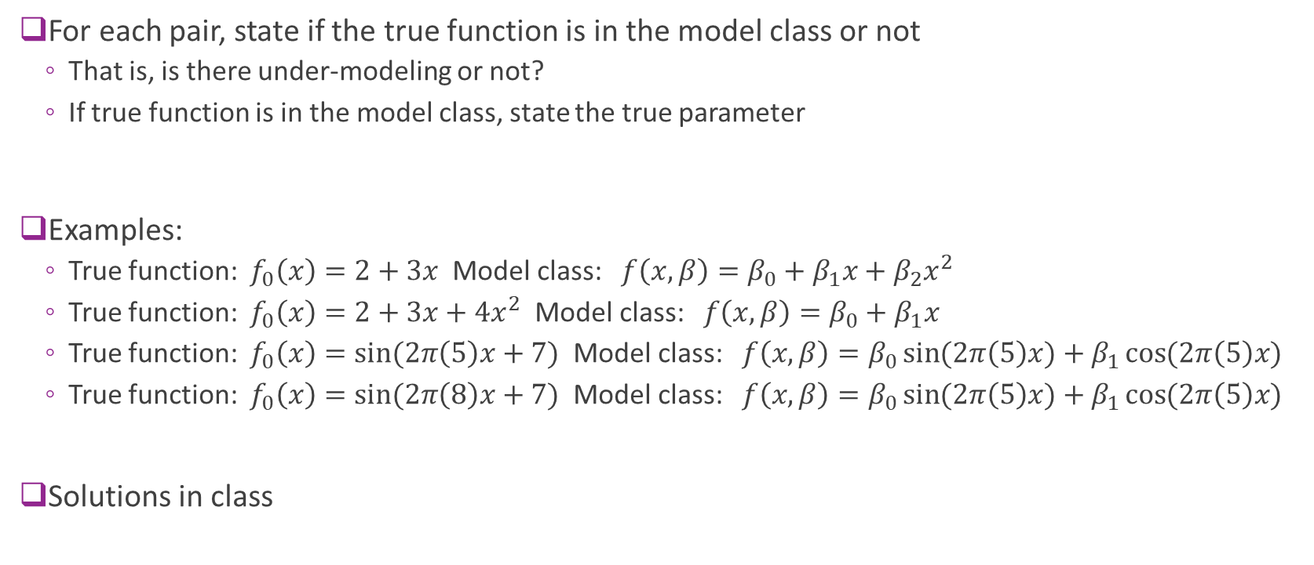
Sample Question
For each pair, state if the true function is in the model class or not
That is, is there under-modeling or not?
If true function is in the model class, state the true parameter
Examples:
True function: $f_{0}\left(x\right)=2+3x$ Model class: $f\left(x,β\right)=β_{0}+β_{1}x+β_{2}x^{2}$
True function: $f_{0}\left(x\right)=2+3x+4x^{2}$ Model class: $f\left(x,β\right)=β_{0}+β_{1}x$
True function: $f_{0}\left(x\right)=\sin{(2π\left(5\right)x+7)}$ Model class: $f\left(x,β\right)=β_{0}\sin{(2π\left(5\right)x)}+β_{1}\cos{(2π\left(5\right)x)}$
True function: $f_{0}\left(x\right)=\sin{(2π\left(8\right)x+7)}$ Model class: $f\left(x,β\right)=β_{0}\sin{(2π\left(5\right)x)}+β_{1}\cos{(2π\left(5\right)x)}$
Solutions in class

Slide 19
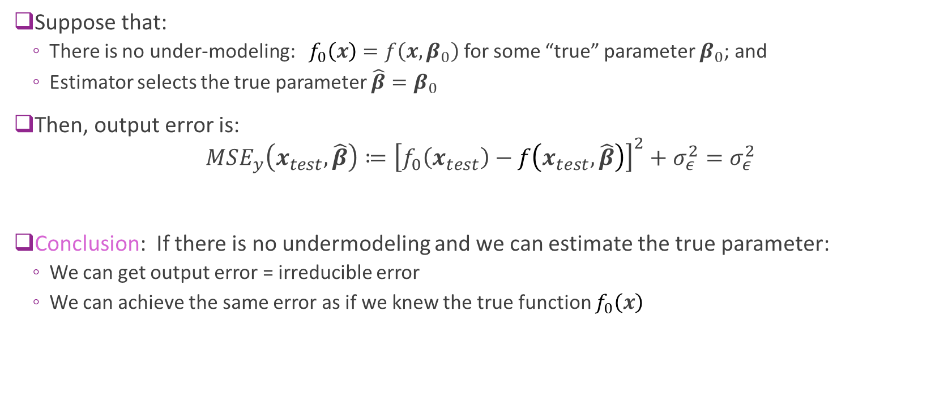
Under-Modeling and Irreducible Error
Suppose that:
There is no under-modeling: $f_{0}\left(x\right)=f\left(x,β_{0}\right)$ for some “true” parameter $β_{0}$; and
Estimator selects the true parameter $\hat{β}=β_{0}$
Then, output error is: $MSE_{y}\left(x_{test},\hat{β}\right)≔{\left[f_{0}\left(x_{test}\right)−f\left(x_{test},\hat{β}\right)\right]}^{2}+σ_{ε}^{2}=σ_{ε}^{2}$
Conclusion: If there is no undermodeling and we can estimate the true parameter:
We can get output error = irreducible error
We can achieve the same error as if we knew the true function $f_{0}\left(x\right)$

Slide 20
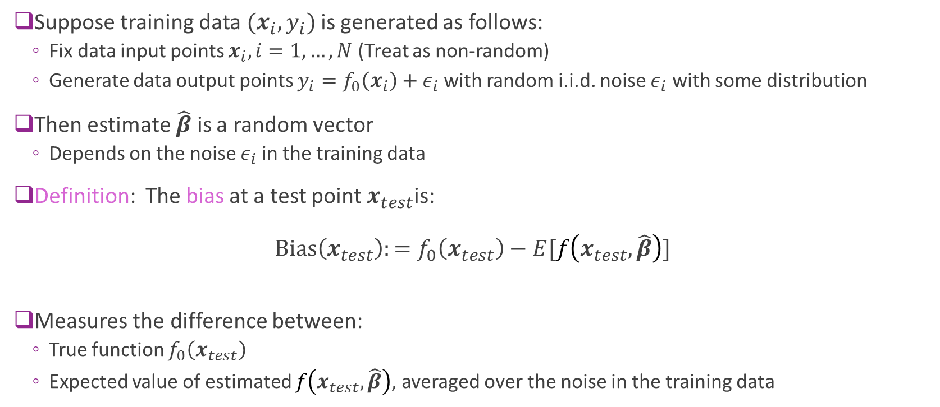
Bias of an Estimator
Suppose training data $(x_{i},y_{i})$ is generated as follows:
Fix data input points $x_{i}, i=1,…,N$ (Treat as non-random)
Generate data output points $y_{i}=f_{0}\left(x_{i}\right)+ε_{i}$ with random i.i.d. noise $ε_{i}$ with some distribution
Then estimate $\hat{β}$ is a random vector
Depends on the noise $ε_{i}$in the training data
Definition: The bias at a test point$x_{test}$is: $\text{Bias}\left(x_{test}\right):=f_{0}\left(x_{test}\right)−E[f\left(x_{test},\hat{β}\right)]$
Measures the difference between:
True function $f_{0}\left(x_{test}\right)$
Expected value of estimated $f\left(x_{test},\hat{β}\right)$, averaged over the noise in the training data

Slide 21
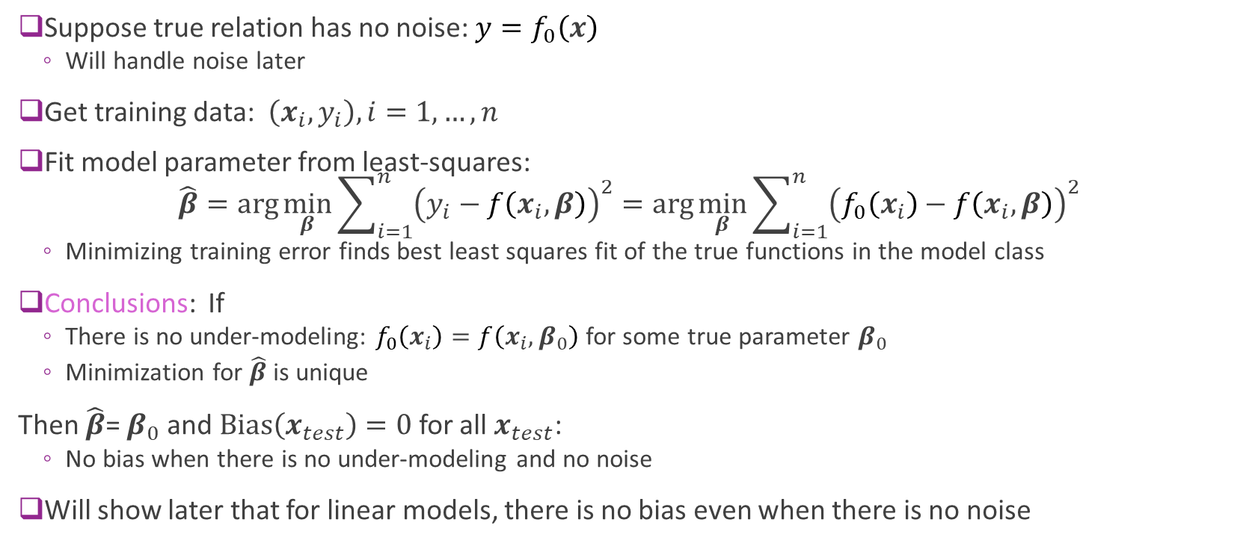
Bias: Noise-Free Case
Suppose true relation has no noise: $y=f_{0}\left(x\right)$
Will handle noise later
Get training data: $\left(x_{i},y_{i}\right), i=1,…,n$
Fit model parameter from least-squares: $\hat{β}=\arg{\min_{β}{\sum_{i=1}^{n}{{\left(y_{i}−f\left(x_{i},β\right)\right)}^{2}}}}=\arg{\min_{β}{\sum_{i=1}^{n}{{\left(f_{0}\left(x_{i}\right)−f\left(x_{i},β\right)\right)}^{2}}}}$
Minimizing training error finds best least squares fit of the true functions in the model class
Conclusions: If
There is no under-modeling: $f_{0}\left(x_{i}\right)=f\left(x_{i},β_{0}\right)$ for some true parameter $β_{0}$
Minimization for $\hat{β}$ is unique
Then $\hat{β}$= $β_{0}$ and $\text{Bias}\left(x_{test}\right)=0$for all $x_{test}$:
No bias when there is no under-modeling and no noise
Will show later that for linear models, there is no bias even when there is no noise

Slide 22
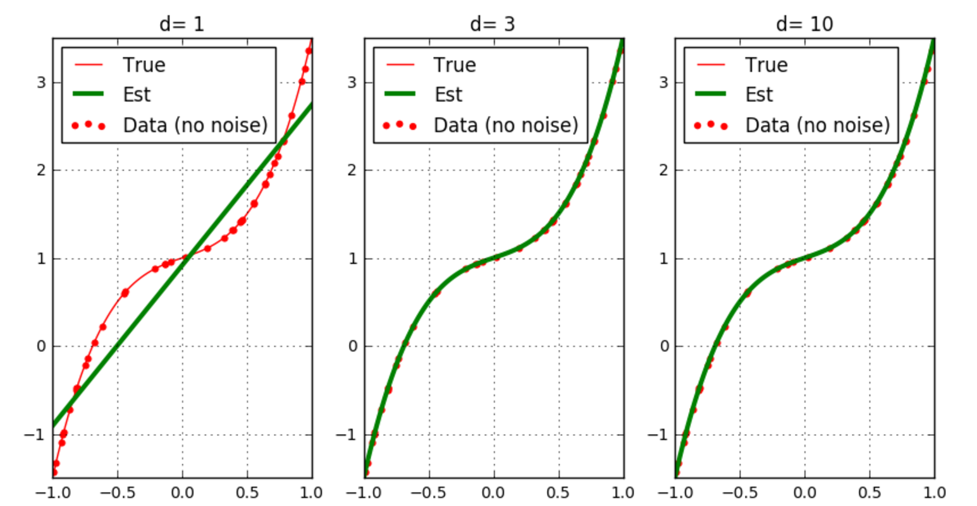
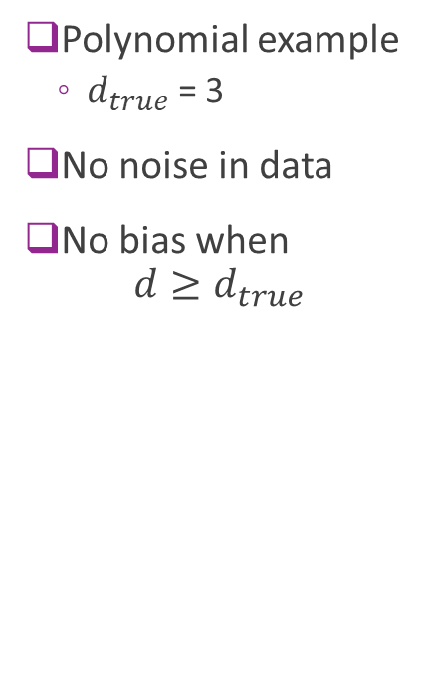
Bias Visualized
Polynomial example
$d_{true}$ = 3
No noise in data
No bias when $d≥d_{true}$
Bias(x)
Model has bias
No bias
No bias

Slide 23
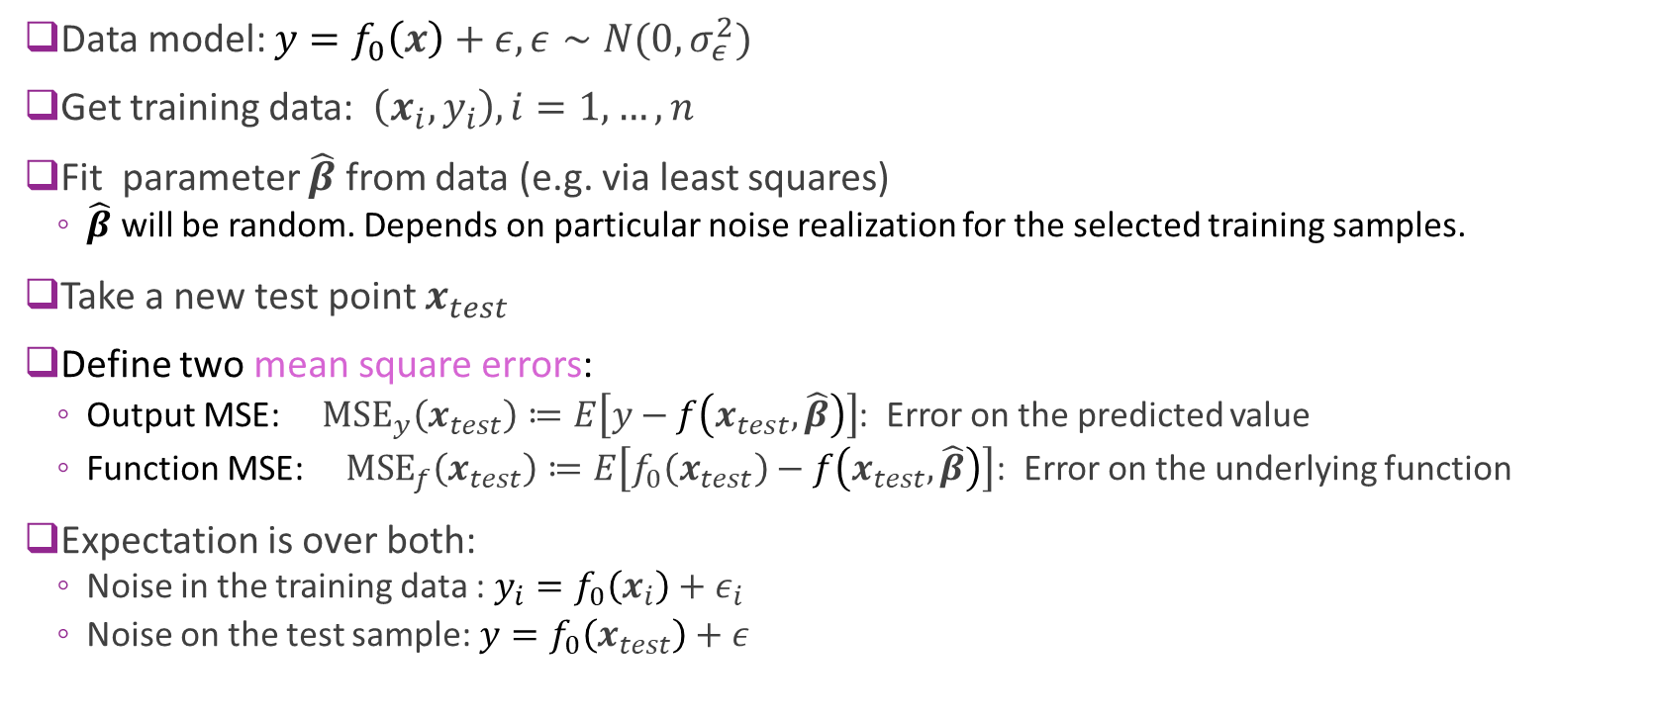
MSE of an Estimator
Data model: ${y=f}_{0}\left(x\right)+ε,ε∼N(0,σ_{ε}^{2})$
Get training data: $\left(x_{i},y_{i}\right), i=1,…,n$
Fit parameter $\hat{β}$ from data (e.g. via least squares)
$\hat{β}$ will be random. Depends on particular noise realization for the selected training samples.
Take a new test point $x_{test}$
Define two mean square errors:
Output MSE: ${\text{MSE}}_{y}\left(x_{test}\right)≔E\left[y−f\left(x_{test},\hat{β}\right)\right]$: Error on the predicted value
Function MSE: ${\text{MSE}}_{f}\left(x_{test}\right)≔E\left[f_{0}\left(x_{test}\right)−f\left(x_{test},\hat{β}\right)\right]$: Error on the underlying function
Expectation is over both:
Noise in the training data : ${y_{i}=f}_{0}\left(x_{i}\right)+ε_{i}$
Noise on the test sample: ${y=f}_{0}\left(x_{test}\right)+ε$

Slide 24
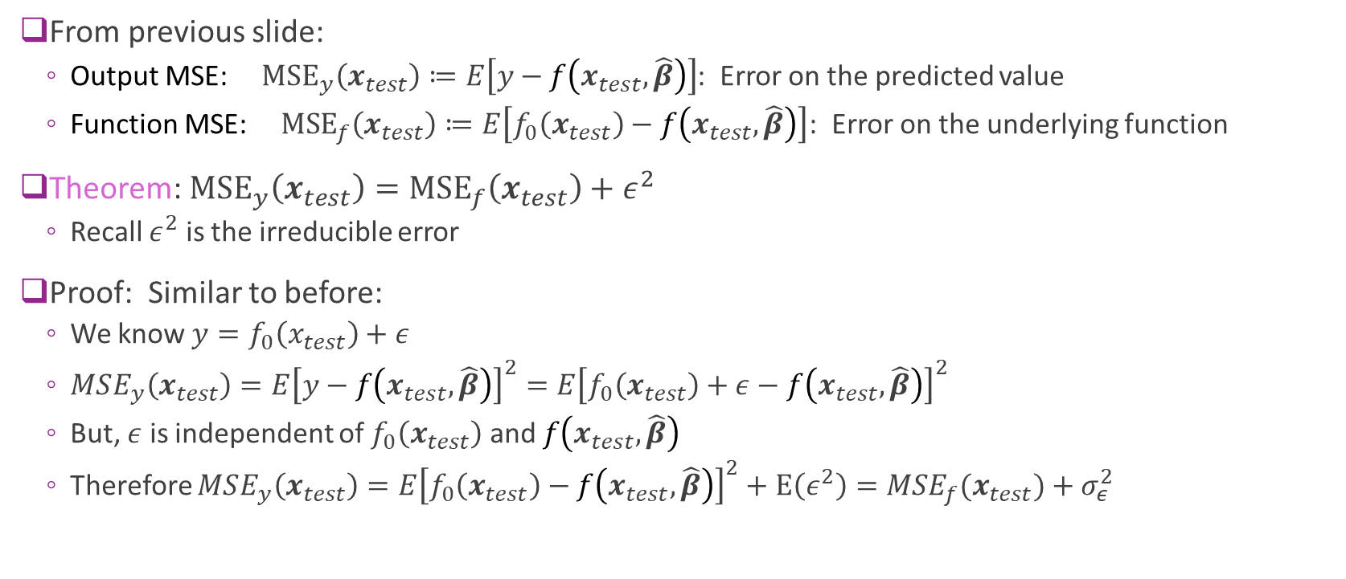
MSE and the and Irreducible Error
From previous slide:
Output MSE: ${\text{MSE}}_{y}\left(x_{test}\right)≔E\left[y−f\left(x_{test},\hat{β}\right)\right]$: Error on the predicted value
Function MSE: ${\text{MSE}}_{f}\left(x_{test}\right)≔E\left[f_{0}\left(x_{test}\right)−f\left(x_{test},\hat{β}\right)\right]$: Error on the underlying function
Theorem: ${\text{MSE}}_{y}\left(x_{test}\right)={\text{MSE}}_{f}\left(x_{test}\right)+ε^{2}$
Recall $ε^{2}$ is the irreducible error
Proof: Similar to before:
We know $y=f_{0}\left(x_{test}\right)+ε$
$MSE_{y}\left(x_{test}\right)=E{\left[y−f\left(x_{test},\hat{β}\right)\right]}^{2}=E{\left[f_{0}\left(x_{test}\right)+ε−f\left(x_{test},\hat{β}\right)\right]}^{2}$
But, $ε$ is independent of $f_{0}\left(x_{test}\right)$ and $f\left(x_{test},\hat{β}\right)$
Therefore $MSE_{y}\left(x_{test}\right)=E{\left[f_{0}\left(x_{test}\right)−f\left(x_{test},\hat{β}\right)\right]}^{2}+E\left(ε^{2}\right)={MSE}_{f}(x_{test})+σ_{ε}^{2}$

Slide 25
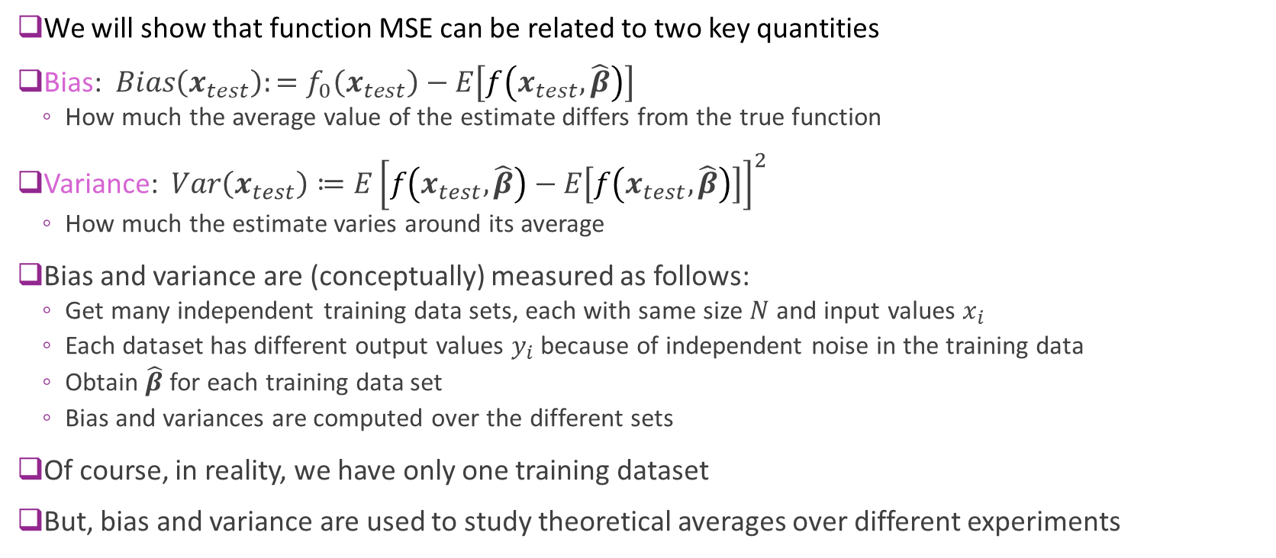
Bias and Variance
We will show that function MSE can be related to two key quantities
Bias: $Bias\left(x_{test}\right):=f_{0}\left(x_{test}\right)−E\left[f\left(x_{test},\hat{β}\right)\right]$
How much the average value of the estimate differs from the true function
Variance: $Var\left(x_{test}\right)≔E{\left[f\left(x_{test},\hat{β}\right)−E\left[f\left(x_{test},\hat{β}\right)\right]\right]}^{2}$
How much the estimate varies around its average
Bias and variance are (conceptually) measured as follows:
Get many independent training data sets, each with same size $N$ and input values $x_{i}$
Each dataset has different output values $y_{i}$ because of independent noise in the training data
Obtain $\hat{β}$ for each training data set
Bias and variances are computed over the different sets
Of course, in reality, we have only one training dataset
But, bias and variance are used to study theoretical averages over different experiments

Slide 26
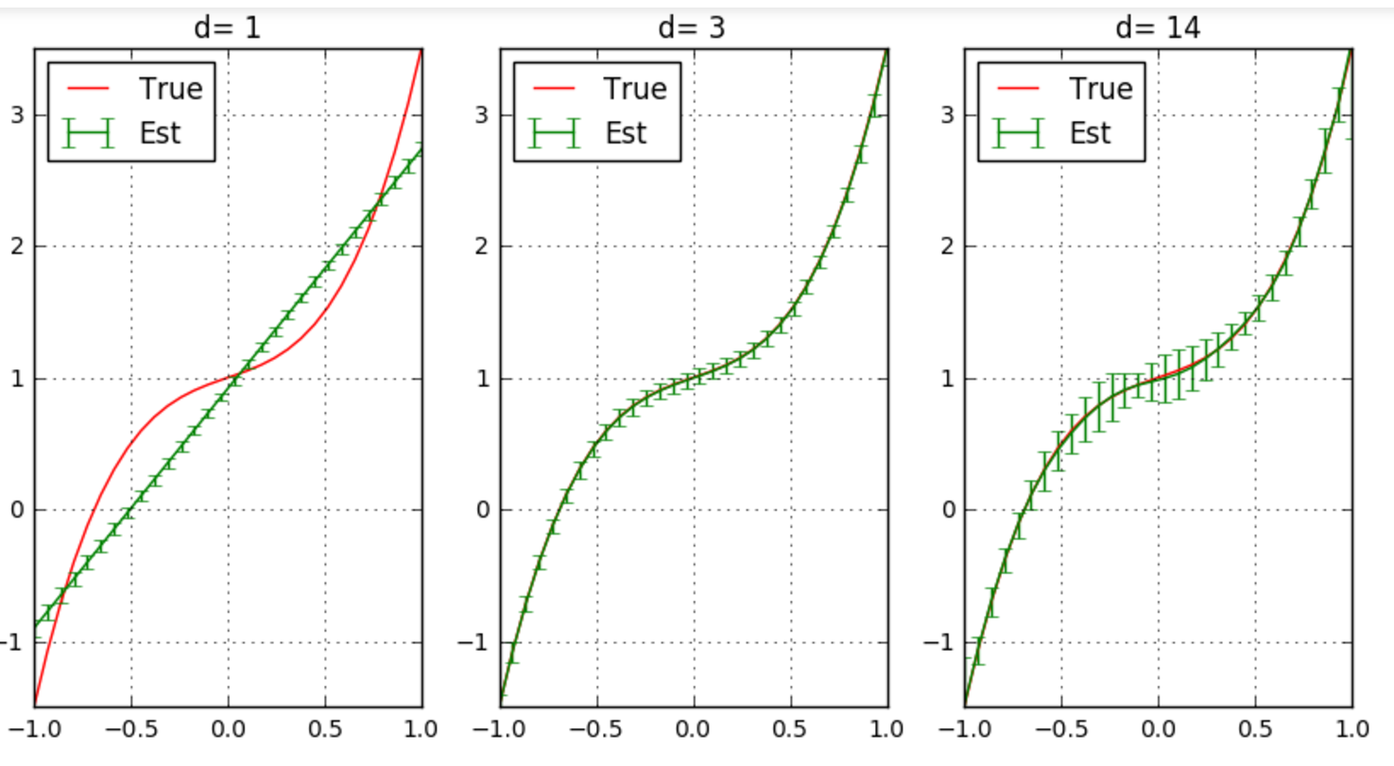
Bias and Variance Illustrated
Polynomial ex
Mean and std dev of estimated functions
100 trials
Solid line: mean estimate among all trials
Error bars: 1 STD
Low variance, High bias
High variance, Zero bias

Slide 27
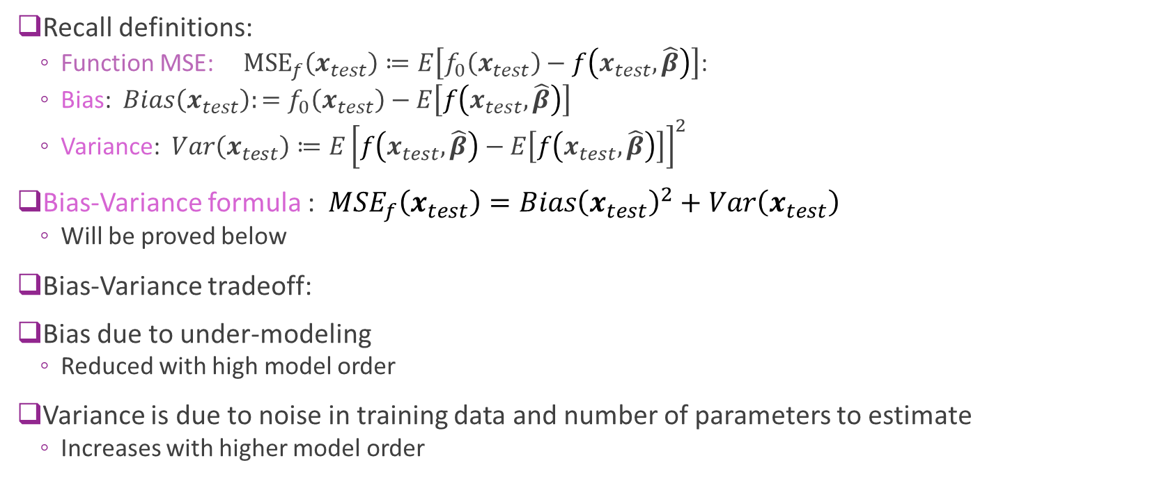
Bias-Variance Formula
Recall definitions:
Function MSE: ${\text{MSE}}_{f}\left(x_{test}\right)≔E\left[f_{0}\left(x_{test}\right)−f\left(x_{test},\hat{β}\right)\right]$:
Bias: $Bias\left(x_{test}\right):=f_{0}\left(x_{test}\right)−E\left[f\left(x_{test},\hat{β}\right)\right]$
Variance: $Var\left(x_{test}\right)≔E{\left[f\left(x_{test},\hat{β}\right)−E\left[f\left(x_{test},\hat{β}\right)\right]\right]}^{2}$
Bias-Variance formula : $MSE_{f}\left(x_{test}\right)={Bias\left(x_{test}\right)}^{2}+Var\left(x_{test}\right)$
Will be proved below
Bias-Variance tradeoff:
Bias due to under-modeling
Reduced with high model order
Variance is due to noise in training data and number of parameters to estimate
Increases with higher model order

Slide 28
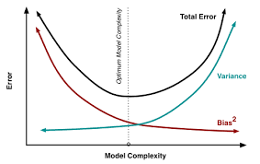
Bias-Variance Tradeoff
Bias:
Due to under-modeling
Reduced with high model order
Variance:
Increases with noise in training data
Increase with high model order
Optimal model order depends on:
Amount of samples available
Underlying complexity of the relation
Floor is the noise variance
Simpler models
Less parameters
Under-fitting
Richer models
More parameters
Over-fitting

Slide 29
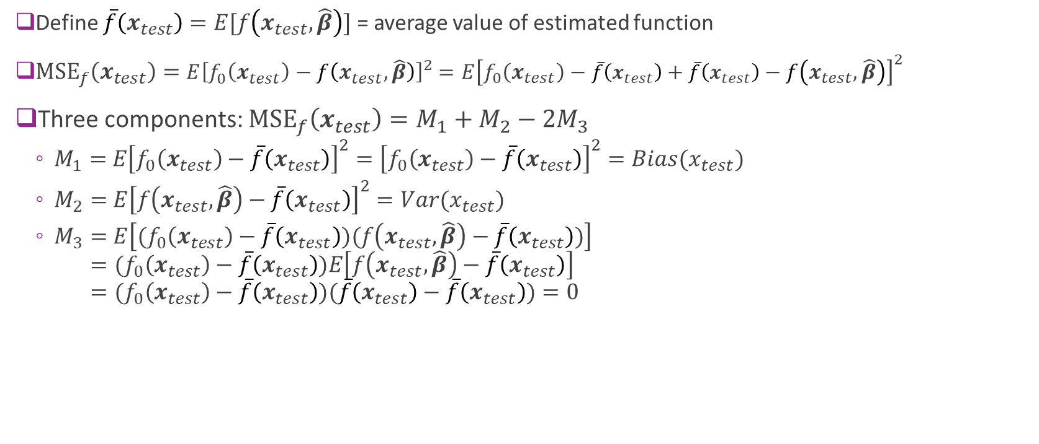
Bias-Variance Formula Proof
Define $\overline{f}\left(x_{test}\right)=E[f\left(x_{test},\hat{β}\right)]$ = average value of estimated function
${\text{MSE}}_{f}\left(x_{test}\right)=E{\left[f_{0}\left(x_{test}\right)−f\left(x_{test},\hat{β}\right)\right]}^{2}$ $=E{\left[f_{0}\left(x_{test}\right)−\overline{f}\left(x_{test}\right)+\overline{f}\left(x_{test}\right)−f\left(x_{test},\hat{β}\right)\right]}^{2}$
Three components: ${\text{MSE}}_{f}\left(x_{test}\right)=M_{1}+M_{2}−{2M}_{3}$
$M_{1}=$ $E{\left[f_{0}\left(x_{test}\right)−\overline{f}\left(x_{test}\right)\right]}^{2}={\left[f_{0}\left(x_{test}\right)−\overline{f}\left(x_{test}\right)\right]}^{2}=Bias(x_{test})$
$M_{2}=$ $E{\left[f\left(x_{test},\hat{β}\right)−\overline{f}\left(x_{test}\right)\right]}^{2}=Var(x_{test})$
$M_{3}=$ $E\left[{(f}_{0}\left(x_{test}\right)−\overline{f}\left(x_{test}\right))(f\left(x_{test},\hat{β}\right)−\overline{f}\left(x_{test}\right))\right]$ $={(f}_{0}\left(x_{test}\right)−\overline{f}\left(x_{test}\right))E\left[f\left(x_{test},\hat{β}\right)−\overline{f}\left(x_{test}\right)\right]$ $={(f}_{0}\left(x_{test}\right)−\overline{f}\left(x_{test}\right))(\overline{f}\left(x_{test}\right)−$ $\overline{f}\left(x_{test}\right))=0$

Slide 30
Outline
Motivating Example: What polynomial degree should a model use?
Bias and variance
Bias and variance for linear models (Advanced)
Cross-validation
Feature selection

Slide 31
This Section is Advanced
This section requires more advanced probability and linear algebra
Means and variances of random vectors
Undergraduates: Skip to final slide for final conclusions
Graduate students: We will cover this
You should review your multi-variable probability and linear algebra

Slide 32
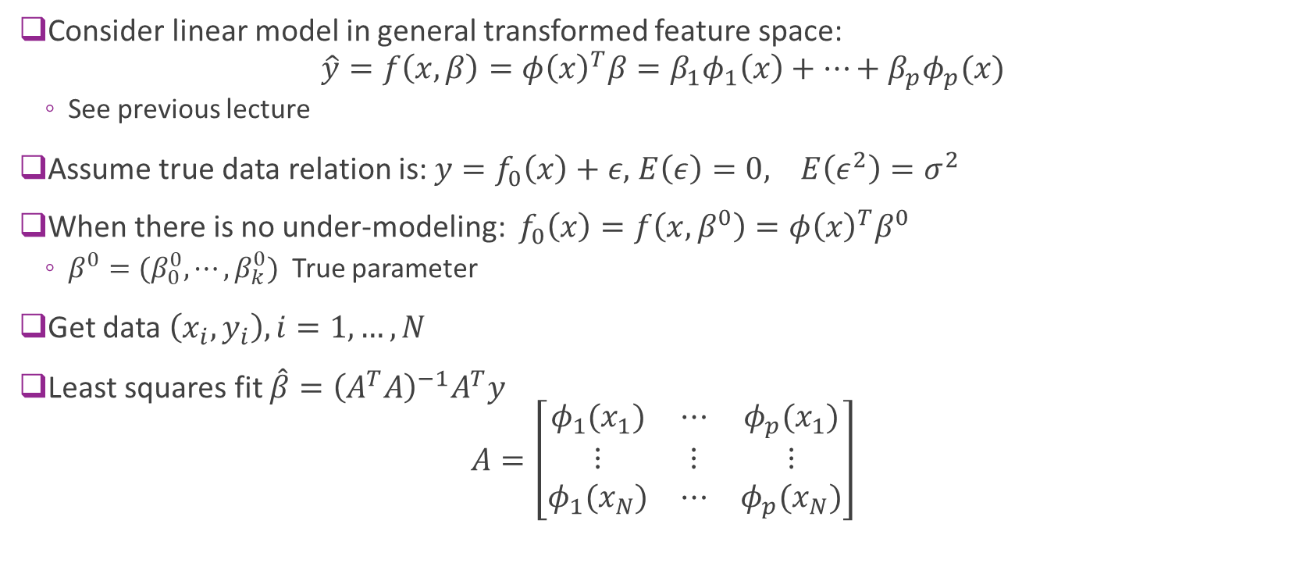
Linear Models
Consider linear model in general transformed feature space: $\hat{y}=f\left(x,β\right)=φ{\left(x\right)}^{T}β=β_{1}φ_{1}\left(x\right)+⋯+β_{p}φ_{p}(x)$
See previous lecture
Assume true data relation is: $y=f_{0}\left(x\right)+ε,$ $E\left(ε\right)=0, E\left(ε^{2}\right)=σ^{2}$
When there is no under-modeling: $f_{0}\left(x\right)=f\left(x,β^{0}\right)=φ{\left(x\right)}^{T}β^{0}$
$β^{0}=(β_{0}^{0},⋯,β_{k}^{0})$ True parameter
Get data $\left(x_{i},y_{i}\right), i=1,…, N$
Least squares fit $\hat{β}={\left(A^{T}A\right)}^{−1}A^{T}y$ $A=\left[\begin{matrix}φ_{1}(x_{1}) & ⋯ & φ_{p}(x_{1}) \\ ⋮ & ⋮ & ⋮ \\ φ_{1}(x_{N}) & ⋯ & φ_{p}(x_{N})\end{matrix}\right]$

Slide 33
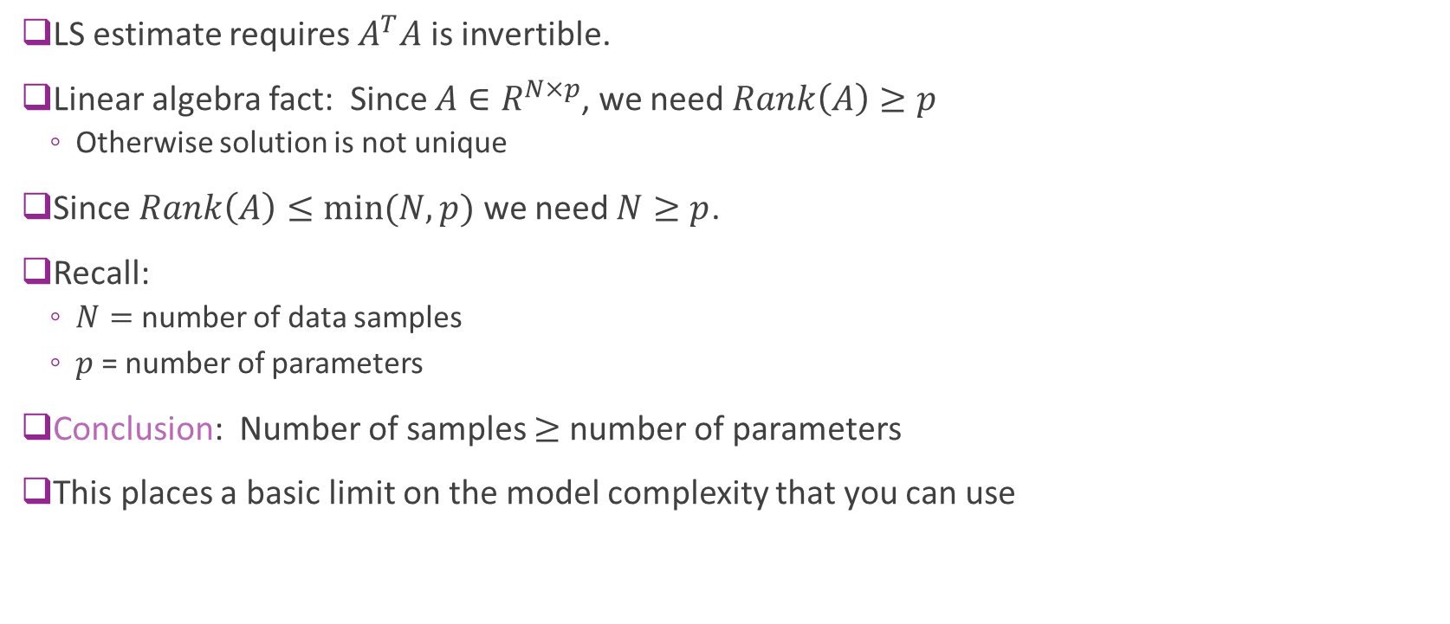
Minimum Number of Samples
LS estimate requires $A^{T}A$ is invertible.
Linear algebra fact: Since $A∈R^{N×p}$, we need $Rank\left(A\right)≥p$
Otherwise solution is not unique
Since $Rank\left(A\right)≤\min{(N,p)}$ we need $N≥p$.
Recall:
$N=$ number of data samples
$p$ = number of parameters
Conclusion: Number of samples $≥$ number of parameters
This places a basic limit on the model complexity that you can use

Slide 34
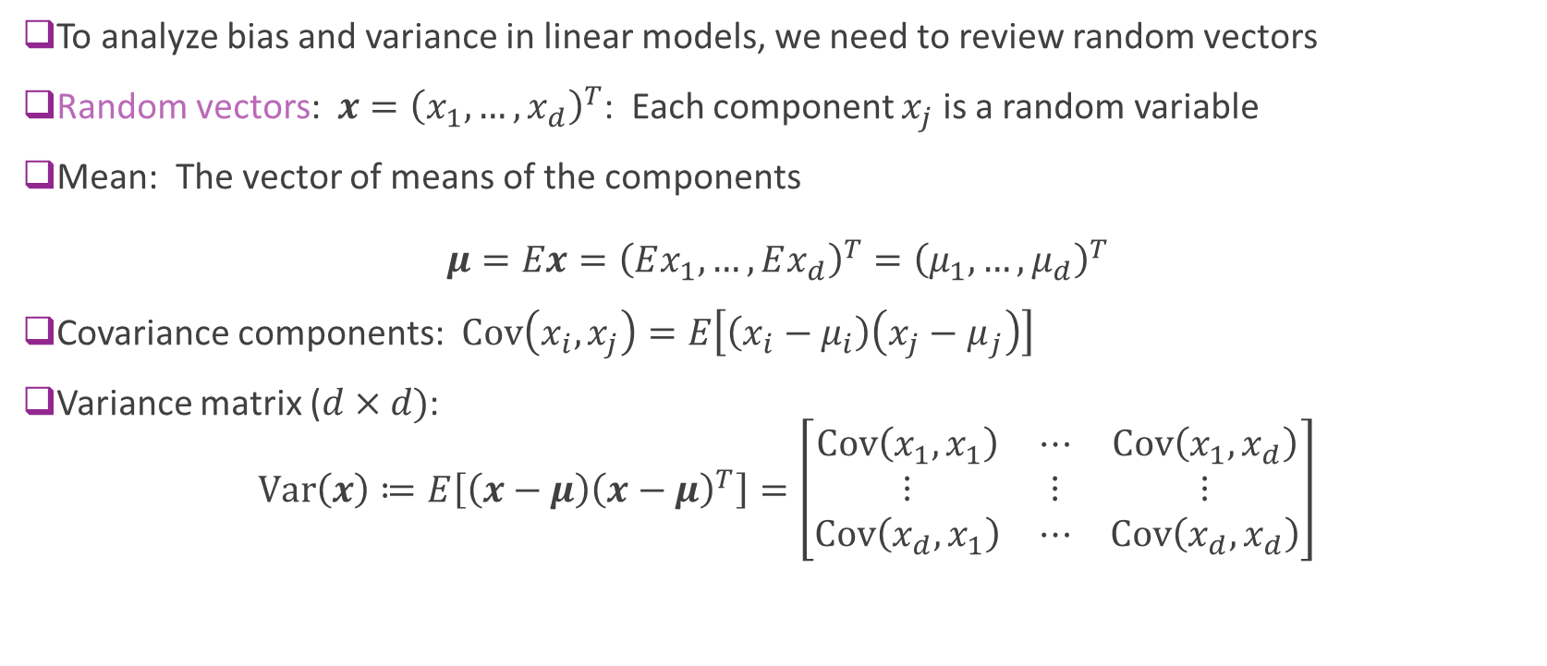
Random Vectors Review
To analyze bias and variance in linear models, we need to review random vectors
Random vectors: $x={\left(x_{1},…,x_{d}\right)}^{T}$: Each component $x_{j}$ is a random variable
Mean: The vector of means of the components $μ=Ex={\left(Ex_{1},…,Ex_{d}\right)}^{T}={\left(μ_{1},…,μ_{d}\right)}^{T}$
Covariance components: $\text{Cov}\left(x_{i},x_{j}\right)=E\left[\left(x_{i}−μ_{i}\right)\left(x_{j}−μ_{j}\right)\right]$
Variance matrix ($d×d)$: $\text{Var}\left(x\right)≔E\left[\left(x−μ\right){\left(x−μ\right)}^{T}\right]=\left[\begin{matrix}\text{Cov}\left(x_{1},x_{1}\right) & ⋯ & \text{Cov}\left(x_{1},x_{d}\right) \\ ⋮ & ⋮ & ⋮ \\ \text{Cov}\left(x_{d},x_{1}\right) & ⋯ & \text{Cov}\left(x_{d},x_{d}\right)\end{matrix}\right]$

Slide 35

Linear Transforms of Random Vectors
A linear transform is a map: $y=Ax+b$
$A∈R^{M×N}$ maps input $x∈R^{N}$ to $Ax∈R^{M}$
Mean and variance matrix under linear map given by
Mean: $E\left(y\right)=AE\left(x\right)+b$
Variance: $Var\left(y\right)=AVar\left(x\right)A^{T}$

Slide 36
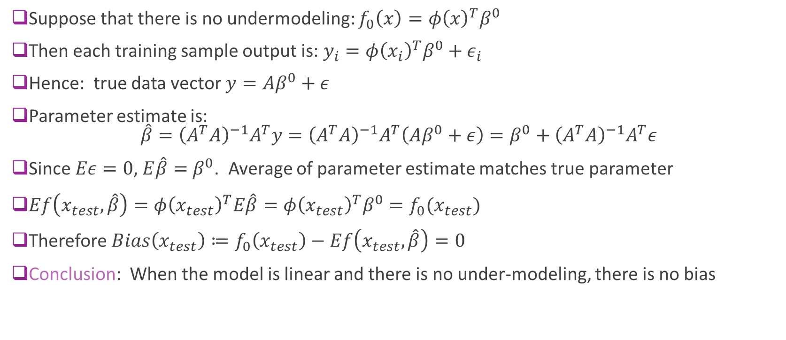
Bias With No Under-Modeling
Suppose that there is no undermodeling: $f_{0}\left(x\right)=φ{\left(x\right)}^{T}β^{0}$
Then each training sample output is: $y_{i}=φ{\left(x_{i}\right)}^{T}β^{0}+ε_{i}$
Hence: true data vector $y=Aβ^{0}+ε$
Parameter estimate is: $\hat{β}={\left(A^{T}A\right)}^{−1}A^{T}y={\left(A^{T}A\right)}^{−1}A^{T}\left(Aβ^{0}+ε\right)=β^{0}+{\left(A^{T}A\right)}^{−1}A^{T}ε$
Since $Eε=0$, $E\hat{β}=$ $β^{0}$. Average of parameter estimate matches true parameter
$Ef\left(x_{test},\hat{β}\right)=φ{\left(x_{test}\right)}^{T}E\hat{β}=φ{\left(x_{test}\right)}^{T}β^{0}=f_{0}(x_{test})$
Therefore $Bias\left(x_{test}\right)≔f_{0}\left(x_{test}\right)−Ef\left(x_{test},\hat{β}\right)=0$
Conclusion: When the model is linear and there is no under-modeling, there is no bias

Slide 37
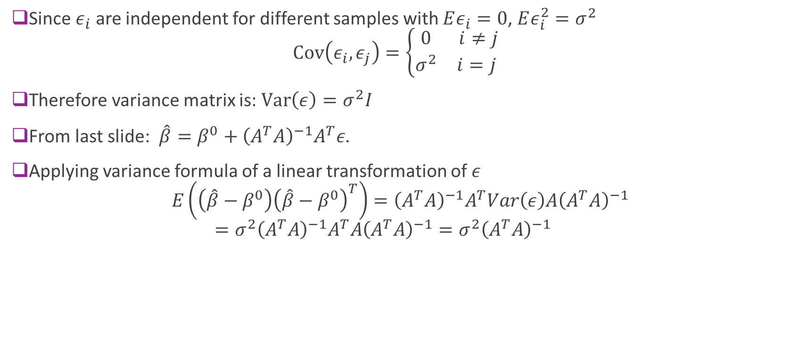
Variance of the Parameters in Linear Models
Since $ε_{i}$ are independent for different samples with $Eε_{i}=0$, $Eε_{i}^{2}=σ^{2}$ $\text{Cov}\left(ε_{i},ε_{j}\right)=\left\{\begin{matrix}0 & i≠j \\ σ^{2} & i=j \end{matrix}\right.$
Therefore variance matrix is: $\text{Var}\left(ε\right)=σ^{2}I$
From last slide: $\hat{β}=β^{0}+{\left(A^{T}A\right)}^{−1}A^{T}ε$.
Applying variance formula of a linear transformation of $ε$ $E\left(\left(\hat{β}−β^{0}\right){\left(\hat{β}−β^{0}\right)}^{T}\right)={\left(A^{T}A\right)}^{−1}A^{T}Var\left(ε\right)A{\left(A^{T}A\right)}^{−1}$ $=σ^{2}{\left(A^{T}A\right)}^{−1}A^{T}A{\left(A^{T}A\right)}^{−1}={σ^{2}\left(A^{T}A\right)}^{−1}$

Slide 38
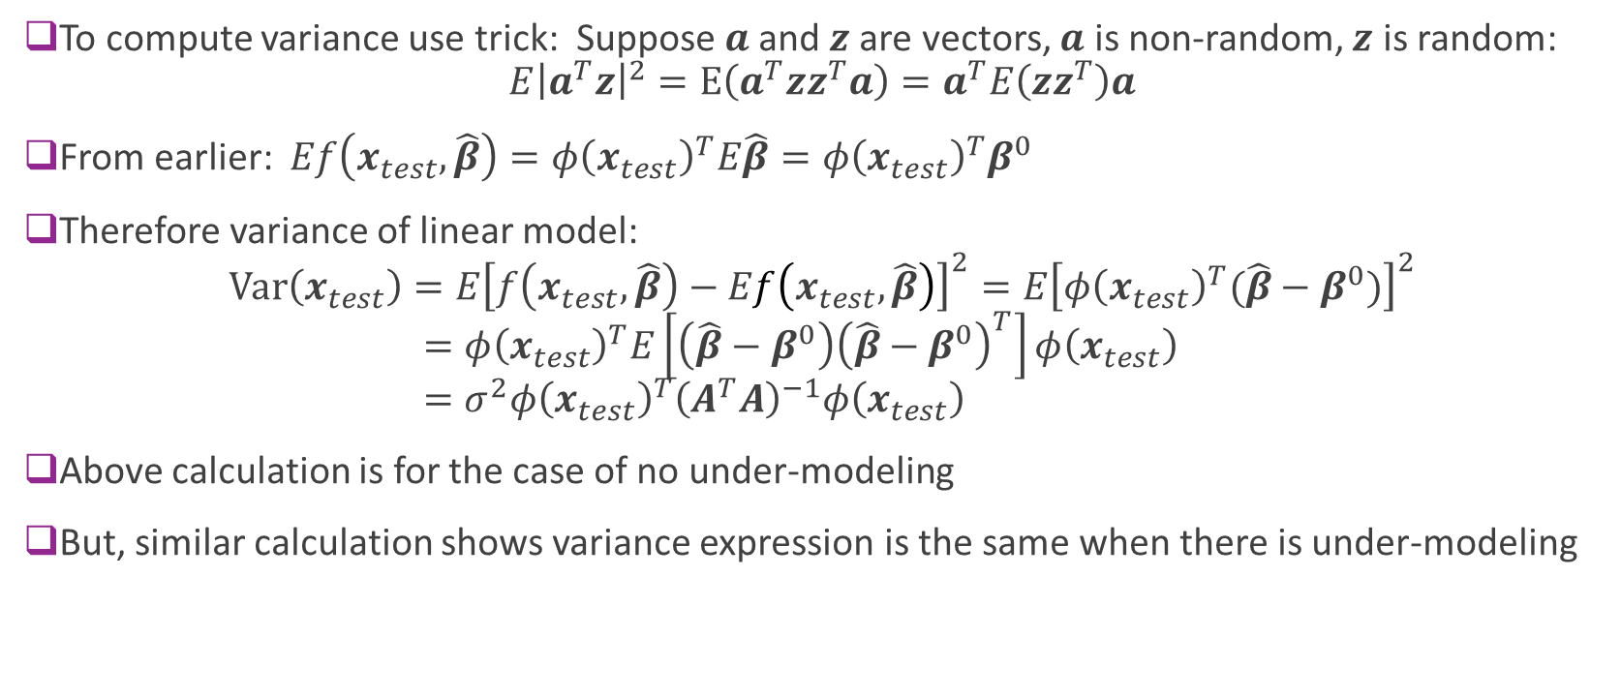
Variance in Linear Estimate
To compute variance use trick: Suppose $a$and $z$are vectors, $a$ is non-random, $z$ is random: $E{\left|a^{T}z\right|}^{2}=E\left(a^{T}zz^{T}a\right)=a^{T}E\left(zz^{T}\right)a$
From earlier: $Ef\left(x_{test},\hat{β}\right)=φ{\left(x_{test}\right)}^{T}E\hat{β}=φ{\left(x_{test}\right)}^{T}β^{0}$
Therefore variance of linear model: $Var\left(x_{test}\right)=E{\left[f\left(x_{test},\hat{β}\right)−Ef\left(x_{test},\hat{β}\right)\right]}^{2}=E{\left[φ{\left(x_{test}\right)}^{T}(\hat{β}−β^{0})\right]}^{2}$ $=φ{\left(x_{test}\right)}^{T}E\left[\left(\hat{β}−β^{0}\right){\left(\hat{β}−β^{0}\right)}^{T}\right]φ\left(x_{test}\right)$ $=σ^{2}φ{\left(x_{test}\right)}^{T}{\left(A^{T}A\right)}^{−1}φ\left(x_{test}\right)$
Above calculation is for the case of no under-modeling
But, similar calculation shows variance expression is the same when there is under-modeling

Slide 39
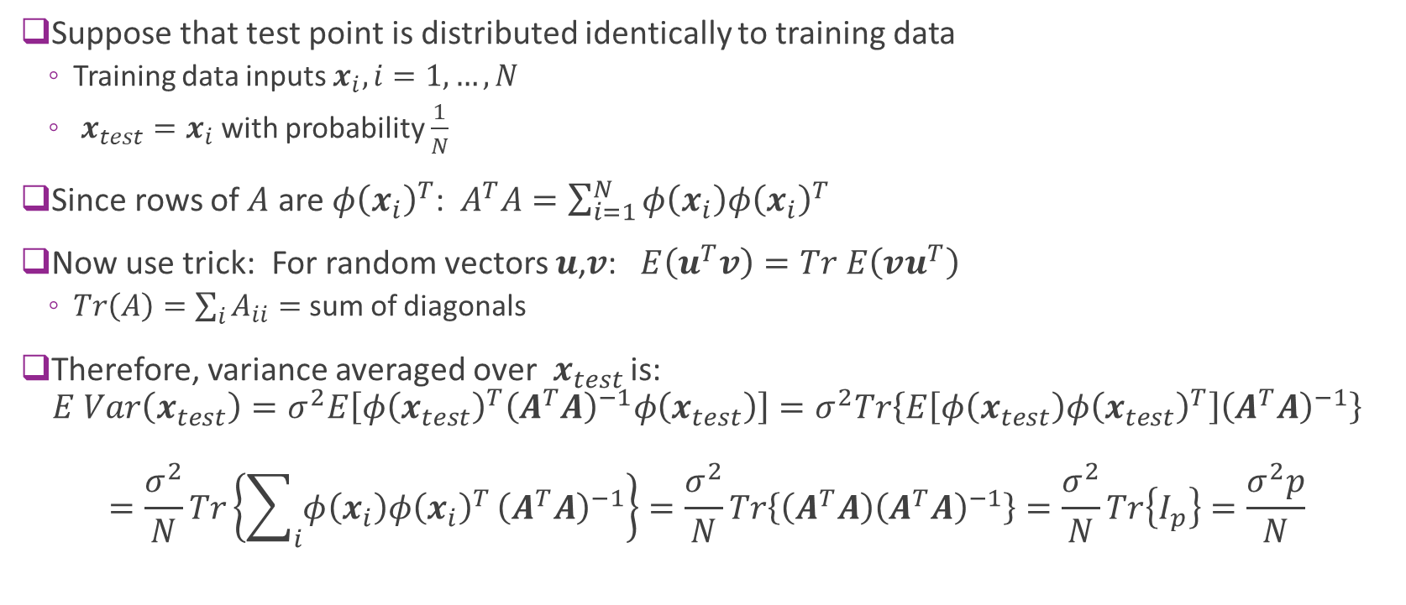
Case with Equal Test & Training Distributions
Suppose that test point is distributed identically to training data
Training data inputs $x_{i},i=1,…,N$
$x_{test}=x_{i}$ with probability $\frac{1}{N}$
Since rows of $A$ are $φ{\left(x_{i}\right)}^{T}$: $A^{T}A=\sum_{i=1}^{N}{φ\left(x_{i}\right)φ{\left(x_{i}\right)}^{T}}$
Now use trick: For random vectors $u$,$v$: $E\left(u^{T}v\right)=Tr E\left(vu^{T}\right)$
$Tr\left(A\right)=\sum_{i}{A_{ii}}=$ sum of diagonals
Therefore, variance averaged over $x_{test}$ is: $E Var\left(x_{test}\right)=σ^{2}E\left[φ{\left(x_{test}\right)}^{T}{\left(A^{T}A\right)}^{−1}φ\left(x_{test}\right)\right]=σ^{2}Tr\left\{E\left[φ\left(x_{test}\right)φ{\left(x_{test}\right)}^{T}\right]{\left(A^{T}A\right)}^{−1}\right\}$ $=\frac{σ^{2}}{N}Tr\left\{\sum_{i}{φ\left(x_{i}\right)φ{\left(x_{i}\right)}^{T}}{\left(A^{T}A\right)}^{−1}\right\}=\frac{σ^{2}}{N}Tr\left\{\left(A^{T}A\right){\left(A^{T}A\right)}^{−1}\right\}=\frac{σ^{2}}{N}Tr\left\{I_{p}\right\}=\frac{σ^{2}p}{N}$

Slide 40
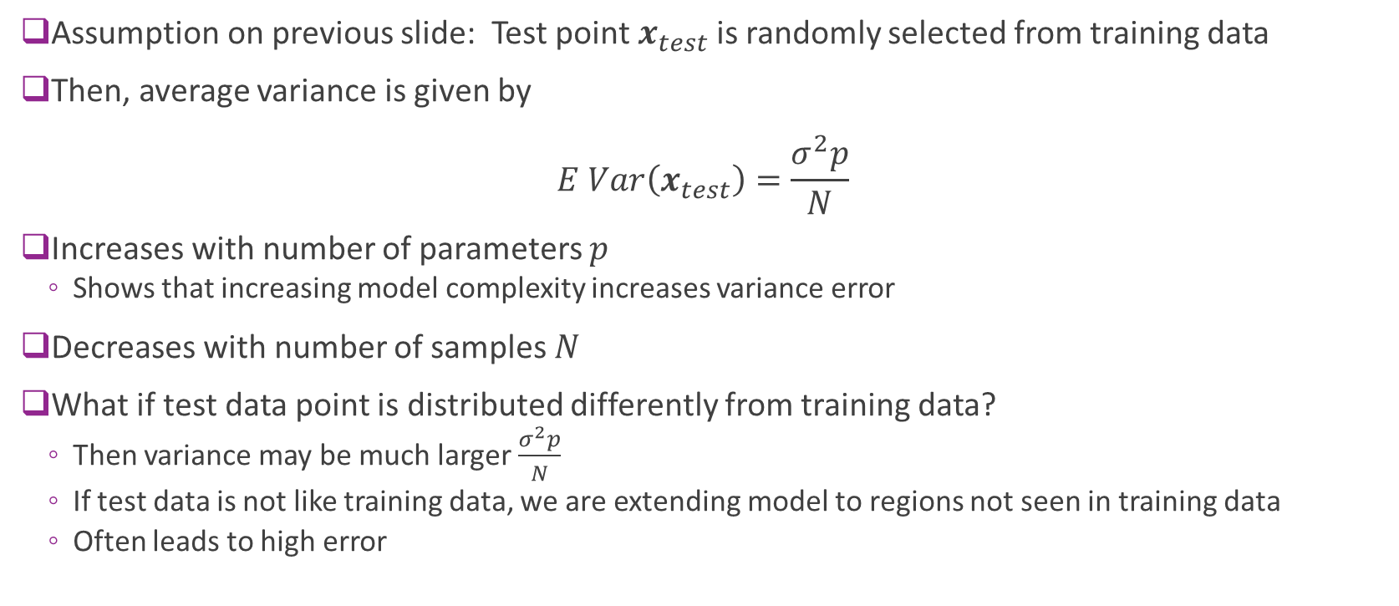
Case with Equal Test & Training Distributions
Assumption on previous slide: Test point $x_{test}$ is randomly selected from training data
Then, average variance is given by $E Var\left(x_{test}\right)=\frac{σ^{2}p}{N}$
Increases with number of parameters $p$
Shows that increasing model complexity increases variance error
Decreases with number of samples $N$
What if test data point is distributed differently from training data?
Then variance may be much larger $\frac{σ^{2}p}{N}$
If test data is not like training data, we are extending model to regions not seen in training data
Often leads to high error

Slide 41
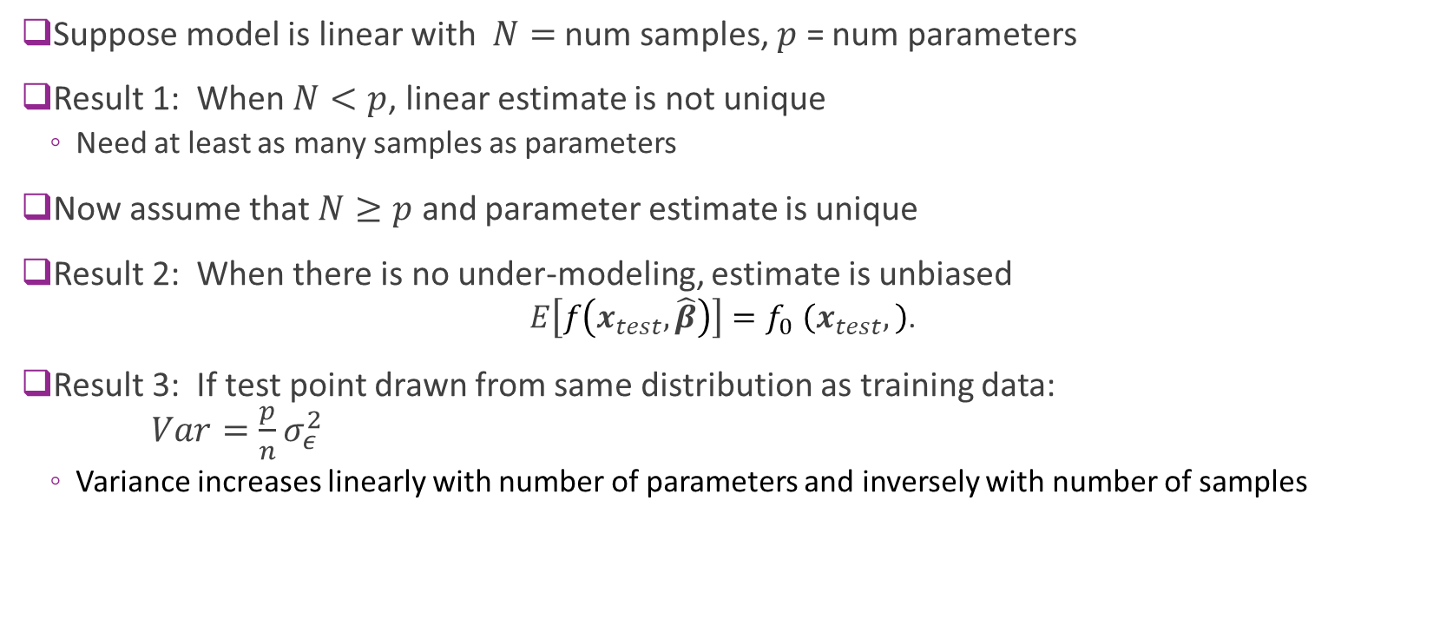
Summary of Results for Linear Models
Suppose model is linear with $N=$ num samples, $p$ = num parameters
Result 1: When $N<p$, linear estimate is not unique
Need at least as many samples as parameters
Now assume that $N≥p$ and parameter estimate is unique
Result 2: When there is no under-modeling, estimate is unbiased
$$E\left[f\left(x_{test},\hat{β}\right)\right]{=f}_{0}\left(x_{test},\right)\text{.}$$
Result 3: If test point drawn from same distribution as training data: $Var=\frac{p}{n}σ_{ε}^{2}$
Variance increases linearly with number of parameters and inversely with number of samples

Slide 42
Outline
Motivating Example: What polynomial degree should a model use?
Bias and variance
Bias and variance for linear models (Advanced)
Cross-validation
Feature selection

Slide 43
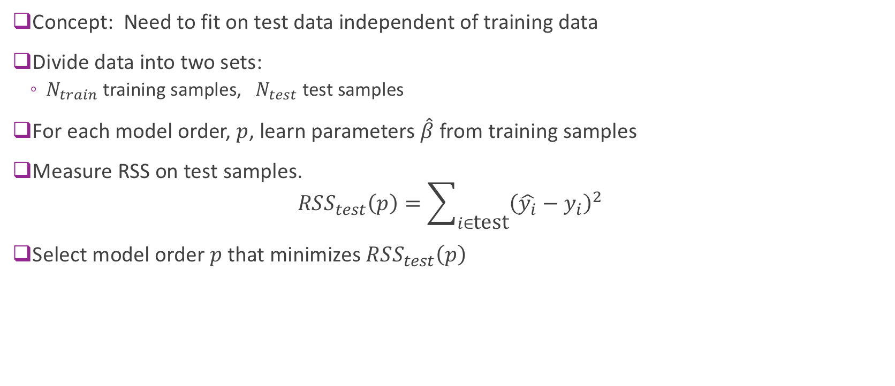
Cross Validation
Concept: Need to fit on test data independent of training data
Divide data into two sets:
$N_{train}$ training samples, $N_{test}$ test samples
For each model order, $p$, learn parameters $\hat{β}$ from training samples
Measure RSS on test samples. $RSS_{test}\left(p\right)=\sum_{i∈\text{test}}{{\left(\hat{y_{i}}−y_{i}\right)}^{2}}$
Select model order $p$ that minimizes $RSS_{test}\left(p\right)$

Slide 44
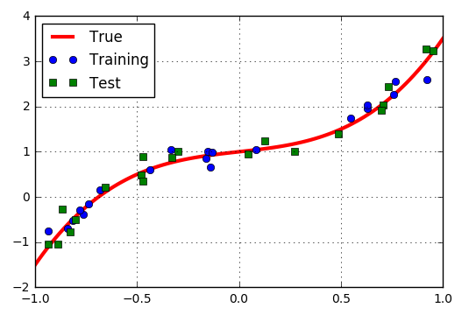
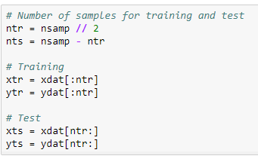
Polynomial Example: Training Test Split
Example: Split data into 20 samples for training, 20 for test

Slide 45
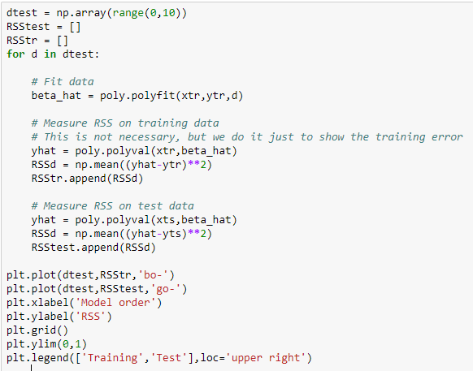
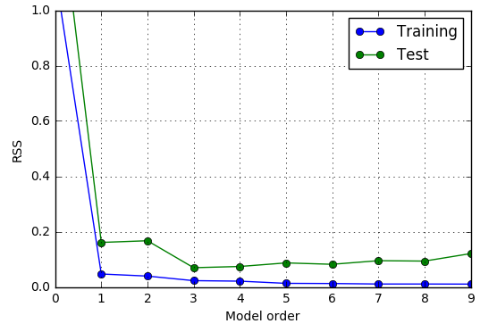
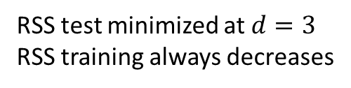
Finding the Model Order
Estimated optimal model order = 3
RSS test minimized at $d=3$
RSS training always decreases

Slide 46

General Procedure
Get data $X,y$
Split into training $X_{tr},y_{tr}$ and test $X_{ts},y_{ts}$
For $p=1 \text{to} p_{max}$ // Loop over model order
Fit on training data with model order $p$: $\hat{β}=fit(X_{tr},y_{tr},p)$
Predict values on test data: ${\hat{y}}_{ts}=predict(X_{ts},\hat{β})$
Score fit on test data: $S[p]=score(y_{ts},{\hat{y}}_{ts})$
Select model order with smallest score: $\hat{p}=\arg{\min_{p}{S[p]}}$

Slide 47
Problems with Simple Train/Test Split
Test error could vary significantly depending on samples selected
Only use limited number of samples for training
Problems particularly bad for data with limited number of samples

Slide 48


K-Fold Cross Validation
$K$-fold cross validation
Divide data into $K$ parts
Use $K−1$ parts for training. Use remaining for test.
Average over the $K$ test choices
More accurate, but requires $K$ fits of parameters
Typical choice: K=5 or 10
Average MSE over K folds estimates the total MSE
(=Bias^2+Variance+irreducible error)
Leave one out cross validation (LOOCV)
Take $K = N$so one sample is left out.
Most accurate, but requires N model fittings
Necessary when N is small.
From http://blog.goldenhelix.com/goldenadmin/cross-validation-for-genomic-prediction-in-svs/

Slide 49

K-Fold Pseudo-Code
Get data $X,y$
For $i=1 \text{to} K$ // Loop over folds
Split into training $X_{tr},y_{tr}$ and test $X_{ts},y_{ts}$ for fold $i$
For $p=1 \text{to} p_{max}$ // Loop over model order
Fit on training data with model order $p$: $\hat{β}=fit(X_{tr},y_{tr},p)$
Predict values on test data: ${\hat{y}}_{ts}=predict(X_{ts},\hat{β})$
Score the fit on test data: $S[p,i]=score(y_{ts},{\hat{y}}_{ts})$
Find average score for each model order: $\overline{S}\left[p\right]=\frac{1}{K}\sum_{i=1}^{K}{S[p,i]}$
Select model order with lowest average score: $\hat{p}=\arg{\min_{p}{\overline{S}[p]}}$

Slide 50

Polynomial Example
Use sklearn Kfold object
Loop
Outer loop: Over K folds
Inner loop: Over D model orders
Measure test error in each fold and order
Averaging test errors from K folds for each model order
Find the model order with the minimal average test errors
Can be time-consuming

Slide 51



Polynomial Example CV Results
For each model order d
Compute mean test RSS over K folds
Compute standard error (SE) of test RSS
SE=STD of mean RSS=RSS std/ $\sqrt{K−1}$
(expectation over different realizations
of data in each fold)
Simple model selection
Select d with lowest mean test RSS
For this example
Estimate model order = 3

Slide 52

One Standard Error Rule
Previous slide: Select d to minimize mse_mean[d]
Problem: Often over-predicts model order
One standard deviation rule
Use simplest model within one SE of minimum
Detailed procedure:
Find d0 to minimize mse_mean[d]
Set mse_tgt = mse_mean[d0] + mse_std[d0]
Find minimal dopt s.t. mse_mean[dopt] <= mse_tgt
mse_tgt
Optimal model order

Slide 53

One SE Rule Pseudo-Code
Get data $X,y$
Compute score as before: $S\left[p,i\right]=$ score for model order $p$ on fold $i$
Compute average, std deviation and standard error of the scores:
$\overline{S}\left[p\right]=\frac{1}{K}\sum_{i=1}^{K}{S[p,i]}, σ^{2}\left[p\right]=\frac{1}{K}\sum_{i=1}^{K}{S[p,i]}, SE\left[p\right]=\frac{σ\left[p\right]}{\sqrt{K−1}}$
Find model order via normal rule: ${\hat{p}}_{0}=\arg{\min_{p}{\overline{S}[p]}}$ (lowest average score)
Compute target score: $S_{tgt}=\overline{S}\left[p_{0}\right]+SE[p_{0}]$
One SE rule: Find simplest model with score lower than target: $\hat{p}=\min\left\{p \right|\overline{S}\left[p\right]≤S_{tgt}\}$
Note that one SE rule always produce a model order $≤$ normal rule ($\hat{p}≤$ ${\hat{p}}_{0}$)

Slide 54
Outline
Motivating Example: What polynomial degree should a model use?
Bias and variance
Bias and variance for linear models (Advanced)
Cross-validation
Feature selection

Slide 55

Feature Selection as Model Selection
In many problems, we have a large number of features $x_{1},…,x_{p}$
But only a small number of features are likely relevant
Fit of linear model on all features may be impossible
Too many parameters
Feature selection problem: Select a subset $S⊆\left\{1,…,p\right\}$ of $k≪p$features
Can fit a linear model for each subset $S$ using linear regression
Model order is $k=$ number of features to use
Higher feature number leads to low bias but higher variance!

Slide 56

Exhaustive Search for Feature Selection
Given potential features $x_{1},…,x_{p}$
Problem: Select subset $S$ of features with $\left|S\right|≤k$
Simple exhaustive search:
Divide data into training test
For each subset $\left|S\right|≤k:$
Fit a model with features in $S$
Measure test error $RSS\left(S\right)$
Select subset $S$ with minimum test $RSS\left(S\right)$

Slide 57

Feature Selection based on Correlation
Exhaustive search may be infeasible when the raw feature dimension is large!
There are $\left(\begin{matrix}p \\ k\end{matrix}\right)$ subsets with size $k$
Suboptimal approach:
For each candidate feature order $k≤p,$ choose $k$ features with the highest correlation coefficients with the target
Use cross validation to determine the RSS mean and variance for this subset
Select the feature subset with minimal RSS mean or using the one standard error rule.
Is using correlation with target a good idea?
Two features that are correlated could both be highly correlated with the target
Hence, they may provide redundant information and ideally only one of them should be used.

Slide 58
Greedy Feature Selection
Forward-Stepwise Selection
Select one feature from all features that provides the lowest RSS with cross validation
Select one new feature from all remaining features, so that previously chosen features plus the new feature provides the lowest RSS
Repeat until the maximum feature number is reached, or when the RSS starts to increase
Backward-Stepwise
First use all features and find the RSS (using cross validation)
Remove one feature and find the new RSS. Go through all possible features to remove.
Find the one that leads to the least RSS increase. Remove this feature.
Repeat the above, remove one from the remaining features, to find the next most important feature.
Except exhaustive search, can all lead to suboptimal solution
We will discuss the method of LASSO in the next lecture for feature selection.

Slide 59

Comparison of Feature selection Methods
Figure from [Hastie2008]: Hastie, Tibshirani, Friedman, The elements of statistical learning.
For more on this subject, see Sec. 3.3

Slide 60




Lab: Neural ECoG Data
Record arm motion
Read a monkey’s brain!
Predict hand motion from electrode measurements (number of spikes in each neuron)
Feature selection
Which neuron signals predict arm motion?
Use correlation to select candidate feature subsets
Data from https://crcns.org/
Open source website on neural data
Great for projects
Arm velocity
Velocity y
Velocity x
Spikes
Neuron
Record spikes (ECoG in M1)
Time

