Slide 1
Lecture 7 Non-Linear Optimization
EE-uy 4563/EL-GY 9123: Introduction to machine learning
Prof. Sundeep rangan

Slide 2
Learning Objectives
Identify the objective function, parameters and constraints in an optimization problem
Compute the gradient of a loss function for scalar, vector and matrix parameters
Efficiently compute a gradient in python.
Write the gradient descent update
Describe the effect of the learning rate on convergence
Determine if a loss function is convex

Slide 3
Outline
Motivating example: Build an optimizer for logistic regression
Gradients of multi-variable functions
Gradient descent
Adaptive step size
Convexity

Slide 4
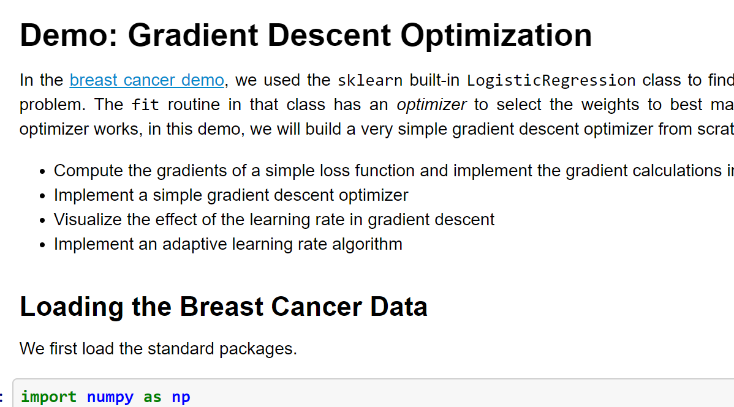
Demo on GitHub
https://github.com/sdrangan/introml/blob/master/optim/grad_descent.ipynb

Slide 5


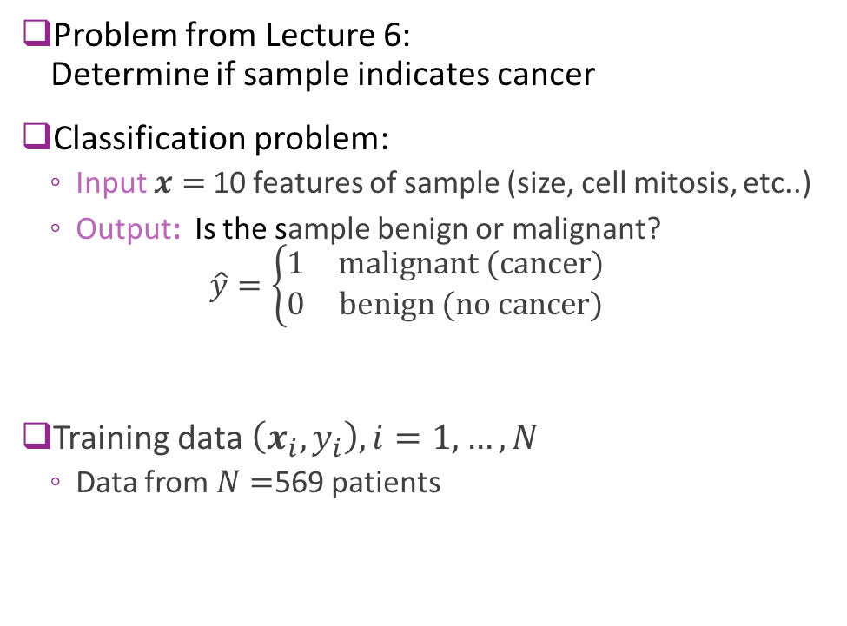
Recap: Breast Cancer Example
Problem from Lecture 6: Determine if sample indicates cancer
Classification problem:
Input $x=$10 features of sample (size, cell mitosis, etc..)
Output: Is the sample benign or malignant? $\hat{y}=\left\{\begin{matrix}1 & \text{malignant}\text{ (}\text{cancer}\text{)} \\ 0 & \text{benign}\text{ (}\text{no} \text{cancer}\text{)}\end{matrix}\right.$
Training data $\left(x_{i},y_{i}\right), i=1,…,N$
Data from $N=$569 patients
Grades of carcinoma cells
http://breast-cancer.ca/5a-types/

Slide 6
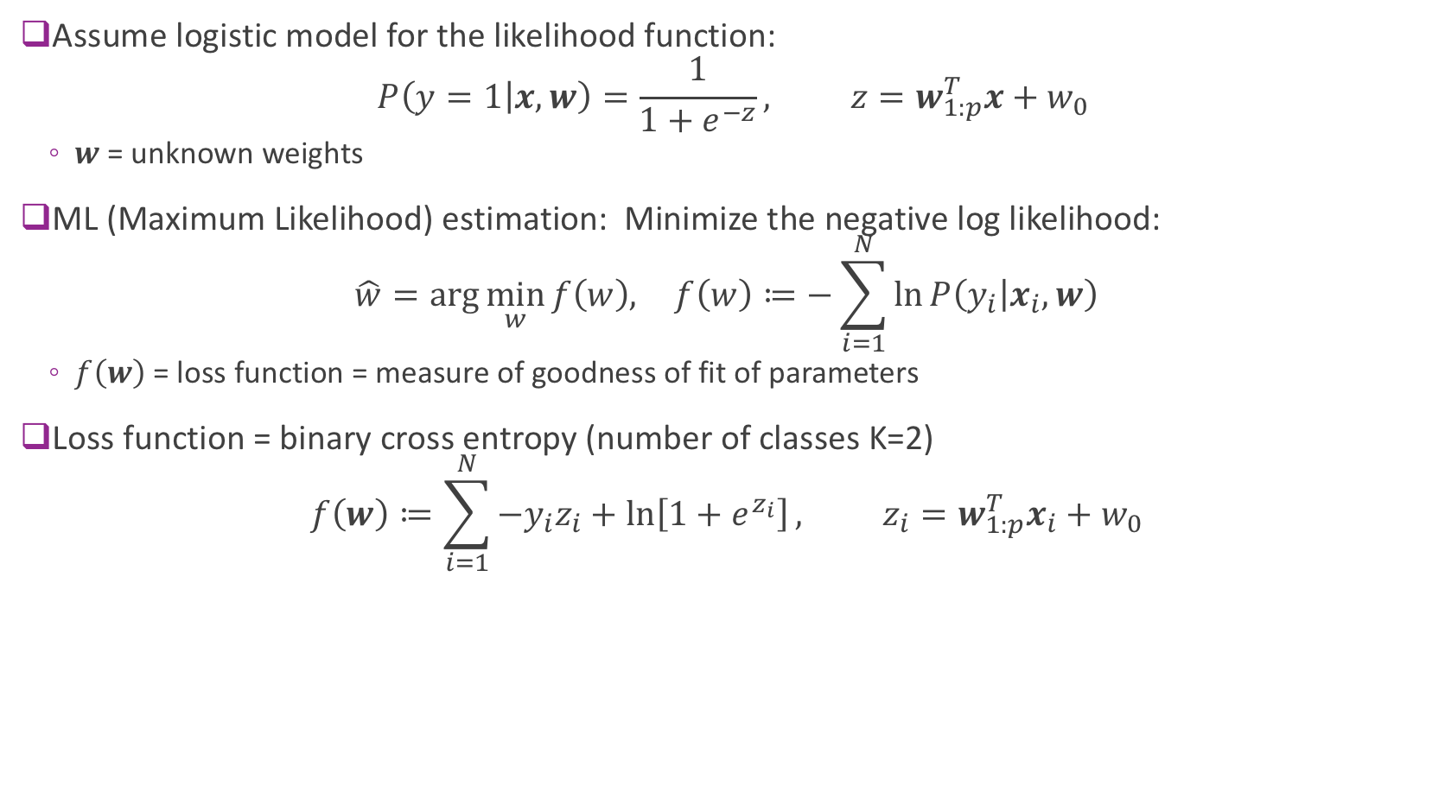
Logistic Regression Maximum Likelihood
Assume logistic model for the likelihood function: $P\left(y=1 | x,w\right)=\frac{1}{1+e^{−z}}, z=w_{1:p}^{T}x+w_{0}$
$w$= unknown weights
ML (Maximum Likelihood) estimation: Minimize the negative log likelihood: $\hat{w}=\arg{\min_{w}{f\left(w\right), }} f\left(w\right)≔−\sum_{i=1}^{N}{\ln{P\left(y_{i} | x_{i},w\right)}}$
$f\left(w\right)$ = loss function = measure of goodness of fit of parameters
Loss function = binary cross entropy (number of classes K=2) $f\left(w\right)≔\sum_{i=1}^{N}{{−y}_{i}z_{i}+\ln\left[1+e^{z_{i}}\right]}, z_{i}=w_{1:p}^{T}x_{i}+w_{0}$

Slide 7
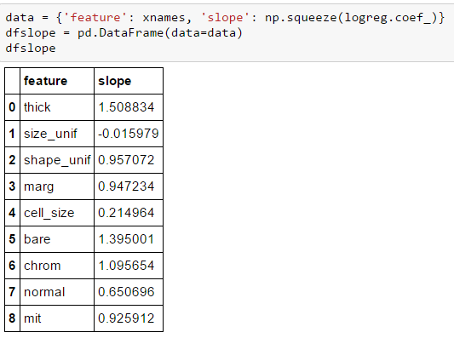


Minimizing the Loss Function
Used sklearn LogisticRegression.fit method
Used built-in optimizer to minimize loss function
Questions:
How does this optimizer work?
How would we build one from scratch

Slide 8
Outline
Motivating example: Build an optimizer for logistic regression
Gradients of multi-variable functions
Gradient descent
Adaptive step size
Convexity

Slide 9
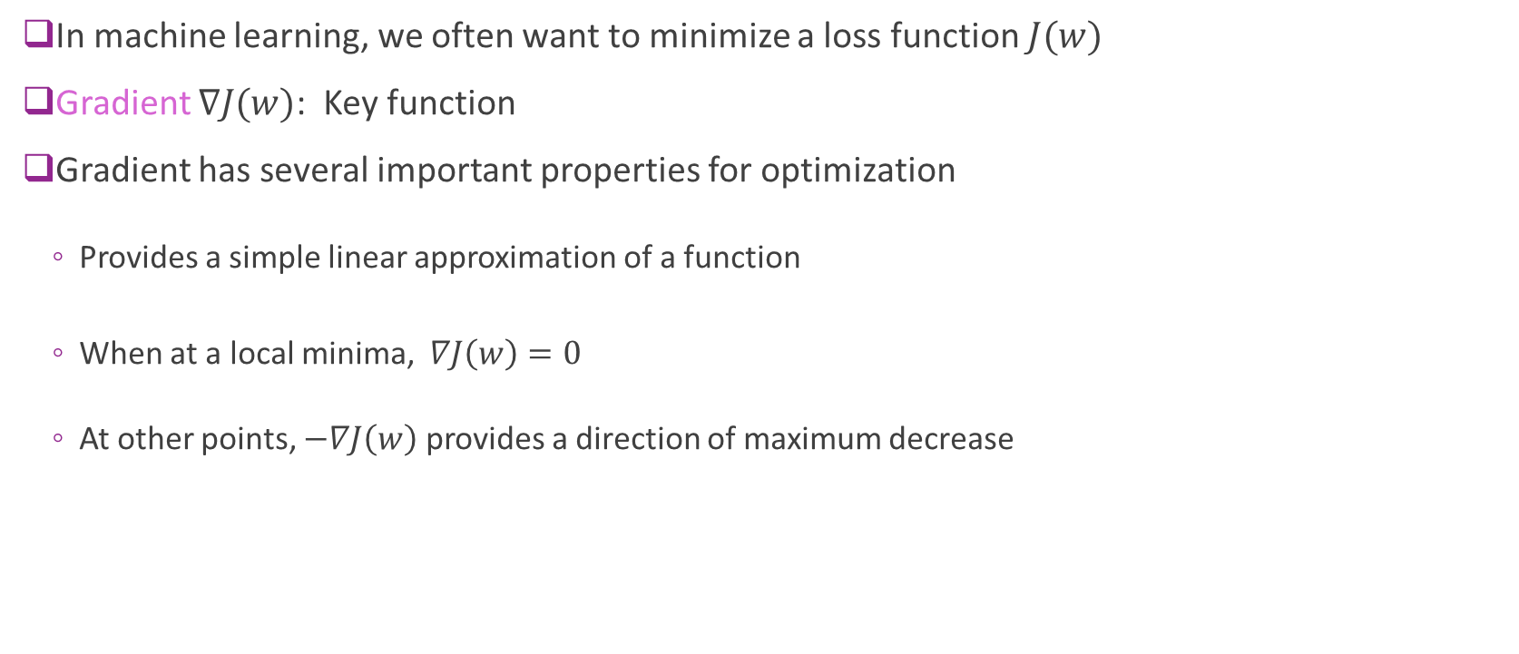
Gradients and Optimization
In machine learning, we often want to minimize a loss function $J(w)$
Gradient $∇J(w)$: Key function
Gradient has several important properties for optimization
Provides a simple linear approximation of a function
When at a local minima, $∇J\left(w\right)=0$
At other points, $−∇J\left(w\right)$ provides a direction of maximum decrease

Slide 10
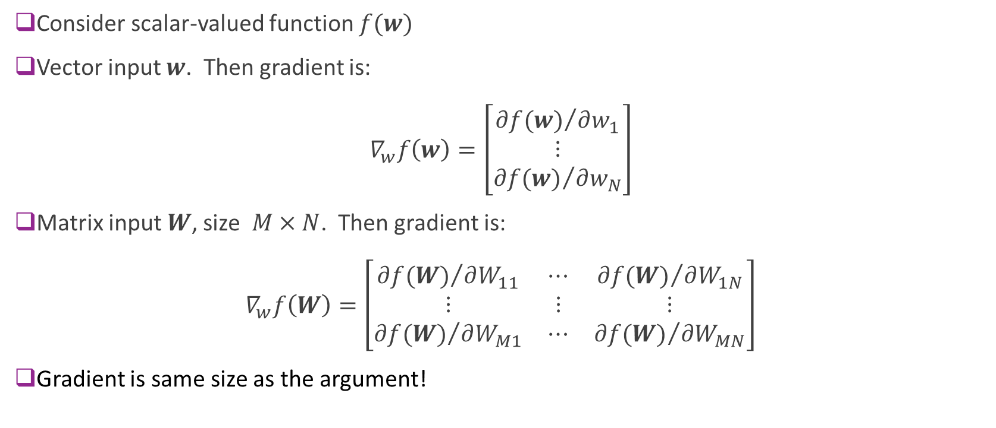
Gradient Defined
Consider scalar-valued function $f(w)$
Vector input $w$. Then gradient is: $∇_{w}f\left(w\right)=\left[\begin{matrix}{∂f(w)}/{∂w_{1}} \\ ⋮ \\ {∂f(w)}/{∂w_{N}}\end{matrix}\right]$
Matrix input $W$, size $M×N$. Then gradient is: $∇_{w}f\left(W\right)=\left[\begin{matrix}{∂f(W)}/{∂W_{11}} & ⋯ & {∂f(W)}/{∂W_{1N}} \\ ⋮ & ⋮ & ⋮ \\ {∂f(W)}/{∂W_{M1}} & ⋯ & {∂f(W)}/{∂W_{MN}}\end{matrix}\right]$
Gradient is same size as the argument!

Slide 11
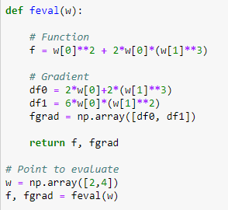


Example 1
$f\left(w_{1},w_{2}\right)=w_{1}^{2}+2w_{1}w_{2}^{3}$
Partial derivatives:
${∂f}/{∂w_{1}}=2w_{1}+2w_{2}^{3}$
${∂f}/{∂w_{2}}=6w_{1}w_{2}^{2}$
Gradient: $∇f=\left[\begin{matrix}2w_{1}+2w_{2}^{3} \\ 6w_{1}w_{2}^{2}\end{matrix}\right]$
Example to right:
Computes gradient at $w=\left(2,4\right)$
Gradient is a numpy vector

Slide 12
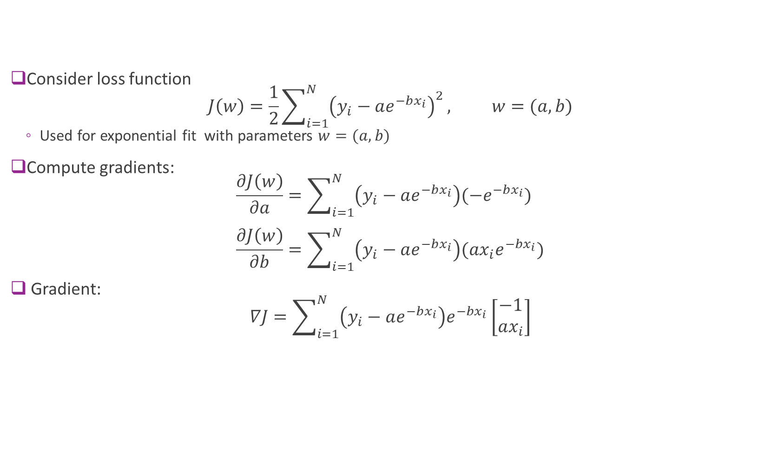
Example 2
Consider loss function $J\left(w\right)=\frac{1}{2}\sum_{i=1}^{N}{{\left(y_{i}−ae^{−bx_{i}}\right)}^{2}}, w=(a,b)$
Used for exponential fit with parameters $w=(a,b)$
Compute gradients: $\frac{∂J\left(w\right)}{∂a}=\sum_{i=1}^{N}{\left(y_{i}−ae^{−bx_{i}}\right)(−e^{−bx_{i}})}$ $\frac{∂J\left(w\right)}{∂b}=\sum_{i=1}^{N}{\left(y_{i}−ae^{−bx_{i}}\right)(ax_{i}e^{−bx_{i}})}$
Gradient: $∇J=\sum_{i=1}^{N}{\left(y_{i}−ae^{−bx_{i}}\right)e^{−bx_{i}}}\left[\begin{matrix}−1 \\ ax_{i}\end{matrix}\right]$

Slide 13
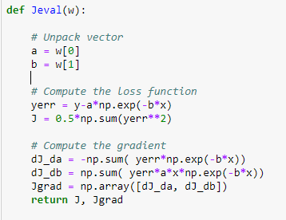
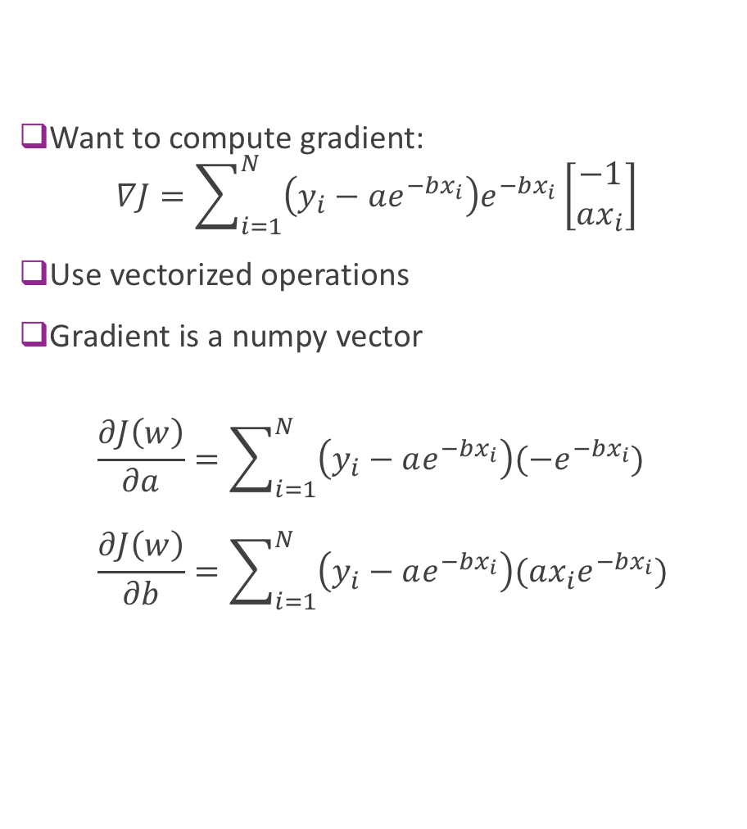
Example 2 in Python
Want to compute gradient: $∇J=\sum_{i=1}^{N}{\left(y_{i}−ae^{−bx_{i}}\right)e^{−bx_{i}}}\left[\begin{matrix}−1 \\ ax_{i}\end{matrix}\right]$
Use vectorized operations
Gradient is a numpy vector
$$\frac{∂J\left(w\right)}{∂a}=\sum_{i=1}^{N}{\left(y_{i}−ae^{−bx_{i}}\right)(−e^{−bx_{i}})} \\ \frac{∂J\left(w\right)}{∂b}=\sum_{i=1}^{N}{\left(y_{i}−ae^{−bx_{i}}\right)(ax_{i}e^{−bx_{i}})}$$

Slide 14
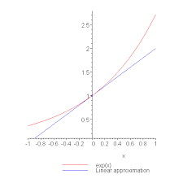
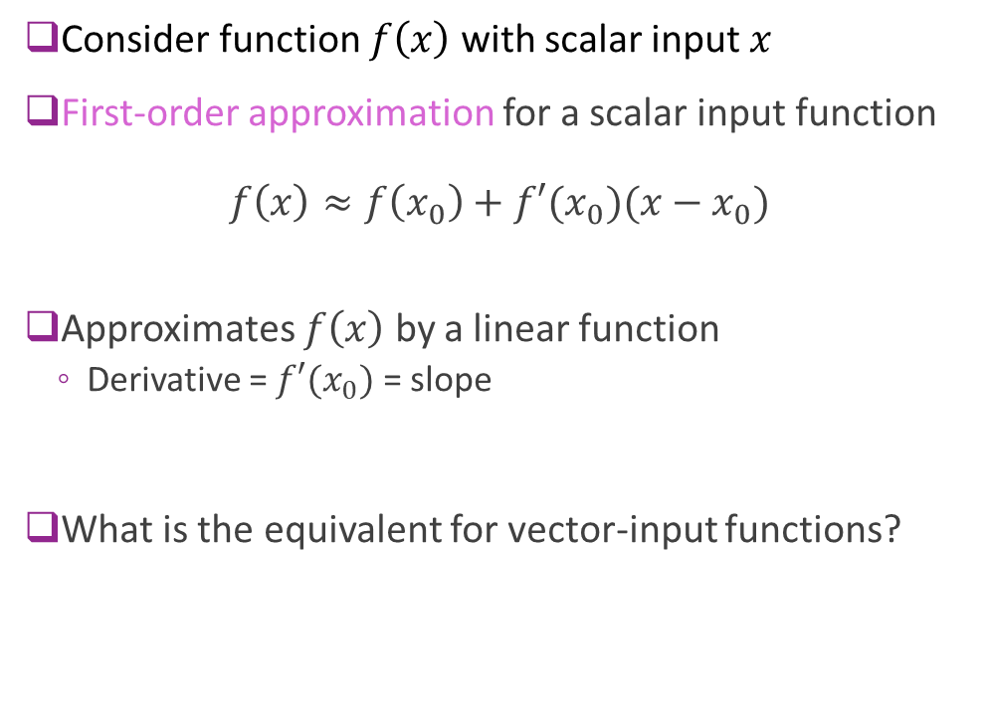
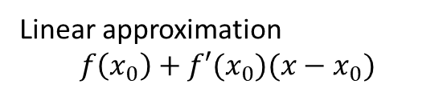
First-Order Approximations Scalar-Input Functions
Consider function $f\left(x\right)$ with scalar input $x$
First-order approximation for a scalar input function $f\left(x\right)≈f\left(x_{0}\right)+f′(x_{0})(x−x_{0})$
Approximates $f\left(x\right)$ by a linear function
Derivative = $f′(x_{0})$ = slope
What is the equivalent for vector-input functions?
Linear approximation
$$f\left(x_{0}\right)+f′(x_{0})(x−x_{0})$$

Slide 15
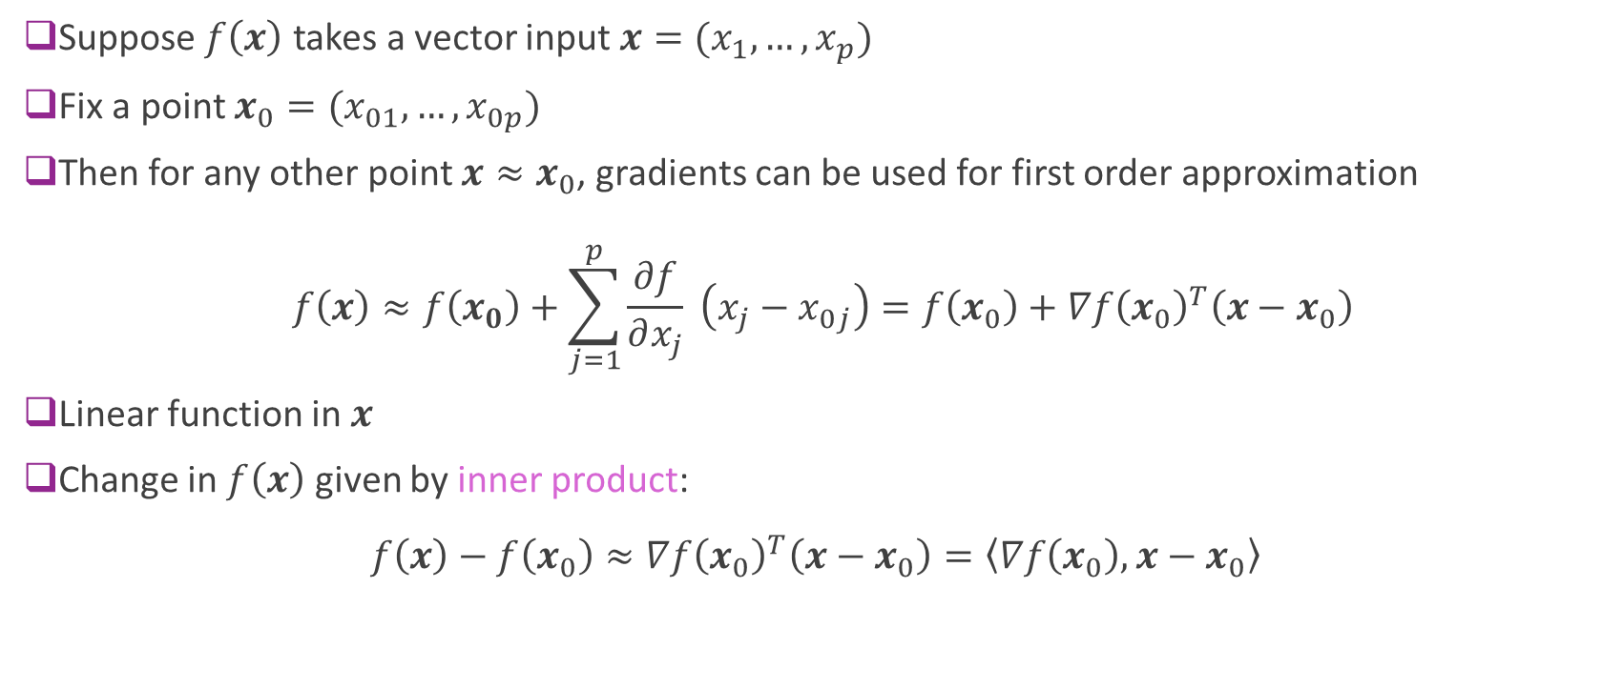
First-Order Approximations Vector Input Functions
Suppose $f\left(x\right)$ takes a vector input $x=(x_{1},…,x_{p})$
Fix a point $x_{0}=(x_{01},…,x_{0p})$
Then for any other point $x≈x_{0}$, gradients can be used for first order approximation
$$f\left(x\right)≈f\left(x_{0}\right)+\sum_{j=1}^{p}{\frac{∂f}{∂x_{j}}} \left(x_{j}−x_{0j}\right)=f\left(x_{0}\right)+∇f{\left(x_{0}\right)}^{T}\left(x−x_{0}\right)$$
Linear function in $x$
Change in $f\left(x\right)$ given by inner product: $f\left(x\right)−f\left(x_{0}\right)≈∇f{\left(x_{0}\right)}^{T}\left(x−x_{0}\right)=\left\langle ∇f\left(x_{0}\right),x−x_{0}\right\rangle$

Slide 16
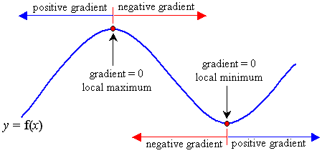
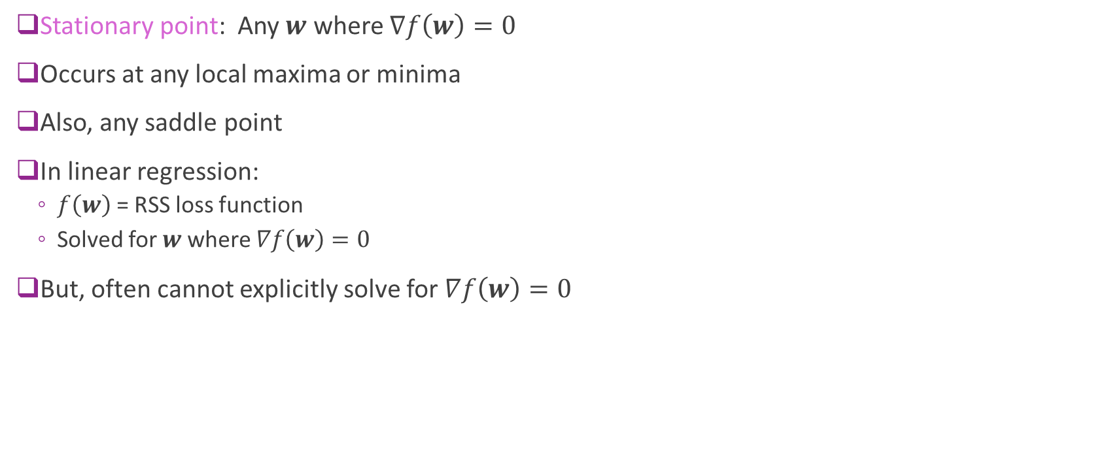
Gradients and Stationary Points
Stationary point: Any $w$ where $∇f\left(w\right)=0$
Occurs at any local maxima or minima
Also, any saddle point
In linear regression:
$f\left(w\right)$ = RSS loss function
Solved for $w$ where $∇f\left(w\right)=0$
But, often cannot explicitly solve for $∇f\left(w\right)=0$

Slide 17
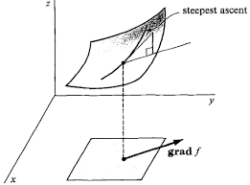
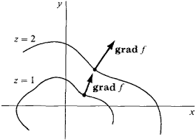
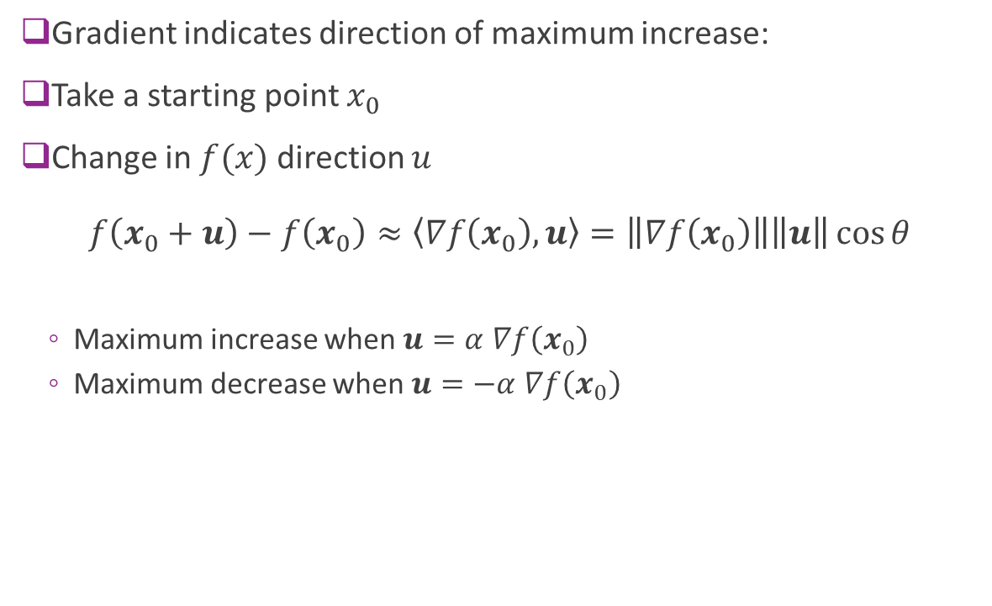
Direction of Maximum Increase
Gradient indicates direction of maximum increase:
Take a starting point $x_{0}$
Change in $f(x)$ direction $u$ $f\left(x_{0}+u\right)−f\left(x_{0}\right)≈\left\langle ∇f\left(x_{0}\right),u\right\rangle =\left\|∇f\left(x_{0}\right)\right\|\left\|u\right\|\cos{θ}$
Maximum increase when $u=α$ $∇f\left(x_{0}\right)$
Maximum decrease when $u=−α$ $∇f\left(x_{0}\right)$

Slide 18
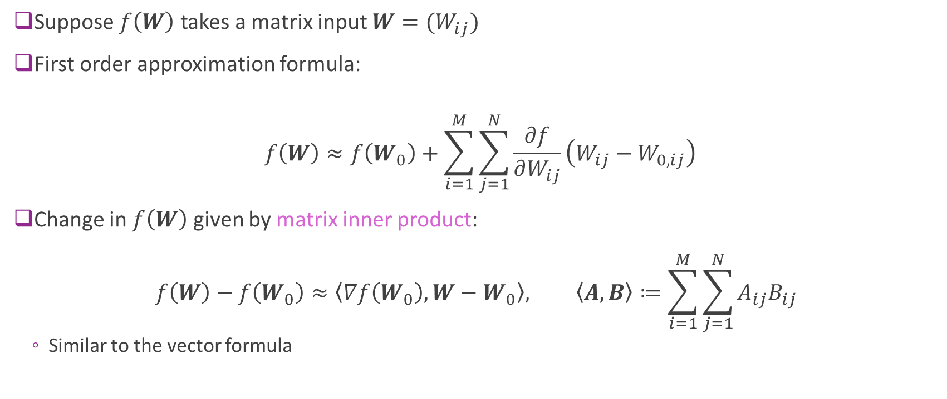
First-Order Approximations Matrix Input Functions (Advanced)
Suppose $f\left(W\right)$ takes a matrix input $W=(W_{ij})$
First order approximation formula:
$$f\left(W\right)≈f\left(W_{0}\right)+\sum_{i=1}^{M}{\sum_{j=1}^{N}{\frac{∂f}{∂W_{ij}}\left(W_{ij}−W_{0,ij}\right)}}$$
Change in $f\left(W\right)$ given by matrix inner product: $f\left(W\right)−f\left(W_{0}\right)≈\left\langle ∇f\left(W_{0}\right),W−W_{0}\right\rangle , \left\langle A,B\right\rangle ≔\sum_{i=1}^{M}{\sum_{j=1}^{N}{A_{ij}B_{ij}}}$
Similar to the vector formula

Slide 19
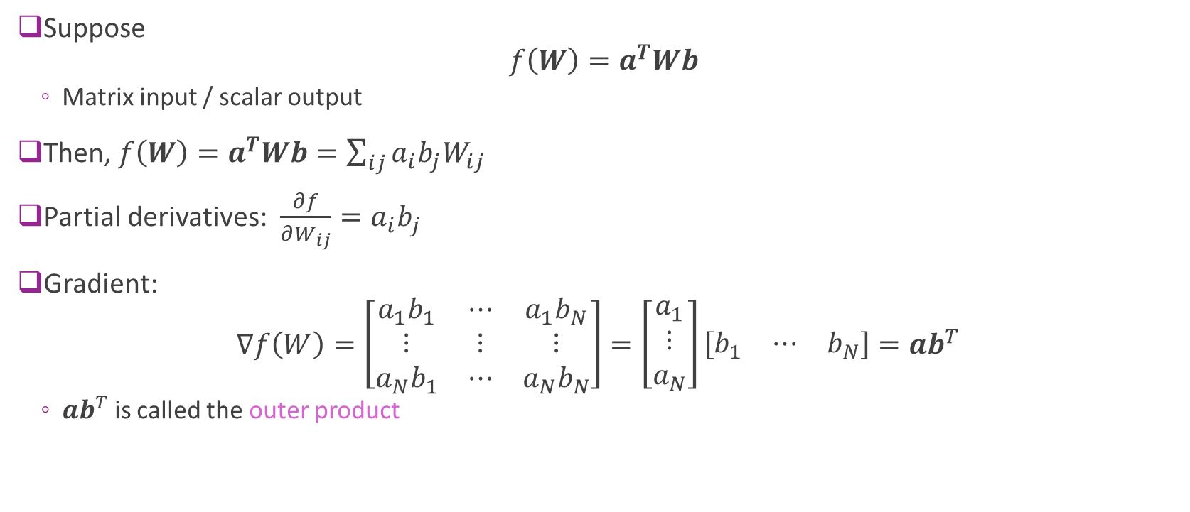
Example 3: Matrix-Input Function
Suppose $f\left(W\right)=a^{T}Wb$
Matrix input / scalar output
Then, $f\left(W\right)=a^{T}Wb=\sum_{ij}{a_{i}b_{j}W_{ij}}$
Partial derivatives: $\frac{∂f}{∂W_{ij}}=a_{i}b_{j}$
Gradient: $∇f\left(W\right)=\left[\begin{matrix}a_{1}b_{1} & ⋯ & a_{1}b_{N} \\ ⋮ & ⋮ & ⋮ \\ a_{N}b_{1} & ⋯ & a_{N}b_{N}\end{matrix}\right]=\left[\begin{matrix}a_{1} \\ ⋮ \\ a_{N}\end{matrix}\right]\left[\begin{matrix}b_{1} & ⋯ & b_{N}\end{matrix}\right]=ab^{T}$
$ab^{T}$ is called the outer product

Slide 20
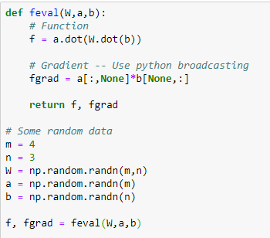

Example 3 in Python
Function: $f\left(W\right)=a^{T}Wb$
Use python `dot` for matrix-vector products
Gradient: $∇f\left(W\right)=ab^{T}$
Want fgrad[i,j] = a[i]b[j]
Avoid for-loops
Use python broadcasting
a[:,None] = m x 1
b[None,:] = 1 x n

Slide 21
Outline
Motivating example: Build an optimizer for logistic regression
Gradients of multi-variable functions
Gradient descent
Adaptive step size
Convexity

Slide 22
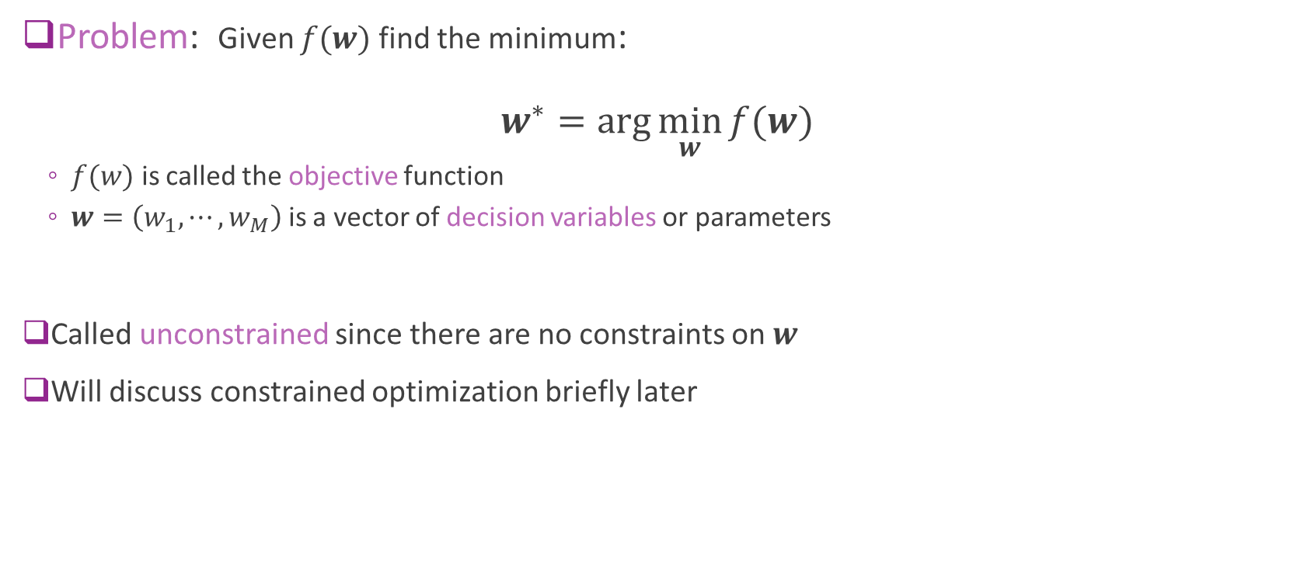
Unconstrained Optimization
Problem: Given $f(w)$ find the minimum: $w^{∗}=\arg{\min_{w}{f(w)}}$
$f(w)$ is called the objective function
$w=\left(w_{1},⋯,w_{M}\right)$ is a vector of decision variables or parameters
Called unconstrained since there are no constraints on $w$
Will discuss constrained optimization briefly later

Slide 23
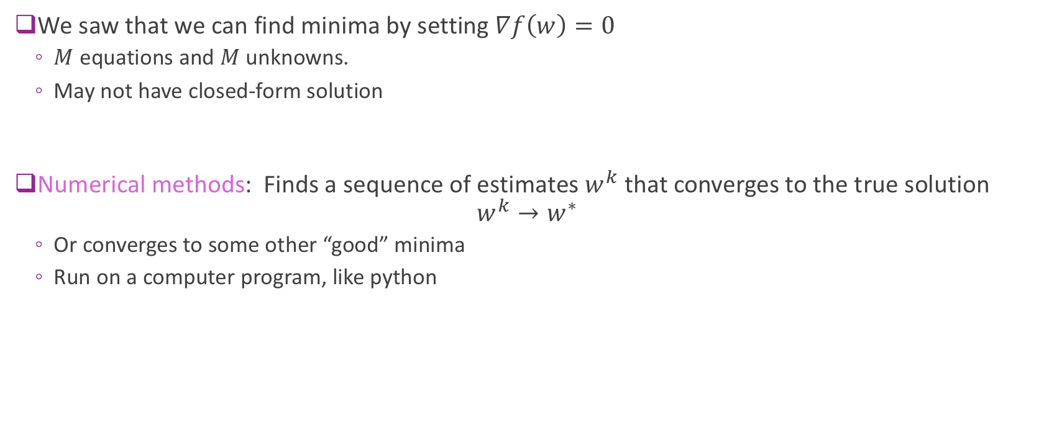
Numerical Optimization
We saw that we can find minima by setting $∇f\left(w\right)=0$
$M$ equations and $M$ unknowns.
May not have closed-form solution
Numerical methods: Finds a sequence of estimates $w^{k}$ that converges to the true solution $w^{k}→w^{∗}$
Or converges to some other “good” minima
Run on a computer program, like python

Slide 24
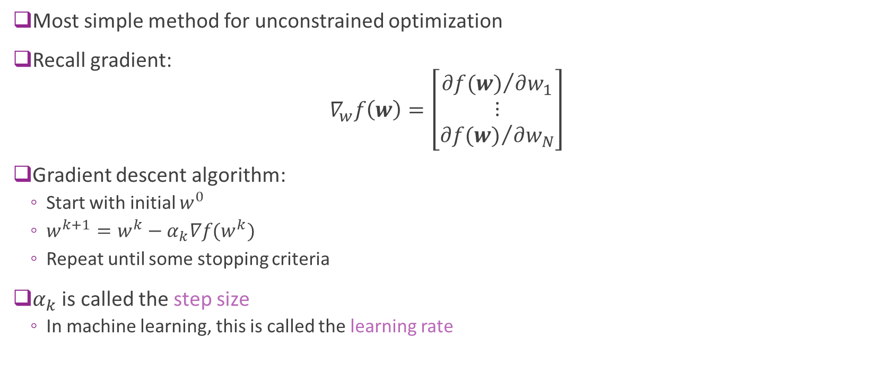
Gradient Descent
Most simple method for unconstrained optimization
Recall gradient: $∇_{w}f\left(w\right)=\left[\begin{matrix}{∂f(w)}/{∂w_{1}} \\ ⋮ \\ {∂f(w)}/{∂w_{N}}\end{matrix}\right]$
Gradient descent algorithm:
Start with initial $w^{0}$
$w^{k+1}=w^{k}−α_{k}∇f(w^{k})$
Repeat until some stopping criteria
$α_{k}$ is called the step size
In machine learning, this is called the learning rate

Slide 25
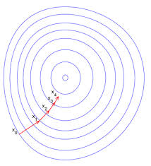
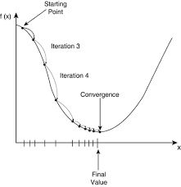
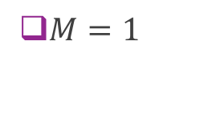

Gradient Descent Illustrated
$M=2$
$M=1$

Slide 26
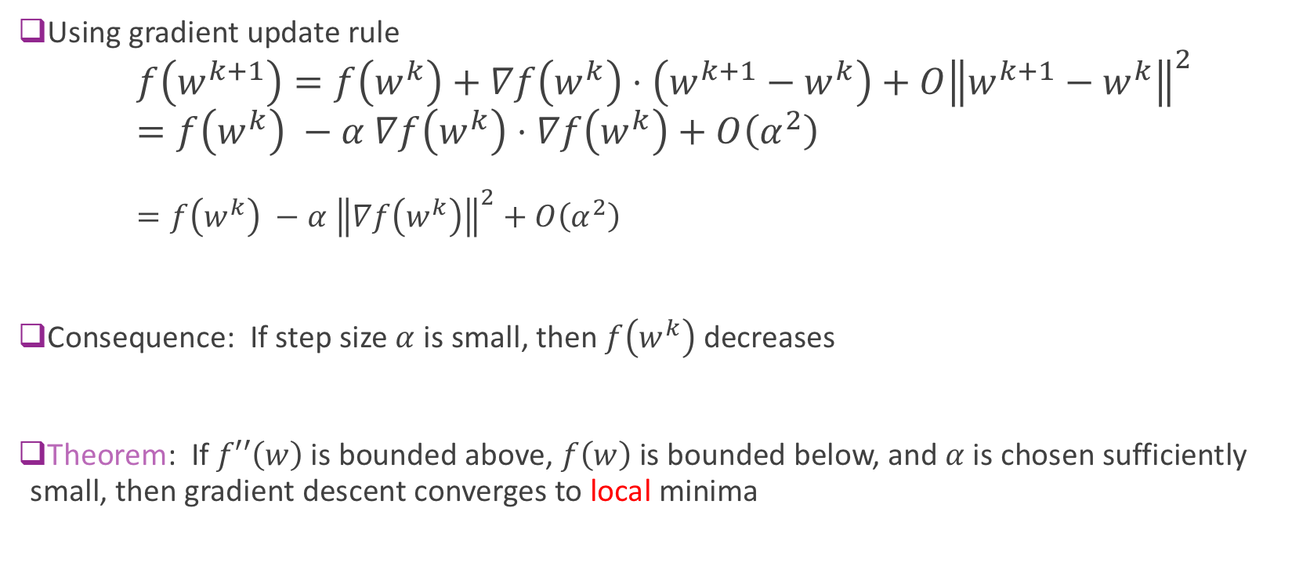
Gradient Descent Analysis
Using gradient update rule $f\left(w^{k+1}\right)=f\left(w^{k}\right)+∇f\left(w^{k}\right)⋅\left(w^{k+1}−w^{k}\right)+O{\left\|w^{k+1}−w^{k}\right\|}^{2}$ $=f\left(w^{k}\right) −α ∇f\left(w^{k}\right)⋅∇f\left(w^{k}\right)+O\left(α^{2}\right)$ $=f\left(w^{k}\right) −α {\left\|∇f\left(w^{k}\right)\right\|}^{2}+O\left(α^{2}\right)$
Consequence: If step size $α$ is small, then $f\left(w^{k}\right)$ decreases
Theorem: If $f′′\left(w\right)$ is bounded above, $f\left(w\right)$ is bounded below, and $α$ is chosen sufficiently small, then gradient descent converges to local minima

Slide 27
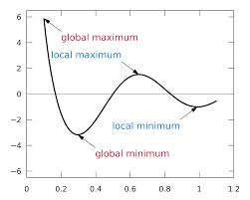
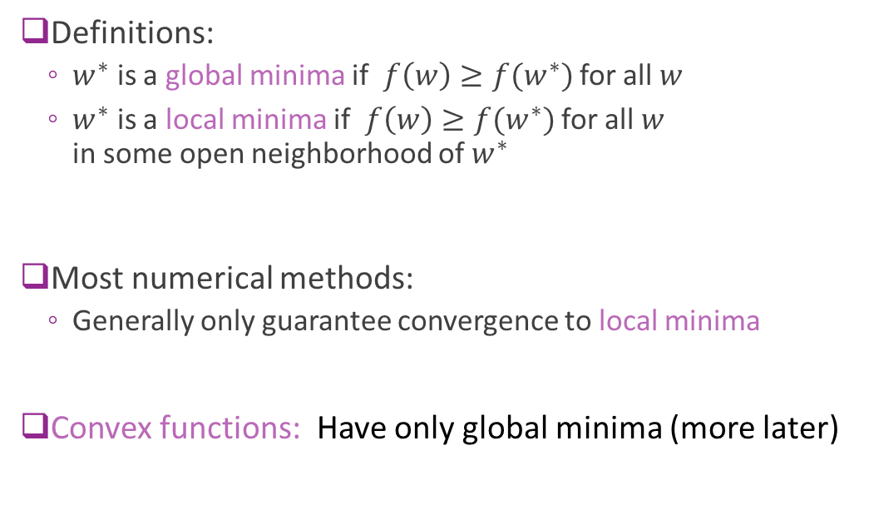
Local vs. Global Minima
Definitions:
$w^{∗}$ is a global minima if $f\left(w\right)≥f(w^{∗})$ for all $w$
$w^{∗}$ is a local minima if $f\left(w\right)≥f(w^{∗})$ for all $w$ in some open neighborhood of $w^{∗}$
Most numerical methods:
Generally only guarantee convergence to local minima
Convex functions: Have only global minima (more later)

Slide 28
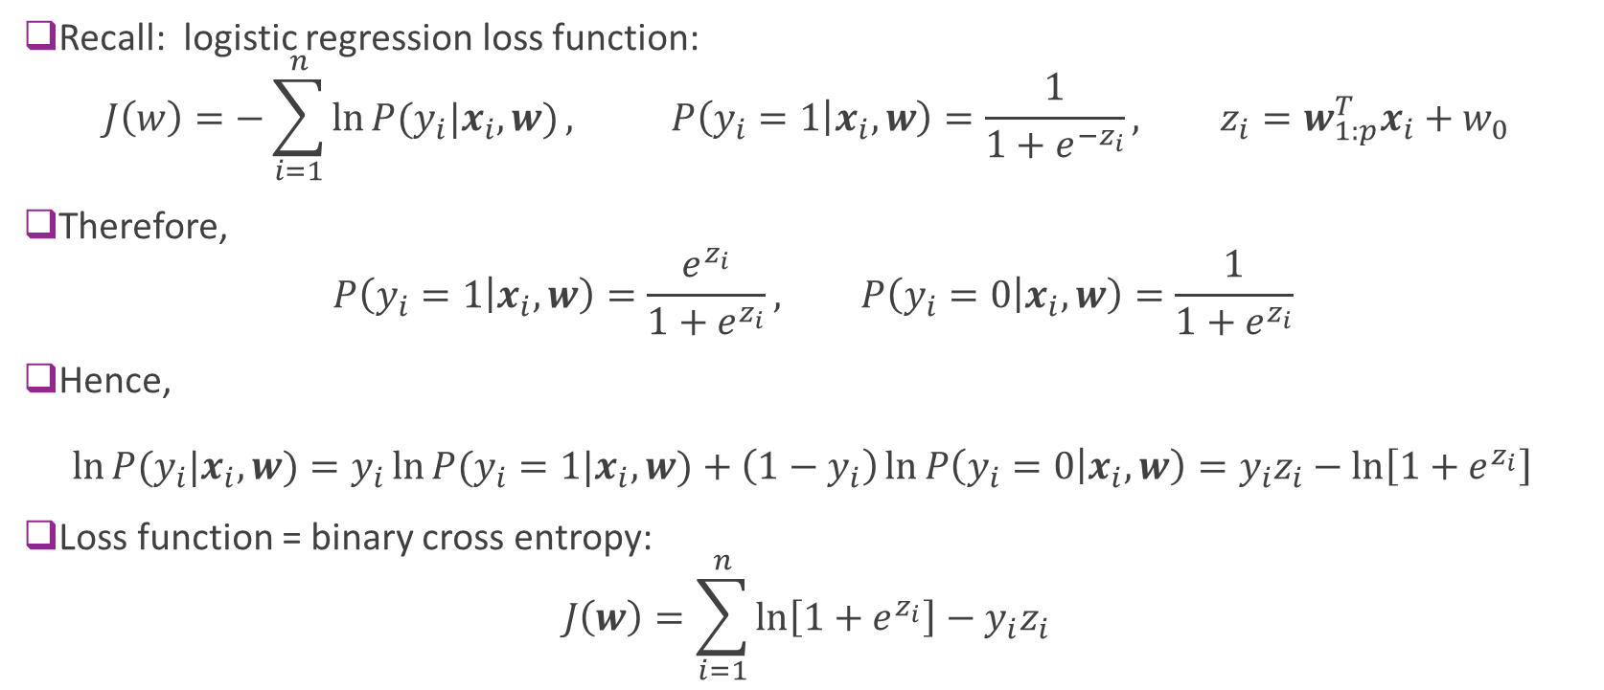
Logistic Loss Function for Binary Classification (Review)
Recall: logistic regression loss function: $J\left(w\right)=−\sum_{i=1}^{n}{\ln{P(y_{i}|x_{i},w)}}, P\left(y_{i}=1 | x_{i},w\right)=\frac{1}{1+e^{−z_{i}}}, z_{i}=w_{1:p}^{T}x_{i}+w_{0}$
Therefore, $P\left(y_{i}=1 | x_{i},w\right)=\frac{e^{z_{i}}}{1+e^{z_{i}}}, P\left(y_{i}=0 | x_{i},w\right)=\frac{1}{1+e^{z_{i}}}$
Hence, $\ln{P(y_{i}|x_{i},w)}=y_{i}\ln{P(y_{i}=1|x_{i},w)}+\left(1−y_{i}\right)\ln{P\left(y_{i}=0 | x_{i},w\right)}=y_{i}z_{i}−\ln\left[1+e^{z_{i}}\right]$
Loss function = binary cross entropy: $J\left(w\right)=\sum_{i=1}^{n}{\ln\left[1+e^{z_{i}}\right]−y_{i}z_{i}}$

Slide 29
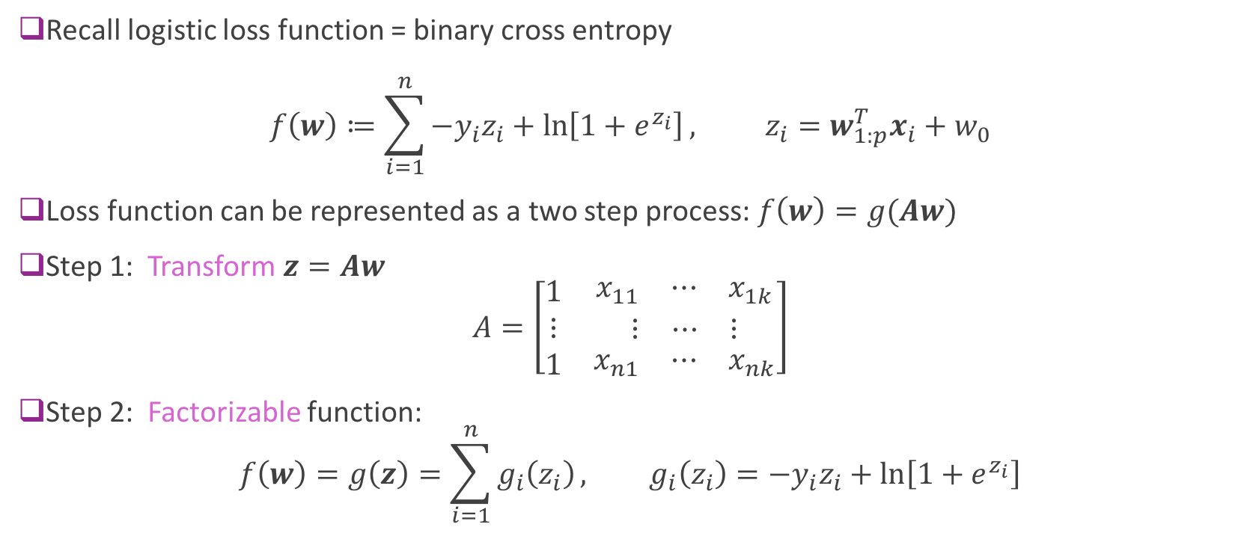
Logistic Loss as a Two Step Function
Recall logistic loss function = binary cross entropy $f\left(w\right)≔\sum_{i=1}^{n}{{−y}_{i}z_{i}+\ln\left[1+e^{z_{i}}\right]}, z_{i}=w_{1:p}^{T}x_{i}+w_{0}$
Loss function can be represented as a two step process: $f\left(w\right)=g(Aw)$
Step 1: Transform $z=Aw$ $A=\left[\begin{matrix}1 & \begin{matrix}x_{11} & ⋯ & x_{1k}\end{matrix} \\ ⋮ & \begin{matrix}⋮ & ⋯ & ⋮\end{matrix} \\ 1 & \begin{matrix}x_{n1} & ⋯ & x_{nk}\end{matrix}\end{matrix}\right]$
Step 2: Factorizable function: $f\left(w\right)=g\left(z\right)=\sum_{i=1}^{n}{g_{i}\left(z_{i}\right)}, g_{i}\left(z_{i}\right)={−y}_{i}z_{i}+\ln\left[1+e^{z_{i}}\right]$

Slide 30
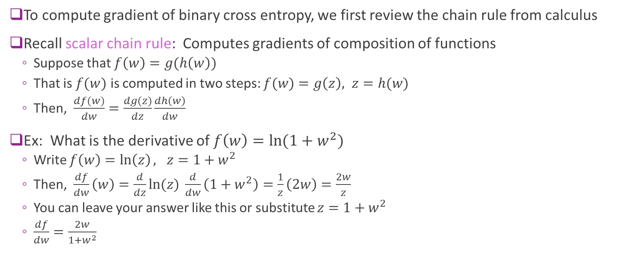
Chain Rule
To compute gradient of binary cross entropy, we first review the chain rule from calculus
Recall scalar chain rule: Computes gradients of composition of functions
Suppose that $f\left(w\right)=g(h\left(w\right))$
That is $f(w)$ is computed in two steps: $f(w)$ $=g\left(z\right), z=h(w)$
Then, $\frac{df(w)}{dw}=\frac{dg(z)}{dz}\frac{dh\left(w\right)}{dw}$
Ex: What is the derivative of $f\left(w\right)=\ln{(1+w^{2})}$
Write $f\left(w\right)=\ln\left(z\right), z=1+w^{2}$
Then, $\frac{df}{dw}\left(w\right)=\frac{d}{dz}\ln{(z)} \frac{d}{dw}\left(1+w^{2}\right)=\frac{1}{z}\left(2w\right)=\frac{2w}{z}$
You can leave your answer like this or substitute $z=1+w^{2}$
$\frac{df}{dw}=\frac{2w}{1+w^{2}}$

Slide 31
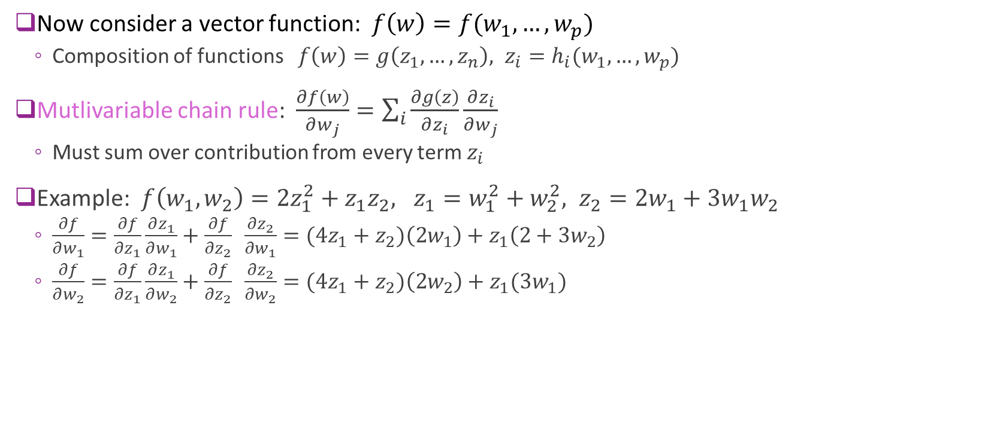
Multi-Variable Chain Rule
Now consider a vector function: $f\left(w\right)=f(w_{1},…,w_{p})$
Composition of functions $f\left(w\right)=g\left(z_{1},…,z_{n}\right), z_{i}=h_{i}(w_{1},…,w_{p})$
Mutlivariable chain rule: $\frac{∂f\left(w\right)}{∂w_{j}}=\sum_{i}{\frac{∂g\left(z\right)}{∂z_{i}}}\frac{∂z_{i}}{∂w_{j}}$
Must sum over contribution from every term $z_{i}$
Example: $f\left(w_{1},w_{2}\right)=2z_{1}^{2}+z_{1}z_{2}, z_{1}=w_{1}^{2}+w_{2}^{2}, z_{2}=2w_{1}+3w_{1}w_{2}$
$\frac{∂f}{∂w_{1}}=\frac{∂f}{∂z_{1}}\frac{∂z_{1}}{∂w_{1}}+\frac{∂f}{∂z_{2}} \frac{∂z_{2}}{∂w_{1}}=(4z_{1}+z_{2})\left(2w_{1}\right)+z_{1}\left(2+3w_{2}\right)$
$\frac{∂f}{∂w_{2}}=\frac{∂f}{∂z_{1}}\frac{∂z_{1}}{∂w_{2}}+\frac{∂f}{∂z_{2}} \frac{∂z_{2}}{∂w_{2}}=(4z_{1}+z_{2})\left(2w_{2}\right)+z_{1}(3w_{1})$

Slide 32
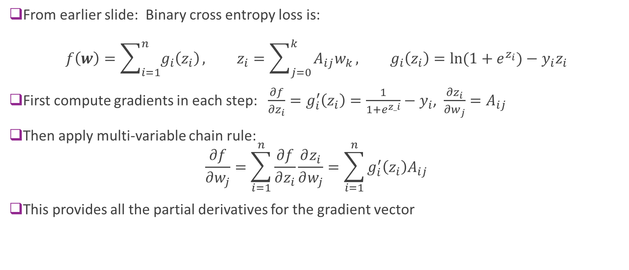
Gradient of Binary Cross Entropy Loss
From earlier slide: Binary cross entropy loss is: $f\left(w\right)=\sum_{i=1}^{n}{g_{i}\left(z_{i}\right)}, z_{i}=\sum_{j=0}^{k}{A_{ij}w_{k}}, g_{i}\left(z_{i}\right)=\ln{(1+e^{z_{i}})}−y_{i}z_{i}$
First compute gradients in each step: $\frac{∂f}{∂z_{i}}=g_{i}^{′}\left(z_{i}\right)=\frac{1}{1+e^{z_i}}−y_{i}$, $\frac{∂z_{i}}{∂w_{j}}=A_{ij}$
Then apply multi-variable chain rule: $\frac{∂f}{∂w_{j}}=\sum_{i=1}^{n}{\frac{∂f}{∂z_{i}}\frac{∂z_{i}}{∂w_{j}}}=\sum_{i=1}^{n}{g_{i}^{′}\left(z_{i}\right)A_{ij}}$
This provides all the partial derivatives for the gradient vector

Slide 33
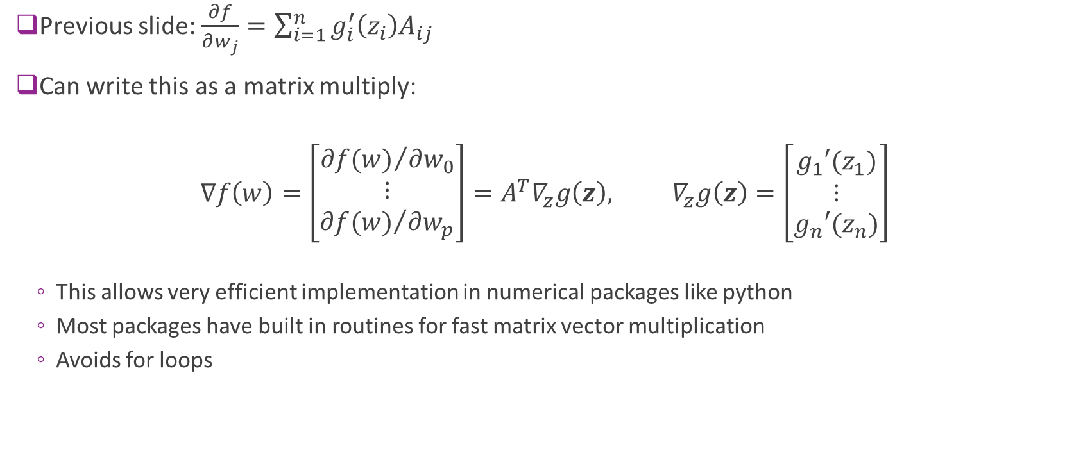
Gradients with Matrix Multiplication
Previous slide: $\frac{∂f}{∂w_{j}}=\sum_{i=1}^{n}{g_{i}^{′}\left(z_{i}\right)A_{ij}}$
Can write this as a matrix multiply:
$$∇f\left(w\right)=\left[\begin{matrix}{∂f(w)}/{∂w_{0}} \\ ⋮ \\ {∂f(w)}/{∂w_{p}}\end{matrix}\right]=A^{T}∇_{z}g\left(z\right), ∇_{z}g\left(z\right)=\left[\begin{matrix}g_{1}′(z_{1}) \\ ⋮ \\ g_{n}′(z_{n})\end{matrix}\right]$$
This allows very efficient implementation in numerical packages like python
Most packages have built in routines for fast matrix vector multiplication
Avoids for loops

Slide 34
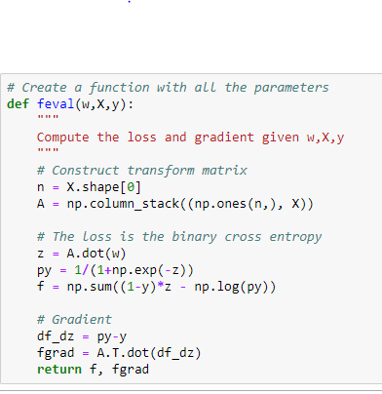
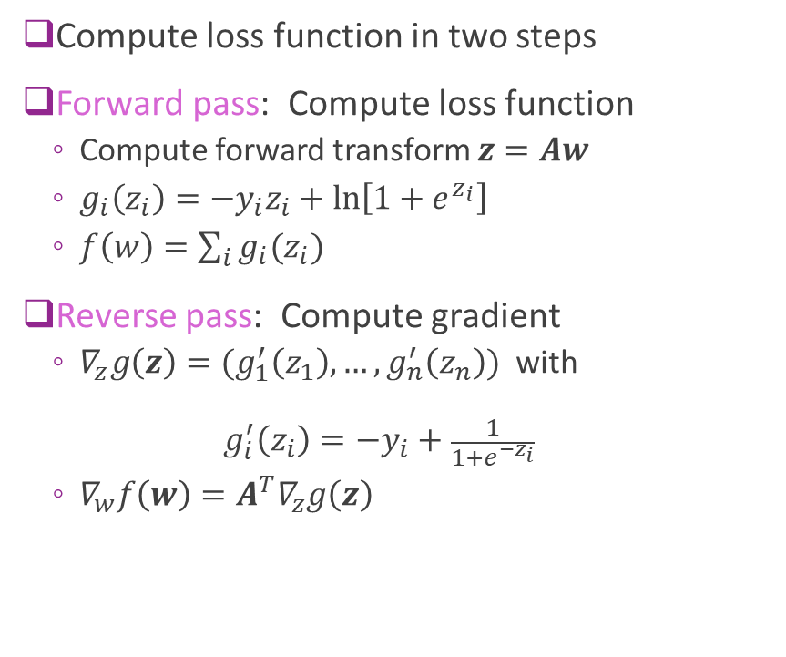
Summary
Compute loss function in two steps
Forward pass: Compute loss function
Compute forward transform $z=Aw$
$g_{i}\left(z_{i}\right)={−y}_{i}z_{i}+\ln\left[1+e^{z_{i}}\right]$
$f\left(w\right)=\sum_{i}{g_{i}(z_{i})}$
Reverse pass: Compute gradient
$∇_{z}g\left(z\right)=(g_{1}^{′}\left(z_{1}\right),…,g_{n}^{′}\left(z_{n}\right))$ with ${ g}_{i}^{′}\left(z_{i}\right)=−y_{i}+\frac{1}{1+e^{{−z}_{i}}}$
$∇_{w}f\left(w\right)=A^{T}∇_{z}g\left(z\right)$

Slide 35
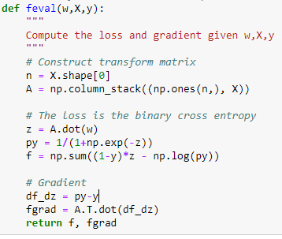
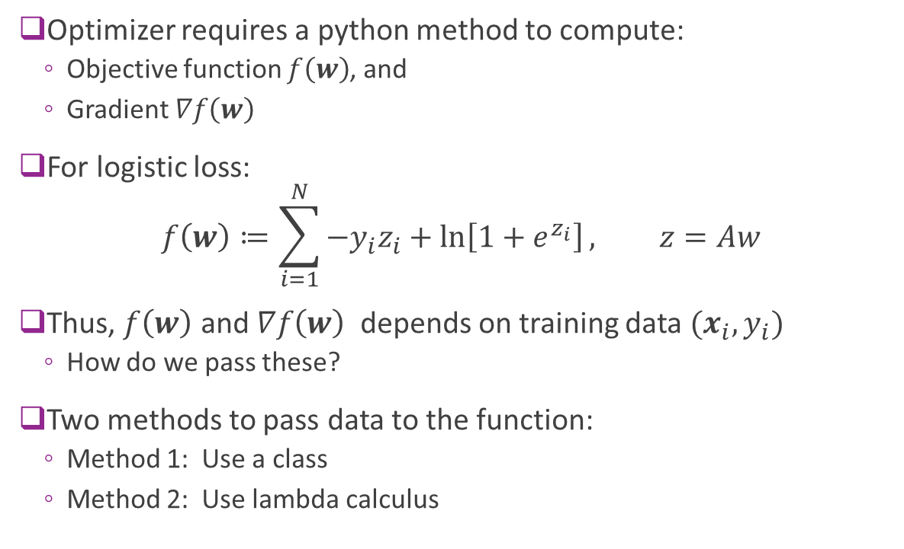
Implementation in Python
Optimizer requires a python method to compute:
Objective function $f\left(w\right)$, and
Gradient $∇f\left(w\right)$
For logistic loss:
$$f\left(w\right)≔\sum_{i=1}^{N}{{−y}_{i}z_{i}+\ln\left[1+e^{z_{i}}\right]}, z=Aw$$
Thus, $f\left(w\right)$ and $∇f\left(w\right)$ depends on training data $(x_{i},y_{i})$
How do we pass these?
Two methods to pass data to the function:
Method 1: Use a class
Method 2: Use lambda calculus
Training data

Slide 36
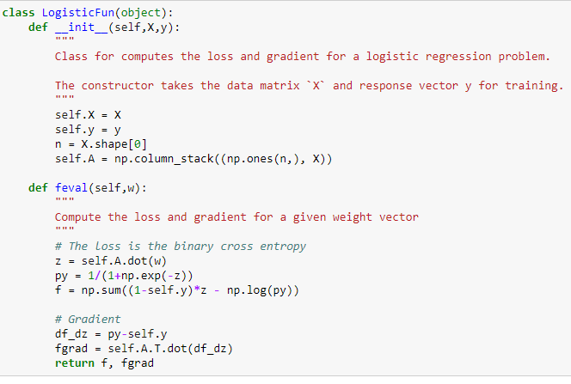


Method 1: Create a Class
Create a class for the objective function
Pass data $(x_{i},y_{i})$in constructor
Also perform any pre-computations
Pass argument $w$ to method feval
Evaluates function and gradient
Can access the data as class members
Note forward-backward method
Instantiate the class with data

Slide 37
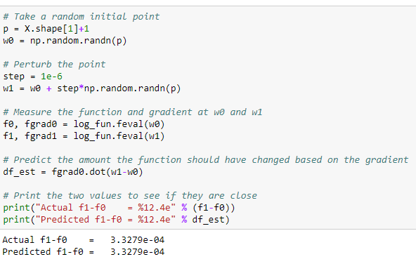

Testing the Gradient
Always test your implementation!
Pick two points $w_{0}$, $w_{1}$ that are close
Make sure: $f\left(w_{1}\right)−f\left(w_{0}\right)≈∇f{\left(w_{0}\right)}^{T}\left(w_{1}−w_{0}\right)$

Slide 38
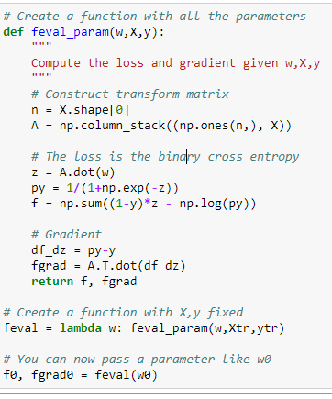

Method 2: Lambda Calculus
Create a function that take $w, X, y$
Use lambda function to fix $X, y$

Slide 39
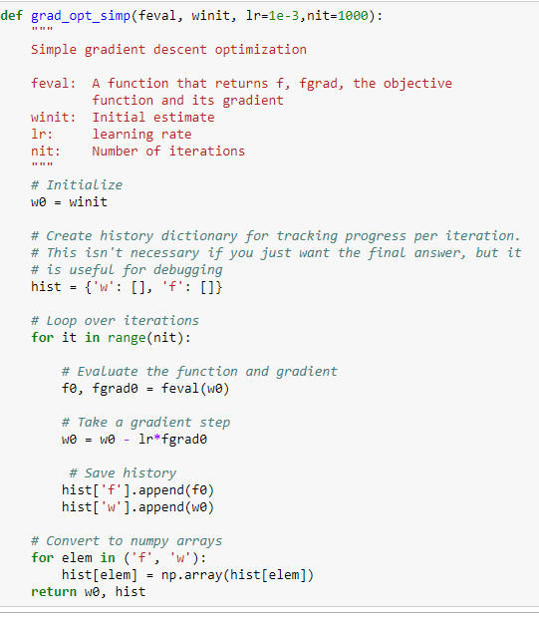
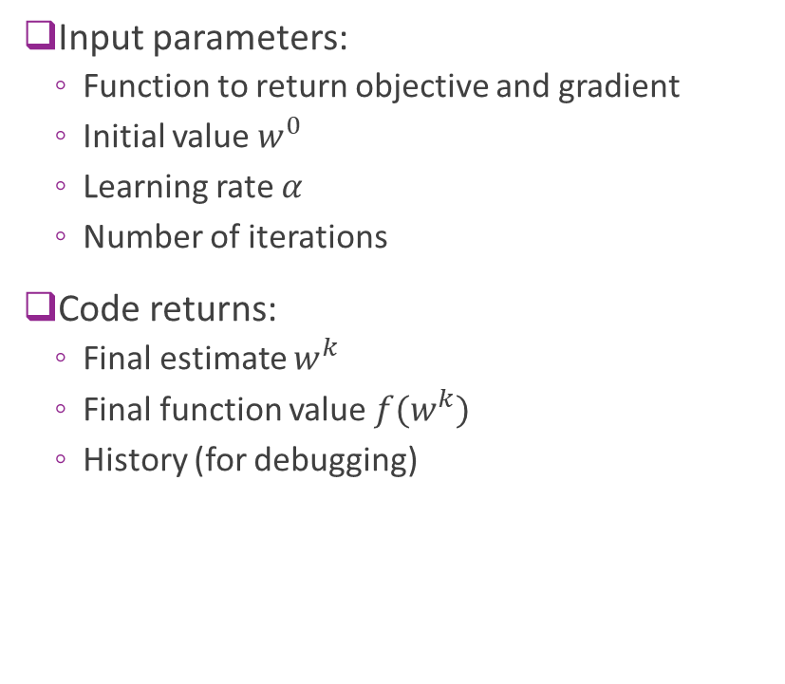
Gradient Descent
Input parameters:
Function to return objective and gradient
Initial value $w^{0}$
Learning rate $α$
Number of iterations
Code returns:
Final estimate $w^{k}$
Final function value ${f(w}^{k})$
History (for debugging)

Slide 40



Gradient Descent on Logistic Regression
Random initial condition
1000 iterations
Convergence is slow.
Final accuracy poor
estimate has not converged

Slide 41


Different Step Sizes
Faster learning rate => Faster convergence
But, may be unstable

Slide 42
Outline
Motivating example: Build an optimizer for logistic regression
Gradients of multi-variable functions
Gradient descent
Adaptive step size
Convexity

Slide 43

Adaptive Step Size Selection
Most practical algorithms change step size adaptively $w^{k+1}=w^{k}−α_{k}∇f(w^{k})$
Tradeoff: Selecting large $α_{k}$:
Larger steps, faster convergence
But, may overshoot

Slide 44

Armijo Rule
Recall that we know if $w^{k+1}=w^{k}−α∇f(w^{k})$
$$f\left(w^{k+1}\right)=f\left(w^{k}\right) −α {\left\|∇f\left(w^{k}\right)\right\|}^{2}+O(α^{2})$$
Armijo Rule:
Select some $c∈(0,1)$. Usually $c=1/2$
Select $α$ such that $f\left(w^{k+1}\right)≤f\left(w^{k}\right) −cα {\left\|∇f\left(w^{k}\right)\right\|}^{2}$
Decreases by at least at fraction $c$ predicted by linear approx.
Simple update:
If Armijo rule passes: Accept point and increase step size: $α^{k+1}=βα^{k}, β>1$
If Armijo rule fails: Reject point and decrease step size: $α^{k+1}=β^{−1}α^{k}$
Can also use a line search

Slide 45



Armijo Rule Illustrated
Armijo rule: $f\left(w^{k+1}\right)≤f\left(w^{k}\right)−cα {\left\|∇f\left(w^{k}\right)\right\|}^{2}$
Guarantees decrements every iteration
No overshoot
Line representing $y(α)=f\left(w^{k}\right)−cα {\left\|∇f\left(w^{k}\right)\right\|}^{2}$ for a given c
Feasible region for $w^{k+1}$

Slide 46



Adaptive Gradient Descent in Python
Simple modification of fixed step size case
What is $β$ here?

Slide 47

In-Class Exercise
Complete Jupyter notebook

Slide 48
Outline
Motivating example: Build an optimizer for logistic regression
Gradients of multi-variable functions
Gradient descent
Adaptive step size
Convexity

Slide 49

Convex Sets
Definition: A set $X$ is convex if for any $x,y∈X$, $tx+\left(1−t\right)y∈X for all t∈[0,1]$
Any line between two points remains in the set.
Examples:
Square, circle, ellipse
$\left\{x \right|Ax≤b \}$ for any matrix $A$ and vector $b$

Slide 50


Convex Set Visualized
Convex
Not convex

Slide 51


Convex Functions
A real-valued function $f\left(x\right)$ is convex if:
Its domain is a convex set, and
For all $x,y$ and $t∈[0,1]$: $f\left(tx+\left(1−t\right)y\right)≤tf\left(x\right)+\left(1−t\right)f\left(y\right)$

Slide 52

Convex Function Examples
Linear function of a scalar $f\left(x\right)=ax+b$
Linear function of a vector $f\left(x\right)=a^{T}x+b$
Quadratic $f\left(x\right)=\frac{1}{2}ax^{2}+bx+c$ is convex iff $a≥0$
If $f^{′′}\left(x\right)$ exists everywhere, $f(x)$ is convex iff ${ f}^{′′}\left(x\right)≥0.$
When $x$ is a vector $f^{′′}\left(x\right)≥0$ means the Hessian must be positive semidefinite
$f\left(x\right)=e^{x}$
If $f\left(x\right)$ is convex, so is $f\left(Ax+b\right)$
Logistic loss is convex!

Slide 53

Global Minima and Convex Function
Theorem: If $f(w)$ is convex and $w$ is a local minima, then $w$ is a global minima
Implication for optimization:
Gradient descent only converges to local minima
In general, cannot guarantee optimality
Depends on initial condition
But, for convex functions can always obtain optimal

Slide 54
Other Topics We Did Not Cover
Our optimizer is OK, but not nearly as fast as sklearn method
Many techniques we did not cover
Newton’s method
Quasi-Newton’s method
Non-smooth optimization
Constrained optimization
Take an optimization class and learn more.

Slide 55

Lab: Estimating the fundamental frequency and harmonics of an audio signal
Common audio signal model
$y\left[n\right]≈c+\sum_{j=0}^{J−1}{a_{j}\cos{2π\left(j+1\right)f_{0}nT_{s}+}}$ $\sum_{j=0}^{J−1}{b_{j}\sin{2π\left(j+1\right)f_{0}nT_{s}}{}}$
${ f}_{0}$ : fundamental frequency (pitch period = 1/ $f_{0}$)
${k f}_{0}: harmonics$
Problem: Given $J$, estimating $f_{0}$ and coefficients ${c, a}_{j}$, $b_{j}$
Nested optimization:
Given estimated $f_{0}$ , find optimal coefficients: least square problem
(Can be solved using linear regression, but you should write your own least squares solver)
Determine optimal $f_{0}$ using gradient descent, using a evaluation function which solves the coefficients for any current $f_{0}$ and evaluate the gradient

Slide 56
What you should know
Identify the objective function, parameters and constraints in an optimization problem
Compute the gradient of a loss function for scalar, vector parameters
Matrix parameters are advanced (graduate students only)
Efficiently compute a gradient in python.
Write the gradient descent update
Describe the effect of the learning rate on convergence
Determine if a loss function is convex

