Slide 1
Intro to Unix
Galvanize Data Science Immersive
Week 1, Day 1, Lecture 1
Land Belenky

Slide 2
Outline
Define an Operating System
Brief History of Unix & Linux
Linux File Structure
Shells and Scripts
Directory Commands
File Commands
→ Python Programming ←

Slide 3
Objective:
After this lecture, you should be able to:
Create and navigate directories
Create and navigate files
Get started in python in at least two modes

Slide 4
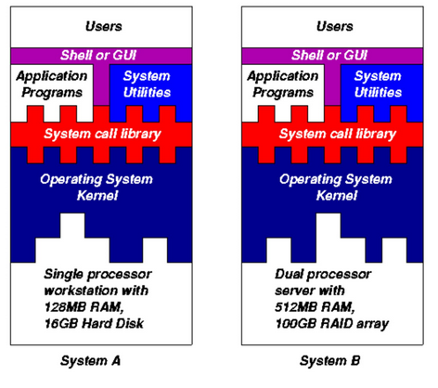
Operating Systems
A set of software routines that allow users and applications to access system resources (CPU, memory, network, storage, etc)
Saves us the trouble of having to know exactly how the computer is built and configured:
  provides a uniform interface for all different types and sizes of computers
Protects the computer from accidental (or deliberate) mismanagement of resources

Slide 5
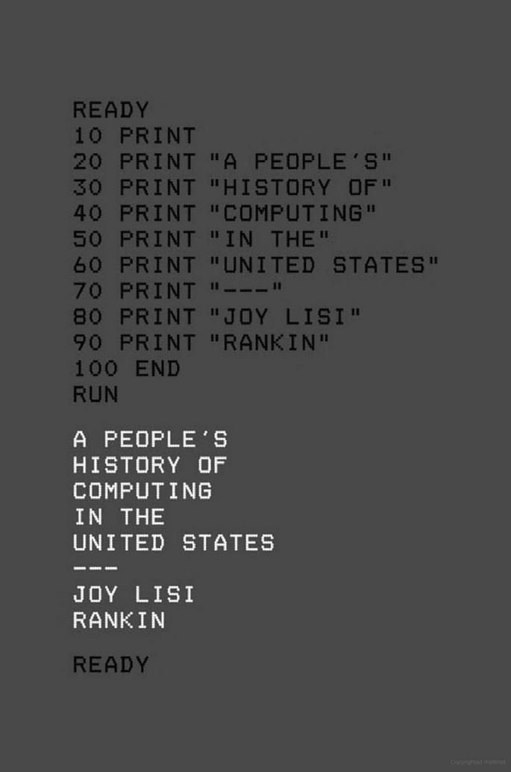
Brief History of Unix
Developed at Bell Labs 1969~1971
Designed for multi-user, multi-tasking, time-sharing, networking
One large computer, multiple connected “terminals” each working in turn
TTY Terminals:
  text-only entry (no GUI)
  line input → line output
  No scrolling up, no editing previous lines
Reputation for being cryptic and obscure
Largely supplanted by Windows circa 1992 for business applications, thanks in large part to friendly GUI

Slide 6

Linux
Linus Torvalds: (b. Helsinki, Finland, 1969)
  Started ~1990
  Free, open-source, community supported
Secure and Reliable
Hundreds of variants
Majority of internet servers
100% of the TOP500 supercomputers
Extremely customizable
Massive (and helpful) user knowledge base

Slide 7
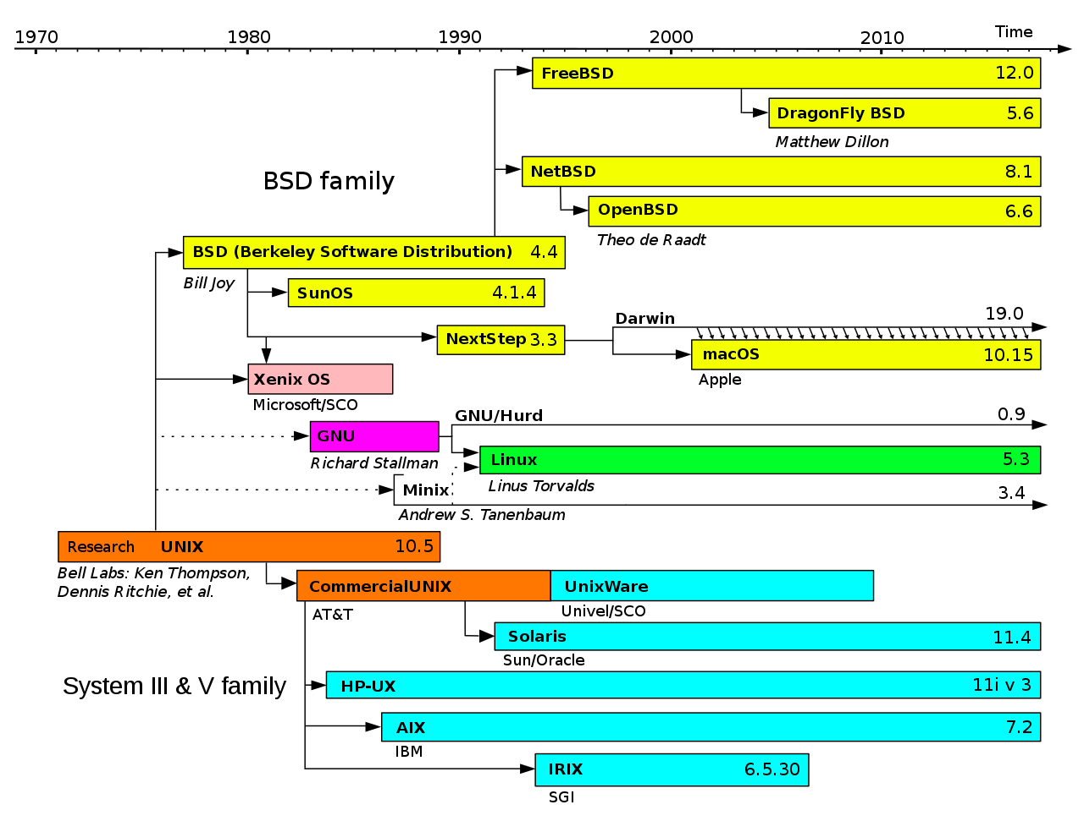
MacOS
Derived from UNIX
Based on BSD/NextStep/Darwin
A cousin to Linux
Shares many common commands and structure
Not completely compatible
  Linux programs may or may not run on Mac and vice-versa

Slide 8
Kernel, Shell and Windows
“kernel”:
  most basic and fundamental part of operating system (I.e, the real OS)
  handles machine-level processes (CPU, Memory, Storage, Input-Output devices)
  We do not interact directly with the kernel
“Shell”:
  frequently called “terminal window” or “command line”
    Some will argue that this is not strictly correct
  Our primary way of interacting with the computer.
  Sends commands to kernel
“Window Manager”
  program to enable drawing of windows
“Desktop Environment”
  set of programs to relay commands to kernel
  a graphical analog of shell
Notes:
The “kernel” is really the operating system. The shell, window manager and desktop environment are adornments and there are several options to choose from.
However, in many situations, they all work together as a unified system we can think of as “the operating system.”

Slide 9
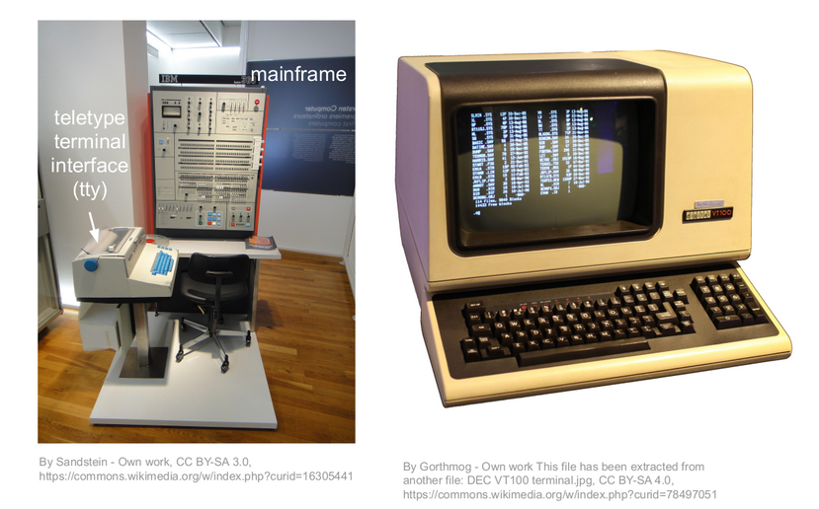
Early Unix Machines
No monitor:
  TTY or line printer
  No going up to edit
No mouse
No GUI or forms
All settings saved in text files
Text-based instructions easy to store in a file, edit and re-launch (unlike mouse-based operations)
Compute time very expensive:
  Don’t make the computer sit idle while the programmer is thinking
  Maintain a queue of work and a set of connected users to time-slice
Notes:
The remnants of the old teletype (TTY) system are still evident in the shell today.
Input is generally one line of text and output is generally one, (or a few) lines of text.
Text scrolls up with each line (like a printer), rather than being modified in-place, like a dashboard.
You can view, copy and repeat previous commands, but you can’t “go back” to them.

Slide 10
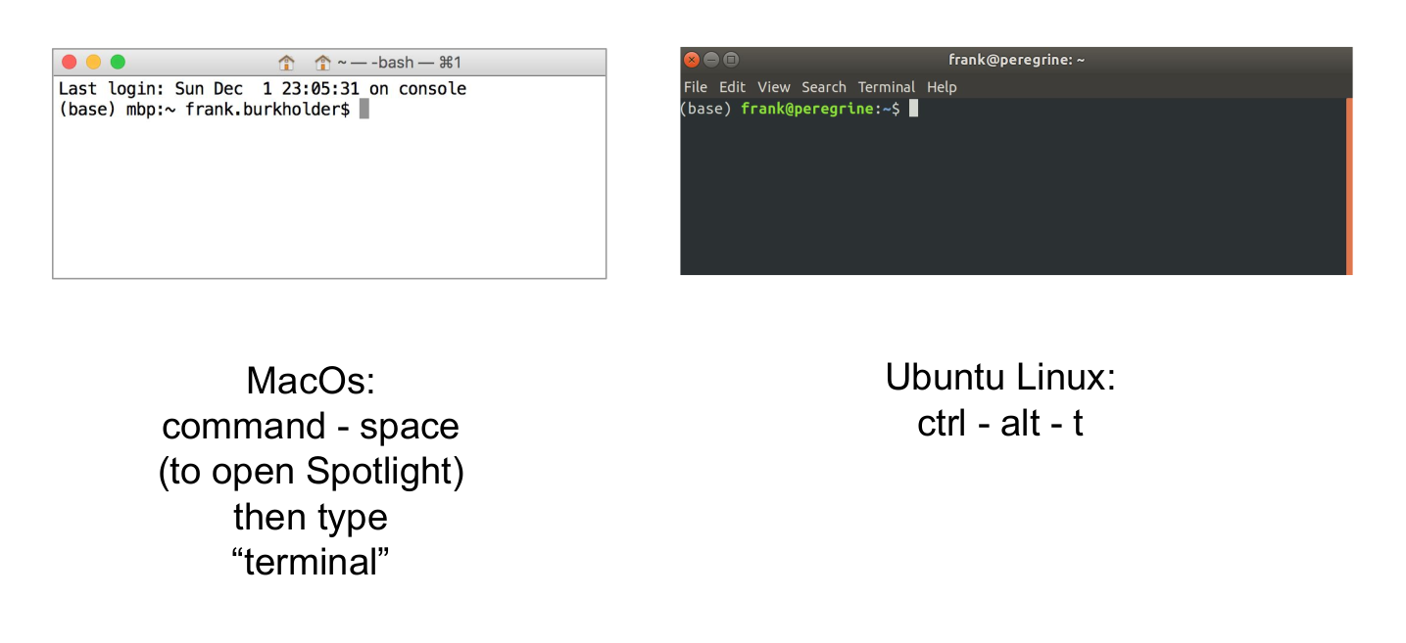
Virtual Terminals in MacOS and Linux
Modeled on old-fashioned tty
Line entry/line output
No editing of previous input
Different options for shell:
  bash (Ubuntu and old Mac default)
  zsh (New Mac default)

Slide 11
Advantages of the Command-Line Interface
Text entry (from keyboard) faster and more accurate than mouse
  Takes some practice
Text entry more customizable
  Use aliases for commonly used commands, rather than repeating sequences of mouse movements
Text-based commands can be saved in a file, or generated from a file. File can be stored, distributed, re-run and modified.
  Document your processes and distribute them to other computers or users
Programs can be run by other programs
  Automated or semi-automated management of clusters: Docker, Kubernetes, DevOPs

Slide 12
UNIX/Linux Design Philosophy
Mike Gancarz, The Unix Philosophy, 1994
Small is beautiful
Make each program do one thing well
Build a prototype as soon as possible
Choose portability over efficiency
Store data in flat text files
Use software leverage to your advantage
Use shell scripts to increase leverage and portability
Avoid captive user interfaces
Make every program a filter

Slide 13
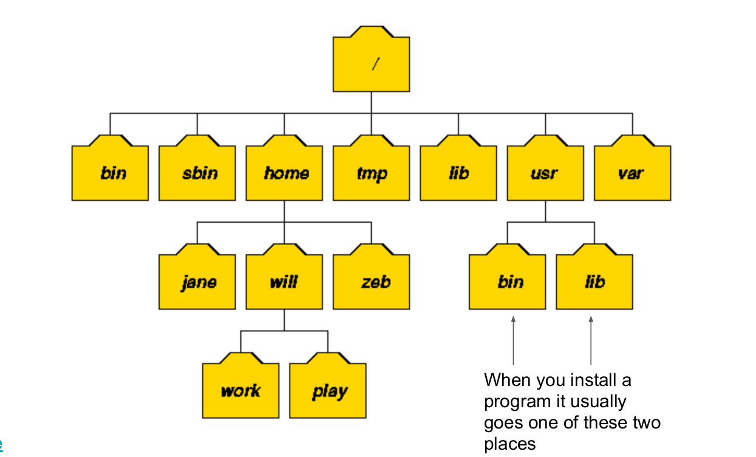
Unix Organization
“Everything is a file”
Frequently a readable text file
All files are in a directory
All directories (except root) in a directory
Root directory: “/”
Tree structure

Slide 14
Directory Navigation
New Terminal: Home Directory (~)
pwd: “Print working directory”
$PWD: variable of working directory
echo $HOME “print home directory”
cd: “Change directory”
  cd → Go home (from anywhere)
  cd .. → go up one level
  cd ../../.. → go up 3 levels
cd <directory_name> → go to sub-directory of this folder (relative path)
cd /home/user/Documents → absolute path
cd ../parent/child → relative path
mkdir <new_directory> → make new directory
rm -rf <directory> → delete directory
  Careful! May not be able to recover!
Notes:
Opening a new terminal window will generally take you to your HOME directory
~ indicates home directory. Both cd ~ and cd wil take you home.
Absolute paths start with a /

Slide 15
File and Directory Tips
Linux uses forward-slash (/) in paths. (Windows uses backslash)
Keep all your work in a folder in your home directory:
  ~/Galvanize/assignments
  ~/Galvanize/capstones
You can use spaces, but it is better not to.
  You will need to use quotation marks or backslashes to escape spaces
  Use_underscore_character_for_spaces
Capitalization matters!
Use <tab> auto-complete
  Type just enough letters to resolve the name, then hit tab.

Slide 16
Contents of a Directory
ls → “list contents” (non-hidden files and directories)
Files or directories beginning with “.” are ‘hidden’
ls /child_directory
ls ..
ls ~/Documents
ll (alias for ls -alF) → vertical list, including hidden, with indicator
Command Line Options:
  Use “man” to get see help menu
    e.g.: man ls
  single-letter options are preceded with a single dash
  single-letter options can be grouped together
    e.g.: ls -alF
  word-length options preceded with double-dash, cannot be grouped
    e.g.: ls --no-group --human-readable

Slide 17
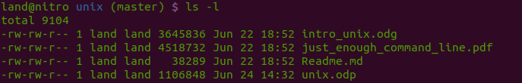
File Ownership and Permission
All files have an owner and an owner’s group
ls -l shows ownership and permission:
owner = land
group = land
rwx = read, write, execute
  “-” indicates permission denied
  Owner, Group, Everyone Else

Slide 18
Changing File Ownership and Permission
chown: “change owner”
sudo: “superuser do”
  Warning! Can accidentally delete or modify important files!
chgrp: “change group”
chmod: “change file mode”
  grant/deny:
    read (4)
    write (2)
    execute (1)
  e.g:
    6 = read and write
    7 = read, write and execute
    0 = no access
  Repeat three times for user, group, everyone else

Slide 19
File Creation
Many different ways to create files:
touch <filename>:
  create new file, or update “last modified” on existing file
echo Hello > hello.txt
  create new file or over-write existing with contents “Hello”
echo $PWD > pwd.txt
  create new file or overwrite existing with working directory
echo goodbye >> hello.txt
  add ‘goodbye’ to end of existing file (or create new file if does not exist)
history > history.txt
  dump list of recent shell commands to file
code .
  open VS Code in the current directory
code <filename>
  open or create new file in VS Code

Slide 20
&, &&, |, ||, >>, and >
One of the most powerful features of shell commands is that they can be chained together
<command 1> &: Run in background
  Do not wait for command to complete before starting next command or returning control to terminal window
<command 1> && <command 2>
  run command 2 after command 1 finishes successfully
<command 1> | <command 2>
  Use the output of command 1 as the input to command 2
<command 1> || <command 2>
  Run command 2 if command 1 does not finish successfully
command > file
  send the output of command to a file, rather than to the monitor
  Over-write contents of file
command >> file
  send output of command to end of file

Slide 21
Viewing Contents of a File
cat <filename>
  print contents of file to screen
head <filename>
  print first 10 lines of file to screen
tail <filename>
  print last 10 lines of file to screen
more <filename>
  print file one screen at a time
less <filename>
  same as more, but more options
May also re-direct output:
head filename > new_file.txt
  create new file with first 10 lines
tail filename >> new_file.txt
  Add last ten lines of file to end of new_file
code <filename>
  open file in VS Code for reading and/or editing
Notes:
There are many different ways to view the contents of a file, but often the best solution is to just open the file in a full-featured text editor (VS Code).

Slide 22
Move, Rename and Delete Files
mv: move file <from> <to>
  used to move and rename files or directories
  may be within the same directory or across directories
cp: copy file (or directory)
  <existing> <new>
  may be within or across directories
rm: remove file
rm -rf: remove directory
  Note: the -rf options are to provide extra protection for deleting the contents of a directory

Slide 23
Editing Text Files
Generally, a full-featured text editor (VS Code) is preferred
When VS code is not available, built-in text editors (VIM, nano, gedit) can be used
Shell scripts can also be used to edit text files because nearly all shell commands are filters
  <text in> → (modify/sort/filter/evaluate) → <text out>
<Text in> can come from a file and <text out> can go to a file
Therefore, there are many different ways to edit text files by stringing together these commands
Some useful commands:
  cat/head/tail/more/less
  sed
  grep
  awk
  perl

Slide 24
Environment Variables
Values that need to be accessed frequently or programmatically can be stored by name as environment variables
env to see a list of environment variables
export used to set variable: (e.g. export MY_VALUE=12345)
$ used to recall values: (e.g. echo $MY_VALUE → 12345)
Environment variables only persist for the duration of the terminal window in which they are defined
Define environment variables in profile file so that they get loaded for every new terminal window
  echo “export MY_VALUE=12345” >> ~/.bashrc
Some useful environment variables:
  $PATH: the list of directories where computer will look for programs to run
  $HOME: your home directory
  $PWD: current working directory
  $SHELL or $0: the name and location of the shell program
  $AWS_ACCESS_KEY and $AWS_SECRET_KEY (Keep these safe)

Slide 25
Aliases
Aliases: shortcuts to run commands:
  alias ll=’ls -alF’
  alias jup=’jupyter notebook’
  alias gh="git log --pretty=format:'%h %ad | %s%d [%an]' --graph --date=short"
  alias goog=“xdg-open https://google.com &”
Use alias to see list of currently defined aliases
Put alias commands in profile file to load at the start of every terminal session
Notes:
Aliases are one of the best ways to customize your system to make it just the way you like.
here are some aliases I find useful, but you’re welcome to come up with your own.
Remember to put your aliases into your profile script so they will always be available

Slide 26
Profile file
Used to set env variables, aliases, execute commands, etc
Run automatically every time a terminal window is started
Can also be run with source command (e.g. source ~/.bashrc)
Depends on which shell you are running:
  bash (Linux) → ~/.bashrc
  bash (Old Mac) → ~/.bash_profile
  zsh (New Mac) → ~/.zshrc
Use echo $0 to determine which shell you are running
can be edited with code ~/.bashrc
can be appended with echo -e “\n new command” >> ~/.bashrc
  Remember to append to file (>>), not over-write (>)!

Slide 27
Python Programming Environments
VS Code + iPython (terminal)
All you need is a text editor and a terminal window
clean, text-only files (.py)
Combination of script-based and interactive programming
Easy to import into other scripts
Jupyter Notebook
Rapid development with in-line output values, charts and markdown
Python code intermixed with html
difficult to import into other scripts
Easy to accidentally execute out-of-order

Slide 28
Python Programming Environments
In this class, you must be proficient with both .py scripts in the terminal window and jupyter notebooks.
Do not become overly reliant on one approach!
(A 3rd option: python filename.py)
We will use this approach less often and discuss later.

Slide 29
Hello World Examples
ipython
VS Code/ipython
jupyter notebook
python

Slide 30
Hello World in ipython
Open a terminal window
type “ipython”
type
  print(‘Hello World’)
See “Hello World”
Advantages:
  extremely fast and easy
  all values retained in memory until `exit`
Disadvantages:
  code not saved in a file
  editing in ipython is difficult
  all values lost upon exit
Suitable for:
  back-of-envelope calculations
  quick exploration of ideas

Slide 31
Hello World in VS Code/ipython
Open a terminal window
cd to directory
code . to open VS Code
type ipython
In VS Code, create new file
type print(‘Hello World’)
save as hello.py
In ipython, type run hello.py
Advantages:
  all values retained in memory until `exit`
  code saved to file
  powerful editing tools in VS Code
  .py files can be imported to other scripts
  .py files can be executed programmatically
  Simple text-only files easy to read
Disadvantages:
  No in-line charts or markdown formatting
Suitable for:
  All work
  Ideal choice for complex projects

Slide 32
Hello World in Jupyter Notebook
Open a terminal window
jupyter notebook to launch in browser (or alias)
Enter browser and create new python notebook
type print(‘Hello World’) in first cell
<ctrl> -Enter to execute cell
Advantages:
  all values retained in memory until `exit`
  code saved to file
  In-line graphs and markdown comments
Disadvantages:
  .ipynb files difficult to import or execute
  Potential for out-of-order execution
  editing across cells can be difficult
  html tags make files sloppy hard to diff
Suitable for:
  Proof of concept
  Development of ideas
  Presentations

Slide 33
Hello World in python (command line)
Open a terminal window
navigate to directory
code . to launch VS Code
create new file,
type print(‘Hello World’)
save as hello.py
on command line, type:
  python hello.py
Advantages:
  code saved to file
  programmatic execution
  dovetails with Ipython/VS Code approach
  .py files can be imported to other scripts
Disadvantages:
  values not retained in memory upon completion
  Always have to run full script, beginning to end
Suitable for:
  Finished projects
  Automated execution

Slide 34
Key Commands you will need
pwd
mkdir
cd
ls
cp
mv
rm
code .
code ~/.bashrc
ipython
jupyter notebook

Slide 35
Final Thoughts
The terminal window (shell) is your first stop for any task
Avoid using mouse
Use keyboard shortcuts:
  <tab>: auto-complete
  up-arrow: repeat recent command
  <ctrl> -r: search recent commands
  history | grep <command> to review recent commands
  !<history number> to repeat a command by number
Must be proficient in both ipython and jupyter notebook
Use man to learn about shell commands
Use VS Code (when available) for general text editing

